Slide 1
Libraries and Literacies: From I to We alt: People in Libraries in the Digital Age
LIDA 2014
Zadar, Croatia
June 16-20, 2014
Gary Marchionini
University of North Carolina at Chapel Hill
gary@ils.unc.edu

Slide 2
Preamble
Thanks to Tatjana and Tefko
Libraries in the digital age: an unfolding story of transformation
This year’s theme of assessing libraries and users reflects some of the existential changes and challenges: we are assessing a changing phenomenon (and focused on point metrics)
One strong trend has been shift from collections of knowledge artifacts (e.g., books, webpages) to programs and services: perhaps it is time to consider collecting people
Library values such as organization, equitable access, knowledge stewardship, and self-directed learning continue to drive libraries in the digital age: toward new kinds of literacies for collaborative learning

Slide 3
My Context: Memes, Ideas, and Challenges
We are increasingly tightly connected to others—let’s call this the Borg trend (fully connected graph)
Personal identity will increase in value as novelty becomes more rare—let’s call this the Island trend (disconnected node)
Libraries aim to help people deal with information needs: gaps and overloads
Information gaps and learning to fill those gaps
Lifeload, workload, cognitive load, and collaborative load

Slide 4
Collaborative Learning, Literacy, and Libraries
One fundamental value and mission is to support self-directed learning (Carnegie).
Libraries in the digital age are centers AND engines of collaborative learning
Nobody works or learns alone
We are hypermediated and need relief (Levy, Stutzman)
Books were the original distance education technology (Jerry Campbell, Feb 2012)
Coursera, EdX, 2U, Deltak, Pearson, etc. are emerging university libraries (or universities)

Slide 5
Challenge 1: Overloads
Collaboration requires resources and these resources require management regardless of collaborative setting
Co-located synchronous
Co-located asynchronous
Remote synchronous
Remote asynchronous

Slide 6
Kinds of Load
Physical
Mechanical, sensory
Cognitive
Intrinsic, extraneous, germane
Collaborative
Synchronous, asynchronous
Key Design Challenge: How to make cognitive prosthetics that do not exacerbate physical and collaborative load.

Slide 7
Cognitive Model for Video-based Collaborative Distance Learning (Mu, 2004)

Slide 8
A Model for Collaborative Information Seeking (Shah, 2010)

Slide 9
Representation Challenges of Collaborative Load in DLs
How to represent history to all parties?
How to represent state to all parties?
Of task
Of progress toward task
Of participant

Slide 10
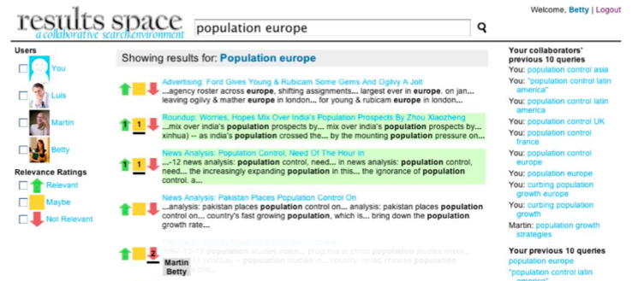

Slide 11
Collections of People
Consider Personal Identity as a new kind of information for libraries to manage

Slide 12
A Scholar’s Identity to ISI, Scopus, Google, and Alts
S
W
G
A

Slide 13
Projections
Reflections
aware
aware
aware
unaware
Purposeful
Incidental
Human Created
Agent Created
unaware
aware
unaware
unaware
Proflections

Slide 14
Identity Views
Person 1
(acquaintance)
You
Library
Your Proflection
Person N

Slide 15
Libraries can collect people: help us manage our memories and our cyberidentities:
Manage our various lifetime profiles:
Electronic Health Records/Personal Health Records
Personal genome, digital identifies (e.g., passwords)
Electronic Learning Records
Financial Profiles (e.g., credit reports)
Manage our multiple weak tie networks

Slide 16
Our Personal Digital Libraries and Beyond
Manage boundaries
Leverage trust—clearly articulate boundaries
Be user-centered—customize and adapt policies
Enforce policies—but encourage community participation in setting and evolving
Authentication for 3rd parties
Manage content
community-sourced moderation
NoveList, GoodReads
Open access workstations (clean tools)
No biosensing (keystroke cadences, mouse activity, video, physical sensors)

Slide 17
The Information Commons
Excludable vs non-excludable
We can vary information access policies
Rivalrous vs non-rivalrous
Information is ‘mainly’ non-rivalrous
Information theory caveat
Libraries can help moderate interfaces (boundaries) across information assets
Libraries can help individuals build and maintain their ‘supernetworks’ of weak ties (Donath, 2014)

Slide 18
The Identity Commons
CyberIdentity is mainly non-excludable (it is increasingly difficult to remain anonymous or have multiple identities)
CyberIdentity is mainly rivalrous (identity theft and masquerades are the exception)
Libraries can begin collecting people (their cyberidentites)
Google Scholar, MS Academic, ResearchGate, Klout
Identity trusts (especially important in cyber afterlife)
Right to be forgotten (EU) vs public history

Slide 19
How do we know how we are doing?
Metrification changes behavior (Cronin)
Data can be used to answer questions. This has always been the case with a priori empiricism, it is sometimes the case with post-hoc analytics (Jim Gray et al.)
Data in search of meaning is PR rather than scholarship
Correlation is not causation; the collection instrument affects what is collected; machine learning is not magic; big data is always dirty (see Tufekci)
Know your goals, state your goals, reflect on your progress
Use the right method and data for the problem (Wildemuth)
Invest time and effort: LCD solutions will lead to cheating or mediocrity
I DO believe in the law of large numbers and evidence-based practice

Slide 20
Which is “Better”?
P, R,
MAP,
Smiles,
Etc.
Query Act
Minimize ‘distance’ versus maximize area? retrieve vs explore?
Notes:
MAP at end state same, cumulative MAP different

Slide 21
Some alt alt assessment
Adoption of trusted services
Number of lawsuits?
Certification reputation
Individuals (badges for expertise; ‘clean’ appendages and tools)
Enterprises (UL seal of approval)
Host of alt metric acceleration measures (rates & pulses; pathways predicted and emergent)

Slide 22
Library Responsibilities and Opportunities
Balance public and private DLs
Privacy policies (e.g., blur my grandchildren’s faces on the public site)
Authority (disambiguation, credentialing?)
Ownership policies (e.g., legacy and inheritance rights; right to be forgotten—see EU data protection regulation; balance history and personal privacy)
User assistance and consultation on PIM
Facilitating writing as well as reading (access)
Be a driver of online learning
Be a useful place
Strong programming tied to interests
Good meeting rooms: audio crucial for virtualization; tools at hand for memory management
Anonymous access is as important as open access

Slide 23
We and I
I: the center of my universe, me, myself, and I. My music, my thoughts, my identity. But lonely.
We: the ground for I. Our tribe, our team, our culture. But equal.

Slide 24
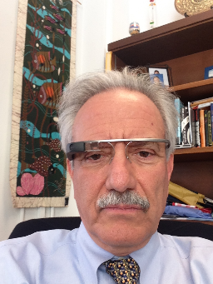
Thank You
Libraries can save the world if they continue to exist and adapt

