Slide 1
Studying User Appropriation of University and Secondary school “Learning Centers”: Methodological Questions and Issues
Susan Kovacs, University of Lille 3 – Nord de France, Geriico Research Laboratory, France
susan.kovacs@univ-lille3.fr
Yolande Maury, Artois University/ESPé, Geriico Research Laboratory, France
yolande.maury@noos.fr
1
Libraries in the Digital Age, University of Zadar, Croatia, June 19th, 2014

Slide 2
Outline
LC: an emergent phenomenon in France
Studying LC appropriation from the point of view of space
A qualitative study, an inductive approach
Questions arising from observations: constructed boundaries
Conclusion

Slide 3
LC: an emergent phenomenon in France
Jouguelet report (2009): how to transpose an innovative model to French institutions and contexts
Recommandations for an integrative approach linking informational practice and pedagogy
New learning paradigm → new resources and services
Hybrid digital resources
Flexible spaces, work-leisure environment
Multi-skilled library staff

Slide 4
LC: an emergent phenomenon in France
At the secondary school level:
Accompany pupils
Bring together attendance and library services
Cost reduction (?)
At the university level:
Adapt to trends in student/youth practices
Revitalized library at the ‘heart’ of campus
New learning environment → student success rates
Involving faculty and library staff

Slide 5
LC: an emergent phenomenon in France
Interdisciplinary research project “Library (r)evolutions: the learning center, a new model to investigate” (June 2013- November 2014), dir.Y. Maury, U. Lille 3;
Three research teams (Information Science, Education): seven researchers
GERiiCO Univ Lille 3 Information Science | S. Kovacs Y. Maury F. Thiault J. Sauteron, Librarian, U Lille 3, PhD candidate
CIREL Univ Lille 3 Education | S. Condette
UMR EFTS, Toulouse Information Science | I. Fabre C. Gardiès
5

Slide 6
LC: an emergent phenomenon in France
U. Lille project: 4 Secondary school LCs
Learning center (LC) | Characteristics | Timetable | Project status during inquiry
High school 1 Professional vocational school Alsace | Motivate students, interaction between faculty/staff/ students | (1) 2013- : restructured spaces, digital resources improved/added; (2) 2014- : modifying practices | Ongoing spatial modifications; discussion about new roles for staff
Residence Hall-Prep school 2 Ile-de-France | Modernize facilities→ create new learning environment | (1) 2008- : networking resources (2) 2013- : Reorganized spaces, extensions | Ongoing spatial modifications; preparation for new digital resources; discussion about roles
Secondary School 3 Nord-Pas de Calais | “Connected school”: new technology → improve pedagogy | (1) 2012-2013: spaces reconfigured (2) 2013-2014: IT development | Evaluating impact ITs; Consolidating partnerships, changing roles for staff
Secondary School 4 Midi-Pyrénées | LC developed ‘naturally’ : proximities between library and attendance office | (1) 2005: reorganized spaces; (2) 2010: formalized restructuring as LC | Ongoing reflection on digital resources

Slide 7
LC: an emergent phenomenon in France
U. Lille project: 5 University-level LCs
Learning center (LC) | Characteristics | Timetable | Project status during inquiry
Science U. 5 Ile-de-France | New building: modular spaces | 2012: Notion of LC integrated into architectural project; Jan. 2013: bldg inaugurated | LC boundaries in question: library? Campus?
Business School 6 Ile-de-France | Online service expansion, new work spaces and cultural offerings | 2008: renovated library spaces and services | Undergoing evaluation for updating of LC
Science-Tech. U. 7 Nord-Pas de Calais | LC “innovation”: new spaces to develop community | Feb 2014: Science center opened 2017: Completion architectural project | Construction underway; services/ programs developed
Humanities - social science U. 8 Nord-Pas de Calais | Humanities LC sub-theme Egyptology/Archeology | Pre-project submitted to funding institutions, based on renovation of bldg | Ongoing projects: renew current spaces (expos, conferences)
Polytechnic engineering U. 9 Midi-Pyrénées | “Third place” for engineering students | 4 phases starting 2009: Innovate teaching, create informal exchange for students, teachers, local businesses | Ongoing: reinforce services, restructure multi-function spaces

Slide 8
Studying LC appropriation from the point of view of space
Space as « practiced place » (M. de Certeau)
Language of space (E. T. Hall)
Co-construction rather than « received space »: agency, ‘doing with’
Information culture related to space: a holistic view
« Culture » rather than literacy
Integrated nexus of social practices: learning/teaching/training/place to be
Dynamics and relations, processual aspect

Slide 9
A qualitative study, an inductive approach
Qualitative study of library appropriation: possible avenues
Cognitive mapping (Fabre, Veyrac 2008)
Sweeps method (Given, Leckie 2003)
Ethnographic observation → user « profiles » (Rosselli, Perrenoud, 2010)
Lille project: ‘a posteriori’ approach
Preliminary contact: project history, floorplans…
Exploratory unstructured observation → gradual focus
Dimensions for further observation
Full description (H. Becker): fieldnotes, photography

Slide 10
A qualitative study, an inductive approach
Dimensions for observational study:
Boundaries | Where does LC start/end? Zones: present or suggested; Modular/hybrid zones; boundaries with competing or complementary spaces
Uses (apparent-emergent) | Occupation of space; ignored spaces; spaces (re)defined by unexpected activity; importance given to activities of learning/teaching/training/living;
Rules/Regulations | Rights, obligations, interdictions → rhythm of life in LC
LC Identity | Terms/symbols appearing or posted to designate site/zones: sign systems, web sites; differentiation of spaces
Tensions | Noise/quiet; autonomy/collaboration, acceptance/resistance
Other emerging dimensions | Unexpected, surprising aspects, activities

Slide 11
A qualitative study, an inductive approach
Informal conversations
Actors: staff / faculty / pupils / students ;
Questions related to observations ;
Formal interviews: semi-structured, openended
Conception of the LC : definitions, keywords ;
Evolution / Revolution ? Time-space of the LC ;
Professional roles;
Uses / practices ;
Questions related to/arising from observations;
(criteria for success ?)

Slide 12
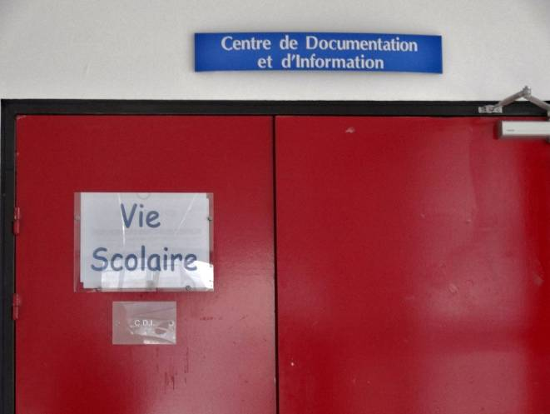
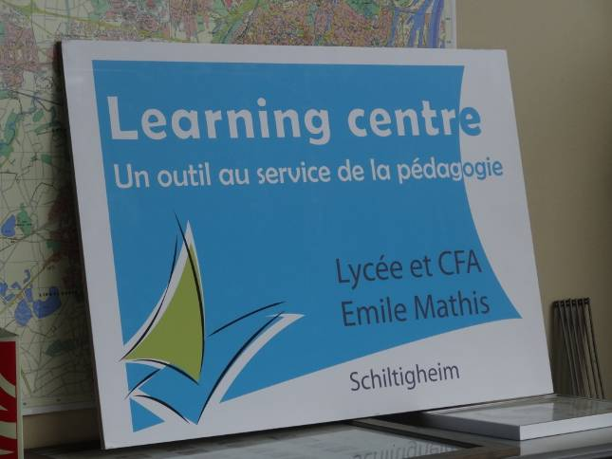
Questions arising from observations: constructed boundaries
High School 1: two different signs present services in the LC | High School 1: an unused poster promoting the learning center
Borders and boundaries: labels and signs

Slide 13
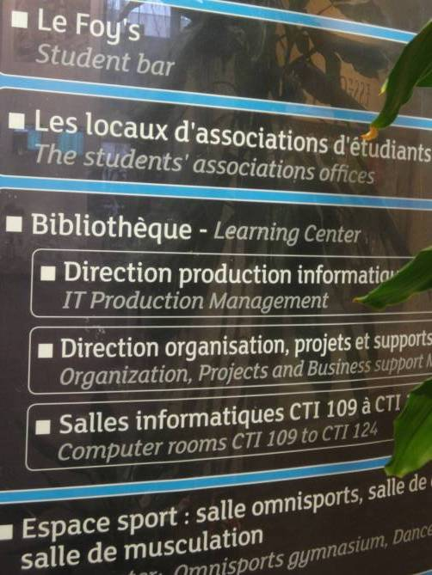
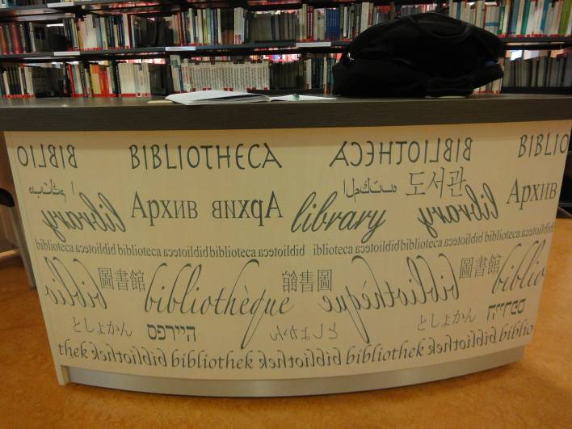
Questions arising from observations: constructed boundaries
Business School 6: Library or Learning Center? LC and surrounding IT center: inside or outside the LC? | Business School 6: an unused reference desk, “library” as a culturally prestigious name
13
Borders and boundaries: labels and signs

Slide 14
Questions arising from observations: constructed boundaries
Borders and boundaries: acting out differentiated zones
Used and unused spaces, movement through space
Space and/vs identity: the problem of hybrid zones
Territory and identity: implicit user ‘hierarchy’
Complementary and competing spaces: « losing ground »?

Slide 15
Conclusion
Constructivist posture
Priority given to direct observation of practice
Practice as it co-constructs space, in its physical, logistical, symbolic dimensions → the culture of the LC?
Information culture: dynamic, relational
Avoid analytical categories in data collection
LC: coming into being
Emergence of regularities
Strengths and weaknesses of observational protocol
Perspectives for data analysis

Slide 16
Bibliography
Becker, H. S. (1996). The Epistemology of Qualitative Research. In Richard Jessor, Anne Colby, and Richard A. Shweder (eds), Ethnography and Human Development: Context and Meaning in Social Inquiry, Chicago: University of Chicago Press, 53-71.
Fabre, I., & Veyrac, H. (2008). Des représentations croisées pour l'émergence d'une médiation de l'espace documentaire. Communication & Langages 156, 103-115.
Given, L. M., & Leckie, G. J. (2003). ‘‘Sweeping’’ the library: Mapping the social activity space of the public library. Library & Information Science Research, 25, 365-385.
Hall, E. T. (1966). The Hidden Dimension. Garden City, NY: Doubleday.
Jouguelet, S. (2009). Les learning centres, un modèle international de bibliothèque intégrée à l’enseignement et la recherche. http://media.enseignementsup-recherche.gouv.fr/file/2009/33/6/Rapport_Learning_Centers_7-12_RV_131336.pdf
Maury, Y. (research coordinator), Condette, S., Fabre, I., Gardiès, C., Kovacs, S., Thiault, F. (2014). (R)évolutions dans les bibliothèques? Les learning centres, un modèle de bibliothèque à interroger. Bonus Qualité Recherche (BQR), Final research report, Université Lille 3, 77 p.
Roselli, M. & Perrenoud, M. (2010). Du lecteur à l'usager: Ethnographie d'une Bibliothèque Universitaire. Toulouse: Presses Universitaires du Mirail, coll. "Socio-logiques", 2010.

