Slide 1
Applying Grounded Theory Methods to Library and User Assessment
Barbara M. Wildemuth
School of Information & Library Science
University of North Carolina at Chapel Hill (USA)
Workshop presented at Libraries in the Digital Age, Zadar, Croatia, June 2014

Slide 2
“Grounded theory methods consist of systematic, yet flexible guidelines for collecting and analyzing qualitative data to construct theories ‘grounded’ in the data themselves.”
--Charmaz, 2006, p.2

Slide 3
Key components of grounded theory methods
Goal/purpose: generate theory
Simultaneous data collection and analysis
Induction of codes/categories from the data
Constant comparative method of analysis
Memo-writing to elaborate and refine categories
Theoretical sampling
Literature review plays a role only AFTER the theory is developed

Slide 4
Fitting the components together

Slide 5
Libraries in the Digital Age 2014
Part 1 theme
Focus on “assessing library impact, value, effectiveness, and use of new and old services”
Different from developing theory

Slide 6
Exercise: Aligning applied/theoretical questions
Write a research question or definition of a phenomenon of interest
For the purpose of assessing a library system or service
For the purpose of developing a theory
Work with a partner to transform your question into the “other” type of question
Join others in discussing the challenges you faced

Slide 7
Finding data
Rich data
Flexibility in data collection
With focus on the phenomenon of interest

Slide 8
Observation
“Observation was once thought of as a data collection technique employed primarily by ethnographers who thought of themselves as objective researchers extrinsic to the social settings they studied. It has become a context in which researchers who define themselves as members of those social settings interact in dialogic fashion with other members of those settings.”
Angrosino & Mays de Pérez, 2000, p.690

Slide 9
Tips on conducting observations
Establish a role for yourself
Consider the multiple sets of norms that apply to the setting
Understand that people in the setting will make judgments about what to show and tell you
Use of technology for data capture could influence what you “see”

Slide 10
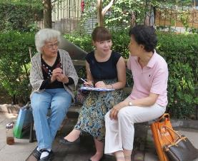
Tips on conducting interviews
Like talking to a friend, but different
Goal is to obtain rich descriptions of the phenomenon of interest
Interviewing involves reciprocity
Questions: icebreakers, transition questions, main questions, cool-down questions

Slide 11
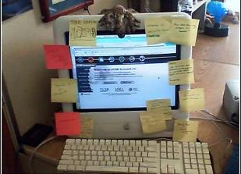
Additional possibilities
Existing documents
Other artifacts at the site

Slide 12
The initial sample of participants
Selection: Purposeful sampling
Recruiting: Access issues

Slide 13
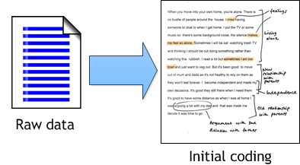
Initial coding
“Coding means naming segments of data with a label that simultaneously categorizes, summarizes, and accounts for each piece of data.”
--Charmaz, 2006, p.43

Slide 14
Coding exercise
Read the assigned transcript
Assign initial codes (10-15 minutes)
The theoretical phenomenon of interest is people’s interactions with records about their health, in terms of potential impact on their health
The interview excerpts focus on people’s current use of health records, in whatever format they have them
Work in teams of 2-3 people, to compare codes and discuss/reconcile differences in coding

Slide 15
Constant comparative method
Compare data to data to identify similarities and differences
Compare codes to codes to identify and define concepts
Compare codes to concepts
Compare concepts to concepts to form categories
Compare categories to categories to understand their relationships

Slide 16
Memo writing
Early memos
Capture initial thoughts about initial codes and emerging categories
Advanced/later memos
Move from analysis of data and codes, to categorization and theoretical concepts

Slide 17
Exercise: Writing an early memo
Choose one or two of the codes assigned to the interview data
Write whatever comes to mind about that code
Get your ideas down as quickly and fully as you can
Write to and for yourself
Write freely (and badly)

Slide 18
Theoretical sampling
“The main purpose of theoretical sampling is to elaborate and refine the categories constituting your theory. You conduct theoretical sampling by sampling to develop the properties of your category(ies) until no new properties emerge.”
--Charmaz, 2006, p.96

Slide 19
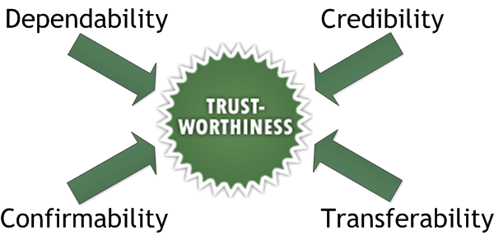
Establishing trustworthiness

Slide 20
Ways to establish trustworthiness
Prolonged stay in the field
Member checking
Peer debriefing and support
Negative case analysis
Triangulation
Audit trail
Rich/thick description of findings

Slide 21
Additional criteria applied to grounded theory studies
Originality: the theory you generate offers new insights on a phenomenon
Usefulness: the interpretations you offer are useful to people in their everyday worlds
From Charmaz, 2006

Slide 22
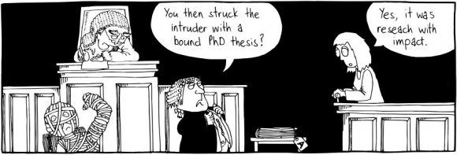
Recap: Using grounded theory
To achieve your research goals
To achieve your library assessment goals

Slide 23
Additional questions or comments?
Contact information:
Barbara Wildemuth
wildemuth@unc.edu
http://ils.unc.edu/~wildem/wildemuth.html

