Slide 1
Collaborative information use by high school students in a digital learning environment: Connecting metatheory, theoretical frameworks and methodology,
Dr. Ross J. Todd
Center for International Scholarship in School Libraries (CISSL)
School of Communication & Information
Rutgers, The State University of New Jersey
rtodd@rutgers.edu
www.cissl.rutgers.edu
www.twitter.com/RossJTodd

Slide 2
CiSSL funded research project 2012-2014
Thanks to Punit Dadlani (Phd student and CiSSL Barham Scholar); LaDawna Harrington (school librarian) and Suzane Snyder (English Teacher), Milburn High School New Jersey

Slide 3
Research Context
Increasing attention being given to team-based inquiry and project-based learning.
Central to this discourse are discussions surrounding “collaborative learning” and “cooperative learning”.
Collaborative learning characterized as involving a higher level of interdependence between group members
Cooperative learning has been shown to involve a more “divide and conquer” type of approach.

Slide 4
Digital Environments
Web spaces used more as a coordination tool for organizing the collaborative work than as a space for negotiating, debating and creating knowledge
Difficulty of moving from individualistic ways of working to achieving real collaborative knowledge building in web spaces
Some evidence of developing team work skills, and project management skills
Difficulty and complexity of promoting real collaborative knowledge building in digital environments
Lakkala (2005); Lakkala, Ilomäki & Palonen, (2007); Johnson, Johnson & Roseth (2010); Scardamalia & Bereiter, 2006); Sormunen et al (2013)

Slide 5
Research Goals
Track the process of team work: to understand how student teams work together to build a shared representation of knowledge
Examine the dynamics of the co-construction of knowledge by teams of students
Track students’ engagement with information sources and how the teams transform and co-construct text into their joint representation of knowledge
Track both individual learning and group learning, and to understand the relationship between individual knowledge developed in the process and the team representation of the joint product created in the process

Slide 6
Sample & Research Task
Grade 9 English
42 students randomly assigned to 14 groups
Course offers wide range of challenging literature; stresses critical thinking, speaking & research strategies
In the research task, groups were assigned a novel and to construct argument surrounding literary merit of the text: literary devices used to support literary merit
Novels, eg.: The Alchemist; Lord of the Flies; The Bluest Eye; The Perks of Being a Wallflower; The Hobbit; The Chosen; Da Vinci Code; Extremely Loud and Incredibly Close

Slide 7
Metatheory: Constructivist Learning
Jean Piaget: (1896-1980) (Swiss Psychologist & Philosopher) Theory of Cognitive Development
John Dewey: (1859-1952) (Educational Philosopher) Philosophy of Pragmatism: knowledge as arising from an active adaptation of the human organism to its environment; Active Learning
George Kelly: (1905-1962) (Psychologist) Personal Construct Theory: People behave according to how they construe the world around themselves
Jerome Bruner: (1915 – ) (Psychologist) Cognitive Learning Theory / “Towards a Theory of Instruction”; Structuralism;
Lev Vygotsky: (1896 - 1934) (Russian-Cultural-Historical Psychology; Social Learning; Metacognition; Zone of Proximal Development – Theory of Children’s Mental Development

Slide 8
Constructivist Learning: Basic Premises
We construct our own unique personal worlds
Construction involves the total person incorporating thinking, feeling, and acting
There is no knowledge independent of the meaning attributed to experience by the learner, or community of learners
We have to focus on the learner in thinking about learning, not on the subject / lesson to be taught
Individual learners must actively build knowledge and skills; learners construct knowledge for themselves
Instruction centers on the experiences and contexts that make students willing and able to learn
“Two basic themes run through the theory of construction. One is that we construct our own unique personal worlds, and the other is that construction involves the total person incorporating thinking, feeling, and acting in a dynamic process of learning.” Kuhlthau (1993, p.15)

Slide 9
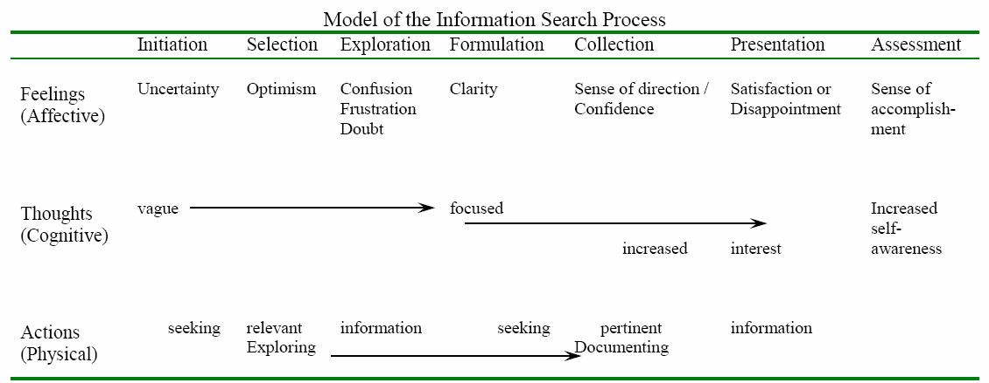
Kuhlthau: ISP
From Metatheory to
Theoretical Framework
INSTRUCTIONAL FRAMEWORK
Kuhlthau, 2004, p. 82)

Slide 10
Wiki Environment & Data Collection
Completed a pre and post reflection task (SLIM “Reflection Tasks” (Student Learning Through Inquiry Measure developed by CISSL)
Students discuss research topics, establish working relationships, create plan and manage the tasks, collect information sources, construct their products (Google Docs); dialog and feedback (class presentation, visual display, and annotated bibliography)
Capture and track their research and writing processes, and decision-making processes
Make daily journal entries during the two weeks that the classes were scheduled in the library
Students required to read each other’s journal responses and comment on at least one other student’s journal response
Overall, a total of 945 conversation entries were recorded. The majority of reflections were about one paragraph (5-6 sentences) long. On average, the responses to other reflections were around 2-3 sentences long, and posts that were responded to tended to receive 2-3 responses.

Slide 11
SLIM Reflection Tasks Cognitive, Affective, Interpersonal
Writing task 1 and 2 consisted of the following questions
1. Write the title that best describes your research project at this time.
Take some time to think about your research topic. Now write down what you know about this topic.
What interests you about this topic?
How much do you know about this topic?
Write down what you think is EASY about researching your topic.
Write down what you think is DIFFICULT about researching your topic.
Feelings about working in groups
Feelings about project

Slide 12
Additional Questions at Writing Task 3
What did you learn in doing this research project? (This might be about your topic, or new things you can do, or learn about yourself)
How did the SCHOOL LIBRARIAN help you?
How did the TEACHER help you?

Slide 13
Student Learning through Inquiry Measure (SLIM)
http://cissl.rutgers.edu/joomla-license/impact-studies/57-impact-studies-slim
Student Learning through Inquiry Measure (SLIM) SLIM Handbook
SLIM Reflection Instruments and Scoring Guidelines SLIM Scoring Sheet

Slide 14
Data Analysis
Employed both EMIC and ETIC approaches in our data analysis
Emic approach takes a grounded approach, developing emergent codes extracted from the text, and establishing categories of codes to identify core concepts and their relationships, driven by the data.
An etic approach to data analysis typically starts with a predetermined set of concepts, and these become the lens though which the data is analyzed and interpreted.
- gives emphasis to what the researchers consider to be important. This importance is often established by the synthesis of the literature review.

Slide 15
Working in Groups
Dimension | Description | Positive | Negative
Social Justice | Refers to core ideas around: shared responsibility, equity of contribution, equity of treatment, division of labor and workload | Work is spread out; The work is split up evenly and workload shared; No one overloaded Working in Groups: EMIC analysis | Waste time in ensuring others are doing their fair share; Uneven distribution of workload; Uneven commitment and effort; Lack of group togetherness; Problem of equal assessment for unequal contribution
Knowledge creation | Refers to the opportunities that group work provides in terms of the knowledge generation and production process | Acquisition of new ideas not thought of previously; Recognition of and engagement with multiple opinions, perspectives and viewpoints; Builds a wider range of ideas and thoughts; Learning and improving from each other’s input; Opportunities to think differently about the topic that is being examined | Difficulty of consensus building; Complexity of compromise; Slowing down completion progress

Slide 16
Digital Environments
Dimension | Description | Positive | Negative
Interpersonal interactions | Refers to the role of and nature of the interactions between group members to accomplish the tasks | Developing group interaction skills; Learning about and from group members; Integration of multiple skills that strengthen the project and create a stronger project; | Difficulty of communicating ideas Group characteristics
Project management | Refers to management functions including distribution of workload, mapping out and monitoring the project progress. | Project auditing and checking Planning perspectives Project timing and organization Managing workload Project monitoring for quality | Complexity of managing process problems: control, responsibility Implementing effective compromise

Slide 17
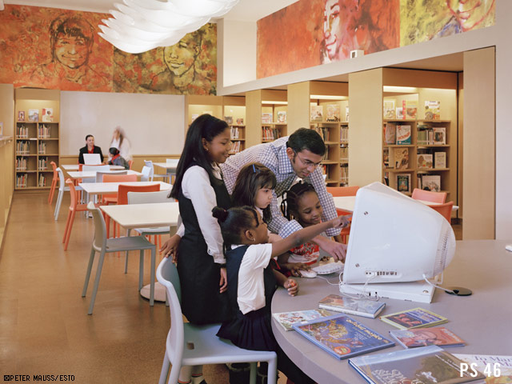
Post-task perceptions of the group process

Slide 18
Dimension | Description | Positive | Negative
Knowledge creation and outcomes | refers to the opportunities that group work provides in terms of the knowledge generation and production process | sharing of different perspectives and viewpoints; depth of knowledge outcome Quality product; Resolution of confusion | Reluctance to compromise on strongly held views
Division of workload and Learning equity | refers to workload balances and resultant learning outcomes | Equitable division of workload and tasks; Reduction of stress; Strength of individual expertise; Efficiency and effectiveness | Time involved in getting team to produce; Realization of shared responsibility; Inequity of group assessment not matched to individual input
Collegiality and cooperation | refers to the role of group tasks in relationship formation and the benefits afforded through this | Mutuality of working to common goal; Development of collegial relationships; Development of interpersonal skills; Learning support | Group tension; Interaction of personal attributes; Stress

Slide 19
Social Justice
Broadly defined: belief that all people deserve equal social, political and economic rights, treatment and opportunities (Zajda et al., 2006, p.6; Rawls, 1971, p.3).
LIS scholars have long grappled with issues that surround the concept of social justice (Chatman, 1985, 1992, 1996, 1999; Fisher, 2004; Futterman, 2008)
All human beings have an inherent worth and deserve information services that help address their information needs (Rioux 2006 p. 13).
Library and Information Science (LIS) discipline has produced little research that directly invokes social justice as an informing metatheory to respective research (Mehra, Albright and Rioux, 2006; Rioux, Mehra and Albright, 2007; Rioux, 2006)

Slide 20
Social Justice: Etic Analysis
Consequentialism: individual perceptions of a situation are considered just if the individual can achieve some end (consequence) which he/she values in some particular way eg. Time-space contexts - situations, meetings, assemblies, work structures and their role in outcomes
Distributive justice: just allocation or distribution of assets and liabilities (or strengths and weaknesses or benefits and burdens) amongst a society or group of individuals
Equality / Egalitarianism: belief that in any given situation, all people should have en equal amount of resources, access to services and skills (goods, services, etc) available to them.

Slide 21
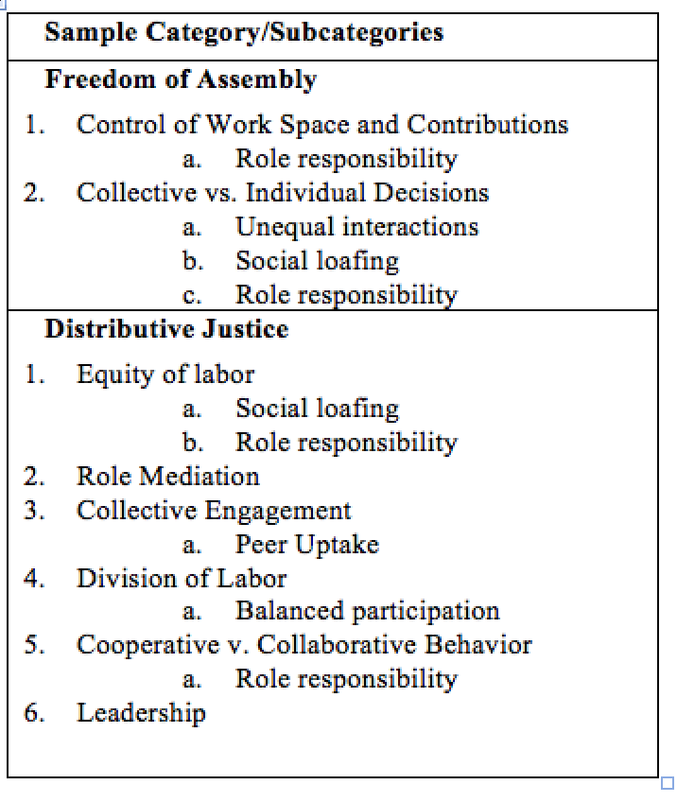

Slide 22
Discussions
Questions

