Slide 1
Researching bibliographic data with users: examples of 5 qualitative studies
Katarina Švab
Tanja Merčun
Maja Žumer

Slide 2
a true story…

Slide 3
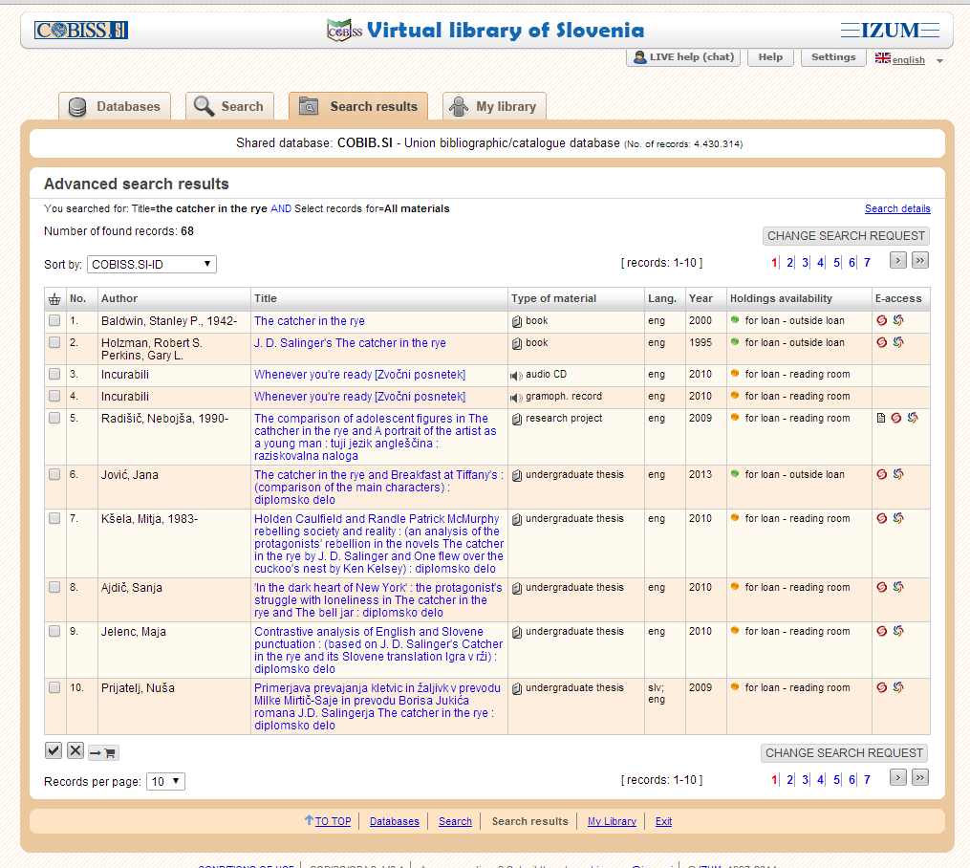

Slide 4
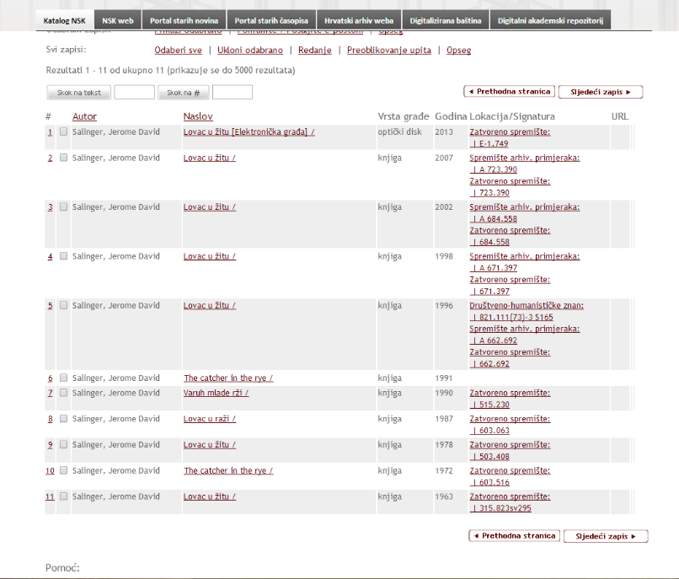

Slide 5
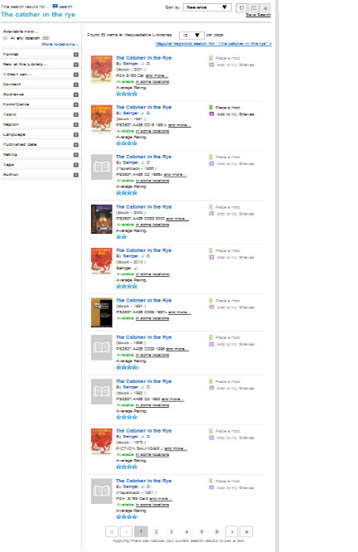
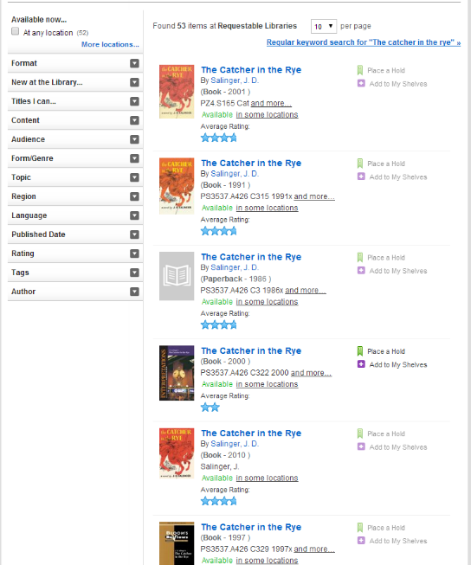

Slide 6
☹

Slide 7
bibliographic elements
library catalogue records
physical copies
user types

Slide 8
results
approaches
research question

Slide 9
fiction
4 user groups
5 studies
mothers of pre-school children
high-school students
adults
librarians
pictures books
required reading assignments
leisure reading
experience: searching for users (users‘ needs and catalog usefulness)
2 studies: focus group + interviews

Slide 10
MOTHERS
(26)
WHY?
Are current bibliographic records appropriate for the selection of books for small children?
Are parents able to make a good choice based solely on information within bibliographic records?
WHEN and WHERE?
July and August 2011
Playgrounds, parks, beach …
HOW?
Interview
Observation
STUDY DESIGN
Imagined scenario:
parents wish to borrow the fairytale Cinderella
6 versions of Cinderella

Slide 12
BIBLIOGRAPHIC RECORDS
author
Dissatisfaction with
illustration
too much text
BROWSING BOOKS
illustration
genre
publication year
story length
memories of parents' childhood
sample page
abridged version

Slide 13
book selected based on bibliographic record:
21 of 26 were not satisfied
after review of physical copies:
22 of 26 would change

Slide 14
HIGH SCHOOL STUDENTS
(105)
WHY?
How do high school student select and identify which book is appropriate among different
versions?
WHEN and WHERE?
November 2011
Two high schools
HOW?
Interview
Observation
STUDY DESIGN
11 versions of Don Quixote (Miguel de Cervantes Saavedra)

Slide 15
UNIFORM TITLE:
El ingenioso hidalgo don Quijote de la Mancha
TITLE:
Veleumni plemič don Kihot iz Manče
AUTHORS: Miguel de Cervantes Saavedra;
Niko Košir (translator)
PLACE OF PUBLICATION: Ljubljana
YEAR OF PUBLICATION: 1977
PUBLISHER: Cankarjeva založba
LANGUAGE: slovenian
SIZE OF BOOK: 20 cm
WEIGHT OF BOOK: 1,5 kg
THICKNESS: 85 mm
COLOR OF THE SPINE: brown
COLOR OF THE COVER: brown with gold lines
BINDING: hardcover
FORM: paper
EXTENT OF THE CARRIER: 2 books; p. 1140
FONT SIZE: normal
TYPE OF LETTER: lower-case letter
CONDITION OF THE ITEM: well (yellowed pages)
ILUSTRATION: without ilustrations
SUBJECT: knights
KEY WORDS: knights, spanish literature, knight's novel
MAIN CHARACTER: Don Quixote, Sancho Panza
PLACE OF THE NOVEL: Spain, La Mancha and surroundings
TIME OF THE NOVEL: renesanse, 16 ^{th} century
SHORT SUMMARY: Alonso Quixano is this middle-aged crazy dude. He reads a lot of books about hero stuff and gets so wrapped up in them, he thinks he is a heroic knight. He changes his name to Don Quixote, puts on some old armor, and goes out to find adventure.
GENRE: novel
INTEGRAL text
ADDITIONAL INFORMATION IN THE BOOK :
Cervantes in njegov Don Kihot (Niko Košir) ... p. 597-602
READING LEVEL: difficult
INTENDED AUDIENCE: adult

Slide 16
The most important bibliographic data
Additional information in the book
Extent of the carrier
Publication date
Genre
Specified reading level
Condition of the item („well preserved“)
Abridgement/integral text

Slide 17
book selected based on bibliographic record:
68% were satisfied
after review of physical copies:
48% would change

Slide 18
ADULTS
(108)
WHY?
Which bibliographic elements play a key role when adults select among different versions of the same work using bibliographic records and when they make a choice using physical
copies?
WHEN and WHERE?
Avgust 2012
Public libraries
HOW?
Interview
Observation
STUDY DESIGN
Quo Vadis (Henryk Sienkiewicz)
The Godfather (Mario Puzo)
The Catcher in the rye (J. D. Salinger).

Slide 19
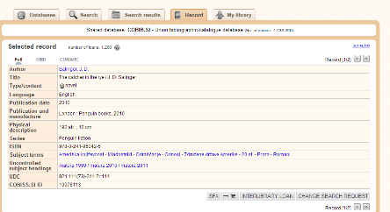
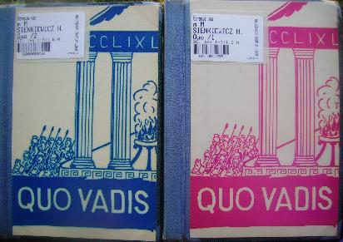
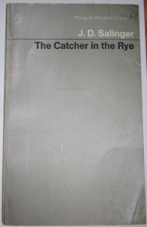
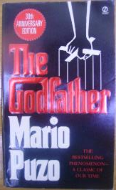

Slide 20
The most important bibliographic data
What they think
Browsing
The newest edition
Translator
Integral text
Condition of the item
Design of the book
Cover of the book
Sample page
Size of the letters
Binding
Condition of the item
Size of book

Slide 21
book selected based on bibliographic record:
~ 82 % were satisfied
after review of physical copies:
43% (traditional record) would change
29% (enriched record) would change

Slide 22
LIBRARIANS
WHY?
Are current library catalogues helpful to reference librarians?
What kind of questions do library users pose to reference librarians?
What bibliographic records are most important to them? ?
WHEN and WHERE?
January and April 2014
Public library
HOW?
Focus group (5)
Interview (6)
STUDY DESIGN

Slide 23
Comparison
method | + | -
Interview | willingness to participate, to explain things at great detail | what people say they do and what they actually do is not always the same
Observation | observe behaviour they did not report themselves and may not even be conscious of | people may behave differently when they are observed
Focus group | interaction between participants useful guide for planning future research | more difficult to get people to participate dominating participants observation still needed to get a complete picture

Slide 24
Conclusions
substantial gap: bibliographic records vs. physical copies
improving our services and systems
more observations of users
in settings/tasks where they are not limited by current practices

Slide 25
Conclusions
researching with users: not easy but essential
different methods + different target audience → bigger picture

Slide 26
thank you!

