Slide 1
Assessing Educational Research – An Information Service for Monitoring
a Heterogeneous Research Field
Karima Haddou ou Moussa¹, Ute Sondergeld², Philipp Mayr¹,
Peter Mutschke¹, Marc Rittberger²
¹ GESIS - Leibniz Institute for the Social Sciences
² German Institute for International Educational Research (DIPF)

Slide 2
Agenda
Project Overview
Indicators
Monitoring Prototyp
Database and technical background
Visualisation of Indicators
Summary and prospect
Zadar, 18.06.2014 I Marc Rittberger I LIDA 2014 I Assessing Educational Research

Slide 3
1. Project Overview
Title: Development and Changing Dynamics of a Heterogeneous Social Science Field Using the Example of Educational Research (Monitoring Bildungsforschung - MoBi)
Duration: 05/2011 - 07/2014
Funding: Leibniz Association (SAW funding measure)
Project manager: Alexander Botte (DIPF)
Co-operations:
+
Zadar, 18.06.2014 I Marc Rittberger I LIDA 2014 I Assessing Educational Research
Notes:
Cooperations:
GESIS - Leibniz Institute for the Social Sciences, Cologne
DIPF - German Institute for International Educational Research, Frankfurt
ZPID Leibniz Institute for Psychology Information, Trier
iFQ: Institute for Research Information and Quality Assurance, Berlin

Slide 4
Educational Research
Research Library for the History of Education
Information Centre for Education: National Center for Educational Information
Zadar, 18.06.2014 I Marc Rittberger I LIDA 2014 I Assessing Educational Research
Notes:
GESIS:
is the Largest infrastructure institution for the Social Sciences in Germany. The institute focuses on interdisciplinary research:
Survey Design and Methodology,
Social Structure, Attitude and Behavior in Modern Societies,
Applied Computer Science and Information Science.
GESIS is divided in five scientific departments. One of them is the department Knowledge Technologies for the Social Sciences. The focus of this department is Development of new and innovative digital services for the Social Sciences like:
Information portals : SSOAR, SOFISwiki, sowiport
Value-added services for searching and linking information: InFoLis, IRM
Services for accessing and registering research data: missy, dara, gesis Panel
DIPF:
Aims to improve conditions of successful education
Supports educational research, practice, policy and administration on the basis of scientific infrastructure services as well as research and educational system evaluations
5 departments (Frankfurt & Berlin), more than 300 people employed

Slide 5
Largest infrastructure institution for the Social Sciences in Germany, interdisciplinary research:
Survey Design and Methodology,
Social Structure, Attitude and Behaviour in Modern Societies,
Applied Computer Science and Information Science:
Department “Knowledge Technologies for the Social Sciences (WTS)”: Development of new and innovative digital services for Social Sciences
Zadar, 18.06.2014 I Marc Rittberger I LIDA 2014 I Assessing Educational Research
Notes:
GESIS:
is the Largest infrastructure institution for the Social Sciences in Germany. The institute focuses on interdisciplinary research:
Survey Design and Methodology,
Social Structure, Attitude and Behavior in Modern Societies,
Applied Computer Science and Information Science.
GESIS is divided in five scientific departments. One of them is the department Knowledge Technologies for the Social Sciences. The focus of this department is Development of new and innovative digital services for the Social Sciences like:
Information portals : SSOAR, SOFISwiki, sowiport
Value-added services for searching and linking information: InFoLis, IRM
Services for accessing and registering research data: missy, dara, gesis Panel
DIPF:
Aims to improve conditions of successful education
Supports educational research, practice, policy and administration on the basis of scientific infrastructure services as well as research and educational system evaluations
5 departments (Frankfurt & Berlin), more than 300 people employed

Slide 6
„2000: Empirical Turn“ in Educational Research
Framework Programme for the Promotion of Empirical Educational Research (BMBF) (2007)
DFG Research Units / Priority Programmes for Empirical
Educational Research (2000/2002)
Agreement on a National Report on Education (2004)
Introduction of National Educational Standards (2003)
Zadar, 18.06.2014 I Marc Rittberger I LIDA 2014 I Assessing Educational Research
Notes:
thus the common objective is to strengthen empirical educational research, to induce the so-called “empirical turn”.

Slide 7
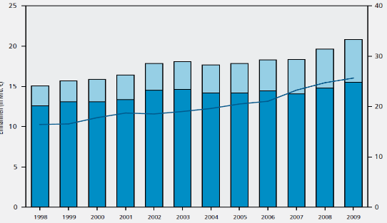
New Governance Model in Research Funding
Basic and third party funding in higher education institutions in Germany
Basic funding
Third party funding
Ratio of third
party funding
Rate of third party funding (%)
Income (in bn €)
Deutsche Forschungs-
gemeinschaft (2012):
Förderatlas 2012, p.30
1998 2000 2002 2004 2006 2008
Notes:
This empirical turn coincides with a second development, the establishment of a new model of financing science and research following the approach of New Public Management.
One important element within this approach is the increase of competition in the granting of funds. For researchers and research institutions it means that achievement gets more and more important for the acquisition of funding. This shift towards an output oriented control of funding is expected to assure an efficient management of resources.
As an example you see a graph on this slide that shows the development of basic and third party funding in higher education institutions from 1996 to 2009. The red line is the interesting thing here because it shows the rate of third party funding that increased in this time period from 16 to 26%.

Slide 8
1. Project overview: Aims of MoBi
Indicators
for
Monitoring Educational
Research
Indicators for Monitoring Educational Research
Reception
Zadar, 18.06.2014 I Marc Rittberger I LIDA 2014 I Assessing Educational Research
Notes:
Aims of the project:
Indicator-based analysis of developments and changing dynamics in educational research
Sources: research projects, publication output of research projects and reception of publications in the field of educational research
Creation of a draft for a web-based service for monitoring the field of educational research and
Construction of monitoring prototype as demonstrator (for research projects)

Slide 9
1. Project overview: Focus of this talk
Indicators
for
Monitoring Educational
Research
Indicators for Monitoring Educational Research
Zadar, 18.06.2014 I Marc Rittberger I LIDA 2014 I Assessing Educational Research
Notes:
Subject of this contribution is the methodology and implementation of the Prototype for monitoring research projects

Slide 10
2. Monitoring Prototyp: Database
Selection of relevant research projects from the SOFISwiki database
Completed projects from 1995 to 2009 with at least one research institution located in Germany
Approx. 9200 research projects in Educational Research
Monitoring prototype as an add-on to SOFISWiki
sofis.gesis.org/sofiswiki
is a community platform for recording and searching in Social Sciences Research projekts
Zadar, 18.06.2014 I Marc Rittberger I LIDA 2014 I Assessing Educational Research
Notes:
Selection of relevant research projects from the SOFISwiki database
Sofiswiki is a community platform that enables storage and search on social sciences research projects from different fields such as education sciences, psychology, political sciences, from German-speaking countries in Europe
Characteristics of the dataset:
completed projects that range from 1995 to 2009
geographical spread: at least one research institution located in Germany
dataset in total comprises approx. 9200 projects
The monitoring prototype is an add-on to SOFISWiki

Slide 11
2. Indicators
Basis for assessment of scientific research
Different levels of complexity
Influence on validity:
Characteristics of the object of investigation
Type and scope of data
Research approach
Zadar, 18.06.2014 I Marc Rittberger I LIDA 2014 I Assessing Educational Research
Notes:
Assessment of scientific research is based on Indicators which present reality in terms of numerical relations and range from simple figures to relative numbers and complex indices.
Validity of indicators is influenced by:
characteristics of the object of investigation:
Educational research is a heterogenous field that comprises diverse and manifold disciplines: Besides traditional core disciplines of educational science, psychology and social sciences, the field encompasses subject didactics as well as many other disciplines concerned with investigating education e.g. economy, law. The entire scope of humanities, social sciences and even natural sciences is involved, and every discipline has its own science theoretical principles, methods, structures and types of communication. In each of these disciplines, a particular indicator plays a different role and bears a different meaning.
type and scope of data:
Scope and structure of the underlying determine which information can be processed and used for construction of indicators.
Research approach:
the concept of what the indicator presents Depending on the approach taken, the number of funded projects might serve as an indicator for research achievements, such as success in competitively acquiring funding. From another perspective, external funding can be interpreted as simple input of financial resources.
In MoBi existing data did not allow for construction of complex indicators. we perceive indicators as metadata that according to their respective character describe different features of a field of research.

Slide 12
2. Indicators: MoBi
Existing data did not allow for construction of complex indicators
In MoBi indicators are metadata that according to their respective character, describe different features of a field of research
Indicators for which the implementation in the prototype is exemplified:
Research activity
Disciplinary area
Type of funding
Qualification
Zadar, 18.06.2014 I Marc Rittberger I LIDA 2014 I Assessing Educational Research
Notes:
To analyse the research projects, we selected such indicators that cover the structure as well as content of a research project.
Existing data did not allow for construction of complex indicators (reason: data structure and content of database)
Against this background, we perceive indicators as metadata that according to their respective character, describe different features of a field of research.
Indicators, for which an implementation in the web prototype is exemplified
“Research activity” models the development of a field of research as a basic indicator.
Taking into account that since the 1990s, research funding is predominantly governed by external sources (Schubert & Schmoch, 2010) and thus the acquisition of research funding is increasingly gaining importance, the indicator for “research funding” reflects the development in educational research.
Development regarding obtainment of degrees, subsumed in the indicator “qualification” (Qualifizierungsarbeiten), demonstrates the state of training for academic research which is highly relevant for the continuity of a discipline and plays a pivotal role in strategies for strengthening educational research (Hauss et al., 2012).
The indicator “disciplinary area” models the subject discipline a project is assigned to, it serves to ascertain what disciplines are active in educational research and reflects the diversity of access to the field.
Beyond these indicators other indicators such as cooperation, research methods and objectives, biographical aspects and target groups were examines

Slide 13
2. Indicators (Projects and Publications)
Research activity
Collaboration
Internationalisation
Funding
Zadar, 18.06.2014 I Marc Rittberger I LIDA 2014 I Assessing Educational Research
Notes:
We analysed a range of indicators for the projects and publications, some of them generally used in research monitoring and evaluations, some of them are less common. Here I will concentrate on indicators that are commonly used (suitable) for both types of information entities, projects and publications. We’ll see whether they are really useful in the context of our datasets.
Research Activity, Collaboration, Internationalisation and Funding

Slide 14
2. Research Activity: Assumptions
Projects
Increase in share of
projects over time
Zadar, 18.06.2014 I Marc Rittberger I LIDA 2014 I Assessing Educational Research
Notes:
The analysis of each indicator is based on particular assumptions (abgeleitet aus der literatur /derived from the scientific literature in this field:
For research activity we assumed an increase in projects and publications over time.

Slide 15
2. Research Activity: Findings
Projects
Increased interest
in educational
research
Zadar, 18.06.2014 I Marc Rittberger I LIDA 2014 I Assessing Educational Research
Notes:
As you see in the table projects were merged to 5 periods of 3 years.
We measured research activity on the basis of the share MoBi projects hold in the total of SOFIS; you remember, SOFIS was our main source. The light orange bars are the number of SOFIS projects per period, the dark orange bar the number of MoBi projects.
The dark line shows the share MoBi projects hold in the total of SOFIS: it increases and remains stable over time. This result indeed indicates an increased interest in educational research within social sciences.

Slide 16
2. Activity in Core Disciplines: Assumptions
Projects
Increase in the area of psychology
Zadar, 18.06.2014 I Marc Rittberger I LIDA 2014 I Assessing Educational Research
Notes:
If we turn towards the Activity in the core disciplines we expected an increase in psychological projects because more and more psychologists work in the field of educational research.

Slide 17
2. Activity in Core Disciplines: Assumptions
Share of MoBi-projects in core disciplines over time
Projects
Decline in psychological projects
Zadar, 18.06.2014 I Marc Rittberger I LIDA 2014 I Assessing Educational Research
Notes:
But the development isn’t conform to our expectations: educational and sociological projects increase, but the share of psychological project declines.
One reason for this non-conform development in psychology could be that SOFIS, our main source for project data, covers only partly the field of psychology; so it’s probable that psychological research in education is not covered adequately in SOFIS.

Slide 18
2. Activity in Core Disciplines: Assumptions
Publications
Higher share of journal articles in psychology
Higher share of monographs in educational sciences and sociology
Zadar, 18.06.2014 I Marc Rittberger I LIDA 2014 I Assessing Educational Research
Notes:
Therefore we analysed the different types of publication within the disciplines. We expected a higher share of journal articles in psychology than in other disciplines and a and a higher share of monographs in educational sciences and sociology.

Slide 19
2. Activity in Core Disciplines: Findings
Publications
No higher share of journal articles in psychology
Higher share of monographs in educational sciences and sociology
Zadar, 18.06.2014 I Marc Rittberger I LIDA 2014 I Assessing Educational Research
Notes:
Results show that the first hypothesis can’t be verified: the share of journal articles in psychology in total was not significantly higher than in other disciplines; The second hypothesis could be verified: there is a higher share of monographs in educational sciences than in the other disciplines. I don’t have a slide for this.

Slide 20
2. Activity in Core Disciplines: Findings
Publications
Share of journal articles in psychology is not significantly higher than in other disciplines
Over time increase of journal articles in Educational Sciences and in psychology
Share of journal articles in core disciplines over time
Zadar, 18.06.2014 I Marc Rittberger I LIDA 2014 I Assessing Educational Research
Notes:
If we take a look at the development over time, we find an increase in journal articles for psychology and educational sciences, being very obvious in educational sciences, and complementary a decrease in monographs in these two disciplines (without slide)
We are still puzzling over the results in sociology…

Slide 21
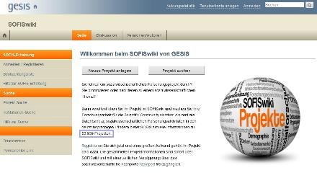
3.1 Database and Technical Background: SOFISwiki
SOFISwiki is based on Semantic Mediawiki technology:
is an extension to Mediawiki that enables quick semantic search and discovery of data in a Wiki system
https://semantic-mediawiki.org/
Zadar, 18.06.2014 I Marc Rittberger I LIDA 2014 I Assessing Educational Research
Notes:
SOFISwiki contains at the moment 53,939 project records. Here you see the website of SOFISwiki. This information portal is based on Semantic Media Wiki (SMW)
Semantik media wiki is a version of MediaWiki, extended by semantic technologies of the platform used by many Wiki applications such as Wikipedia. The purpose of this extension is to enable quick semantic search and discovery of data in a Wiki system

Slide 22
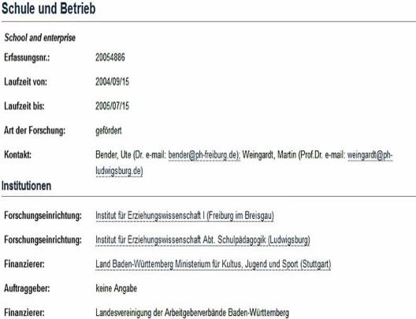
3.1 Database and Technical Background: SOFISwiki
User View
Zadar, 18.06.2014 I Marc Rittberger I LIDA 2014 I Assessing Educational Research
Notes:
Each Wiki page in SOFISwiki has a list of various attributes and their values, which is referred to as metadata schema. Two types of representation exist for this schema, i.e. user and developer view. The Figures represent screenshots of the attribute list of a Social Science project. The user view only displays the most important information that is used to describe a project and that is relevant for the user. These include the metadata of the project (title, author, year, etc.), the abstract, and the institutions and research institutions involved. If the project is funded, the sponsor is displayed, too. In addition, the methods used in the project (empirically, empirically-quality, etc.) and tags are shown.
To evaluate the indicators on the basis of the SOFISwiki structure we selected certain attributes in the developer view, values thereof serve as the basis for the visualisation of these indicators. Regarding the indicator “disciplinary area”, a SOFISwiki field was queried and evaluated. For the remaining three features of “research activity”, “type of funding” and “qualification” new attributes needed to be generated from existing ones (e.g. „Type of research“ (Forschungsart)) based on templates and additional PHP extensions.

Slide 23
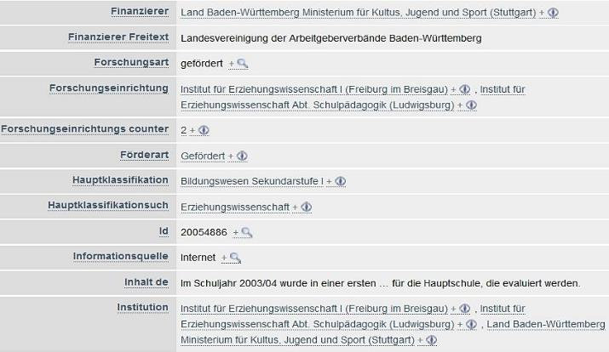
3.1 Database and Technical Background: SOFISwiki
Developer View
Zadar, 18.06.2014 I Marc Rittberger I LIDA 2014 I Assessing Educational Research
Notes:
Each Wiki page in SOFISwiki has a list of various attributes and their values, which is referred to as metadata schema. Two types of representation exist for this schema, i.e. user and developer view. The Figures represent screenshots of the attribute list of a Social Science project. The user view only displays the most important information that is used to describe a project and that is relevant for the user. These include the metadata of the project (title, author, year, etc.), the abstract, and the institutions and research institutions involved. If the project is funded, the sponsor is displayed, too. In addition, the methods used in the project (empirically, empirically-quality, etc.) and tags are shown.
To evaluate the indicators on the basis of the SOFISwiki structure we selected certain attributes in the developer view, values thereof serve as the basis for the visualisation of these indicators. Regarding the indicator “disciplinary area”, a SOFISwiki field was queried and evaluated. For the remaining three features of “research activity”, “type of funding” and “qualification” new attributes needed to be generated from existing ones (e.g. „Type of research“ (Forschungsart)) based on templates and additional PHP extensions.

Slide 24
3.1 Database and Technical Background: Concept of Functionalities
Determine project status
Determine geographical area
Determine default time period or a time slice
Choose indicator:
(completed projects)
(Germany)
Semantic result formats:
JqPlot
Sparkline
Tag cloud
D3
...
Research activity
Disciplinary area
Type of funding
Qualification
http://www.capinio.de/social-media-monitoring-optimierung/
Zadar, 18.06.2014 I Marc Rittberger I LIDA 2014 I Assessing Educational Research
Notes:
The prototype concept assumes that:
the user wishes to make some selections on the project data corpus.
He should be able to determine the project status (completed project, starting or current) as well as determine the geographical area (Germany or german speaking countries)
He should be able to determine a certain time slice or view the default time period and then choose the indicators.
Whereas the data structure in SOFISwiki allows for the implementation of these functionalities, In the current implementation of the prototype we depend on the underlying datasets of educational research projects that limit functionalities to:
completed projects
research institutions located in Germany
indicators: Research activity, Disciplinary Area, Type of funding, Qualification
The visualisation extensions available from Semantic MediaWiki were used and adapted accordingly (e.g. Sparkline, D3, jqPlot).

Slide 25
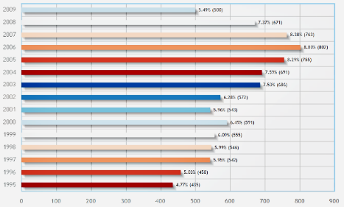
3.2 Visualisation of Indicators
Research activity
Number of achieved projects per year in the period from 1995 to 2009
Visualisation
JqPlot Extension
The project scope was highest in 2006
Zadar, 18.06.2014 I Marc Rittberger I LIDA 2014 I Assessing Educational Research
Notes:
The “research activity” indicator informs about the number of projects per year, defined as the number of completed projects in MoBi. Diverse outcome formats of the Semantic MediaWiki were tested for the representation of this indicator, e.g. Sparkline and jqPlot. The Figure shows the result of a jqPlot presentation in a bar chart.
→ The project scope was highest in 2006; i.e. in 2006 the highest annual number of educational research projects was carried out looking at the period from 1995 to 2009. The share of the projects changes over time and is not linear.

Slide 26
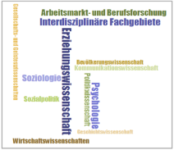
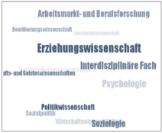
3.2 Visualisation of Indicators
Disciplinary area Relates projects to one of 12 disciplines or research
fields based on the Social Sciences classification:
Sociology, Population Science, Political Science,
Education, Psychology, Communication Sciences,
Economics etc.
Visualisation
Tag cloud Extension (above: wordcloud, below: sphere widget)
from 1995 to 2009 “Education” is the most frequent discipline
Zadar, 18.06.2014 I Marc Rittberger I LIDA 2014 I Assessing Educational Research
Notes:
To provide a disciplinary distribution of the field the indicator “disciplinary area” relates all research projects to one of 12 areas based on the Social Sciences classification. These are: Social Sciences and Humanities, Sociology, Population Science, Political Science, Education, Psychology, Communication Sciences, Economics, Social Policy, Labour market and occupational research, Interdisciplinary Subjects and History.
To visualise the indicator "disciplinary area” we used the following display options provided by Semantic MediaWiki: Sparkline, jqPlot, D3 and Tag cloud. For example, Figure 7 displays disciplines as Tag clouds.
→ The font size indicates how strongly a discipline was represented in the period from 1995 to 2009. In this time period, education (Erziehungswissenschaft) is the most frequent discipline, followed by psychology.

Slide 27
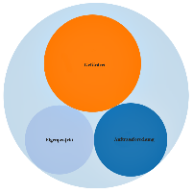
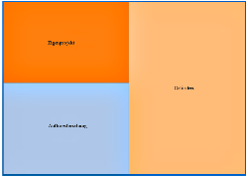
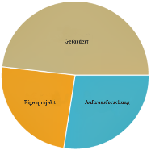
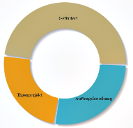
3.2 Visualisation of Indicators
Type of funding
Distinguishes between:
In-house projects
Third-party funded reasearch
Contract research
Visualisation 1
D3: bubble chart and treemap
JqPlot: pie and donut
Third-party funding is the most common funding type in educational research
Zadar, 18.06.2014 I Marc Rittberger I LIDA 2014 I Assessing Educational Research
Notes:
To investigate influences of the funding and financing of the projects, a distinction is drawn between institutional (in-house) projects, third-party funded research and contract research. To visualise the indicator "disciplinary area” we used the following display options provided by Semantic MediaWiki. The extensions D3 and jqPlot served to generate the results as shown in Figure (D3: bubble chart and treemap, JqPlot: pie and donut).
→ Between 1995 and 2009, the number of third-party funded projects far exceeded the number of projects assigned to the other two funding types. Over time, a continuous decrease of institutionally (in-house) funded projects is observable, while since 1997 the proportion of contract research has been rising. From 2005 on, a significant decrease is evident for all types of funding.

Slide 28
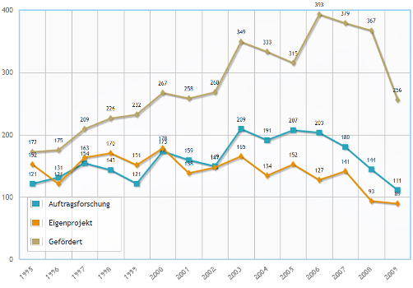
3.2 Visualisation of Indicators
Type of funding
Distinguishes between:
In-house projects
Third-party funded reasearch
Contract research
Visualisation 2
Jqplot series
strong increase in third-party funded research and decrease in other funding types over time
Zadar, 18.06.2014 I Marc Rittberger I LIDA 2014 I Assessing Educational Research
Notes:
To visualise the indicator over time, the jqPlot series extension was applied to the processed funding types. Results are shown in the line chart.
→ Between 1995 and 2009, the number of third-party funded projects far exceeded the number of projects assigned to the other two funding types. Over time, a continuous decrease of institutionally (in-house) funded projects is observable, while since 1997 the proportion of contract research has been rising. From 2006 on, a significant decrease is evident for all types of funding.

Slide 29
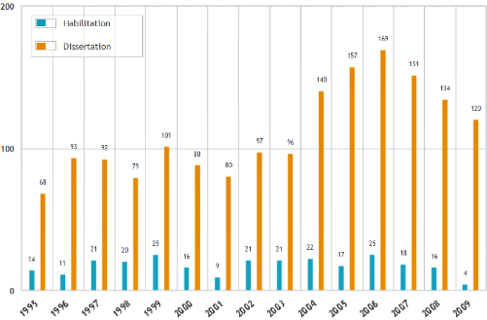
3.2 Visualisation of Indicators
Qualification
Distinguishes between doctoral and habilitation theses over time
Visualisation
JqPlot series Extension
Strong increase of “doctoral theses” and standing of “habilitation theses”
Zadar, 18.06.2014 I Marc Rittberger I LIDA 2014 I Assessing Educational Research
Notes:
The qualification of young scientists is an important indicator in the evaluation of research organisations and is based on the number of completed theses. To distinguish between doctoral and habilitation theses the indicator “qualification” was introduced. The Figure shows how the proportion of doctoral and habilitation theses changed in the course of time from 1995 to 2009.
→ Figure 10 shows how the proportion of doctoral and habilitation theses changed in the course of time from 1995 to 2009.

Slide 30
4. Summary and Prospect
Semantic MediaWiki is a good starting point for visualising information
Alignment and expansion is necessary
Challenges
Development of models to visualise significant deviations
Visualisation of indicators with more than one value
Expansion of functionalities and integration of additional indicators
Zadar, 18.06.2014 I Marc Rittberger I LIDA 2014 I Assessing Educational Research
Notes:
Semantic MediaWiki is a powerful software for the visualisation of various data sets, yet, it is not sufficiently flexible to meet the specific requirements required by MoBi.
We therefore had to expand functionalities by introducing our own scripts and templates to reach the desired results.
To do / Challenges:
Some indicators are assigned to more than one value: the existence of different counting models poses specific demands as to the assignment of one respectively more than one value.
Visualisation of significant deviations or anomalies across time is targeted as well; no international database exists that would be comparable to the content area and metadata structure of SOFISwiki. It is thus impossible to draw a comparison based on comparative external data, so we will focus on the obtainable SOFISwiki-data

Slide 31
Ende – Finito – Einde - Fin – End rittberger@dipf.de
k.haddououmoussa@gesis.org
sondergeld@dipf.de
philipp.mayr@gesis.org
peter.mutschke@gesis.org
Zadar, 18.06.2014 I Marc Rittberger I LIDA 2014 I Assessing Educational Research

