Slide 1
The Failure of Altmetrics
And what information scientists and library professionals can do about it
CASSIDY R. SUGIMOTO
INDIANA UNIVERSITY
LIDA 2014: Assessing libraries and library users and use
Part II: Altmetrics – new methods in assessing scholarly communication and libraries
Notes:
Thank you for having me here today. I’m going to talk about the failure of altmetrics (pause) and what information scientists and library professionals can do about it.

Slide 2
The Metric Menagerie
Tweets, likes, and other social media metrics in the library
Notes:
Now some of you may have seen my first title, which was far rosier in nature. However, it took a darker turn when I delved into work on this presentation.

Slide 3
Altmetrics failed.
Notes:
This is because I came to one simple conclusion in my research. Altmetrics failed. That is, the altmetrics movement has failed.

Slide 4
Criticism: Nature Materials (2010)
“Two years on since the publication of altmetrics manifesto, little has changed in academia. Social media has not been taken up as an integral part of the academic measurement of scientific achievement. There seems to be a lot of skepticism concerning its real value. Resistance to such change is rooted in that these new evaluation methods have not sufficiently been validated to be ready for adoption.”
Notes:
Of course, I am not the first one to criticize the altmetric movement or consider that it hasn’t fulfilled it’s promise. In 2010, a damning Nature Materials editorial wrote…. “Two years on since the publication of altmetrics manifesto (by Jason Priem), little has changed in academia. Social media has not been taken up as an integral part of the academic measurement of scientific achievement. There seems to be a lot of skepticism concerning its real value. Resistance to such change is rooted in that these new evaluation methods have not sufficiently been validated to be ready for adoption….As a result altmetrics seems to fall short of the established research evaluation standards.”

Slide 5
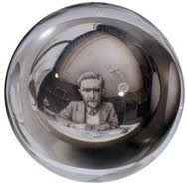
Criticism: Wouters & Costas (2012)
Altmetrics need a “far stricter protocol of data quality and indicator reliability and validity” before they can be appropriately applied to impact assessment.
Notes:
Two years later, after a thorough review of altmetric tools and applications, Paul Wouters and his team concluded that…”altmetrics need a far stricter protocol of data quality and indicator reliability and validity“ before they can be appropriately applied to impact assessment.

Slide 6
Beyond validity and reliability
Notes:
However, both of these things are mostly about reliability and validity. However, I think the failure goes beyond this.

Slide 7
The vision of altmetrics: Priem (2014)
“an approach to uncovering previously invisible traces of scholarly impact by observing activity in online tools and systems”
“agues that citations, while useful, miss many important kinds of impacts”
“citations are products of a slow rigid formal communication systems, while scientific ideas themselves are born, nursed, and raised in messy, fast-moving informal invisible colleges”
Notes:
To give you more context on how I came to this conclusion, let me walk you through what I see as the narrative and promise of altmetrics.
In my co-edited book with Blaise Cronin, Beyond Bibliometrics, Jason Priem provides the following introduction to altmetrics. He calls this “an approach to uncovering previously invisible traces of scholarly impact by observing activity in online tools and systems”. He “argues that citations, while useful, miss many important kinds of impacts, and that the increasing scholarly use of online tools like Mendeley, Twitter, and blogs may allow us to measure these hidden impacts.”
Later, he argues that “citations are products of a slow rigid formal communication systems, while scientific ideas themselves are born, nursed, and raised in messy, fast-moving informal invisible colleges” - there is a criticism here (and in the altmetrics manifesto) that there is not only a problem with the measurement, but with the system itself (Priem later attacks peer-review)

Slide 8
The promise of altmetrics
Graphic by Stefanie Haustein
Notes:
Simply put, altmetrics promised to be a great democratization of measuring the use and impact of information. Zealots of altmetrics couched their rheotric in one of comparison: altmetrics were alternative to citations. Citation were critized as being slow, as representing only a small fraction of use—that is, scholars who read, cite, and get published. Almetric advocates spoke of a world in which we could reveal the varied impact of information, looking at how all types of information are disseminated and consumed by multiple stakeholders. Thus altmetrics are set up as some that is altnerative to using citations as it can measure things which citations cannot.

Slide 9
The critique of citations
Notes:
This was all couched in the failure of citations to represent this broader array of activites.
All within this formal rigid system

Slide 10
The reality of altmetrics
Notes:
Unfortunately, the bulk of the altmetric tools and research has reverted to focusing on a single genre: the journal article and measuring use through a single type of platform: social media sites. Furthermore, the community, myself included, has spent a great deal of effort examining the degree to which these altmetrics are correlated with citation counts (as detailed in Blaise’s earlier talk). Therefore, we’ve taken this broad use and have restricted it to the same unit that was previously well-studied. In this way, altmetrics failed.

Slide 11
Broadening the conversation
Cronin (1998): measuring “the diverse ways in which academic influence is exercised and acknowledged” on the web
Force11 manifesto (2011): “we need to derive new mechanisms that will allow us more accurately to measure true contributions”
REF (2014): defines impact “as an effect on, change or benefit to the economy, society, culture, public policy or services, health, the environment or quality of life, beyond academia”
Notes:
Looking for correlations between citations and altmetrics is missing the point. Setting altmetrics up as an alternative to citations is also missing the point. We should be looking beyond that; we should be looking at this in a broader way.
Long before Jason Priem tweeted about Altmetrics, Blaise Cronin talked about measuring “the diverse ways in which academic influence is exercised and acknowledged” on the Web (1998).
The Force11 manifesto asked for “true impact” and “true contributions”
the REF 2014 defines asks for research to have an impact where: “Impact is defined as an effect on, change or benefit to the economy, society, culture, public policy or services, health, the environment or quality of life, beyond academia”

Slide 12
IMLS Outcomes Based Evaluation
Defines outcomes as benefits to people: specifically, achievement or changes in
Skill
Knowledge
Attitude
Behavior
Condition, of
Life status
for program participants.
Notes:
This definition is not unlike the IMLS description of outcomes. IMLS defines outcomes as benefits to people: specifically, achievements or changes in skill, knowledge, attitude, behavior, condition, or life status for program participants.
These are pretty lofty goals that are looking to define the social good of the services provided.
Looks at the social impact

Slide 13
The Provision of Public Services
Inputs
Outcomes logic model
Processes
Outputs
Outcomes
Notes:
This is framed in the notion of outcomes based evaluation which comes, in large part, from the public administration literature. In an outcomes logic model, all inputs and processes are designed in a way to achieve the desired outcomes, where outcomes are seen as something that is one step beyond outputs.
Inputs, that which is purchased by the organization, the processes, the services that are provided, the outputs that is, the results achieved, and then you come to the holy grail of the outcomes.

Slide 14
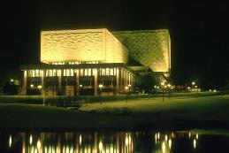
Inputs in the library
Organizations do not exist to purchase stuff.
And measurements of these things should not determine an organizations value.
Notes:
And measurements of these things are not measurements of the value of the library, even though all of you will see stats on a library bragging about the number of volumes held

Slide 15
Processes in the library
Organizations do not exist to conduct activities.
And measurements of these things should not determine an organizations value.
Notes:
And we should not explore our value

Slide 16
Outputs in the library
Organizations do not exist to achieve results.
And measurements of these things should not determine an organizations value.

Slide 17
Outcomes in the library
To provide access to knowledge.
To contribute to an informed citizenry.
To improve the lives of patrons.
To further knowledge.
To lead to improvements in future generations.
Organizations exist to achieve outcomes.
We need measurements of outcomes.
Notes:
A library exists to increase the quality of life of the population. Similarly, the objective of scholarship is not to be tweeted or to be tagged in CiteULike. The objective should be to further knowledge and society.

Slide 18
Altmetrics $≠$ Outcomes
Notes:
The problem here is that altmetrics do not measure outcomes. What we need are better measures that are both more diverse and better able to measure the social impact of these inputs, processes, and outputs.
Inputs and outputs are fairly easy to conceptualize and operationalize.
Outcomes are more difficult to measure.
Results in goal displacement.
“The construct validity of citation counts as a measure of ‘quality’ in science derives from the proposition that if a scientist’s work is of value it will be used by others both to build upon and to extend” (Lindsey)
The question is: do altmetrics measure outcomes, inputs, processes, or outputs??

Slide 19
can social impact be realized & measured?
Notes:
So how do we rebuild the altmetric movement?
Well, I’d like to go back to the ideology behind the premise. How can we break open the varied ways in which information is 1) produced, 2) disseminated, and 3) consumed and find new tools for evaluating this? How can we measure broader “social impact”?
So what might we, as information scientists and library professionals, do about this? How can we realize the potential of the promise of the altmetric movement. How do we get to the outcomes that we want to achieve? How might we truly analyze “Social Impact” of scholarship and libraries– that is, “the demonstrable effect of scholarship on society.” and the “social impact” of libraries – “the demonstrable effect of libraries on society”
Instead of talking about altmetrics as something that is constrated with citations; let’s change the conversation. Let’s talk about social impact and how this might be realized and measurement.
Let’s look not only at all the different ways that knowledge is produced, but also how it is disseminated and consumed for broader social impact.

Slide 20
Axes of social impact
Production
Assessment
Dissemination
Engagement
Notes:
To frame this conversation, I’m going to look at the ways in which libraries and scholars produce, dissemination, …. Their work and scholarship. Then we will discuss how we might look more deeply at the social impact of these activites. I will warn you now, that I will, in this discussion, provide more questions than answers.

Slide 21
Production
Notes:
The first notion is production. How can we capture more types of production and the social impact of these types of production?

Slide 22
MakerSpaces in libraries
Notes:
For those of you who are unaware of the makerspace movement, this is a movement largely in the public library environment that provides spaces where people can, quite literally, make something. This could be anything from an engineering project to writing and binding your own book. The social impacts of this are potentially vast: fostering innovation and entrepreneurship in young adults in particular could reap benefits for soceity. But how might be trace the diffusion of this process to it’s outcome? Should we trace the patents, publications, etc. that are eventually produced by these children? How do we measure the social impact of providing a space for people to gain self-efficacy in constructing tools and materials.
Patents, publications, etc. that come out are the outputs; how do we measure the social impact of providing a space for people to gain self-efficacy in constructing tools and materials?

Slide 23
Diversifying genres
Notes:
Research at Wolverhampton has been investigating the various types of sources that researchers incorporate into their scholarship. This table demonstrates the number of Scopus publications citing wikipedia, blogs, videos, social networks and other sources. The rising numbers in all of those show the impact that these forms are having on scholarship. Why not then also investigate these news forms as reputable forms of knowledge production?
Data sources may change: as Blaise noted, yesterday we had ISI, today we have GoogleScholar, and tomorrow we will have social media metrics. However, we have failed if all three of these continue to look at one form of scholarship.
Now each of these has expanded a bit; ISI-now WoS—now offers a web, book, conference proceeding, and data citation index. Yet these are far from comprehensive.
These statistics suggest that scholars are making greater use of a diversity of sources in producing their work; yet, the value of these genres has yet to be fully embraced by tenure and promotion committees. How can we establish the value of other forms of production? How does the social good of a tweet, for example, compare to the social value of a blog?

Slide 24
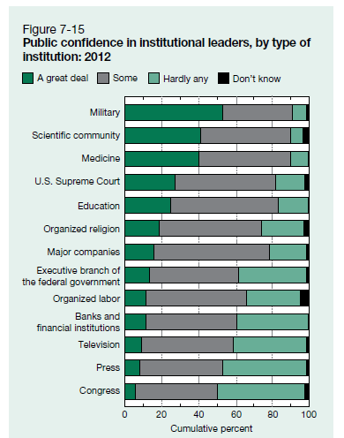
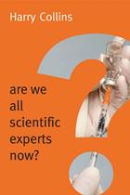
What does it matter who is speaking?
Notes:
We have also changed who has the authority to speak. As Foucault famously wrote in his piece on authorship, “What does it matter who is speaking?”
The science and engineering statistics in the US looks at the public confidence placed in institutional leaders. As shown, the scientific community is second only to the military in the us and is far above major companies, the government and television and the press. Of course, it should come as no surprise that Congress ranks lowest on our list. But this list belies the fact that many of the main science communication venues right now are not made up of academics.

Slide 25
Changing notions of authority
Notes:
Yet, we are beginning to blur the boundaries on who is allowed to speak and who carries authority.
Take, for example, the popular TED talks series. Now, some of you might know that I’ve been doing some research in this area and have found some fairly surprising results.
This begs the question of redefinitions of authorship and authority in the diversification of genres. For example, we recently published a piece in Nature describing the distribution of authorship by gender for the last 5 years. We found that female authorship constituted 30% of authorships. We also examined presenters in TED talk and found that 25% were women. Therefore, the mere diversification of genres does not necessarily a lessening of current disparities. Also, very few TED talks were from academics—that is, those associated with institutes of higher education. So, in terms of social impact--does it matter who is speaking?
As we investigate these novels forms, we must also ask who has the authority to produce information and how that’s evaluated on the web. For example, in our recent work on TED talks we demonstrated that only 25% of TED talks were given by academics. Of course, one has to acknowledge the fact that some of the talks are purely entertainment. However, a large portion are dealing with science and technology and, in one of our studies, we found that every TED talk in our sample had appeared on at least one syllabi. Therefore, these are being used as authoritative points of information for pedagogical purposes.

Slide 26
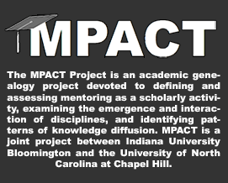
Producing people
Advice
Norms
Knowledge
Network
…
Notes:
Academic genealogy; how do we measure the impact that one person has on another; do we need more doctoral students; are certain students more likely to be productive and improve society if they are mentored by a certain individual? How can we reward those individuals whose students are doing the most public good?

Slide 27
Dissemination
Notes:
Just as our modes of production are proliferating, so too are our dissemination metrics

Slide 28
Open <fill in the blank>
Notes:
Much of this has been wrought by the “openness” movement. Open is the word de jour: open access, open data, open science, open education. This concomitant rise in openness has certainly shaped the altmetrics movement. It implies that all kinds of scholarship should be open to all kinds of people; but it also means that all types of people should have a voice in discussing this scholarship. The argument here is that scholarship is a public good and should be open.

Slide 29
A tale as old as time
“It is one of the noblest duties of a university to advance knowledge, and to diffuse it not merely among those who can attend the daily lectures—but far and wide”
Daniel Coit Gilman (1878) at the establishment of the Johns Hopkins University Press
Notes:
Now, this isn’t a particularly new tale in libraries or higher education. Daniel Gilman wrote, in the late 19th century, that one of the noblest duties of a university is to advance knowledge, and to diffuse it not merely among those who can attend the daily lectures—but far and wide.” This was his rationale behind the establishment of the John Hopkins University Press, considered to be the first university press in the US.
What has changed, however, is our ability to diffuse and to measure the diffusion and people’s interaction with it in order to see whether the scholarship produced has demonstrable effect.

Slide 30
#rocketcats
Notes:
Social media can be used to promote collections as well. For example, there was a great story in the Chronicle of Higher Education this March about a 16th century manuscript that went viral after it was digitized by Upenn’s library. The manuscript, shown here, had numerous pictures of cats with rockets tied to their back. Given the love of cats on the internet, it’s easy to see how a hashtag #rocketcats might pick up speed on twitter. However, this again questions whether this metric can actually lead to the ultimate goal of increased usage of the collections or engagement with archival material. The Chronicle story reported that the library blog saw a traffic spike, but only 5% of those clicked through to the universit’s digital-manuscript repository. However, I see this as a boon—5% who might not otherwise have been aware of it. Furthermore, a few pieces came out in the news following, talking about the content of the manuscript. Therefore, what started as a meme became something that led to knowledge generation and synthesis. This, I would argue is a true outcome and “social impact” that came from the virality of rocketcats.

Slide 31
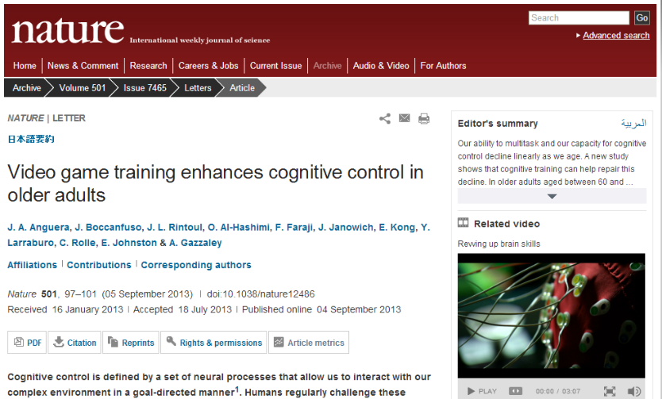
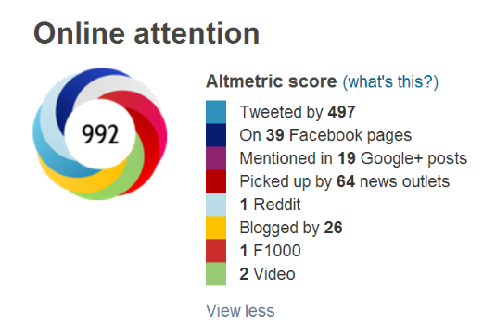
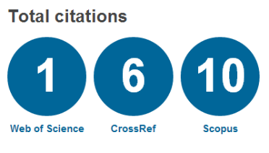
Article level metrics
Notes:
Just as we can measure how far rocketcats can fly, we can also watch how far a single piece of scholarship flies. However, this still fails to show the social impact. Is the fact that something was tweeted 497 a sign of social impact?

Slide 32
Blaise’s Beethoven or Bieber test
Article | Journal | C | T
Hess et al. (2011). Gain of chromosome band 7q11 in papillary thyroid carcinomas of young patients is associated with exposure to low-dose irradiation | PNAS | 9 | 963
Yasunari et al. (2011). Cesium-137 deposition and contamination of Japanese soils due to the Fukushima nuclear accident | PNAS | 30 | 639
Sparrow et al. (2011). Google Effects on Memory: Cognitive Consequences of Having Information at Our Fingertips | Science | 11 | 558
Onuma et al. (2011). Rebirth of a Dead Belousov–Zhabotinsky Oscillator | Journal of Physical Chemistry A | -- | 549
Silverberg (2012). Whey protein precipitating moderate to severe acne flares in 5 teenaged athletes | Cutis | -- | 477
Wen et al. (2011). Minimum amount of physical activity for reduced mortality and extended life expectancy: a prospective cohort study | Lancet | 51 | 419
Kramer (2011). Penile Fracture Seems More Likely During Sex Under Stressful Situations | Journal of Sexual Medicine | -- | 392
Newman & Feldman (2011). Copyright and Open Access at the Bedside | New England Journal of Medicine | 3 | 332
Reaves et al. (2012). Absence of Detectable Arsenate in DNA from Arsenate-Grown GFAJ-1 Cells | Science | 5 | 323
Bravo et al. (2011). Ingestion of Lactobacillus strain regulates emotional behavior and central GABA receptor expression in a mouse via the vagus nerve | PNAS | 31 | 297
Notes:
For example, the following is a table of the top 10 most tweeted documents. We can apply Blaise’s Beethoven or Bieber test to this: the first two things look at the Fukushima accident—we might argue these are tweeted because of timeliness, rather than lasting social impact. An article on open access is at number seven, showing what I would argue as the large user group of people interested in open access on twitter. Now, I understand the seriousness of penile fractures, but the fact that this article that shows penile fracture is more likely during sex under stressful situations was most likely tweeted due to humor rather than true social impact. Therefore, we need better measures of the intentions, use, and audience for these articles before using them as metrics for social impact.

Slide 33
Institutional repositories
Rationale from a recent article on altmetrics in IRs
“inform collection development”
“encourage depositors to send more material”
Notes:
Many libraries are including social media metrics into institutional repositories. These typically include page views, downloads, citations, saves on Mendeley, delicious, citulike, twitter, fb, blog posts. Many of these include an “opt out” option for faculty. In an article promoting the use of altmetrics in Irs, it was noted that these can “inform collection development” and “encourage depositors to send more material”. I would strongly argue that these are not outcomes—encouraging more people to submit should not be an end in itself. Do these repositories provide more access than, say, a disciplinary or general repository (e.g., arXiv, SSRN, REPEC, sribd)? If not, is the library investing resources appropriately and measuring the right thing?

Slide 34
Engagement
Notes:
Engagement is perhaps the most exciting potential measure of social impact.

Slide 35
Crowdsourcing in libraries
Notes:
There is also a renewed interest in citizen science, particularly enabled by web technologies. My college Hamid Ekbia has termed this heteromation, in which humans become the mechanical cogs in a work task. The library is increasingly taking advantage of citizen science to engage the patrons around work.
For example, the Australian Newspapers Digitisation Program has allowed users to correct OCR errors and tag newspapers from the project. More than 1300 users registered and corrected more than 2 million lines of text. Library of Congress also invited tagging of historical photos on flickr; 79% of these photos have been made a “favorite” that is, incorporated into person collections;
Catalog tagging of records to assist in patrons searching; social reference tools like LibAnswers
Collaborative cataloging
We have metrics on how many people tagged, how many tags were applied, and how many were incorporated into personal collections. But did this improve the lives of the patrons? Did it serve to improve quality of life? Did it lead to historical discoveries.?
Mention the success of wikipedia; new faith in public knowledge

Slide 36
Revised unisist
PRODUCERS
INTERNET BASED SOURCES
informal
formal
E-mail, List servers,
UseNet news newsgroups,
Electronic meeting/webcam
conferencing
PREPRINT
DATABASES
E-journals
Online journals
PRIMARY SOURCES
Selection
Production
Distribution
PUBLISHERS
EDITORS
PEER-REVIEW
Thesis, reports
ABSTRACTING &
INDEXING SERVICES
SECONDARY SOURCES
SCIENTIFIC &
RESEARCH
ORGANIZATIONS
SERVERS
Analysis & storage
Dissemination
E-LIBRARIES
SEARCH ENGINES/META SEARCH TOOLS AND
VIRTUAL LIBRARIES/DIRECTORIES/CLEARNING HOUSES
Dictionaries,
thesaurus
Abstracts &
Index
Journals
Special
Bibliographies,
Translation
TERTIARY SERVICES
OPACS
Evolution
Compression
Consolidation
Reviews,
Syntheses, etc.
USERS
(Sondergaard, Andersen, & HjØrland, 1971)

Slide 37
Formal vs. Informal
Published vs. Unpublished
Genres
Book
Review
Curated DB
Article
Multimedia
Slideshow
Conf. paper
Blog
Report
Dissemination
Email
Production
Creator
Draft
Tweet
Prosumer
Consumer
NEW MODEL

Slide 38
#SixWordPeerReview
Your bibliography is a giant selfie
I don’t get paid for this
Too much data, too little evidence
How could you not cite Wellman? [tweeted by Wellman]
Have you tried a linear regression?
Taking my time. Love, your Competitor
Contradicts my findings. Can’t be true.
I thought of this in 1973
Please do more experiments for me
Notes:
One of the ways we can see this are in new forms of peer review and engagement with articles online. This is a hashtag going across twitter which does peer review in six words. Now, this is a humorous example [find story about this], but it’s illustrative of a greater trend. People can and do critique articles online. Many times this happens early enough in the process that people can make changes to the scholarship; there are a number of stories of bloggers correcting scientific errors; yet, how do we reward and incentivize this type of participation? Most of the novel forms of open peer review have largely failed and this is in no small part due to the lack of proper incentives. How can we demonstrate the social good of public engagement?
Phil Davis;

Slide 39
assessment
Notes:
Of course, a host of tools have arisen around the use of altmetrics for assessment. I will briefly discuss a few of these and their potential utility in measuring social impact.

Slide 40
Mendeley Institutional Edition
Notes:
Mendeley’s institution edition is one example. Using the power of Mendeley, an online reference management software, a video with a gentleman with a nice voice will tell you how the internet has made the library all but irrelevant. However, Mendeley can help you to connect with your researchers and put the scholar back in the library. You, the librarian, can now help the researcher to find collaborators, review literature, and disseminate findings, among other activities.

Slide 41
Microsoft Academic Search
Unique topics
Shared
topics
Notes:
Microsoft academic search of academic analytics, which was discussed briefly yesterday;

Slide 42
Social Crawlytics
Notes:
Social Crawlytics will as the tagline commits, help you to “identify your competitor’s most shared content.” This allows you, the researcher or library to compare your altmetric score with another.

Slide 43
Campbell’s Law
“The more any quantitative social indicator is used for social decision-making, the more subject it will be to corruption pressures and the more apt it will be to distort and corrupt the social processes it is intended to monitor.”
Notes:
We must be constantly diligent to avoid goal displacement—to not let the tweet become and end in itself. As Campbell’s Law states:

Slide 44
the future of altmetrics
Challenges and opportunities ahead
Notes:
I began with the failure of altmetrics, so I would like to end with the future of altmetrics, specifically focusing on the challenges and opportunities ahead

Slide 45
LibGuides
Notes:
Altmetrics are coming with subscription products that librarinas buy (e.g. Plum Analytics); we need to ask, do students, faculty and administrators know what these mean? There is a large tradition of outreach and liaison work in libraries and altmetrics certainly deserves user education.
Librarians as educators: over 43,000 result pages that mention library guides and altmetrics together; but are librarians well informed on the uses and abuses of altmetrics? Are they serving as informed liaisons between faculty and metrics hungry administration?

Slide 46
Standardization and unification
Notes:
NISO was awarded a Sloan Foundation grant to look “explore, identify, and advanced standards and/or best practices related to a new suite of potential metrics”. ORCID could be used to identify all of an individual’s work across multiple platforms and, hopefully including all data types; SPARC had great success in spreading the word on open access issues through consolidation efforts and has now produced a primer on article level metrics.
This work in standardization can help to ease the reliability and validity concerns raised earlier.
From article level metrics to social media measures

Slide 47
As Protégé
Dissertation
Advisor
As Mentor
Advisees
Affiliation
Discipline
Institution
Discipline
More…
More….
Mentoring
Publication
Grant
Altmetrics
Demographic
Gender
Career Age
More…
Demo.
Publication
Papers
Topics
Citation
Cites
Collaboration
Co-author
More….
Venue
More….
References
More…
NSF
Award
Amount
NIH
Award
NEH
Award
Time
More…
Amount
Time
More…
Amount
Time
More…
SNS
Twitter
Facebook
Ref. Man.
Mendeley
Press
Blogs
More…
Zotero
News
More…
Notes:
Librarians are also being asked to do research assessment exercises and incorporate altmetrics into these; now, I don’t have time in this talk to go into the dangers of individual level bibliometrics—I’ll leave that to Paul Wouter’s talk. However, it is imperative that librarians themselves are aware of the potential limitations of social media metrics when they are doing their work.
Issues of author name disambiguation and other problems; how do you unify all that a scholar has done; all the conversations
ORCHID

Slide 48
Providing access or amplifying disparities
Notes:
Altmetrics could be a great way for scholars from other countries to gain more reputation; however, it can also be another space for disparities to occur. Just because something is viral or accessible, doesn’t mean it’s equitable. One of the challenges ahead of us it to ensure that production and dissemination are done equitably. As boyd and crawford pointed out, we can’t mistake the Twitter population for the world population

Slide 49
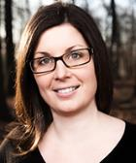
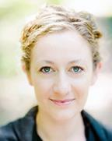
Meanings and motivations
Notes:
Finally, we have a long way to go in terms of undersatnding the meanings and motivations behind these novel metrics. The sloan foundation has provided us with funding to examine the meanings and motivations behind social media metrics and we hope this will get us closer to being able to create a theory around social media metrics and move towards the development of social impact measures.

Slide 50
From Article level metrics to social impact measures
Notes:
In closing, I would like to urge all of you to think critically about altmetrics – and frankly, all metrics– and ask: are they measuring objectives? Do they serve to improve the public good? Are these truly measures of social impact? Because if they are not, we might want to rethink them.

Slide 51
Thank you!
CONTACT
CASSIDY R. SUGIMOTO SUGIMOTO@INDIANA.EDU WITH QUESTIONS

