Slide 1
Are downloads and readership data a substitute for citations? The case of a scholarly journal?
Christian Schlögl
Institute of Information Science and Information Systems
University of Graz
Austria

Slide 2
Project team
Juan Gorraiz
University of Vienna, Vienna University Library,
Dept of Bibliometrics, A-1090 Vienna (Austria)
Christian Gumpenberger
University of Vienna, Vienna University Library,
Dept of Bibliometrics, A-1090 Vienna (Austria)
Kris Jack
Mendeley, London (UK)
Peter Kraker
PhD student, Know-Center, Inffeldgasse 13,
A-8010 Graz (Austria)
Christian Schlögl
University of Graz, Institute of Information Science and
Information Systems, A-8010 Graz (Austria)

Slide 3
Acknowledgments
This paper is partly based on anonymous ScienceDirect usage data and Scopus citation data kindly provided by Elsevier within the framework of the Elsevier Bibliometric Research Program (EBRP).

Slide 4
Contents
Introduction
Research questions and data sources
Methodology
Results
Downloads
Citations
Readership data
Relations among downloads, citations and readership data
Conclusions

Slide 5
Introduction
Several studies have compared downloads and citations
Possible sources for download data
Repositories/preprint archives: e.g. Chu and Krichel (2007) - RepEc, Brody et al. (2006) - arxiv
Single journals: Moed (2005), Coats (2005)
Commercial full-text databases (e.g. ScienceDirect): e.g. Schlögl & Gorraiz (2010), Schloegl & Gorraiz (2011)
Recently, social reference management systems have received a lot of attention as a possible source for altmetrics
A few studies have compared readership and citation data (Bar-Ilan 2012, Li and Thelwall 2012 , Kraker et al. 2012, Schlögl et al. 2013, Gorraiz et al. 2013, Haustein et al. 2015)
In this study, we compare citations, downloads, and readership for the Journal of Phonetics

Slide 6
Research questions
Are the most cited articles the most downloaded ones, and those which can be found most frequently in user libraries of the collaborative reference management system Mendeley?
Do citations, downloads, and readership have different obsolescence characteristics?
Are there other features in which citation, download and readership data differ?
Do journals from other disciplines (information systems) differ from Journal of Phonetics with regards to RQ 1 – RQ 3?

Slide 7
Data sources
Journal of Phonetics :
covers phonetic aspects of language and linguistic communication processes
Topics:
speech production
speech perception
speech synthesis
automatic speech and speaker recognition
speech and language acquisition
4 issues a year
Peer reviewed
Anglo-Saxon dominated authorship: 75% of authors, 50% US
4 issues per year (Elsevier, 2014)

Slide 8
Data sources
Data sources:
ScienceDirect (SD): monthly download data (PDF & HTML)
Scopus: monthly citation data
Mendeley: monthly additions to user libraries (full length articles)
Period of analysis: 2002 – 2011
Analyzed documents: 395 (ScienceDirect)

Slide 9
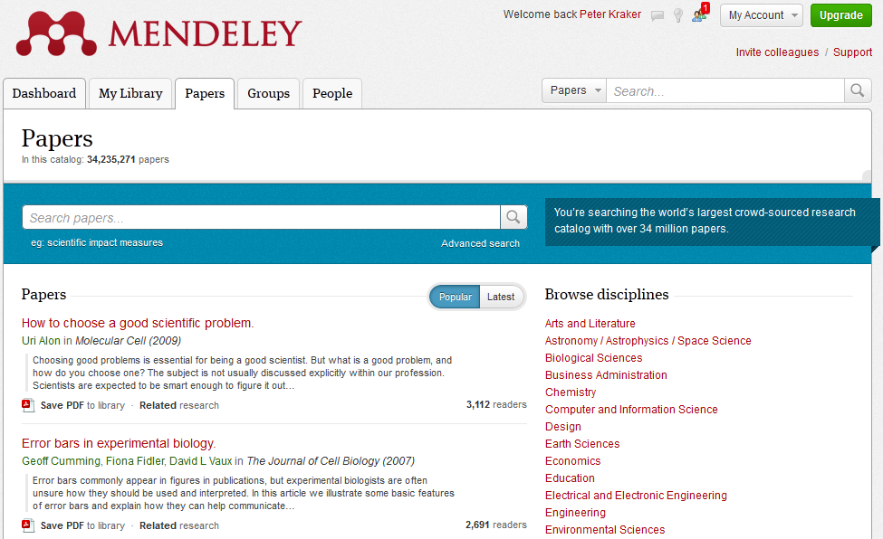
Mendeley
Social reference management system
Organizing personal research library
Creating user profile
Crowdsourced Mendeley research catalog:
> 2.5 million Users
> 110 million unique articles
“Readership” counts: how many Mendeley users have added a document to their user library
http://www.mendeley.com/research-papers/

Slide 10
Methodology
Preprocessing:
Matching documents between ScienceDirect (SD) and Scopus
No unique key for SD and Scopus
Different document types between SD and Scopus
Matching via journal name, vol, (first) page
Matching documents (only full length articles) between Scopus and Mendeley via title
Descriptive statistics: document types, publication dates, downloads, readers
Correlation analysis:
Downloads vs. cites, readers vs. Cites, downloads vs. readers

Slide 11
Results downloads: Downloads per document type
 | n | % docs | % down­loads (DL) | DLs per doc - relations¹
Announcement | 2 | 0.5% | 0.1% | 1.8
Book review | 1 | 0.3% | 0.1% | 1.7
Contents list | 2 | 0.5% | 0.1% | 1.9
Discussion | 9 | 2.3% | 2.7% | 8.7
Editorial Board | 30 | 7.6% | 1.1% | 1.1
Editorial | 5 | 1.3% | 1.5% | 8.7
Erratum | 3 | 0.8% | 0.5% | 4.4
Full length article (FLA) | 324 | 82.0% | 92.3% | 8.2
Index | 1 | 0.3% | 0.1% | 1.8
Miscellaneous | 9 | 2.3% | 0.4% | 1.3
Other contents | 1 | 0.3% | 0.1% | 2.1
Personal report | 2 | 0.5% | 0.2% | 3.4
Publishers note | 3 | 0.8% | 0.1% | 1.0
Short communication | 2 | 0.5% | 0.3% | 4.8
Short survey | 1 | 0.3% | 0.3% | 9.9
 | 395 | 100% | 100%
FLAs (82%) are the most downloaded document type (92%)
DLs per doc higher for discussions, editorials, FLAs and short surveys

Slide 12
Results downloads - JoSIS: Downloads per document type
FLAs (56%) are the most downloaded document type (94.1%)
Document type | n | % docs | % downloads | Downloads per doc – relations
Announcement | 5 | 1.6% | 0.4% | 5.9
Book review | 4 | 1.2% | 0.3% | 5.5
Contents list | 29 | 9.0% | 0.4% | 1.0
Editorial Board | 29 | 9.0% | 0.6% | 1.5
Editorial | 49 | 15.3% | 3.3% | 4.6
Erratum | 1 | 0.3% | 0.1% | 5.7
Full length article | 181 | 56.4% | 94.1% | 35.4
Index | 12 | 3.7% | 0.2% | 1.3
Miscellaneous | 9 | 2.8% | 0.2% | 1.8
Publishers note | 2 | 0.6% | 0.2% | 7.0
 | 321 | 100% | 100%
Source: ScienceDirect; n=321

Slide 13
Results downloads Downloads per publication year (ratios)
PY | n | Download year
 |  | 2002 | 2003 | 2004 | 2005 | 2006 | 2007 | 2008 | 2009 | 2010 | 2011 | all
2002 | 28 | 0.2 | 1.6 | 1.5 | 1.3 | 1.3 | 1.5 | 1.5 | 1.4 | 1.3 | 1.0 | 12.6
2003 | 29 |  | 2.2 | 3.4 | 2.4 | 2.2 | 2.1 | 3.1 | 2.8 | 2.5 | 1.9 | 22.4
2004 | 21 |  | 0.3 | 2.7 | 2.6 | 2.0 | 2.3 | 2.8 | 2.9 | 2.5 | 2.1 | 20.3
2005 | 20 |  |  | 0.0 | 3.1 | 2.5 | 1.9 | 2.0 | 2.2 | 1.7 | 1.4 | 14.9
2006 | 22 |  |  |  | 0.6 | 4.4 | 4.7 | 4.1 | 4.1 | 3.5 | 2.9 | 24.4
2007 | 29 |  |  |  |  | 0.9 | 5.4 | 5.1 | 4.2 | 3.1 | 2.7 | 21.3
2008 | 35 |  |  |  |  |  | 0.2 | 6.6 | 6.3 | 4.3 | 3.3 | 20.7
2009 | 32 |  |  |  |  |  |  | 0.3 | 6.7 | 5.3 | 3.0 | 15.3
2010 | 51 |  |  |  |  |  |  | 0.0 | 0.7 | 7.8 | 6.8 | 15.3
2011 | 57 |  |  |  |  |  |  |  |  | 0.3 | 10.4 | 10.7
all | 324 | 0.2 | 4.1 | 7.6 | 10.1 | 13.3 | 18.2 | 25.5 | 31.2 | 32.2 | 35.6 | 178.0
Download maximum in nearly all cases in the publication year
Download half-life 2011 = 2.2 years

Slide 14
Results downloads - JoSIS Downloads per publication year (ratios)
 |  | DL-year
PY | n | 2002 | 2003 | 2004 | 2005 | 2006 | 2007 | 2008 | 2009 | 2010 | 2011 | all
2002 | 13 | 1.0 | 2.3 | 1.7 | 1.3 | 1.2 | 1.4 | 2.4 | 2.8 | 2.8 | 2.7 | 19.6
2003 | 21 | 0.0 | 1.3 | 2.2 | 1.0 | 1.0 | 0.9 | 1.5 | 1.3 | 1.5 | 1.1 | 11.9
2004 | 17 |  |  | 1.7 | 2.6 | 2.1 | 2.2 | 2.4 | 2.7 | 2.9 | 2.3 | 18.9
2005 | 18 |  |  |  | 1.7 | 2.3 | 1.8 | 2.0 | 2.4 | 2.6 | 2.2 | 15.0
2006 | 14 |  |  |  | 0.2 | 2.4 | 2.1 | 1.8 | 2.1 | 2.0 | 2.0 | 12.5
2007 | 18 |  |  |  |  | 0.0 | 2.7 | 3.6 | 3.4 | 3.5 | 2.9 | 16.1
2008 | 16 |  |  |  |  |  | 0.0 | 2.9 | 3.5 | 3.0 | 2.4 | 11.8
2009 | 14 |  |  |  |  |  |  |  | 3.1 | 4.0 | 3.1 | 10.2
2010 | 21 |  |  |  |  |  |  |  |  | 3.9 | 4.4 | 8.3
2011 | 29 |  |  |  |  |  |  |  |  | 0.3 | 5.6 | 5.9
all | 181 | 1.0 | 3.7 | 5.6 | 6.8 | 8.9 | 11.1 | 16.6 | 21.4 | 26.4 | 29.0 | 130.4
Download maximum in many cases 1 year after publication
Download half-life 2011 = 3.5 years (I&M: 5 years)
Source: ScienceDirect; FLA only (n=181)

Slide 15
Results citations: Citations per document type
Doc type | n | Uncited | % uncited | Cites | % cites | Cites per doc type
Article | 316 | 74 | 23% | 2331 | 84% | 7.4
Review | 17 | 0 | 0% | 432 | 16% | 25.3
Editorial | 5 | 3 | 60% | 6 | 0% | 1.2
Letter | 3 | 0 | 0% | 15 | 1% | 5.0
Notes | 1 | 1 | 100% | 0 | 0% | 0.0
Erratum | 3 | 3 | 0% | 0 | 0% | 0.0
 | 345 | 81 | 23% | 2784 | 100% | 8.1
Different document types in Scopus and ScienceDirect (FLA ≈ articles +
conference papers + reviews)
Most citations per document for reviews
Ca. 25% of all documents not cited (primarily editorials, notes and erratum)

Slide 16
Results citations - JoSIS: Citations per document type
Doc type | no. docs | % uncited | Cites | Cites per doc type
Article | 151 | 15% | 2563 | 14.8
Conference paper | 13 | 69% | 8 | 0.4
Editorial | 33 | 79% | 13 | 0.2
Review | 18 | 6% | 383 | 20.2
All | 215 | 27% | 2967 | 10.9
Source: Scopus; n=215

Slide 17
Results citations: Citations per publication year
PY | n | Citation year
 |  | 2002 | 2003 | 2004 | 2005 | 2006 | 2007 | 2008 | 2009 | 2010 | 2011 | all
2002 | 28 | 5 | 12 | 44 | 45 | 46 | 53 | 73 | 73 | 72 | 80 | 503
2003 | 37 |  | 55 | 23 | 60 | 78 | 91 | 64 | 93 | 120 | 107 | 691
2004 | 23 |  | 4 | 6 | 42 | 48 | 53 | 61 | 51 | 81 | 57 | 403
2005 | 18 |  |  | 1 | 7 | 17 | 27 | 28 | 35 | 48 | 32 | 195
2006 | 23 |  |  |  |  | 12 | 34 | 40 | 57 | 86 | 97 | 326
2007 | 29 |  |  |  |  |  | 5 | 41 | 59 | 71 | 58 | 234
2008 | 35 |  |  |  |  |  | 1 | 11 | 52 | 67 | 66 | 197
2009 | 32 |  |  |  |  |  |  |  | 7 | 44 | 74 | 125
2010 | 51 |  |  |  |  |  |  |  | 1 | 16 | 49 | 66
2011 | 57 |  |  |  |  |  |  |  |  |  | 23 | 23
all | 333 | 5 | 71 | 74 | 154 | 201 | 264 | 318 | 428 | 605 | 643 | 2763
Only a few documents are cited in publication year - citation maxium is reached
several years after publication
Difference to downloads reaching their maximum usually in the publication year

Slide 18
Results citations - JoSIS: Citations per publication year
Special Issue on “Trust
in the Digital Economy“
Pub year | n | Citation year |  |  |  |  |  |  |  |  |  |  | cites per doc
 |  | 2002 | 2003 | 2004 | 2005 | 2006 | 2007 | 2008 | 2009 | 2010 | 2011 | all
2002 | 13 | 2 | 19 | 38 | 69 | 88 | 105 | 158 | 165 | 194 | 199 | 1037 | 79.8
2003 | 14 |  | 1 | 6 | 21 | 27 | 39 | 35 | 41 | 40 | 39 | 249 | 17.8
2004 | 17 |  |  | 0 | 15 | 40 | 56 | 74 | 78 | 88 | 107 | 458 | 26.9
2005 | 19 |  |  |  | 0 | 16 | 46 | 78 | 76 | 93 | 99 | 408 | 21.5
2006 | 14 |  |  |  | 1 | 2 | 14 | 31 | 31 | 53 | 49 | 181 | 12.9
2007 | 18 |  |  |  |  |  | 1 | 31 | 74 | 92 | 85 | 283 | 15.7
2008 | 15 |  |  |  |  |  |  | 3 | 30 | 69 | 83 | 185 | 12.3
2009 | 14 |  |  |  |  |  |  |  | 3 | 34 | 57 | 94 | 6.7
2010 | 18 |  |  |  |  |  |  |  |  | 5 | 40 | 45 | 2.5
2011 | 8 |  |  |  |  |  |  |  |  |  | 14 | 14 | 1.8
all | 150 | 2 | 20 | 44 | 106 | 173 | 261 | 410 | 498 | 668 | 772 | 2954
Special Issue with
conference papers
Source: Scopus; Document types: articles, reviews, conference papers; only cited documents (n=150)

Slide 19
Results Mendeley: Readership structure
75% of all FLA are coverd by Mendeley
57% of readership counts come from students
13% from PostDocs, 20% from professors
Source: Mendeley; doc type: FLA; n=4741

Slide 20
Results Mendeley – JoSIS/I&M: Readership structure
97%/88% of all FLA are coverd by Mendeley
2/3 of readership counts come from students
3%/2% from PostDocs, 12%/14% from professors

Slide 21
Results: Downloads vs. readers vs. cites (only FLAs and cited docs)
Journal of Phonetics:
Moderate correlation (Spearman) between downloads and citations (0.59) and between downloads and readers (0.73)
Moderate correlation between citations and readers (r=0.51
JoSIS:
Moderate to high correlation (Spearman) between downloads and citations (0.77) and downloads and readers (0.73)
Moderate correlation between citations and readers (r=0.51)

Slide 22
Conclusions
Comparison of different measures not always easy
Different obsolesence characteristics of downloads and cites (readership to be determined)
Moderate correlation between downloads and cites and downloads and readership data
Moderate correlation between cites and readership data
Results for information systems journals go into the same direction though there might be disciplinary differences
→ Downloads, citations and readership data measure different aspects of journal use

Slide 23
Thank you very much for your attention!

