Slide 1
Digital Library assessment through multiple measures
Melissa Lamont
San Diego State University
San Diego, California

Slide 2
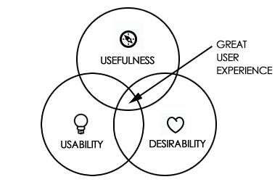
From: http://hongyoonjung.wordpress.com/

Slide 3
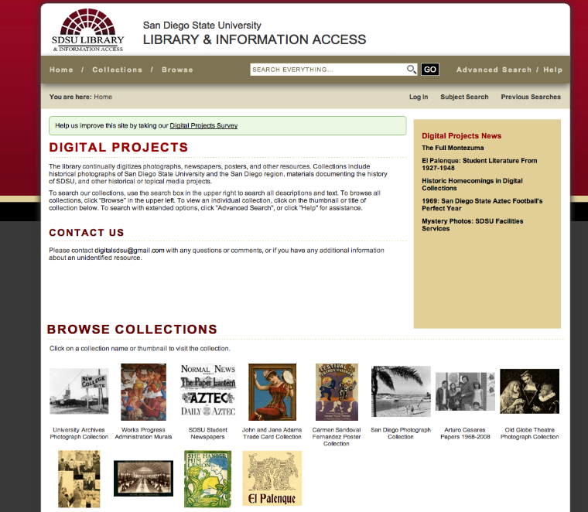

Slide 4
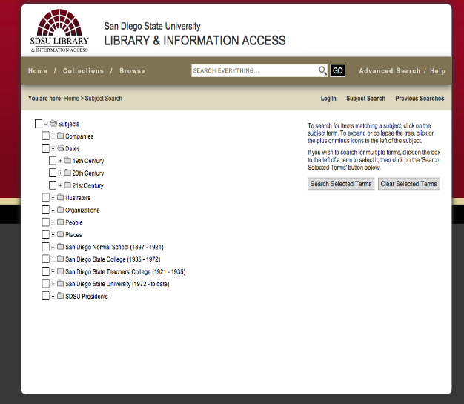
Subject tree

Slide 5
Terms searched in the Database
2010-March 2014

Slide 6
Why Searches Failed

Slide 7
Search Engine results, not google

Slide 8
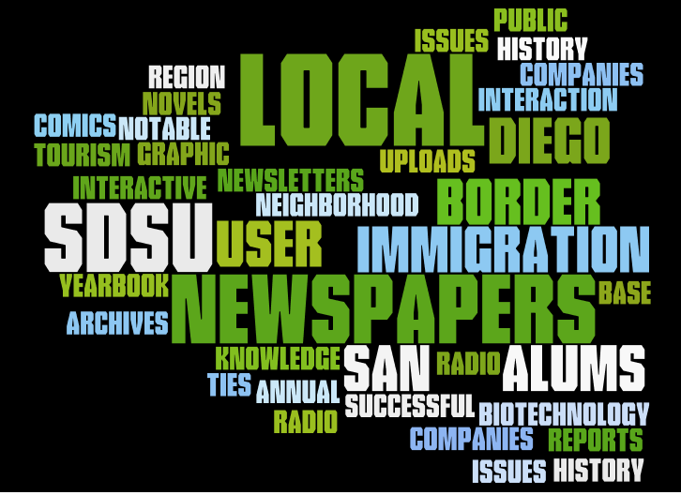

Slide 9
Interviews: Why digital library is useful

Slide 10
Digitization Suggestions

Slide 11
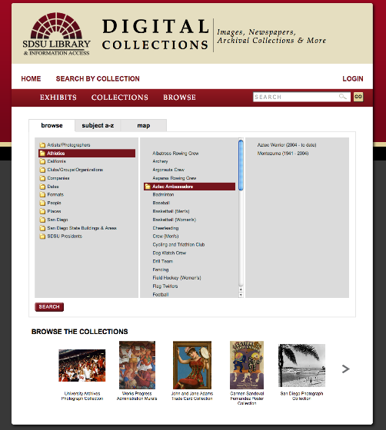
Draft new interface

Slide 12
Thank you
Digital Projects at SDSU
http://ibase.sdsu.edu
Melissa Lamont mlamont@rohan.sdsu.edu

