Slide 1
Assessing requirements for research data management support in academic libraries: introducing a new multi-faceted capability tool.
Liz Lyon
Visiting Professor, School of Information Sciences (iSchool)
University of Pittsburgh, USA

Slide 2
Research data at your University
Laboratory and experimental data?
Any regional or national data centres?
Pittsburgh: Health & medicine focus
Carnegie Mellon: Science & engineering focus
Data diversity, volume, types, status etc.
Sensitive data? Security issues? Storage?
Departments, groups, labs, projects, individuals
Readiness, maturity, capability, state-of-the-nation, risks, actions….

Slide 3
Selected assessment tools
Data Audit / Asset Framework (DCC)
AIDA Toolkit (ULCC)
CARDIO & CARDIO-lite (DCC)
Web surveys e.g. Bristol Online Survey
Interviews and Focus Groups
Personas and people (UColorado)
Data Curation Profiles (Purdue)
DMVitals (UVirginia)
Community Capability Model & Profile Tool (UKOLN / Microsoft)

Slide 4
2007
Liz Lyon - UK Report for Jisc
“Rec 4: JISC should develop a Data Audit Framework to enable all Universities and colleges to carry out an audit of departmental data collections, awareness, policies and practice for data curation and preservation”
http://www.jisc.ac.uk/media/documents/programmes/digitalrepositories/dealing_with_data_report-final.pdf

Slide 5
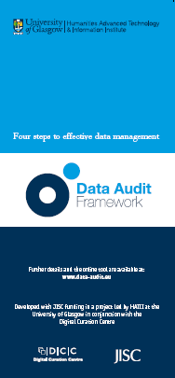
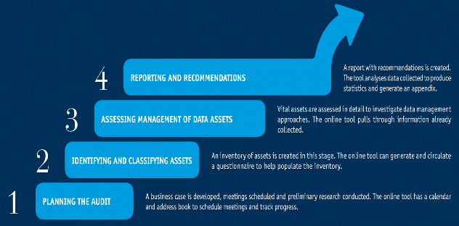
Benefits:
Prioritisation of resources
Capacity development and planning
Efficiency savings – move data to more cost-effective storage
Manage risks associated with data loss
Realise value through improved access & re-use
http://www.data-audit.eu/DAF_Methodology.pdf

Slide 6
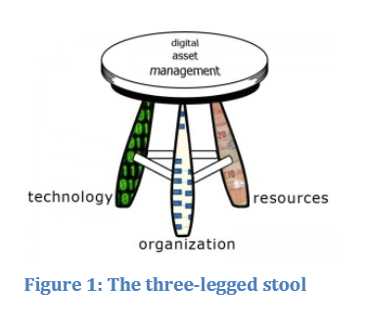
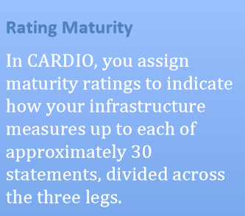
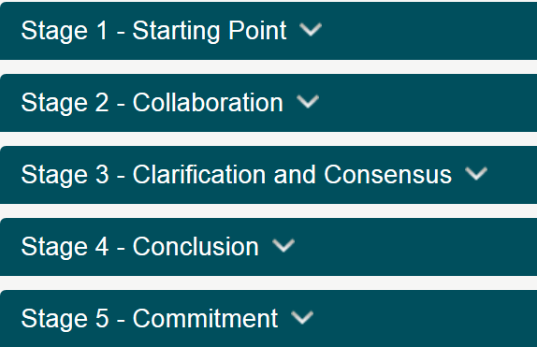
CARDIO: Collaborative Assessment of Research Data Infrastructure and Objectives
http://cardio.dcc.ac.uk/

Slide 7
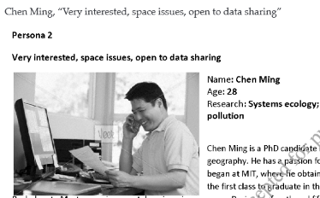
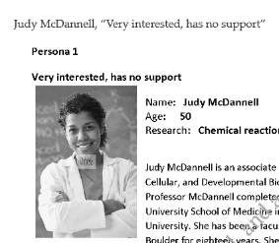
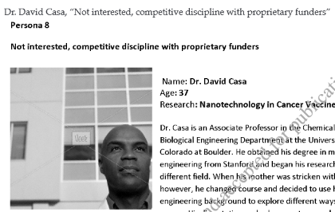
Personas
Recruited participants
26 interviews
9 departments
Grid mapping answers
8 personas
Offer data services to researchers who share traits….
http://www.press.jhu.edu/journals/portal_libraries_and_the_academy/portal_pre_print/current/articles/11.4lage.pdf

Slide 8
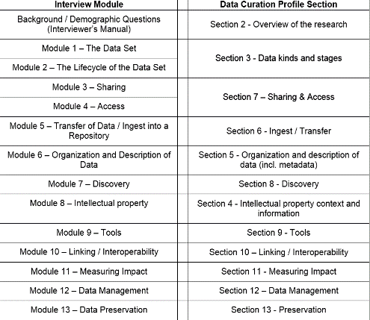
IMLS grant
Toolkit download
http://datacurationprofiles.org/download
User Guide
Interviewer’s Manual
Interview Worksheet
Template

Slide 9
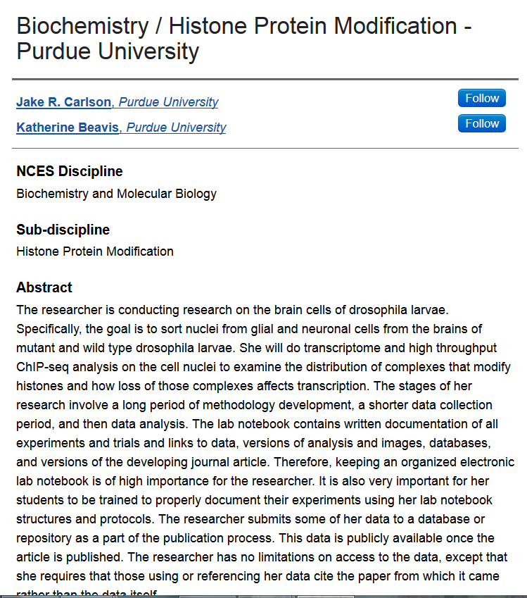
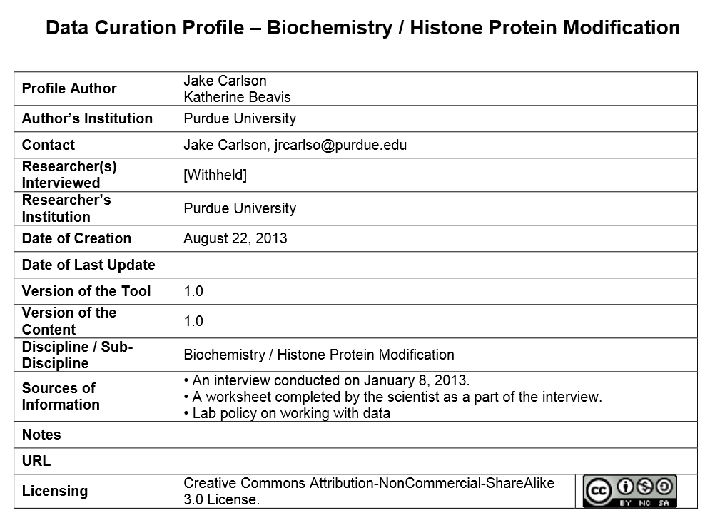

Slide 10
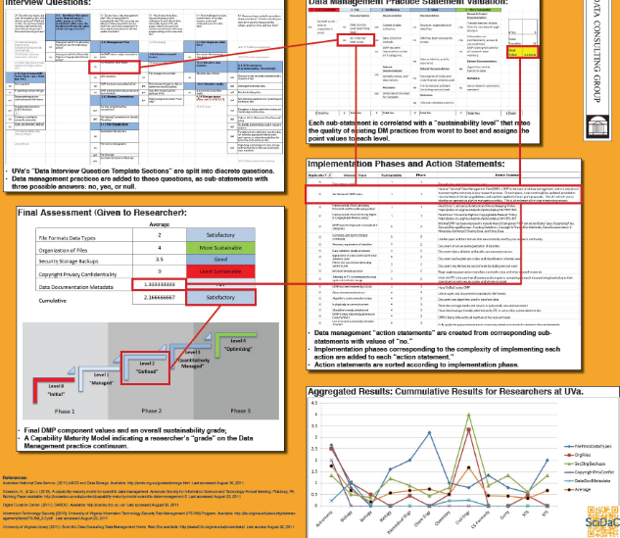
Interviews
Excel tool
5-level maturity model
Scores
Sustainability Index
DMVitals
From: IASSIST poster
Lake & Borda 2012

Slide 11
Local RDM Requirements
London School of Hygiene & Tropical Medicine
Web survey Report 2013
Faculties of Epidemiology & Population Health, Public Health & Policy, Infectious & Tropical Diseases
http://blogs.lshtm.ac.uk/rdmss/files/2013/04/LSHTM-RDM-Web-Survey-Report.pdf

Slide 12
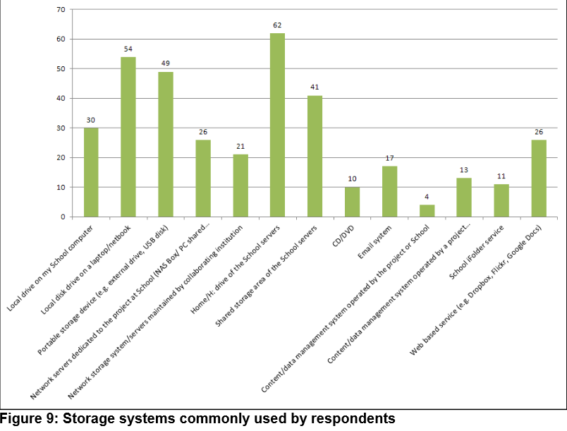
From: Gareth Knight, LSHTM Web Survey Report 2013

Slide 13
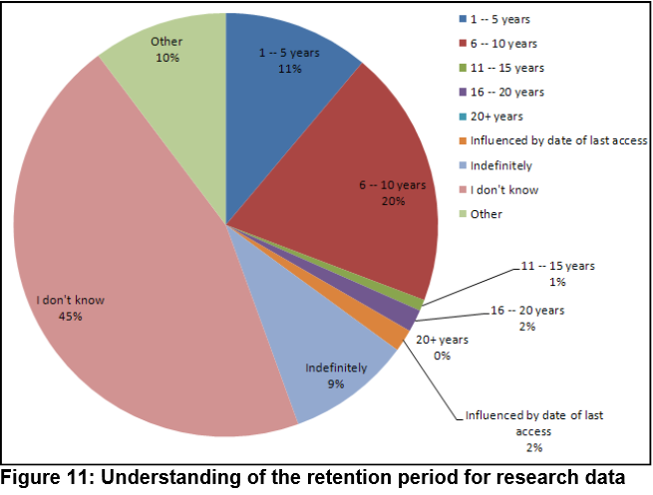
From: Gareth Knight, LSHTM Web Survey Report 2013

Slide 14
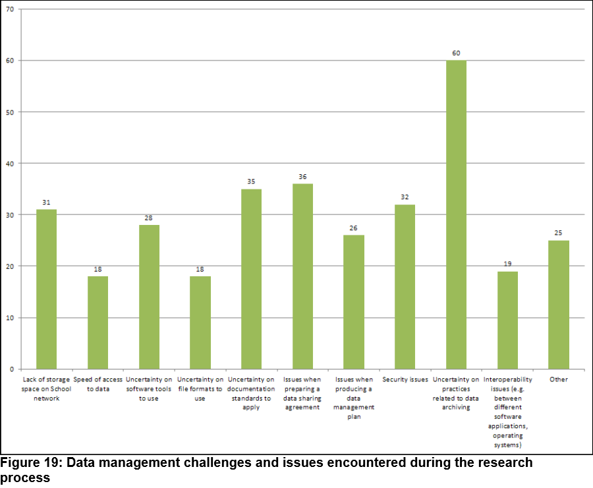
From: Gareth Knight, LSHTM Web Survey Report 2013

Slide 15
A new tool: Community Capability Model Framework

Slide 16
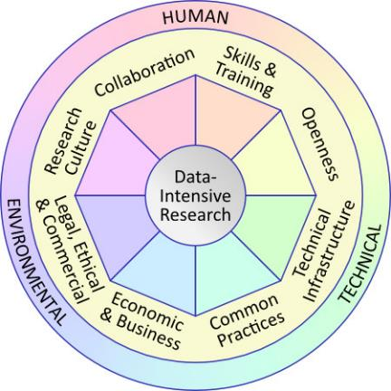
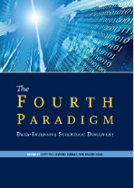
CCM Framework
The Community Capability Model Framework (CCMF)
Profiling current readiness or capability of a community
Indicating priority areas for change and investment
Developing roadmaps for achieving a target state of readiness
Funded by Microsoft Research Outreach
Developed through consultation:
Six international workshops
Case studies
Research Data Alliance – Interest Group
communitymodel.sharepoint.com

Slide 17
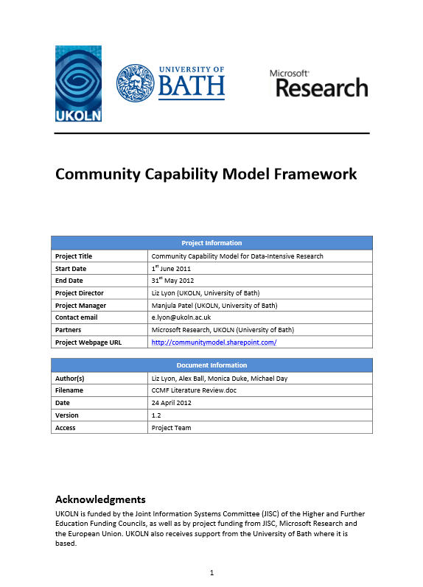
Community Capability Model Framework
White Paper
April 2012
http://communitymodel.sharepoint.com/

Slide 18
CCM Framework
Categorised into Environmental, Human and Technical elements with eight capability factors:
Collaboration
Skills & Training
Openness
Technical Infrastructure
Common Practices
Economic & Business
Legal, Ethical & Commercial
Research Culture
Each factor has characteristics associated with it
communitymodel.sharepoint.com

Slide 19
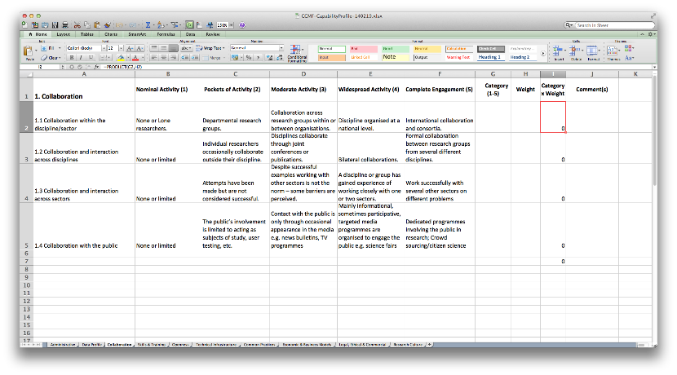
CCMF Capability Profile Template
Implemented as an MS Excel spreadsheet
Separate worksheets for each of the eight CCMF factors
A scorecard tool (5 levels or dimensions for each characteristic within each capability factor)
Download from http://communitymodel.sharepoint.com/

Slide 20
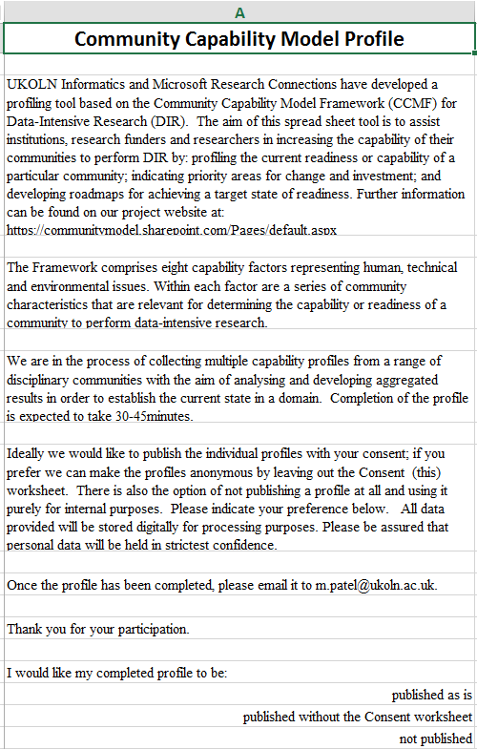
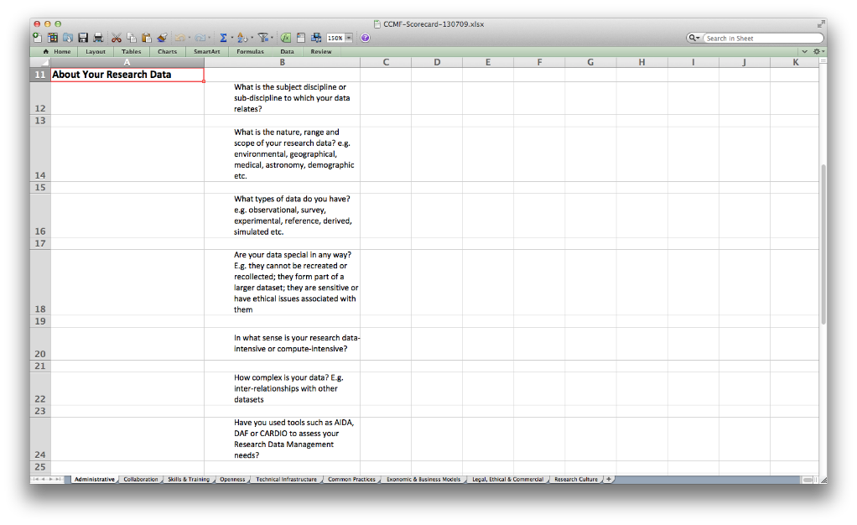
Administrative – About you and your data

Slide 21
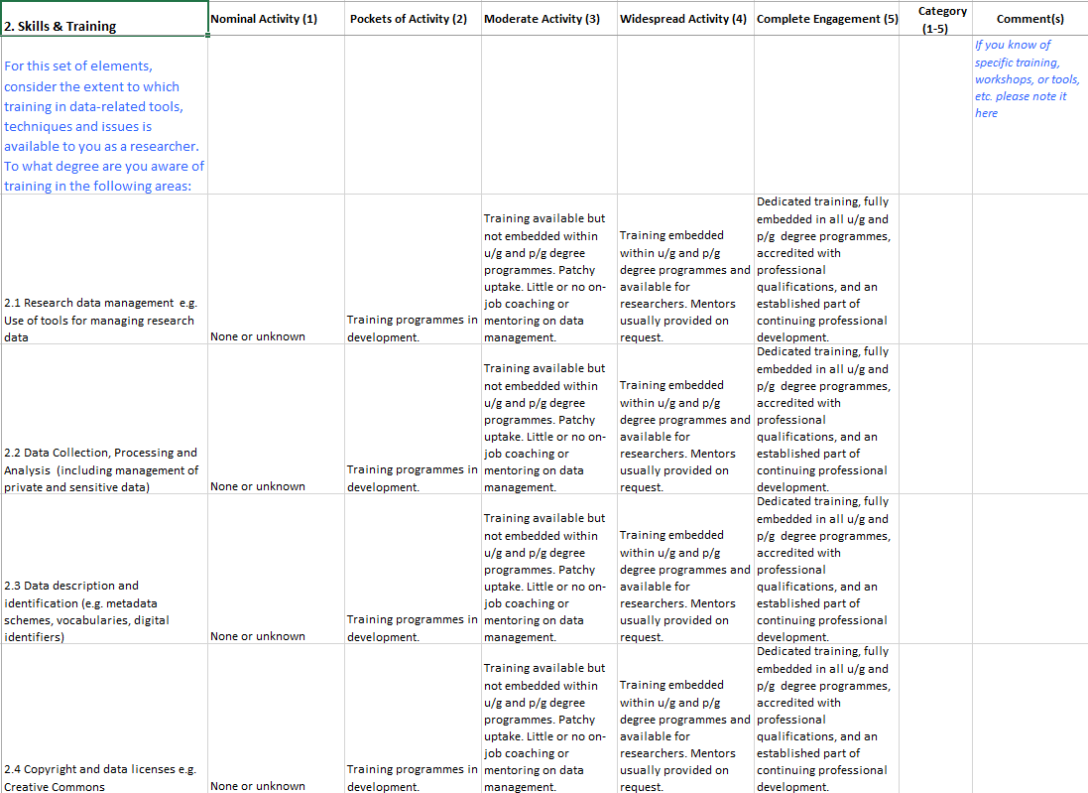
Skills & Training

Slide 22
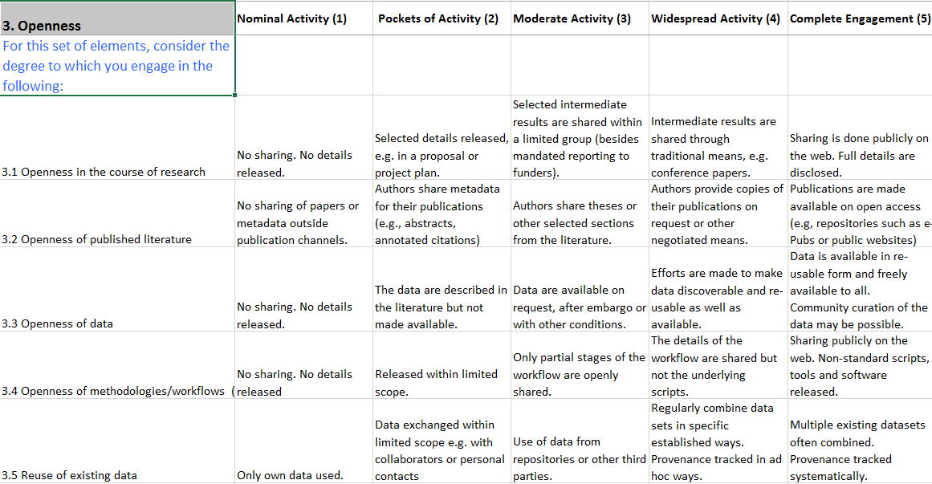
Openness

Slide 23
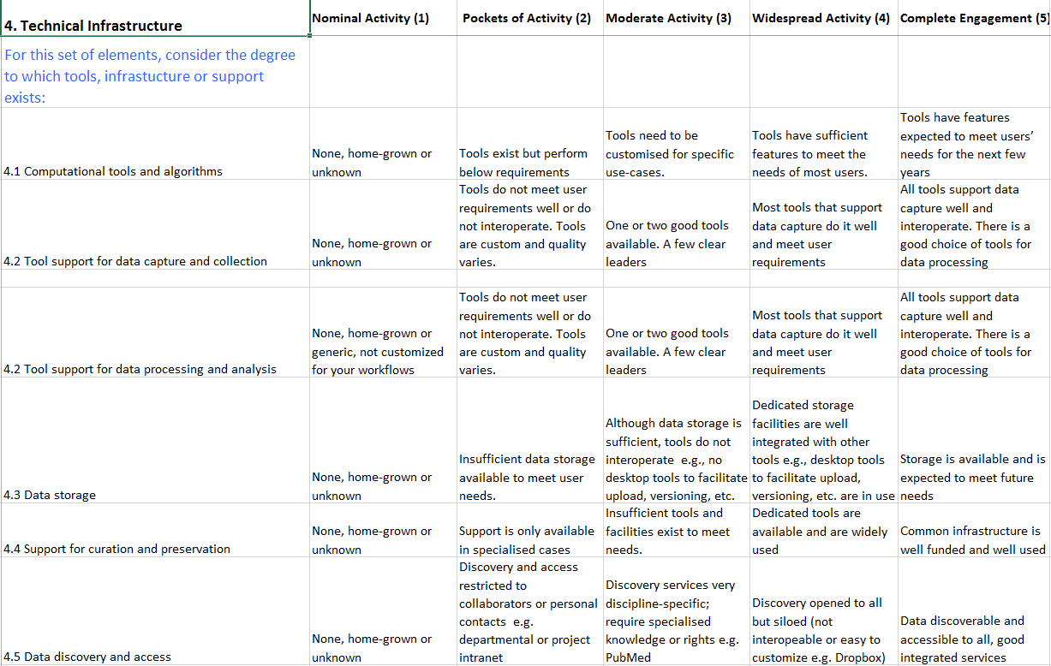
Technical Infrastructure

Slide 24
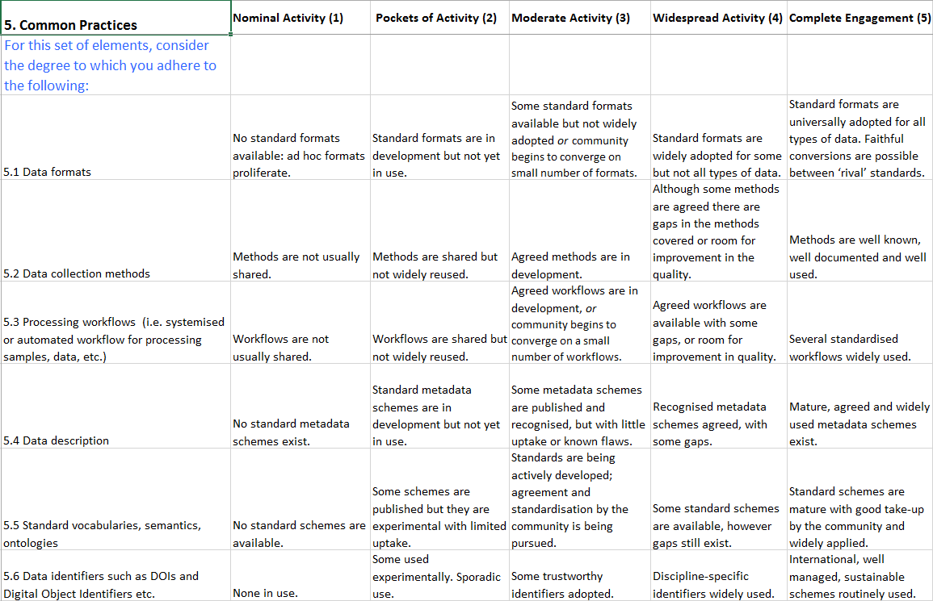
Common Practices

Slide 25
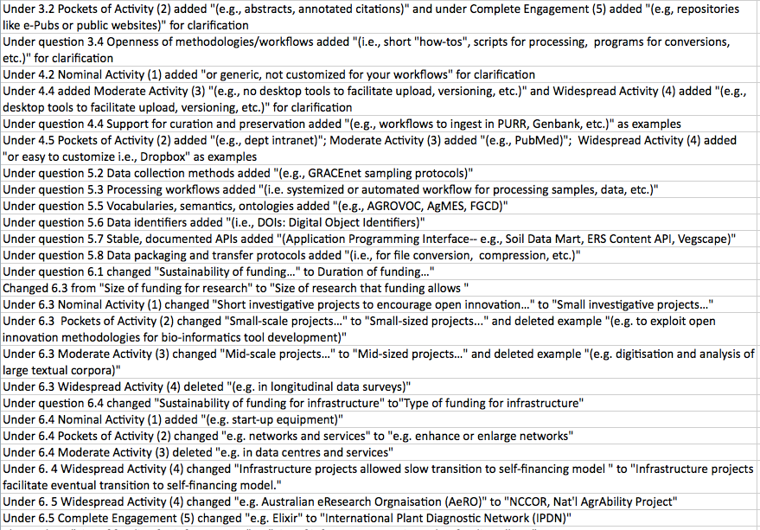
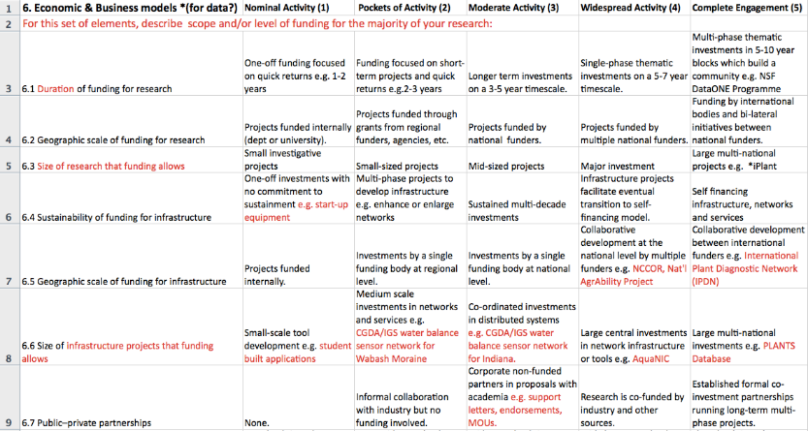
Review CCMF applicability for agriculture (Slides: Scott Brandt, Purdue)
Under question 5.2 Data collection methods added "(e.g., GRACEnet sampling protocols)"
Under question 5.3 Processing workflows added "(i.e. for processing samples, data, etc.)"
Under question 5.5 Vocabularies, semantics, ontologies added "(e.g., AGROVOC, AgMES, FGCD)"
Notes:
I worked with Dr Sylvie Brouder, a professor of Agronomy who has been working with the Libraries on numerous data organization, management and curation projects since 2007. In October of 2013 she led a workshop title Smarter Agriculture to discuss issues related to developing increasing data infrastructure for greater access to agricultural research data. As you can see here the majority of edits for using the CCMF with this project involved creating examples to help better understand the activities. In a few places we had to reword the questions as well.
Dr Brouder believes the CCMF would be useful to others in agricultural settings in several aspects… First, by going through the CCMF researchers become aware of issues related to computational research that occur within their community. Then, in responding to the questions, they think about the issues, often having, if not an “aha” moment, a “hmmm, maybe I need to think about this a little more” moment. Then, perhaps engaging in dialog with, in this case, the librarian facilitating the assessment, to begin discussing gaps and possible actions to take to bridge them.

Slide 26
Test CCMF with agronomy groups
Capability | Total | Researcher1 | Researcher2 | Researcher3
1 | 20 | 10 | 13 | 15
2 | 75 | 28 | 22 | 23
3 | 25 | 10 | 10 | 13
4 | 40 | 15 | 10 | 19
5 | 40 | 14 | 8 | 11
6 | 40 | 16 | 15 | 11
7 | 15 | 16 | 8 | 9
8 | 15 | 4 | 4 | 5
Technical Infrastructure
Economic & Business Models
Legal, Ethical & Commercial
Research Culture
Collaboration
Skills & Training
Openness
Common Practices
Notes:
So in this case, all three researchers are agronomists, working in areas that are similar. Their research foci are different, but they collaborate--- all three share grad students, methods, and resources. #1 oversees a field station for studying water quality and works with other groups on campus, #2 works with environmental Nano materials works with other groups regionally, and #3 works in crop physiology/ecology and works with national groups.
This is a cursory analysis comparing the three scores of researchers from least amount of activity or engagement in an area (0) to what would be most activity or engagement (indicated in blue). As can be seen, area 2, Skills and Training, is the area of largest gaps, but there are relative gaps throughout. For researcher 1, the highest score was 3 (8 times) and the mode was 2, or Pockets of Activity. For researcher 2, 1, or Nominal Activity, was the mode, and the highest rating was a 4 (Widespread Activity) in Openness of literature. Researcher 3 had much more variety, slected 4 (Widespread Activity) 7 times, and gave Openness of Literature a 5 , indicating comlete engagement.

Slide 27
We are collecting CCM profiles!
Download and test the tool in your community!
http://communitymodel.sharepoint.com/

Slide 28
Thanks to the CCM Team:
Manjula Patel, UKOLN Informatics, University of Bath, UK
Kenji Takeda, Microsoft Research Outreach
Download from http://communitymodel.sharepoint.com/
Questions?

