Slide 1
Beethoven vs. Bieber On the meaningfulness of (alt)metrics
Blaise Cronin, PhD, DSSc, DLitt (h.c.)
Rudy Professor of Information Science,
Indiana University, USA

Slide 2
Canonicity vs. Iconicity

Slide 3
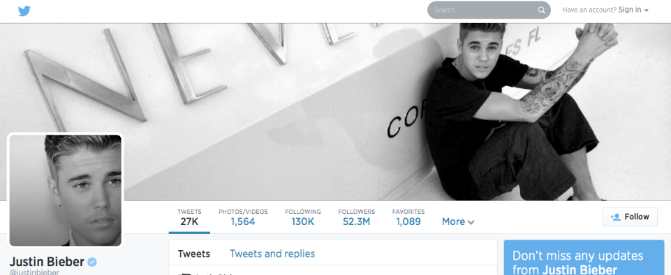
Twit(ter)

Slide 4
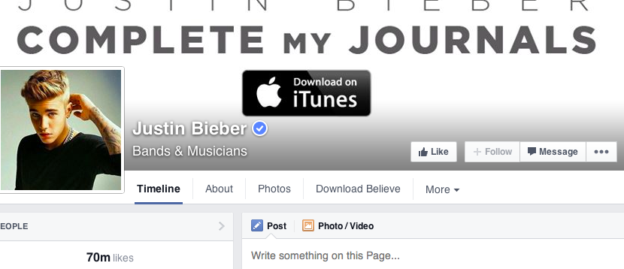
Facebook

Slide 5
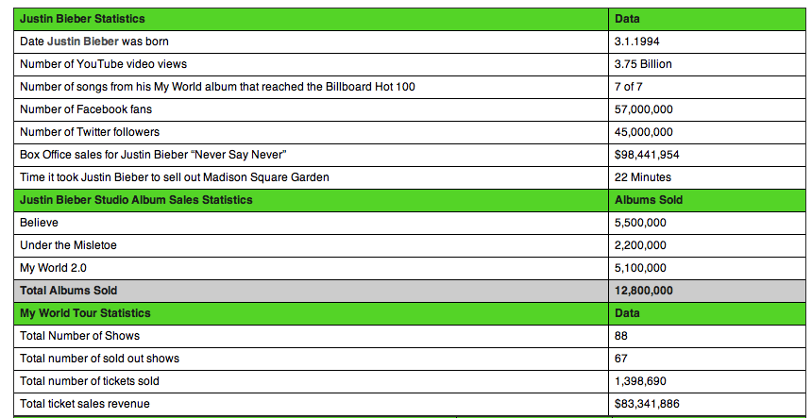
Biebermetrics

Slide 6
Facebook

Slide 7
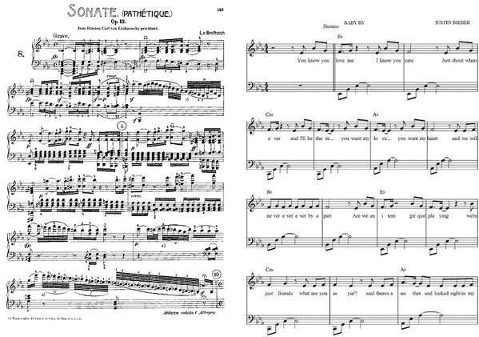
Beethoven vs. Bieber

Slide 8
Apples & Oranges

Slide 9
Apples … and apples

Slide 10
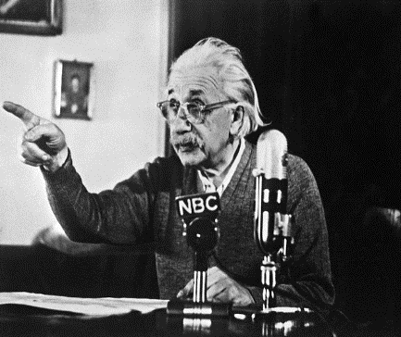
The numbers game
‘Not everything that can be counted counts and not everything that counts can be counted’

Slide 11
Defining excellence
‘But I know it when I see it ….’
U.S. Supreme Court Justice Potter Stewart, 1964
‘It is easier to measure activities than it is to measure quality’
NISO, 2014

Slide 12
Assessing excellence (Peer review … on a good day)
• Domain knowledge
• Expertise
• Discrimination
• Connoisseurship
• Wisdom

Slide 13
A culture of metrics
Yesterday (c. 1955): ISI’s Citation indexes (SCI, SSCI A&HCI)
Today: WoS, Scopus, Google Scholar, et al.
Tomorrow: Social media monitoring & analytics (e.g., altmetric.com)

Slide 14
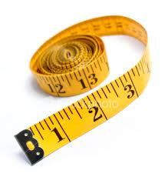
Measuring article impact
• Reputation of journal
• Journal Impact factor
• No. of citations
• Quality of citations
• Persistence of citations
• Times accessed
• Times downloaded
• Included in syllabi
• Media mentions
etc.

Slide 15
Beyond bibliometrics
• Citations miss important traces/impacts & are lagged
• Online reference managers, slide-sharing services and social media capture impacts in real-time (but only partially)

Slide 16
Twitter reality
a) All scholars
b) % with Twitter accounts
c) % who tweet
d) % of tweets about scholarly topics
e) % that are “Twitter citations”/ “tweetations”

Slide 17
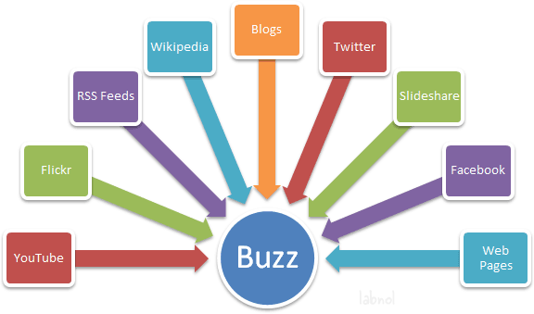
Scholarly buzzometer

Slide 18
‘Researchers must ask if altmetrics really reflect impact, or just empty buzz.’ – altmetics manifesto

Slide 19
Citations ≠ Altmetrics
Cites → authors
Alts → readers
Cites → few
Alts → many
Cites → lagged
Alts → real-time
Cites → mandatory
Alts → optional

Slide 20
Effects of research
Immediate vs. delayed impacts
Scholarly vs. professional vs. social impacts
Cited vs. read vs. used
Substance vs. buzz

Slide 21
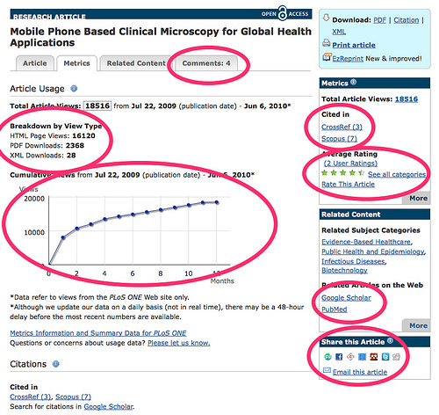
Immediate effects: PLOS article-level metrics

Slide 22
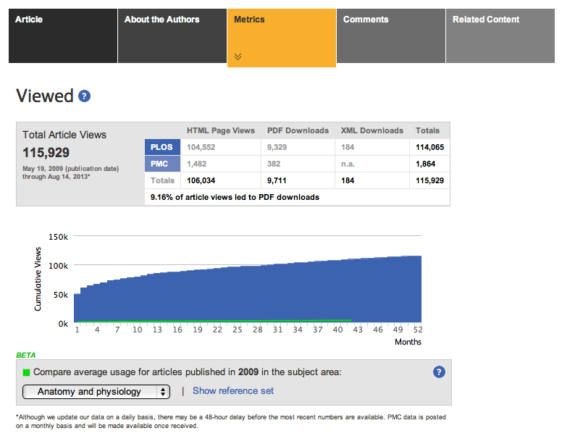

Slide 23
Article-level metrics
• Transparency
• Real-time
• Multi-dimensional
• Countable
• Ego-boosting
• Behavior-modifying
• Culturally corrosive?

Slide 24
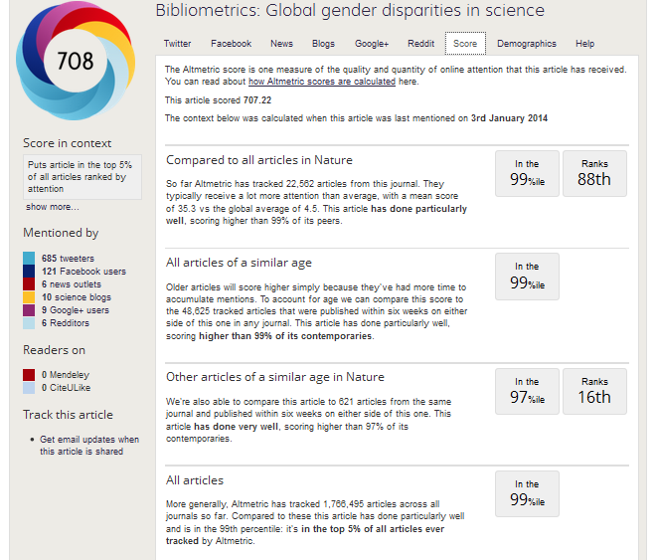

Slide 25
Academic social capital
• Highly ‘liked’
• Much tweeted/followed
• Heavily blogged about
• Frequently recommended
• Often mentioned/quoted in the media

Slide 26
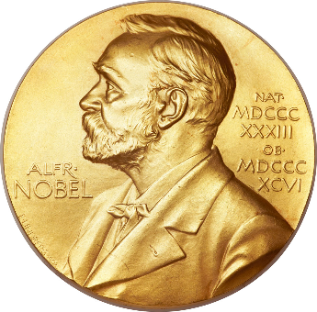
Not to be confused!
Social capital
Symbolic capital

Slide 27
Complementary metrics
• Acknowledgments
• Data citation counts
• Micro-attributions for data curation
• Social media mentions
• Recommendations
• Downloads
• Mentions in extra- scientific texts
• Press coverage
etc., etc…

Slide 28
Anticipating altmetrics: ‘Invoked on the Web’ (Cronin et al., 1998)
‘polymorphous mentioning’
‘presence density’
‘diverse ways in which academic influence is exercised and acknowledged’

Slide 29
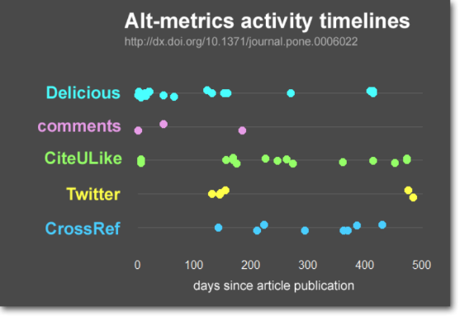
Jason Priem, 2011

Slide 30
Genres of altmetrics Taylor & Plume (2014)
Altmetrics
Social activity
(tweets, ‘likes’)
Mass media
(news coverage)
Scholarly commentary
(scientific blogs)
Scholarly activity
(reference managers)

Slide 31
Unequal attention Taylor & Plume (2014)

Slide 32
The hunt for correlations…
• Citations in Wikipedia and JCR data (Nielsen, 2007)
• Article tweets and citations (Eysenback, 2012)
• F1000 score and JIF (Nature Neuroscience, 2005)
• Inclusion in reference managers and citations (Bar-Ilan, 2012)
• Downloads and subsequent citations (Brody et al., 2006; Nieder, Dalhaug, Aandahl, 2013)
• Citations in blogs and subsequent citations (Shema, Bar-Ilan, Thelwall, 2013)
• Altmetrics and citations (Thelwall, Haustein, Larivière & Sugimoto, 2013; Costas, Zahedi & Wouters, 2014)
Etc., etc., ….

Slide 33
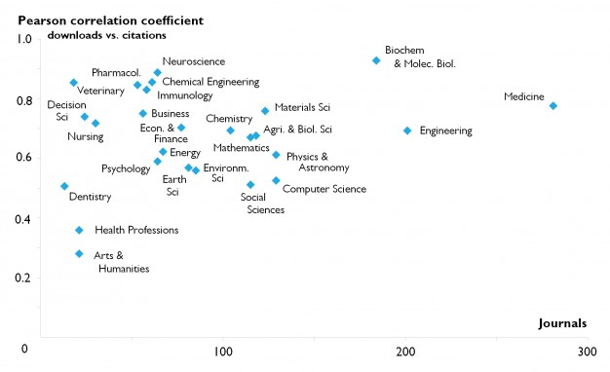
Downloads vs. citations ScienceDirect (Moed, 2012)

Slide 34
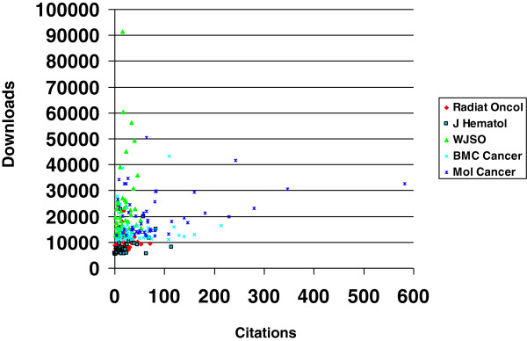
Downloads & citations Nieder, Dalhaug & Aandah (2013)

Slide 35
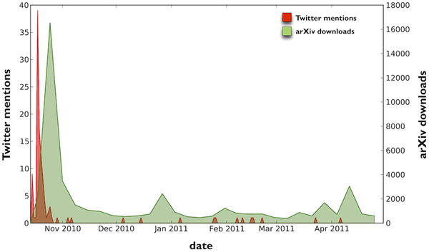
Twitter mentions & arXiv downloads Shuai, Pep, Bollen (2012)

Slide 36
Downloading, reading, citing Schlögl et al. (2014)

Slide 37
1 citation = ? tweets
Citations
Acknowledgments
Downloads
Tweets
‘Likes’
etc.

Slide 38
(Alt)metrics issues
Metrics
Platforms
• Validity
• Reliability
• Utility
• Ethicality
• Transparency
• Usability
• Persistence
• Cost/benefit ratio

Slide 39
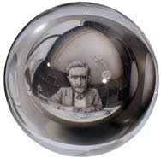
Mirror, mirror on the wall, who is the fairest of them all?
Users, narcissism and control – tracking the impact of scholarly publications in the 21st century
Wouters & Costas (2012)

Slide 40
Google Scholar: Narcissism?

Slide 41
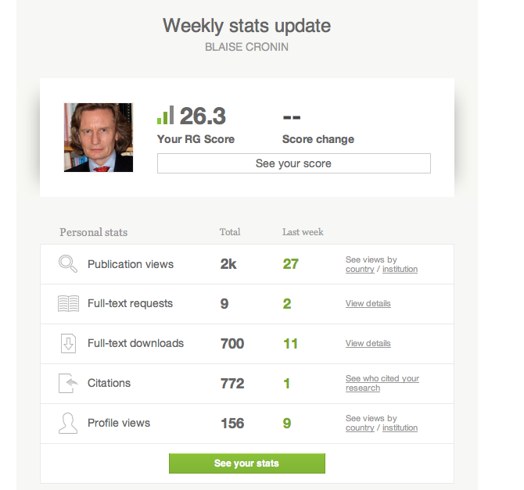

Slide 42
Scholarly Panopticon?
‘an Orwellian surveillance net’
‘cybernating the academy’
Sosteric, 1999

Slide 43
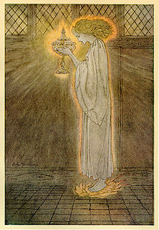
The Holy Grail of holism
A matrix of established & alternative metrics?
A unified measure/composite score (a super h-index)?

Slide 46
New Age numerology?
• Atomization of inputs, outputs and impacts
• Fetishization of metrics
• Transparency vs. triviality
• Immediacy vs. canonicity
• Goal displacement?

Slide 47
Suggested readings
Scholarly Metrics Under the
Microscope
edited by
Blaise Cronin and
Cassidy R. Sugimoto
2014
ITI / ASIST

Slide 48
And the winner is ….

