Slide 1
The Impact of Public Libraries on Small Rural Communities: Challenges to Conducting Research
Martina Dragija Ivanović
University of Zadar

Slide 2
Introduction
Public library - significant influence – how we can prove that?
Necessity of their existence is something that requires justification
Possibilities of their influence on an individual and/or particular group

Slide 3
Theoretical framework
Public libraries in rural communities – Bernard Vavrek
Library and information services in the Pacific Islands - Miles Jackson
Development of rural libraries in the Solomon Islands - John Evan
Anne Goulding
Literature of library impact:
Roswitha Poll, Rebecca Linely, Bob Usherwood, Peter Brophy, David McMenemy , Joan Durrance, Karen Fisher-Pettigrew, Svanhild Aabø, Jon Strand, Sharon Markless, David Streatfield
Sociological literature:
Petak, Rogić, Štambuk, Podgorelec, Ilišin, Župančić, Hodžić, Cifrić, Cassirer

Slide 4
Why that kind of reserach.....
Evaluation of the impact of libraries on island communities
Impact on the commmunity
Impact on skills, behavior
Why ?
Need for that kind of research in Croatia
Island rural communities - specific, libraries are very important

Slide 5
The Research Method
Based on “New Measures for the New Library: A Social Audit of Public Libraries”
Aim:
To examine the influence that public libraries have on the local population and the role of the public library in a rural island community
To test model for the suitability of the proposed model for the evaluation of the impact of the library on a community

Slide 6
Research question
What is the role of the library in the life of a rural island community?
Do the particularities of an island community impact the specifics of libraries work methods the management of the library and how it offers its services?
How do libraries participate in the cultural life of the community?
Have the methods until now of collecting data on the management of libraries been of any assistance to the decision makers (at the local and national level) when confirming the role of the library in these communities and how they are financed?
What are the suitable methods and models for the evaluation of the impact of the library on a community?

Slide 7
Methods
Case studies
Document analysis
Semi-structured interviews
Focus groups and questionnaires
2 public libraries - Sali on the island of Dugi Otok and Kolan on the island of Pag
Basis of selection: Geographical characteristics (rural) socio-economic characteristics and similarity in work methods (solo librarians)

Slide 8
Sample - interviews
Decision makers
National level - Ministry of Culture, Department for books and libraries – head
Zadar county
Prefect and deputy prefect
Department of social services – head
Local community
Mayor s of Sali and Kolan
Experts in the field of librarianship
Croatian Institute for Librarianship , Consultant for public libraries
Croatian Library Council, president
Central development offices for public and school libraries in Zadar county – head
Library directors
In Sali and Kolan

Slide 9
Sample – local population
 | Sali | Kolan
Interviews | 6 (3 women, 3 men) | 2 (1 woman, 1 man)
focus groups | 1 group of parents (4) 1 group of young pople (5) | 1 group of parents (4)
group interviews |  | group interviews with teachers group interviews with children
questionnaire | 57 respondents | no questionnaire

Slide 10
Conclusions of the research – selected
Decision makers do not use the results of research in fundraising and making decisions
There is no consensus between decision makers and library experts regarding the institution responsible for the development of libraries in smaller communities (like islands)

Slide 11
Conclusions....
Research into the impact of libraries... both important and necessary
Work methods of island libraries are specific
The role of library in a rural community is complex and multilayered

Slide 12
...
The library is also a place that encourages the development of the community identity
the library has a symbolic value
Library – space and services!
Holt - “a library is exactly what the local community wants it to be”

Slide 13
Some thoughts about research
best to use a combination of research methods
qualitative methods should be primary (interviews and close observation)
Crawford – “...qualitative methods are compatible to the social nature of libraries as they provide us with the answers for „how“and „why”
Changes in the choice of respondents, interviews turning out differently, unplanned observations and information gathered from informal conversations

Slide 14
Some thoughts about research
What is problematic?
To take control of our relationship with the respondents and stay objective
Research also helped to promote public awareness of the importance of the library in the community.
A holistic approach

Slide 15
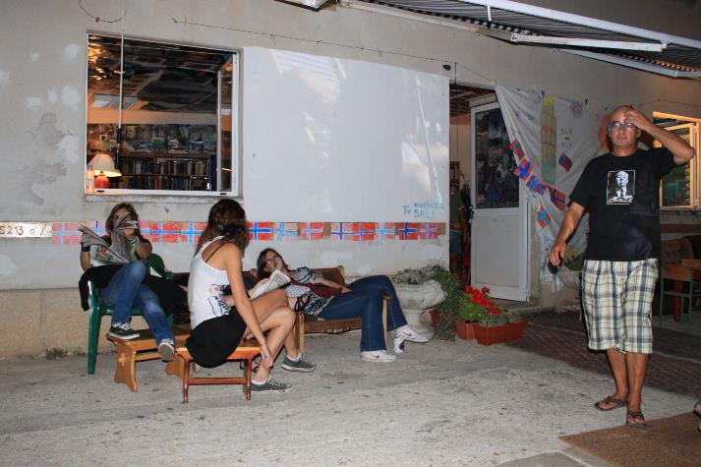
Library by night (Sali, 22:00)

Slide 16
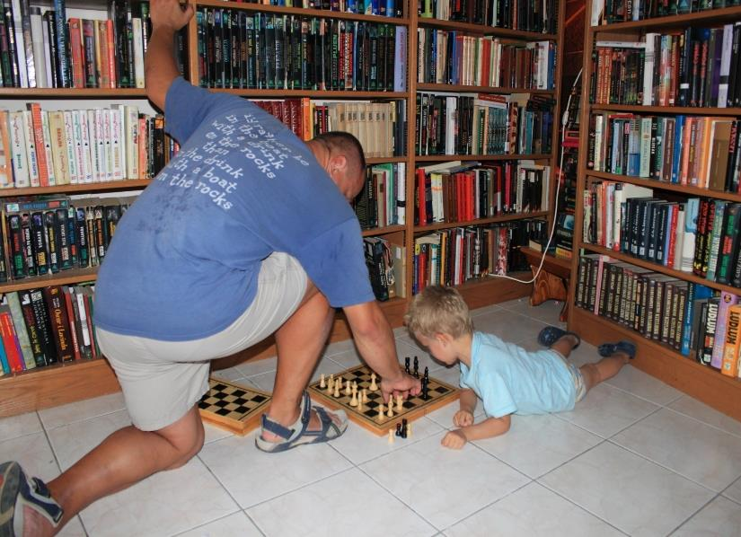

Slide 17
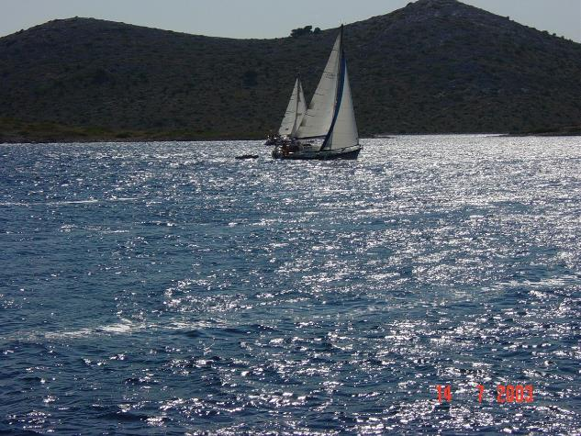
Thank you! See you on Croatian islands!

