Slide 1
Proposal for a qualitative study of LIS students' self-assessment of growth and direction using Dervin's Sense-Making Methodology applied to intrapersonal examination of their ongoing eportfolio development Linda Z. Cooper Graduate School of Library and Information Studies Queens College, CUNY
Libraries in the Digital Age
Zadar, Croatia
June 16, 2014

Slide 2
Why did I want to do this study?
Our students are required to complete a culminating research project
The project must be substantial
Ideally the project should be:
Meaningful to the student researcher
Support interests that have developed and/or matured
It is desirable to consider the topic/direction of this project sometime before it needs to begin

Slide 3
Potential benefits of this study
Participants will have a better sense of direction and purpose as they move toward their culminating project
Wider use of eportfolios in the department
Data collected may inform the department regarding improvements that can be made in overall program and curriculum

Slide 4
Eportfolios
A digitalized collection of artifacts, including demonstrations, resources, and accomplishments; text-based, graphic, or multimedia; multiple levels of access
Show student progress and encourage student participation in learning
Help students understand goals, reflect on what they have learned
Provide an excellent venue for learners to piece together new and old information to construct personal understandings

Slide 5
Eportfolios – more good things
Achievement has been found to be positively correlated with higher order thinking skills (Cheng & Chau, 2013; Tochel et al, 2009; Alexiou & Paraskeva, 2010)
Support student reflection by emphasizing both process and product in learning (Cheng & Chau, 2013)
Self-assessment can be both valid and reliable/ consistent teachers and end term exam results (Chang, Liang, & Chen, 2013)
Evaluation of student eportfolios across a program can be used for by administration for curriculum and program assessment (Buzzetto-More, 2010; Reardon & Hartley, 2007)

Slide 6
Dervin’s Sense-Making Methodology (SMM)
"[D]eveloped to study the making of sense that people do in their everyday experiences" (Dervin, 1992)
Discontinuity is at the core of SMM – reality changes with every step we take
SMM describes our movement from moment to moment and how we construct sense from our world
When we come to a point where we cannot make sense, we have come to a gap and need to bridge the gap in order to continue our journey

Slide 7
How to bridge the gap? Sense-Making Methodology interview questions
Sense-maker is the focus of the query rather than any particular system
Rather than ask
"What information can I get for you from our library?"
a question might be
"What has brought you here?"
The first question predicates a solution that is supplied by the library system.
The second question focuses the information seeker

Slide 8
Sense-Making Methodology interview questions (continued)
Attempt to understand the information seeker's situation by asking about helps, hindrances, muddles, and feelings that the information seeker has experienced
Use of "verbing" as opposed to "nouning" to emphasize the notion of discontinuity and constant change. Focusing on verbs in Sense-Making reminds us that sense is constantly.
Verbing example: What did you like doing the most in your LIS studies? What do you think explains your liking?

Slide 9
Rationale – Why eportfolio + Sense-Making Methodology?
SMM and learning via eportfolios both embrace constructivist ideals, value reflection and self-guided direction.
SMM is a means to study the constructing that people do to make sense of their experiences. Eportfolio construction (constructing) is a means to gather and arrange experiences/information to organize it and make sense of it.
SMM focuses on behavior changes over time. Eportfolio building is a constructive process that takes place over time. Pairing SMM with the eportfolio reflection may be a means to help connect the discontinuity regarding direction of study to a point where sense is made and a gap can be bridged/a direction is clarified.

Slide 10
Methodology - Background
Making Connections mini grant – 2008-2009
Met with other educators from a wide geographic area to learn how electronic portfolios had been successfully implemented other schools and worked together to plan similar initiatives in our own schools
Working together with the Queens College Center for Teaching and Learning and constituents across campus, a decision was made regarding the eportfolio platform that best suited the needs of all constituents

Slide 11
Methodology - Participants
All participants will be graduate level LIS students studying to be teacher librarians
All teacher librarian students in this program are required to keep eportfolios containing both voluntary and prescribed entries including a Learning Matrix keyed to AASL standards
Participants for the study will be self-selected and solicited via a posting to the general student list serve directed to the attention of teacher librarian students who have both maintained their eportfolio AASL Learning Matrix throughout their course of study and plan to take the culminating research course during one of the following two terms

Slide 12
Call for participants
[P]participants for a research study examining the use of Sense Making Methodology to help students prepare for selecting a research topic for LBSCI 709 Research in Library and Information Studies. Participants for this study need to be:
LMS students who have maintained the AASL Learning Matrix in their eportfolio throughout their LMS courses
Planning to take LBSCI 709 in Fall 2014 or Spring 2015
Participants will be asked to review their eportfolio and AASL Learning Matrix and then complete and submit an anonymous questionnaire regarding their professional and/or scholarly interests, both enduring and developing, during their time at GSLIS.

Slide 13
Prompt
This exercise is meant to help you toward a better sense of your direction and focus as you move to begin your course 709 Research in Library and Information Studies.
Please do your best to respond to the following self-interview. There are no right answers and the purpose is to assist you in digging deeply into your recollections, thoughts, questions, and feelings. Please review all parts of your eportfolio, especially the Learning Matrix which notes the assignments you have entered, to assist in recalling aspects of your progress through this program, both helps and hindrances, before you respond to these questions.

Slide 14
Interview situation
Researcher not in room
Participant name not on response sheet
Response deposited in common envelope
Response time about 30 minutes
Participants received a $15 gift card

Slide 15
The self-interview questions
Constructed in the spirit of Dervin's (2008) core questions to be used in Sense-Making Methodology interviews
Dervin's core questions attempt to focus on a person's movement through time and space by querying situations, gaps, bridges, outcomes, struggles, evaluations, and helps
SMM is recursive in order to focus deeply on each question, however, modified here to simplify process and because of time considerations

Slide 16
Self-interview questions
What led you to enter study in library and information science? Think here not only of events and experiences but also struggles, questions, and conclusions. (This question queries, for example, situation, struggles, gaps, bridges.)
What did you hope to accomplish...what were your interests at the time you decided to enter LIS study? (This question queries, for example, outcomes sought.)

Slide 17
Self-interview questions
As you moved through your studies, what were the big things that helped you and how did each help you? (This question queries, for example, bridges that helped to cross gaps.)
What did you like doing the most in your LIS studies? What do you think explains your liking? (This question queries, for example, outcomes sought or obtained.)

Slide 18
Self-interview questions
As you moved through your studies, what were the big things that hindered you and how did each hinder you? (This question queries, for example, situation and gaps.)
What did you like doing the least in your LIS studies? What do you think explains your disliking? (This question queries, for example, struggles and situation.)

Slide 19
Self-interview questions
Thinking about your LIS studies, would you say there were experiences from your life before coming to LIS that impacted you during your studies? What were these and how did each impact you? If more than several, can you choose one or two that stand out the most in your mind? (This question queries, for example, situation and outcome.)
Thinking again about your LIS studies, would you say there were current life experiences that impacted you during your studies? What were these and how did each impact you? (This question queries, for example, situations and outcomes.)

Slide 20
Self-interview questions
Now, towards the end of your studies for an MLS, how does your outlook or destination differ (if at all) from your sense of these at the beginning of your studies? If you see things as having changed, how did they change? What do you see as accounting for the change? (This question queries, for example, evaluation.)
At this time, what is your sense of what you would like to do in your culminating project? How do you see this as potentially helping you -- serving your needs and interests? (This question queries, for example, outcomes sought.)

Slide 21
Planned analysis
Grounded attempt
Will examine responses for broad concepts emerging from data
Concepts will be placed into groups having a commonality noted by researcher
Groups examined for insights into participant experience, growth, perceptions, anything else

Slide 22
Follow-up
Idea: invite participants for a second round of questions regarding what they have learned (if anything) from participating in an SMM study
Did participation affect choice of topic for culminating project?
Did it affect anything else i.e. outlook, self-knowledge?
“If you had a magic wand” question: If you could wave a magic wand, what would you wish to happen as you move forward?

Slide 23
Hopes
Reflection at this point in their studies will help participants to make more informed decisions regarding culminating project
Wider application of eportfolios within the department
Data may inform improvements in program and curriculum

Slide 24
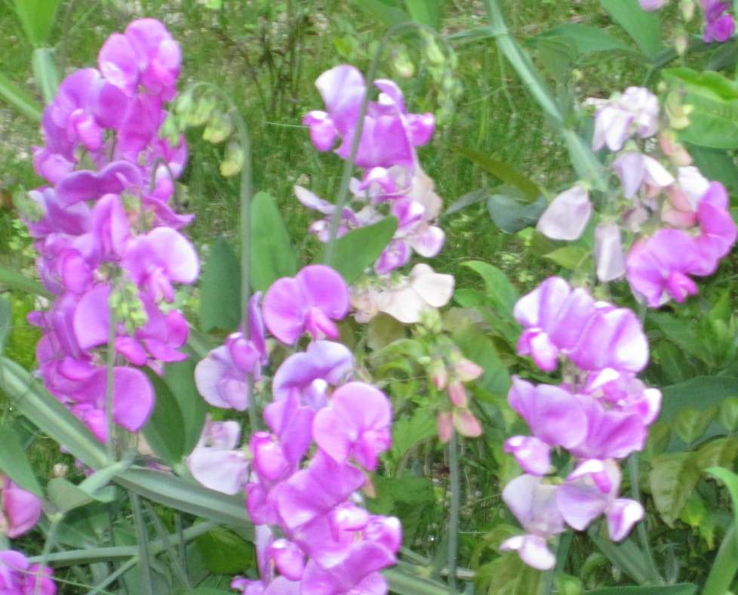
Thank You
Dr. Linda Cooper
Associate Professor
Graduate Advisor LMS & Coordinator LMS Programs
Graduate School of Library and Information Studies
Queens College, CUNY
linda.cooper@qc.cuny.edu

