Slide 1
USING INFORMATION VISUALIZATION
(IN LIBRARIES): why, when, and how
LIDA, Zadar, 16th June 2014

Slide 2


Workshop Leaders
Tanja Merčun
Research Associate
University of Ljubljana, Slovenia
tanja.mercun@ff.uni-lj.si
Maja Žumer
Professor
University of Ljubljana, Slovenia
maja.zumer@ff.uni-lj.si

Slide 3
Agenda
WHAT?
WHY?
WHEN?
WHAT?
HOW?

Slide 4
Goals
overview of information visualization
recognize potential benefits and drawbacks
conceptually think about and design information services using information visualization
understand why, when, and how information visualization could be applied to library data

Slide 5
WHAT is information visualization?

Slide 6
Definitions
process
of transforming data, information, and knowledge
into visual form
that makes use of humans’ natural visual
capabilities

Slide 7
Definitions
the depiction of information
using spatial or graphical
representations,
to facilitate comparison, pattern
recognition, change detection, and other cognitive skills
by making use of the visual system.
(Hearst)

Slide 8
Definitions
compact graphical presentation
and user interface
for manipulating large numbers of items…
enables users to make discoveries, decisions, or explanations
about patterns, groups of items, or individual items
(Shneiderman)

Slide 9
Key concepts
visual principles
interaction
user interface
design
visualization techniques
mental models
transformation
user
tasks
data
analysis
objectives
structure

Slide 10
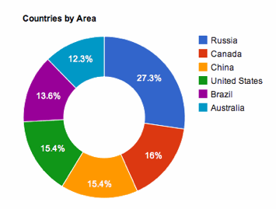
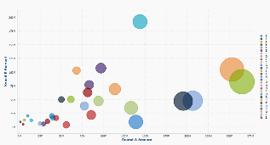
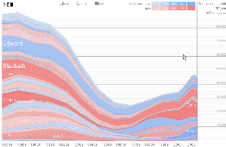
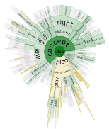
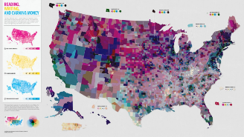
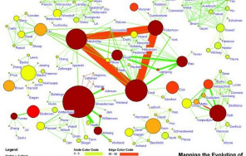
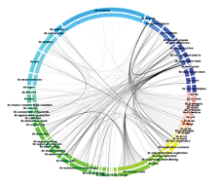
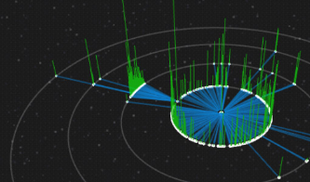
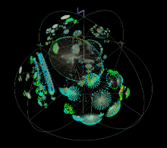

Slide 11
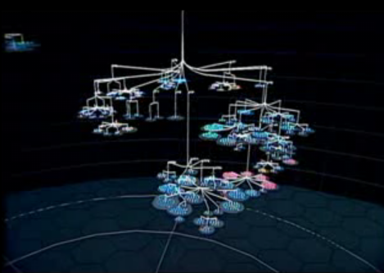
video

Slide 12
WHY information visualization?

Slide 13


Problem
  big & complex datasets
  increasing quantities of information
how to understand them
?

Slide 14
Problem
how to:
  scan, understand, operate, and navigate the vast amounts of information
  efficiently acquire useful information and knowledge
  reduce mental workload

Slide 15
Challenge
    The design of useful and intuitive user interfaces that will
      help users quickly understand and easily analyse sets of data, thus finding information they seek
      support an interactive process between the user, the system, and the data

Slide 16
Potential
… to amplify cognition
  increase info. processing by reducing working memory load
  enhance the detection of patterns and structures

Slide 17
Potential
… to provide insight
  lets you see things that would likely go unnoticed
  helps in
    decision-making
    discoveries
    understanding
    generating hypothesis

Slide 18
Potential
… well suited for tasks:
  broad or introductory searches
  exploratory data analysis
  revealing characteristic features of large datasets
  revealing patterns, outliers, groups, relationships

Slide 19
Issues
… implementation
  converting abstract information into a graphical form
  selection: what data is relevant to the task at hand
  representation: how to convey abstract concepts (colour, shape, etc.)
  presentation: layout and placement
  scale: scale & number of dimensions
  manipulation: rearrangement, interaction, and exploration
  externalization: what the user sees on the display

Slide 20
Issues
… implementation
  common design problems
  not every visualization works for every type of data or every purpose/goal
  pretty design but lacks narrative
  not the right data
  bad design
  goal is unclear
  what can be done instead of what should be done

Slide 21
Issues
… implementation
  technology and programming knowledge
  more complex visualizations require a team of specialists
  running visualizations may need high computing power
  only now more tools and ready-made libraries are starting to appear

Slide 22
Issues
… user acceptance
  do visualizations do a better job than other methods?
  no definite answer yet, few proven success stories
  works better if supplemented with text
  simple visualizations better than complex ones
  depends on individuals‘ cognitive differences
  users prefer what they are used to

Slide 23
WHEN to use information visualization?

Slide 24
2 objectives
a) presentation and communication
(explanatory visualization)
  simplification
  the designer knows the story behind the data and would like to communicate it to the reader through visualization

Slide 25
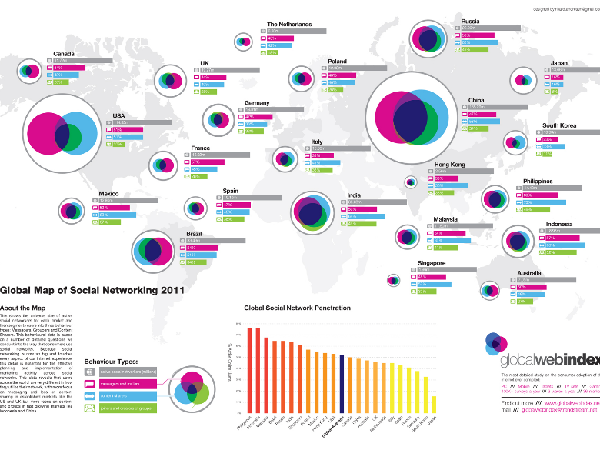
http://visual.ly/global-map-social-networking-2011

Slide 26
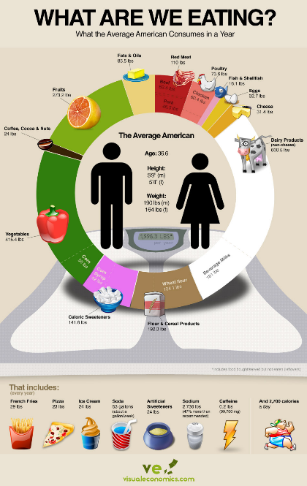

Slide 27
2 objectives
b) analysis
(exploratory visualization)
  derive information/understanding from the data
  interact with the data
  discover patterns, trends, …

Slide 28
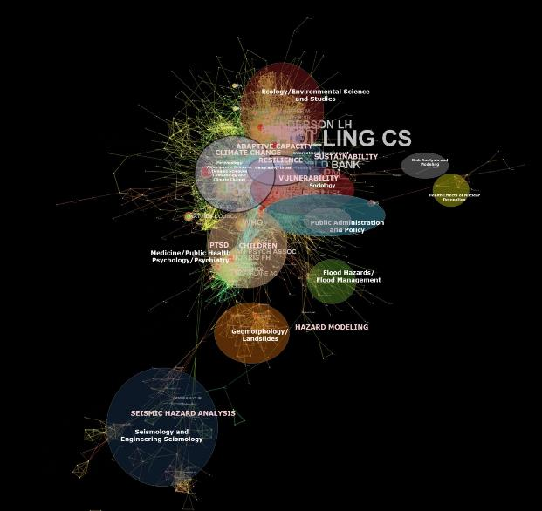
http://disastergestalt.com/2013/04/07/a-preliminary-look-at-the-co-citation-network-from-the-15000-article-dataset/

Slide 29
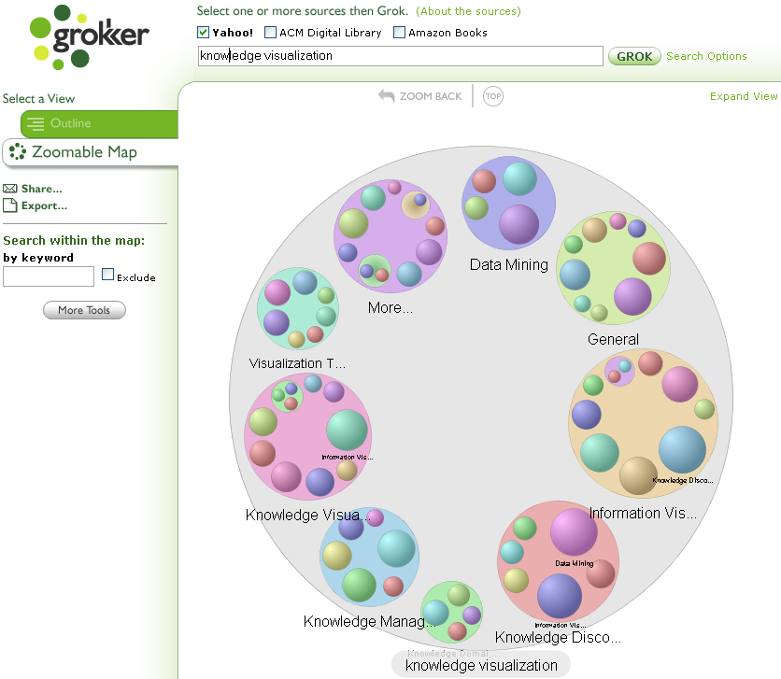

Slide 30
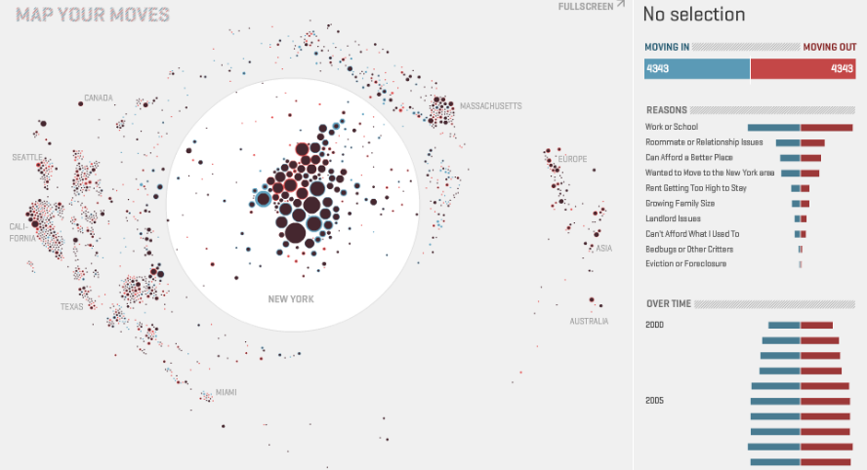
http://moritz.stefaner.eu/projects/map%20your%20moves/

Slide 31
Exploratory visualization
searching: finding a speciﬁc information in a data set
browsing: survey, inspect, look for interesting information
analysis: compare, ﬁnd outliers and extremes, spot patterns

Slide 32
Searching
  query specification
  visual representation of results
  search results analysis
    categorizing results based on content
    displaying the frequency of a search term in a document
    displaying the match between search terms and retrieved results
    managing search results
  query reformulation

Slide 33
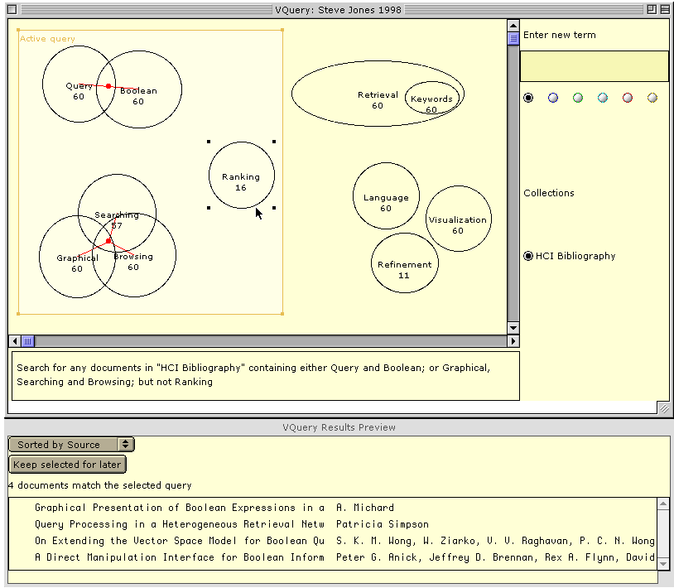
Steve Jones and S. McInnes. Graphical query specification and dynamic result previews for a digital library. In Proceedings of the 11th annual ACM symposium on User Interface Software and Technology (UIST'98), November 1998

Slide 34
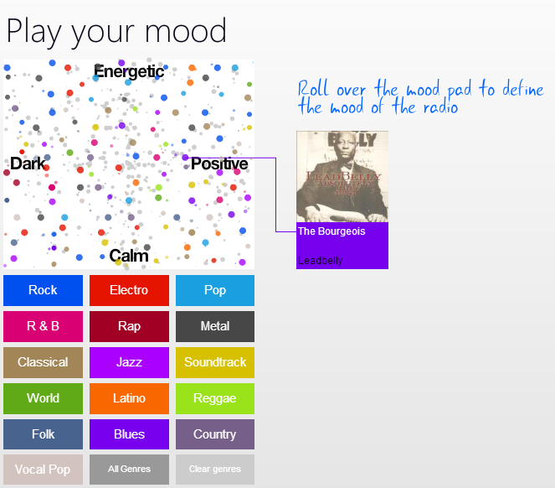
http://musicovery.com/

Slide 35
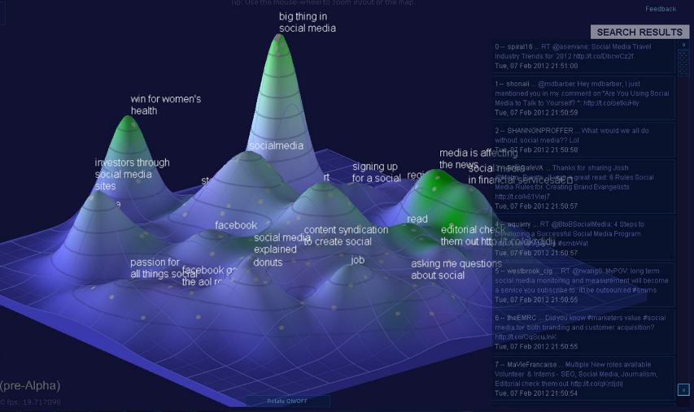
Notes:
http://www.youtube.com/watch?v=5uIXpF8MyIk

Slide 36
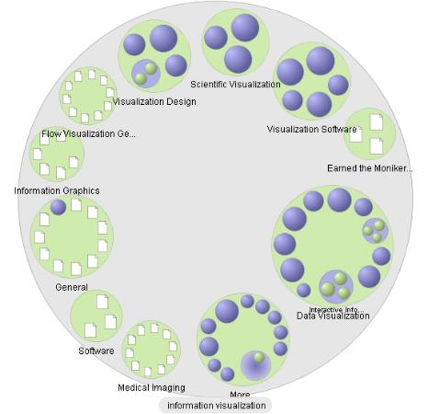
Grokker search engine (no longer available)

Slide 37
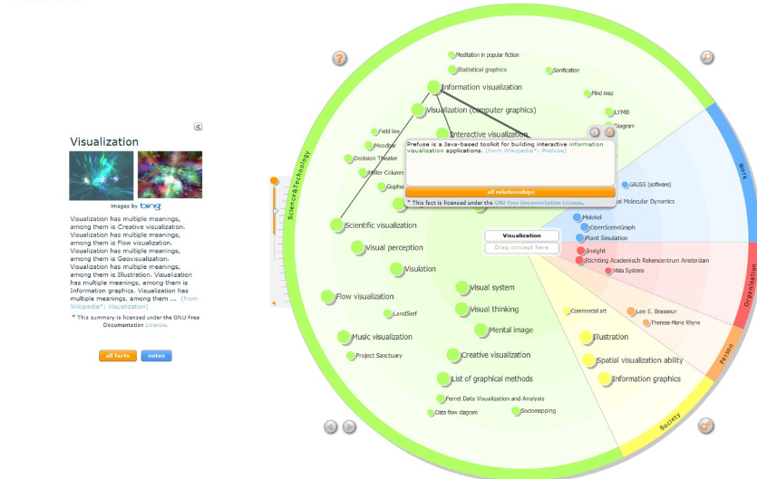
http://en.vionto.com/show/

Slide 38
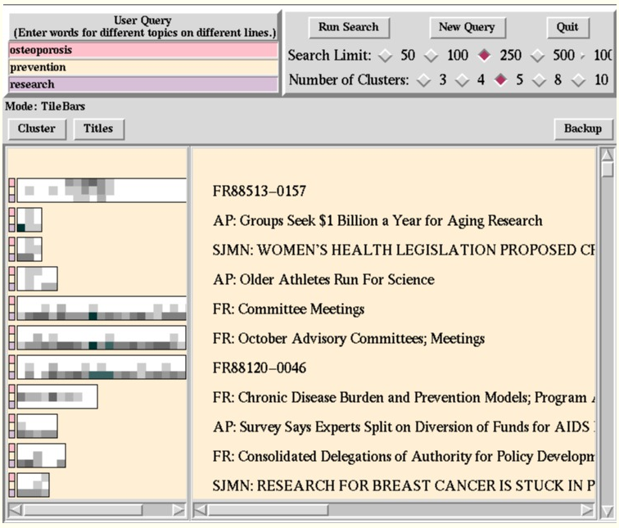
M.A. Hearst. TileBars: Visualization of Term Distribution Information in Full Text Information Access. InProceedings of the SIGCHI Conference on Human Factors in Computing Systems (CHI'95), Denver, CO, May 1995.

Slide 39
Browsing
  overview by:
    subject hierarchies (MESH, LCSH, …)
    similarity (grouping)
    connections (relationships)

Slide 40
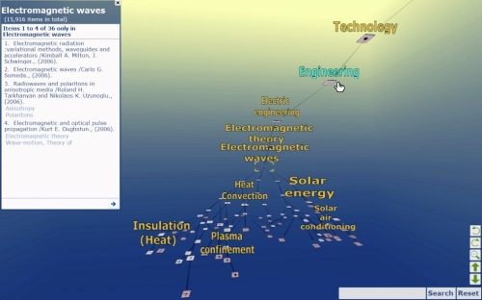
http://www.mcgill.ca/sis/people/faculty/julien

Slide 41
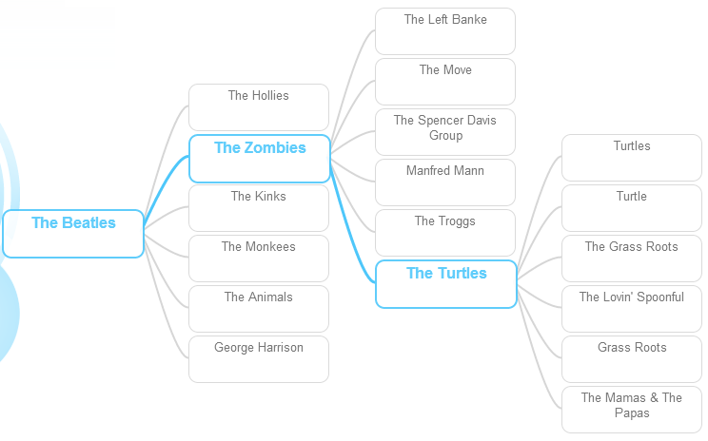
http://www.musicmaze.fm/

Slide 42
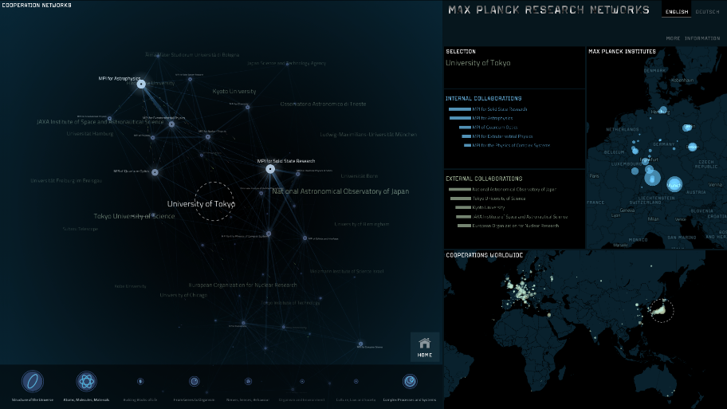
http://max-planck-research-networks.net/

Slide 43
Analysis
  Information visualization for
  text mining
    discovery by computer of new, previously unknown information, by automatically extracting information from different written resources
    identify important entities within the text and attempt to show connections among those entities
  word frequencies
  literature and citation relationships
    e.g. connections between documents and authors or scientific fields
    …

Slide 44
Analysis
WHEN
  temporal analysis
  events/observations ordered in one dimension – time
  to predict future trends, understand temporal distribution of a dataset (trends, patterns, peaks)

Slide 45
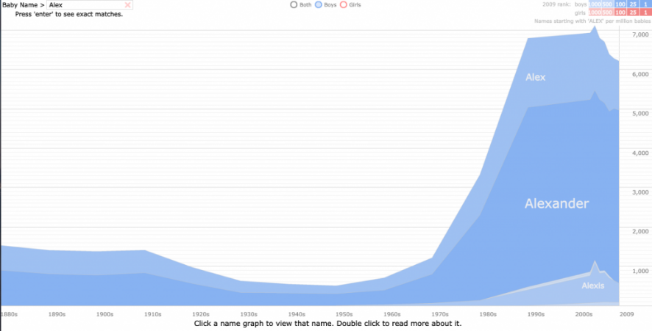
http://www.babynamewizard.com/

Slide 46
Analysis
WHERE
  geospatial analysis
  emphasis on location, spatial distribution of one or more variables
  understand thematic distribution of a dataset on a certain geographical area

Slide 47

http://www.visualcomplexity.com/vc/project.cfm?id=747

Slide 48
Analysis
WHAT
  topical analysis
  to understand topical distribution of a dataset
  (what – classification/clustering, how much – frequency analysis, bursts of topics, topic change, emergence)
  micro (single document, single individual)
  macro (journal, discipline, country, institution)

Slide 49
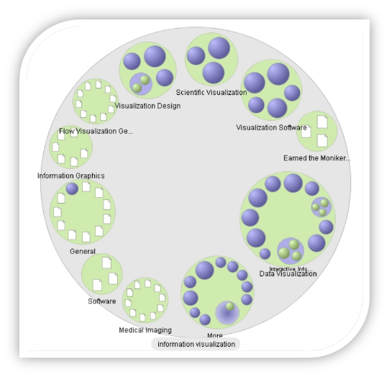

Slide 50
Analysis
WITH WHOM
  relationship analysis
  to understand connections between entities or groups of entities (types, intensity, groups, …)

Slide 51
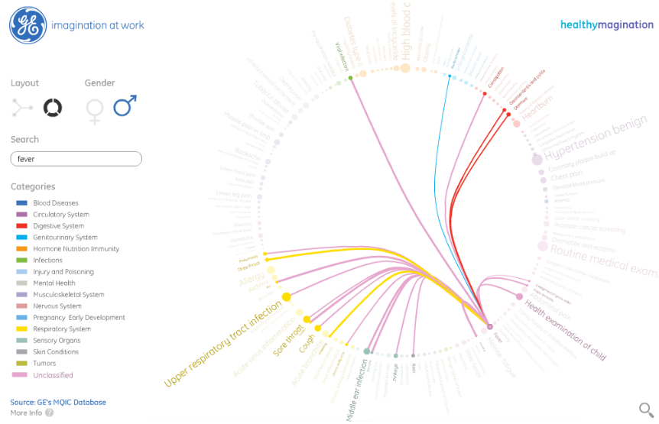
http://visualization.geblogs.com/visualization/network/

Slide 52
WHAT data to visualize?

Slide 53
PANEL DISCUSSION
Which library data can be presented visually?

Slide 54
Data types
data
  metadata
  tables
  databases
  „big data“
documents
  text

Slide 55
Document visualization
single document
  vocabulary (word frequency, distribution, structure)
  semantic structure
  content
document collections
  document themes
  changes over time
  document relationships
  document similarity

Slide 56
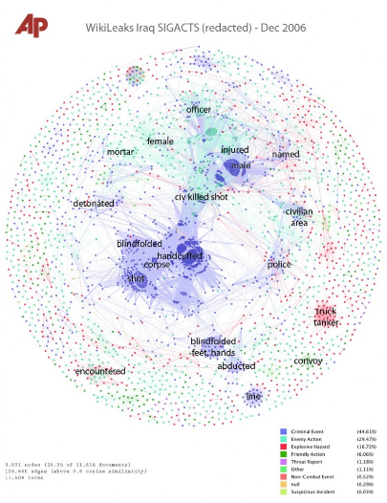

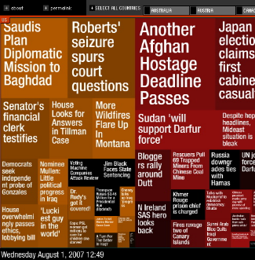
http://jonathanstray.com/a-full-text-visualization-of-the-iraq-war-logs
http://newsmap.jp/

Slide 57
HOW to design information visualization?
…not only to design, but also to interpret visualizations

Slide 58
Key points
establish the purpose of visualization
understand:
  properties of the data
  properties of the image
  rules for mapping data to images

Slide 59
3 knowledge blocks
from data to information
(definition of the problem, conversion of raw data into information by means of metadata, the treatment, cleaning, generation of derived data)
from information to visualization
(identify the best graphical structure to represent information so that the underlying patterns and structures are easy to appear and to be identified. Use of visual variables, graphic language, composition rules, visual metaphors)
from visualization to understanding
(concepts related to vision sciences, Gestalt, cognitive psychology, mental models, usability evaluation and interaction design)

Slide 60
Workflow design
needs
purpose
validation
deployment
visually encode data
overlay data
select visualization type
data collection
data analysis
visualization

Slide 61
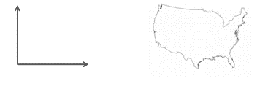
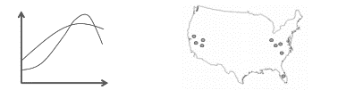
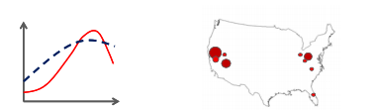
Visualization
3 step process
select visualization type
(reference system)
overlay data
(modify reference system,
add data and links)
visually encode data
(graphic variables)

Slide 62
Visualization types
a reference system on which the data is mapped
  charts: no reference system, e.g. Wordle, pie chart
  graphs: timelines, bar graphs, scatter plots
  geospatial maps
  networks: visualize dependencies, connections and hierarchies, e.g. tree graphs, networks
Katy Börner and David E Polley (2014) Visual Insights: A Practical Guide to Making Sense of Data. MIT Press.

Slide 63
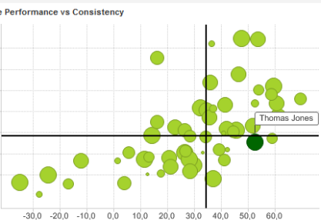
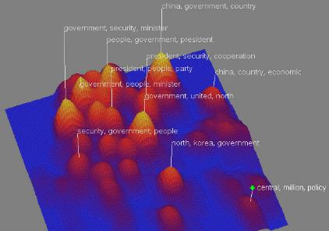
Graph: scatterplot
2D
3D

Slide 64

Graph: scatterplot
Notes:
http://www.youtube.com/watch?v=5uIXpF8MyIk

Slide 65
Tree or hierarchical graphs
node
edge
parent
leaf nodes
sibling
child

Slide 66
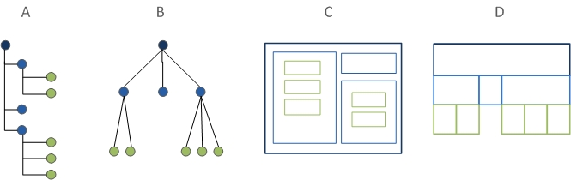
Tree or hierarchical graphs
node-link representation
space-filling representation

Slide 67
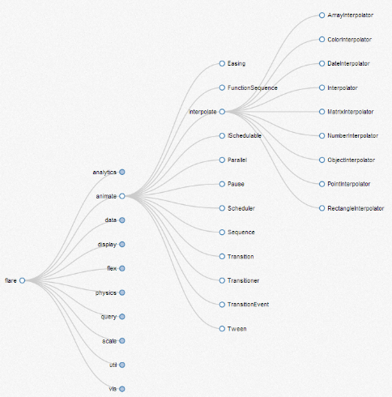
Tree or hierarchical graphs
tree
Notes:
http://mbostock.github.io/d3/talk/20111018/tree.html

Slide 68
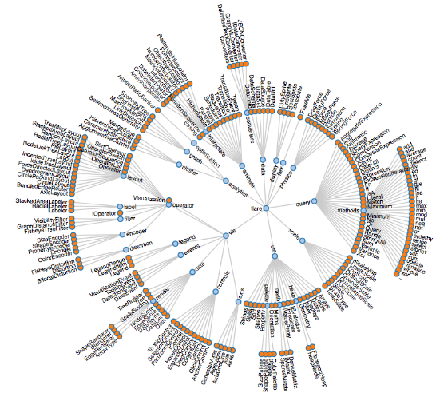
Tree or hierarchical graphs
radial tree

Slide 69
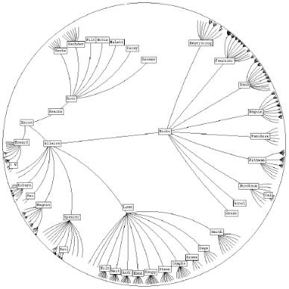
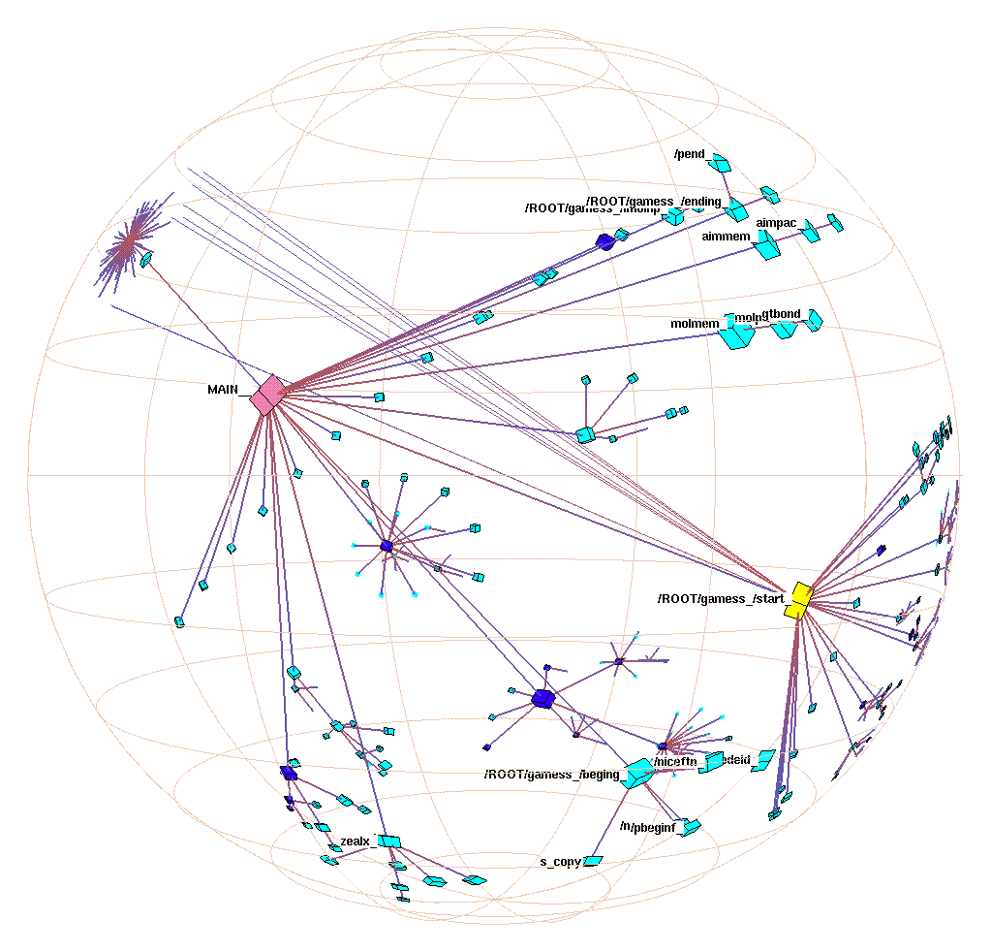
Tree or hierarchical graphs
hyperbolic tree
dynamic display
2D
3D

Slide 70
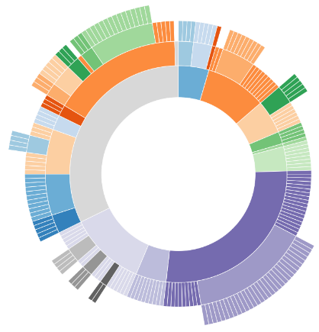
Tree or hierarchical graphs
sunburst

Slide 71
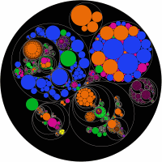
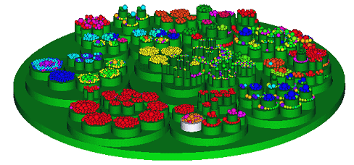
Tree or hierarchical graphs
circlepack or circular treemap
2D
3D

Slide 72
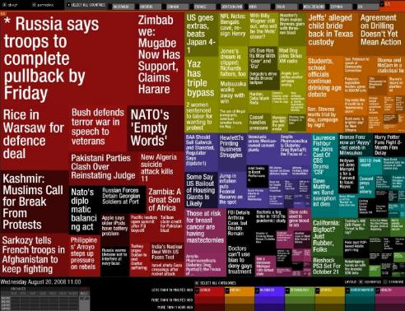
Tree or hierarchical graphs
treemap

Slide 73
Network graphs
conveys relationships among variables
node position might depend on node attributes or node similarity
no implied ordering
do not scale well to large sizes -- the nodes become unreadable and the links cross into a jumbled mess
node
edge

Slide 74
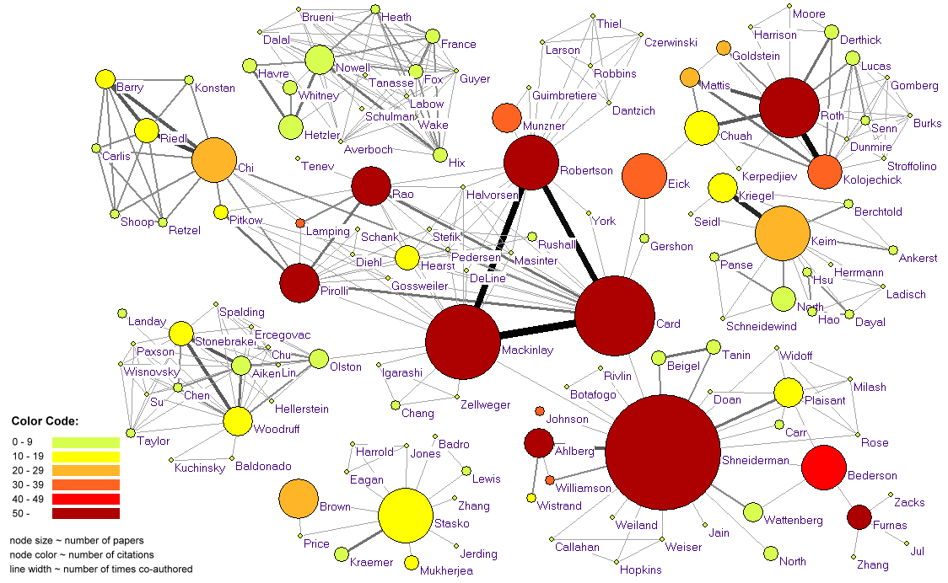
Network graphs
bibliometric analysis

Slide 75
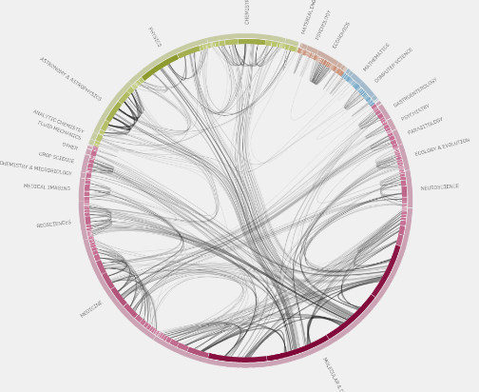
Network graphs
nodes arranged into a circle
links cross the centre of the circle or connect to other nodes in the circle's center
http://well-formed.eigenfactor.org/radial.html#/?id=

Slide 76
Data overlays
Visually encode attributes to:
nodes, links & base map/reference system
  position (1D, 2D, 3D)
  sensory properties (size, lightness, colour, orientation, shape)
  animation/interactivity

Slide 77
Visual encoding
people are good at scanning, recognizing, remembering images
  graphical elements facilitate comparisons and distinction via length, shape, orientation, texture, and colour
  animation shows changes across time
important to understand the principles of human perception and perceptual properties which can affect the design
  a bad visualization can have the opposite effect and requires even more effort and time for processing information

Slide 78
Visual encoding
DATA TYPES
quantitative, interval, and ordered data are easier to convey visually
nominal or categorical variables are more difficult to display graphically because they have no inherent ordering

Slide 79
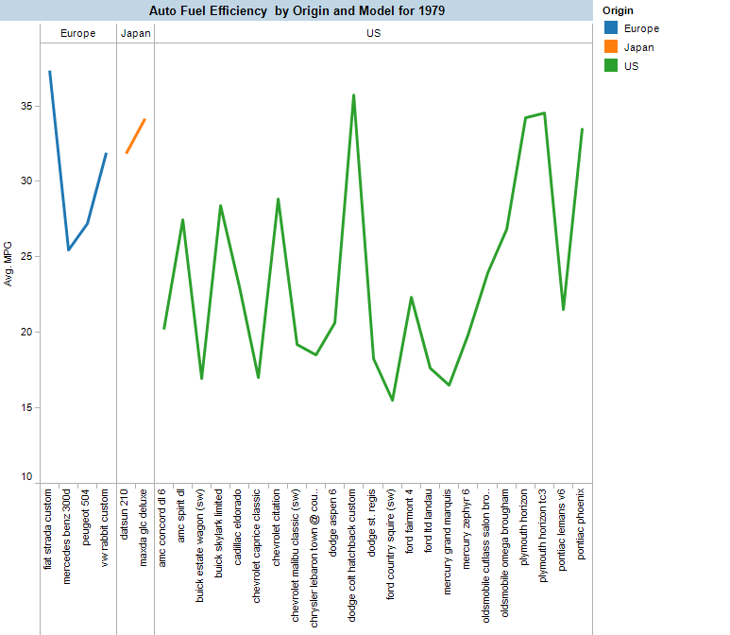
http://searchuserinterfaces.com/book/sui_ch10_visualization.html

Slide 80



Graphic variables
position: x,y (z)
form:
  size
  shape
  orientation/rotation
colour:
  value (lightness)
  hue (tint)
  saturation (intensity)
quantitative
quantitative
qualitative
qualitative
quantitative
qualitative
quantitative

Slide 81
Graphic variables
colour
  convey importance
  call attention to specific items
  label, categorize, compare
  generate emotions, increase the appeal of visualization
  colour-blindness simulator

Slide 82
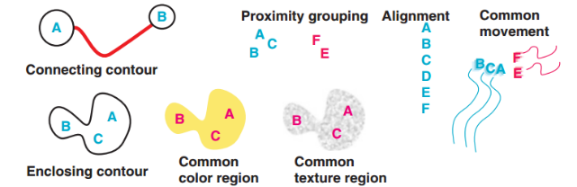
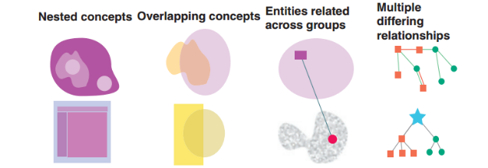
Patterns for design
Relationships between entities
Structure of ideas and relationships between concepts
Colin Ware. Visual Thinking for Design. 2008.

Slide 83
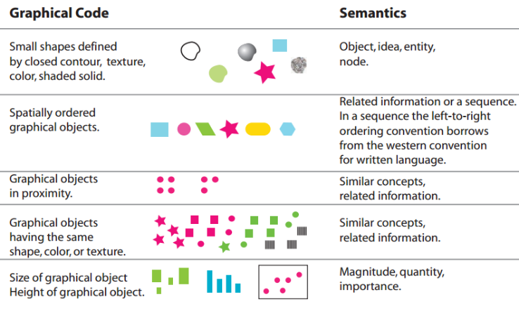
Semantic patterns
Colin Ware. Visual Thinking for Design. 2008.

Slide 84
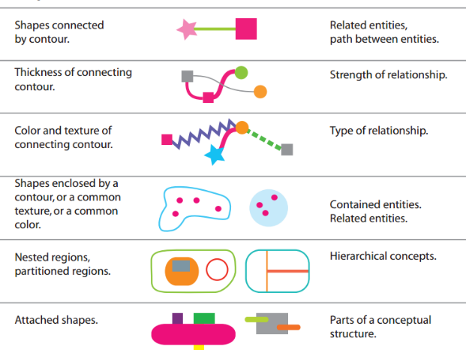
Semantic patterns
Colin Ware. Visual Thinking for Design. 2008.

Slide 85
Interactivity
STATIC VISUALIZATIONS
  a single perspective on available information
  provide useful ways to understand information
  tools for display
  charts, graphs, word clouds …

Slide 86
Interactivity
INTERACTIVE VISUALIZATIONS
  many ways to interact with the data
  viewed from different perspectives
  aim to explore available data
  contribute to new ways of understanding the material
  discover new material with no prior knowledge

Slide 87
Interactivity: techniques
animation
  draw attention
  retain context
  help make occluded information visible
  with careful design, animated transitions can improve perception of changes between different graphical representations of information

Slide 88
Interactivity: techniques
overview + zoom/filter + panning
  see the bigger picture
  see details
  move across the visualization

Slide 89
Interactivity: techniques
distortion
  draw the viewer's attention to the most important part of the display, while shrinking down the less important information
  http://well-formed.eigenfactor.org/map.html

Slide 90
Design problems
Existing studies indicate that some features can be problematic:
  pan-and-zoom
  3D navigation
  distortion
  node-and-link representations of concept spaces (overlapping)
  displaying text (large representations)
  scaling: large number of nodes, links, data points…

Slide 91
INFORMATION VISUALIZATION & LIBRARIES

Slide 92
GROUP ASSIGNMENT
A library wants to visually present data about its collection. Propose a design for such a presentation, focusing on any aspect of the collection.

Slide 93
Information visualization potential
… for internal analysis
… for end-users
… as a marketing tool
… as a discovery tool
… as a storytelling tool

Slide 94
Information visualization potential
Visualise data on
  collections (growth, size, thematic coverage,…)
  catalogue use (search queries, time,…)
  circulation (days, location, themes,…)
  library network
  patrons
  …

Slide 95
Information visualization potential
Information systems (digital libraries, OPACs, journal databases)
  overview of the collection
  query formulation
  inspection of results
  browsing
    subject
    related items, concepts
    …

Slide 96


LCSH browsing in a library catalogue
Julien, C.-A., Guastavino, C., Bouthillier, F., & Leide, J. E. (2010). Subject Explorer 3D: a Novel Virtual Reality Collection Browsing and Searching Tool. Paper presented at the Annual Conf. of the Canadian Association for Information Science, Concordia University.

Slide 97

Browsing subject headings in a digital library
Zhu, B. and Chen, H. (2005), Information visualization. Ann. Rev. Info. Sci. Tech., 39: 139–177. doi: 10.1002/aris.1440390111

Slide 98

Digital Public Library of America collections
http://www.libraryobservatory.org/

Slide 99

http://www.scimaps.org/maps/map/design_vs_emergence__127/detail/

Slide 100
Library collection by DDC
http://journal.code4lib.org/articles/6300

Slide 101

Co-citation patterns among 155 human information behaviour papers
http://www.informationr.net/ir/10-2/paper220.html

Slide 102

Amazon based: explore similar or works by (music, books, movies)
http://www.touchgraph.com/TGGoogleBrowser.html

Slide 103

Amazon based: explore similar or works by (music, books, movies)
http://www.liveplasma.com/

Slide 104
FRBRVIS
OUR EXPERIMENT

Slide 105




Slide 106
M
M
M
M
M
W
W
W
W
W
M
M
E
E
E
E
E
E
E
M
M

Slide 107
W
W
W
W
W
W
W
W
W
W
W
W
W
imitations
novel
motion picture
musical
picture book
play
adaptations
W
W
W
W
W
complemented with
subject of
E
E
E
E
E
E
E
W
W
W
W
W
W
W
W
W
W
W
novel
literary criticism
TV documentary
M
M
M
M
M
M
M
M
W
M
illustrations
foreward

Slide 108
essays
W
biographies
W
W
fairy tales
novels
W
W
editor
W
plays
W
W
W
W
W
literary criticism
W
W
W
W
W
poems
W
author
by
about
W
W
W
A
W
W
W
W
W
W
W
W
W
W
W
translator
W
reference works
poems
W
illustrator
W
W
W
W
W
W
children‘s stories
W
W
W
TV documentaries
W
W
W
W
W
Notes:
Bring together different versions and editions of a work
Create relationships within a broader concept of a work family
Provide the needed information and navigational structure that would give and overview and support explore, find, identify and select user tasks

Slide 109

Data complexity

Slide 110


Interface design
4 hierarchical layouts
hierarchical indented list
radial tree
circlepack
sunburst

Slide 111

Interface design

Slide 112
Conclusions
relatively new area
in time, ideas on what works and what does not will crystalize themselves
important to evaluate:
careful design + iterative user testing = useful visualizations

Slide 113
http://voyant-tools.org/tool/Bubblelines
http://www.wordle.net/
http://disastergestalt.com/category/library-and-information-sciences-lis/bibliometrics/
http://dlsanthology.commons.mla.org/information-visualization-for-humanities-scholars/
http://www.tapor.ca/
http://www.infovis.net/printMag.php?num=187&lang=2
http://searchuserinterfaces.com/book/sui_ch10_visualization.html
http://www.infovis.net/printMag.php?num=104&lang=2
http://www.quadrigram.com/become-an-expert/tutorials/principles-of-visualization-design
http://www.medien.ifi.lmu.de/lehre/ss07/mmi2/mmi2_3a.pdf

