Slide 1
Little Scientist, Big Data Information fusion towards meeting the information needs of scholars
Nasrine Olson¹, H. Joe Steinhauer², Alexander Karlsson², Gustaf Nelhans^{1,} Göran Falkman², and Jan Nolin¹
¹ Swedish School of Library and Information Science (SSLIS), University of Borås, Sweden
² Informatics Research Center, University of Skövde, Sweden
Notes:
I think that everyone can agree – to a different degree – that the increasing number of scholarly publications and new forms of publication types and outlets on the internet and elsewhere is at least taxing at the borders of what a single person can handle in his or her daily practice. In this paper I will talk about a study being conducted, where we try to develop if not solutions, so at least remedies to these problems, by combining information retrieval and bibliometric methods, with information fusion (the latter is introduced from computer science research). Data visualization techniques will be a focus of ours in the future, although in this presentation they take a less prominent seat.

Slide 2
Notes:
So let’s start with the digital transition and the multitude of information that is the norm today. There are literally millions of researchers out there everyday trying to make sense of data from different sources and making overviews of the research area that they are involved in. Although I have seldom needed to use this old technology, of course, I am aware of that these boxes of highly structured, yet in our view today – limited devices – once were the backbone of information retrieval in the library. Today, in most cases at least we have moved from a manual, analogue process of information retrieval in scholarly practice like this.

Slide 3
Notes:
To a digital and automatized practice where not only the references to the information but also the contents and all there is to know exists at our fingertips (and with tablet technology such as iPads and smartphones ”literally” at our fingertips).
-BUT!
Despite the developments in making the information available to us the techniques and methods of searching and selecting information and weighing together the results have not changed very much from earlier times. Not only that, but the data that we use is often proprietary, locally constructed and black-boxed, which makes it hard to work with. This does not fit very well with the researcher who wants to be able to combine and rework the data into information.

Slide 4
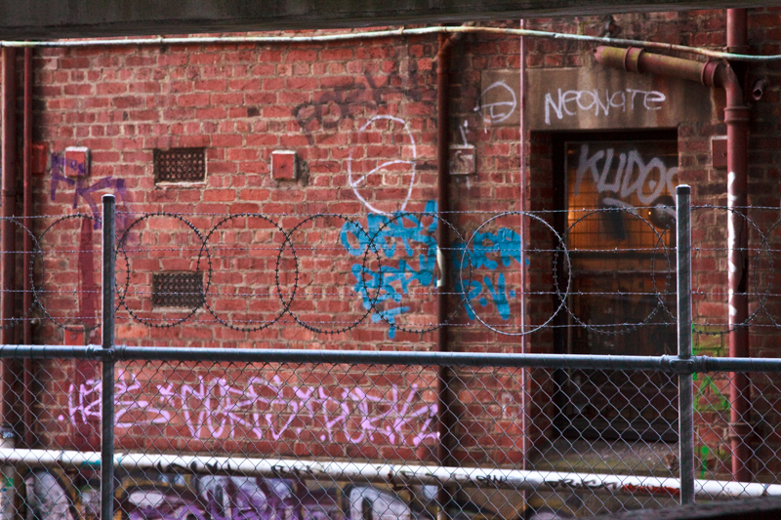
Merton’s norm system of science
Communalism
Universalism
Disinterestedness
Originality
Scepticism
Merton, R. K. 1973 (1942). The Normative Structure of Science. In The sociology of science:
theoretical and empirical investigations. Chicago: The University of Chicago Press. 267-278.
Notes:
Maybe Merton’s norm system of science has never been as threatened than today. On the one hand the CUDOS norms directs us in how we should conduct and how to interact with each other, which arguably relates to how we handle our sources as well, but on the other hand…

Slide 5
CUDOS vs. PLACE
Communalism
Universalism
Disinterestedness
Originality
Scepticism
Proprietary
Local
Authoritarian
Commissioned
Expert
Ziman, J. (1984). An Introduction to science studies. Cambridge: Cambridge University Press.
Mitroff, I (1974).Norms and Counter-Norms in a Select Group of the Apollo Moon Scientists:
A Case Study of the Ambivalence of Scientists. American Sociological Review 39, 579-595
Notes:
(On the other hand) …the counter norms presented by Science Scholars such as John Ziman and Ian Mitroff, in my view seem at least as valid now, as when they were presented in the mid 70’s-80’s. If we think of the names of some of the major players among the bibliographic databases today, it is hard not to put them at the far right hand side of this “sliding scale” of “norms and counter norms in scientific practice”.

Slide 6
Notes:
But in the end, wouldn’t it be good to at least have some user controlled and quality controlled mecanisms to facilitate the researchers’ process of forming reviews and overviews of research, combining data from different heterogenous sources? You might wonder, how we will deliver on such a promise?
Well I am going to keep you waiting for a little while while I present our cross scientific project INCITE, an the background to the problem we are discussing here.

Slide 7
INCITE: Information Fusion as an E-service in Scholarly Information Use
Information Retrieval / Bibliometrics
Information Fusion
INCITE
Aim to develop improved methods and tools addressing emerging user-needs.
Notes:
The INCITE project, as mentioned before tries to combine information retrieval and bibliometric methods, with information fusion. It aims to develop methods and tools addressing emerging user-needs in scholarly practice. Two of the fields mentioned here probably does not need an introduction, but the last one might, since it is the odd one in this ensamble.
Information fusion: the research field of multi-sensor, multi-source, multi-process information (fusion). It is often used in the form of human supervised applications of algorithms. Applications in military practice is evident but also in other civil contingency practices as in directing traffic in a harbor and multisensory applications within environmental science, among others. These are situations where the setting could change fast and you have less than optimal data to solve the situation at hand in every instance.

Slide 8
Outline
Report on an explorative qualitative user study in which the emerging needs of researchers in the age of ‘big data’ are studied
Result in the identification of challenges related to the multiplicity of information sources and extent of data were identified
Example of solution to the identified challenge, ranking of individual sources, building on Information Fusion (Dempster-Shafer Theory).
designed to allow for interactive individual ranking of information sources in the process of a coordinated search across different information sources.

Slide 9
Overall assumptions
accessing and reviewing publications and forming overviews of research are integral parts of the scholarly practice.
the combination of emerging new information content, and the diversity of information sources, as well as the sheer size of the available information may lead to difficulties in locating, accessing and processing the data required for forming overviews of different research fields.) Shorten
Notes:
(A basic assumption underpinning the INCITE project is that accessing and reviewing publications and forming overviews of different research areas are integral parts of the scholarly practice.
A second assumption associated with the idea of the INCITE project is that the combination of emerging (new) phenomena, and diversity of information sources, as well as the sheer size of the available information may lead to difficulties in locating, accessing and processing the data required for forming overviews of different research fields.)

Slide 10
User study
To date, seven interviews with scholars from seven different countries
Three professors with extensive knowledge of their respective research field. Among these, two were also editors of scholarly journals
Two researchers with an several years of post doctoral research activities
One Ph.D. student
One researcher / expert bibliometrician based in the university library that support researchers with bibliometric studies.
All participants have a background in LIS
Notes:
Problem: Vast amounts of data, reaching the peeks of what is normally handled by a single mind, even when using digital tools.

Slide 11
Overall research question
In what way, has the availability of increased volume of information, multiplicity of sources, and emergence of new data types had a bearing for scholar’s information behavior in their processes of forming an overview of a research field and or writing literature reviews?
Notes:
Overall question is about what happens when the sheer volume of material, as well as the sources to find literature and the introduction of new data types increses.

Slide 12
sub questions
Which information sources are used/prioritized?
How are new upcoming sources and publications identified and to what extent are these accessed and used?
What amounts of documents and bibliographic data are typically accessed and or reviewed?
What are the methods and tools used when faced with large amounts of data/publications?
How is prioritization done, if at all?

Slide 13
”Big data”?
Many definitions, but no matter what definition is chosen: we are in the age of big data.
Size of data:
In terms of measurement units such as Exabyte
Oxford Internet Institute:
unprecedented in scale and scope in relation to a given phenomenon.
Gartner IT:
Big data is high-volume, high-velocity and high-variety information assets that demand (…) innovative forms of information processing (…)

Slide 14
Why do research reviews and overviews?
“I think it’s necessary in order to realise that we are not reinventing the wheel all the time” and so that one does not address “something that has already been studied tonnes”.
“I need to start with a little bit of sense of overview at least of what’s going on there”
“well I do the literature reviews because it is expected”
” I want to position myself within a scholarly discourse”
“we know that there are some rules and these are probably silly, maybe they are, but this is the only way for us in order to be accepted”

Slide 15
Results, user study
Systematic searches too time consuming and not possible
Lack of tools and services to facilitate a systematic coordinated use of multiple sources and vast amount of data
Lack of user-friendly, flexible and transparent tools
Lack of financial resources
Search on terms is inadequate (too many items)
Lack of tools and services that facilitate meaningful content analysis of vast amount of data

Slide 16
Results (cont’d)
Complexity due to volume
main problem identified in relation to established fields of study was the challenges brought forth by the huge size of numbers of relevant publications
Individual strategies: Highly cited articles:
known problem with citations, used anyway
System shortcomings
Bad data
Notes:
Some respondents verbalized highly set ideals on the choice of relevant sources the task of identifying and including them in a systematic search seemed to be a challenge.
In practice, Scholarly ideals …
… seems to meet practical demands, settings.
For example, most of the participants expressed concerns using citation data or impact factor based metrics to evaluate their sources, but in the end they often answeared that these were just the indicators that were used.

Slide 17
Challenges
the sheer size of available material,
limitations in the available tools and methods for locating and accessing the material
limitations in the available tools and methods for meaningful content analysis of the material
limited time and resources and
scholars’ know-how are identified in this study as factors affecting the level of information accessed and used.

Slide 18
Visualisation
Most respondents found the use of visualization tools of interest in creating overviews of research.
Two main drawbacks:
Learning curve for their creation
Interpretation of outcomes
Additionally:
’Algorithmic transparency’: are the algorithms on which the tools are based properly descibed or ”black-boxed”?

Slide 19
Example: Interactive Individual Ranking (IIR)
Method for weighting qualitatively different evaluation/preference variables
Information sources
Ranked papers
Sources are judged by the user based on evaluation criteria (assigned by researcher)
Weighting of the trustworthiness of each source
Sources are different data sources
E.g. three different data sources such as a bibliographic index, web-based database and a pre-print archive
Assumes that search methods are different (variation)
Variables: e.g. ’trust’ ’comprehension’ ’perceived impact’
Notes:
Take a set of sources and weight their contribution.
Here, three components: trust, comprehensibility and perceived impact

Slide 20
IIR steps I
1. Individual judgement of chosen attributes:
3. Rankings translated into mass functions:
m_{A}, m_{B}, and m_{C}, frame of discernment: Ω = {a, b, c, d}
simple and intuitive translation:
1st ranked paper: 0.45
2nd –” – 0.30
3rd –” – 0.15
4th –” – 0.1
2. Ranked lists of papers:
Notes:
Information sources, three attributes based on the scholar’s individual judgements. 1= low, 2= medium, and 3= high
’Second, searches are run on all three sources (think bibliographic databases, the web, preprint archives and such). This yields three ranked lists of papers as in table 2.
Rankings translated into a mass function. This is arbitrary, or rather based on a model as shown here.
When the situation occurs that there are more papers found than rankings available, as shown in this example, where four relevant papers were found, the mass of 0.1

Slide 21
IIR steps II
4. the mass function is renormalized
5. Combining these mass functions with Dempster’s rule of combination
-> new mass function mABC.
mA(a) = 0.43 | mB(a) = 0.05 | mC(a) = 0.28
mA(b) = 0.28 | mB(b) = 0.43 | mC(b) = 0.14
mA(c) = 0.14 | mB(c) = 0.28 | mC(c) = 0.05
mA(d) = 0.05 | mB(d) = 0.14 | mC(d) = 0.43
mA(Ω) = 0.10 | mB(Ω) = 0.10 | mC(Ω) = 0.10
General: ranking based on algorithm
To allow for individual ranking, a discounting factor is added:
Columns Trust, Comp, Impact are ranked so that the most trusted source= 1, second = 0.5, third = 0.25
Notes:
4. The mass function is renormalized. The result for the example is as shown in 4
5. This forms the basis of combined ranking of papers as shown in Table 3 in the second column.
“Combining these mass functions with Dempster’s rule of combination, we receive a new mass function mABC, which is the basis of the combined ranking of all found papers in table 3.”

Slide 22
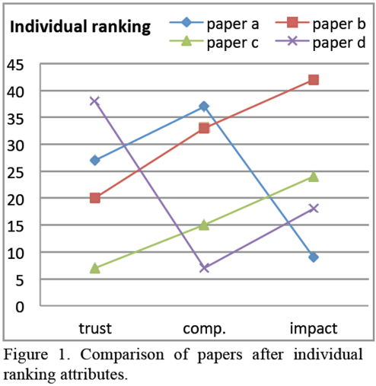
IIR steps III. Overview of all four papers with regard to each individual ranking attribute.
Notes:
From the figure it can, e.g., be seen that paper b is the one believed to have the highest perceived impact.
Paper a is believed to be most easy to comprehend, but has the lowest perceived impact
and paper d is highly trusted, but believed to be difficult to comprehend.

Slide 23
IIR steps IV. Certainty of the combined ranking
Values of upper and lower bound on the probability (uncertainty) can be used to provide more information about the certainty of the combined ranking.
The triangle on each line corresponds to the pignistic probability.

Slide 24
Conclusion
This method focuses on the interactivity of users.
Translation of ranks into a mass function is a simple qualitative approach
The reliability of the ranking of sources depend on how well the internal ranking processes are known.
Discounting factors for evaluating papers based on users choices are very crude in this example (low, medium and high).
Further features would be to add the possibility to manually add sources of information such as a literature list from a colleague.
This approach can take care of many information sources, and a vast list of ranked papers from each source, simultaneously.
“Personalized Information Retrieval”

Slide 25
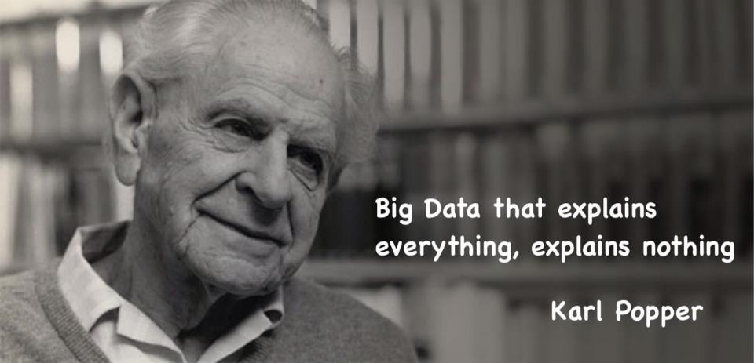
Source: http://deadwise.tumblr.com/
karl popper
big data
data
explains
everything
nothing
quotes
popper quote

Slide 26
INCITE: present and future directions
Accepted paper for the Special Issue on “Scientometrics and Information Retrieval” in Scientometrics:
“Modeling uncertainty in bibliometrics and information retrieval: an information fusion approach”
Scholarly contribution
Studies combining bibliometrics and information fusion
E.g. Research overviews
author disambiguation
Suggested methodologies
Topic modelling
Sentiment analysis
citation context analysis
Focus on the Information Fusion portfolio:
Handling Uncertainty
Interoperability
Practical contribution (e-service)
Prospective original solutions and ”middleware” (e.g. web services, portals to devices) helping scholars in doing
Call for Collaboration
Interest in collaborating with partners: Institutional and individual.
Potential EU-grants (Horizon 2020)

