Slide 1
“The noblest pleasure”?: on gaining understanding from qualitative research in library/information science
David Bawden
Department of Library and Information Science
City University London

Slide 2
Notes:
Enthusiasts for a certain position

Slide 3
To measure is to know.
If you can not measure it
you can not improve it
William Thomson, Lord Kelvin

Slide 4
Francis Cole and Nellie Eales
Statistical analysis of literature of comparative anatomy, Science Progress, 1917, 11, 578-596
Notes:
Francis Cole Museum of Zoology, Reading University

Slide 5
Notes:
So quantitative studies have a long history,
Is qualitative second rate? What is its value?

Slide 6
thick description .. In a particular context .. [to] allow for deeper understanding
Alison Pickard
Notes:
Focus on this ideas of understanding. And look first to the discipline of chemistry

Slide 9
Theoretical explanations in [organic chemistry] are often produced after the fact to rationalise results, and it is often not possible to make numerical predictions about the behaviour of novel reactions. Those explanations that are produced are frequently qualitative.
William Goodwin
Notes:
British Journal for the Philosophy of Science

Slide 10
Organic chemists have made a trade-off: they have de-emphasised quantitative prediction and unambiguous explanation for something much more useful, given their pragmatic goals: a theory that helps them make plausible, but often qualitative or relative, assessments of chemical behaviour
William Goodwin

Slide 11
Chemical structure representation
Alexander Crum-Brown
(Edinburgh) 1865

Slide 12
Notes:
All representation underlied by qualitative concepts – even in hard science

Slide 13
The noblest pleasure is the joy of understanding
Leonardo da Vinci

Slide 14
Understanding requires the grasping of explanatory and other coherence-making relationships in a large and comprehensive body of information.
Jonathan Kvanvig
Notes:
Baylor College

Slide 15
Information poverty Truth
Slow information Subject
Relevance Digital library
Document Task
Information avoidance Digital literacy
Knowledge lnformation literacy
Notes:
Concepts where primarily qualitative is needed/useful

Slide 16
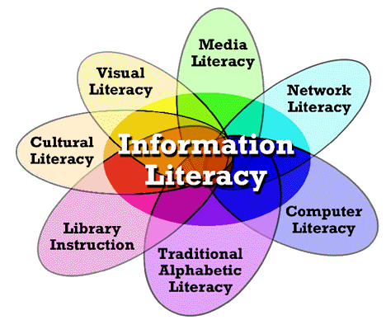

Slide 17
Notes:
William martin’s one literacy to rule them all

Slide 18
Notes:
I’ve been talking in generalisations – one point to address – (how) can we combine qualitative results?

Slide 20
Notes:
Meta analysis

Slide 21
Qualitative evidence synthesis
Critical interpretive synthesis
Thematic synthesis
Meta-ethnography

Slide 22
UK Research Excellence Framework 2014
Research: a process of investigation leading to new insights, effectively shared
Impact: an effect on, change or benefit
Notes:
Implies understanding

Slide 23
Notes:
Understanding is primarily qualitative
We need qualitative methods that will complement – postmodern mixed - quantitative for full benefit;

Slide 24
A humble reverence for everything we shall never measure
Václav Havel

