Slide 1
Eliciting Examples of Theories in Practice: A Methodological Discussion
Amy VanScoy, Tanja Merčun,
Africa Hands, Katarina Švab, and Maja Kuhar

Slide 2
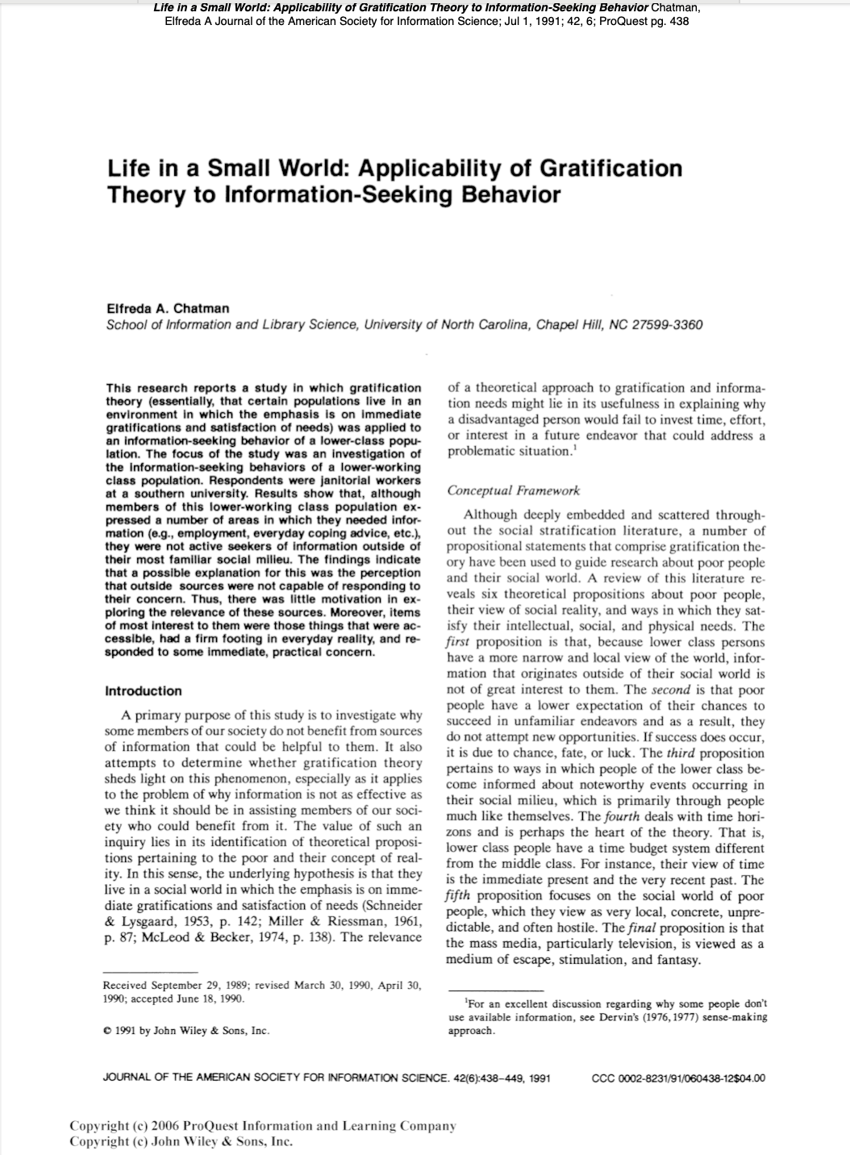
Theory/Practice Gap

Slide 3
Research Questions
How familiar are public librarians who provide information services with information behaviour theories, models, and concepts?
To what extent do public librarians use these theories, models, and concepts in their reference practice?
How does familiarity with and use of information behaviour theories, models, and concepts differ by country?

Slide 4
Previous research on knowledge/use of theory
Survey (familiarity with critical theory)
Interviews (relevance of open access theory)
Observation of teaching
Discussion of scenarios
Guided reflection
Written narratives

Slide 5
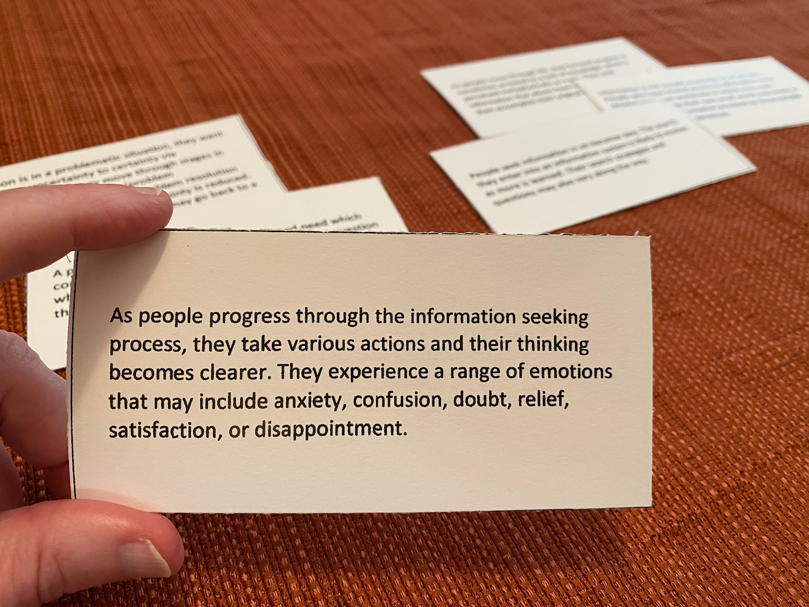
Making the Abstract Concrete

Slide 6
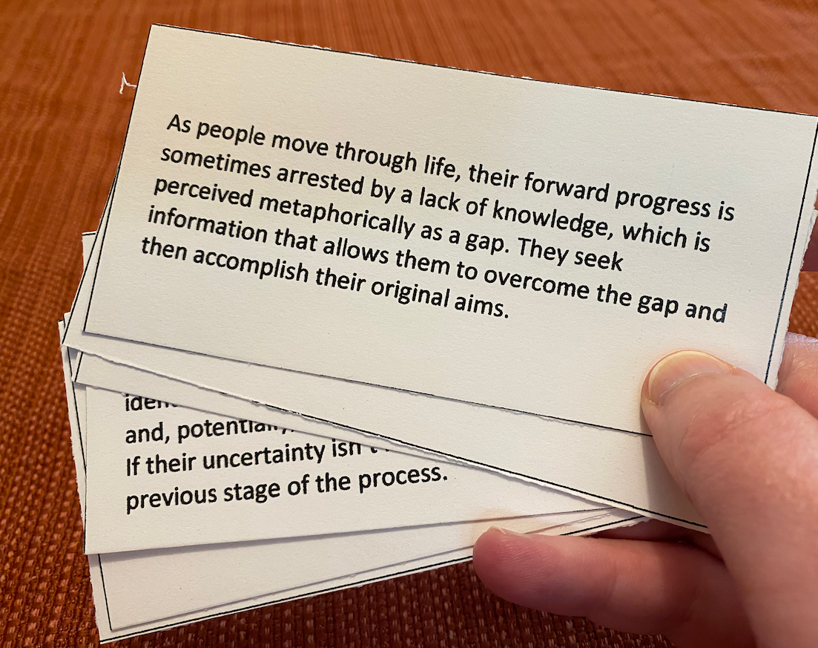
Using Plain Language

Slide 7
Thank you to our experts!
Jenna Hartel, University of Toronto
Heidi Julien, University of Buffalo
Polona Vilar, University of Ljubljana
Maja Žumer, University of Ljubljana

Slide 8
Focus on Information Behaviour

Slide 9
Theories, models, & concepts used
Information search process (Kuhlthau, 1991)
Sense-making (Dervin, 1992)
Information need (Taylor, 1968)
Berrypicking (Bates, 1989)
Imposed query (Gross, 1995)
Information poverty (Chatman, 1996)
Everyday life information seeking (Savolainen, 1995)
Model of information seeking (Wilson, 1999)
Anomalous states of knowledge (Belkin, 1982)
Information seeking model (Ellis, 1989)
Bounded rationality (Simon, 1955)
Gratification theory (Chatman, 1991)

Slide 10
Cross-cultural differences

Slide 11
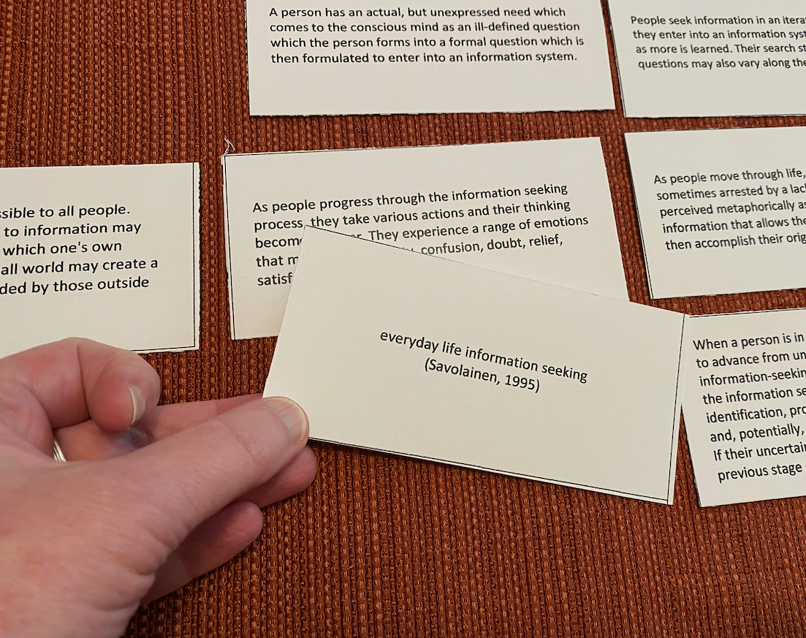
Pilot Study

Slide 12
Pilot Study

Slide 13
Eliciting Examples of Theories in Practice: A Methodological Discussion
Amy VanScoy vanscoy@buffalo.edu
Tanja Merčun mercunt@ff.uni-lj.si
Africa Hands
Katarina Švab
Maja Kuhar

