Slide 1
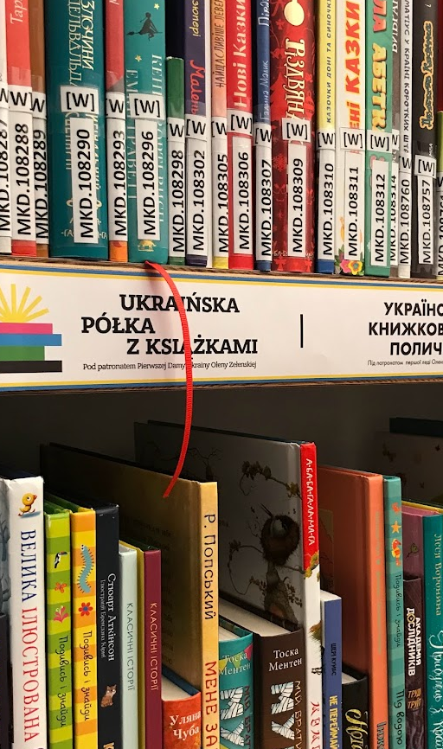
Public Library Services for Ukrainian Refugees in Hungary and Poland
Presenters: Jamie Johnston (Oslo Metropolitan University, Norway), Anna Mierzecka (University of Warsaw, Poland)
Co-authors: Jamie Johnston (Oslo Metropolitan University, Norway), Anna Mierzecka (University of Warsaw, Poland), Máté Tóth (University of Pécs, Hungary), Małgorzata Kisilowska (University of Warsaw, Poland), Norway), Magdalena Paul (University of Warsaw, Poland), Andreas Vårheim (UiT The Arctic University of Norway; Norway), Casper Hvenegaard Rasmussen (University of Copenhagen, Denmark), Kersin Rydbeck (Uppsala University, Sweden), Ágústa Pálsdóttir (University of Iceland, Iceland), Henrik Jochumsen (University of Copenhagen, Denmark), Mahmood Khosrowjerdi (Inland Norway University of Applied Sciences, Norway), Roswitha Skare (Arctic University of Norway (UiT),

Slide 2
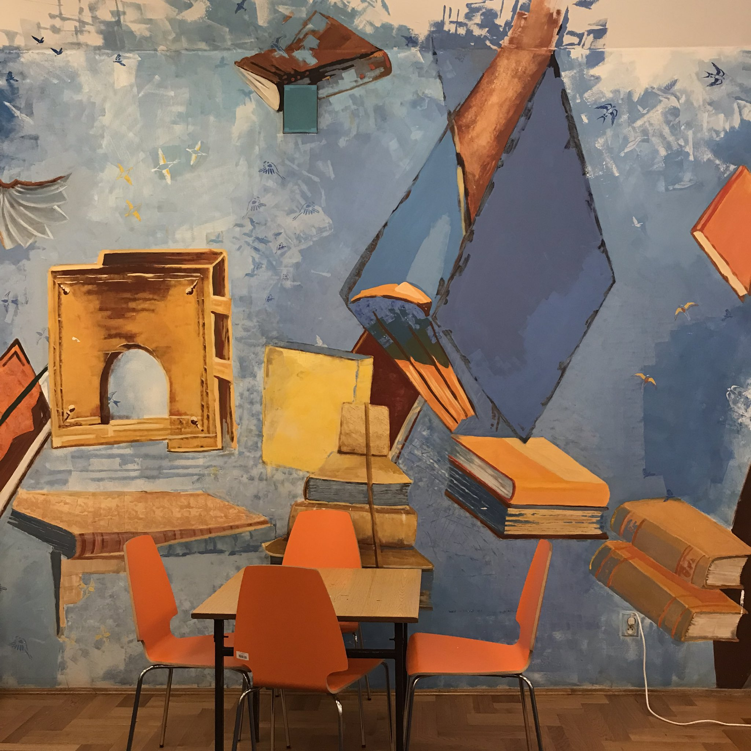
Overview of research group and current study

Slide 3
PubLIB for Refugees
A research group that studies how public libraries respond to the needs of recently arrived refugees and other immigrants.
Project partners include prominent library researchers from universities in Denmark, Hungary, Iceland, Norway, Poland, and Sweden.
Website: https://sites.google.com/view/publib-for-refugees/home?authuser=0

Slide 4
Project Partners
Casper Hvenegaard Rasmussen, University of Copenhagen, Denmark
Henrik Jochumsen, University of Copenhagen, Denmark
Jamie Johnston, (coordinator) Oslo Metropolitan University (OsloMet), Norway
Mahmood Khosrowjerdi, Inland Norway University of Applied Sciences Norway
Małgorzata Kisilowska, University of Warsaw, Poland
Anna Mierzecka, University of Warsaw, Poland
Anna Olson, Uppsala University, Sweden
Magdalena Paul, University of Warsaw, Poland
Ágústa Pálsdóttir, University of Iceland, Iceland
Kerstin Rydbeck, Uppsala University, Sweden
Roswitha Skare, Arctic University of Norway (UiT), Norway
Máté Tóth, University of Pécs / Hamvas Béla Pest County Library, Hungary
Andreas Vårheim, Arctic University of Norway (UiT), Norway

Slide 5
Current Study
The current study started in autumn 2022 and focuses on how public libraries are developing their services in response to the arrival of Ukrainian refugees

Slide 6
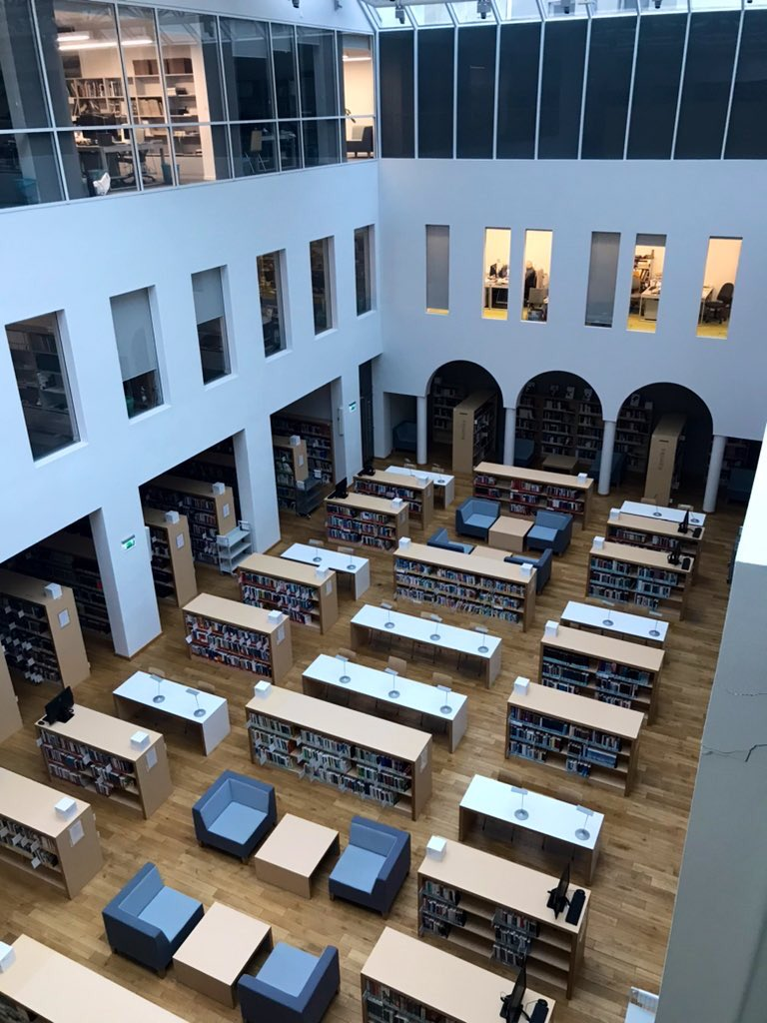
Background to the study

Slide 7
Background
UNHCR reports that more than 7.5 million refugees from Ukraine have been recorded across Europe.
Hungary: Approx. 2.7 million border crossings from Ukraine registered since February 2022; around 35 thousand Ukrainians are officially registered for Temporary Protection
Poland: Approx. 11.6 million border crossings from Ukraine registered since February 2022; 9.4 return crossings; round 1.6 million Ukrainians are officially registered for Temporary Protection or similar national protection schemes
UHNCR | Operational Data Portal: https://data2.unhcr.org/en/situations/ukraine

Slide 8
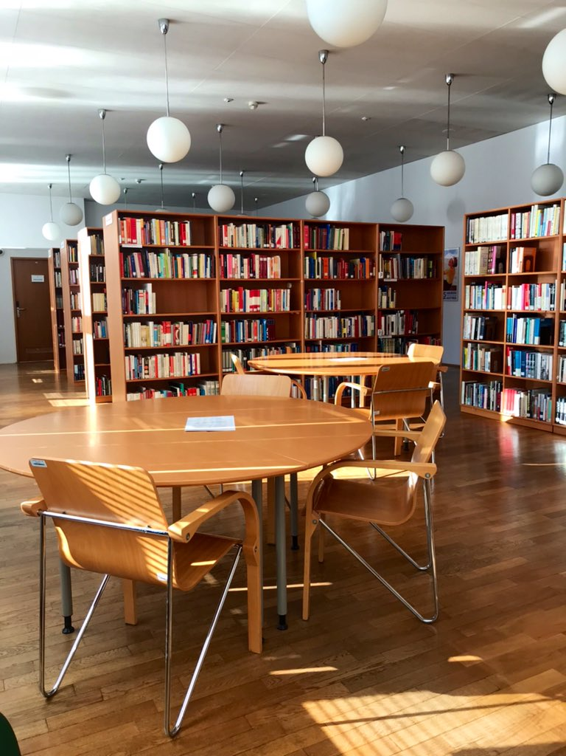
Overview of the literature

Slide 9
A growing area of research
A core value of public libraries is that libraries are for everyone, which has resulted in librarians’ extensive and ongoing support for people in vulnerable and marginalized situations (Grossman et al. 2022; Muddiman et al. 2000; Hvenegaard Rasmussen and Jochumsen 2003)
This is reflected in concepts such as frequently used in the professional and public discourses on public libraries:
Empowerment (Abu et al. 2011)
Social inclusion (Muddiman 2000)
Social justice (Pateman and Vincent 2010)

Slide 10
Library Programming and Services
Library research has shown that there has been a marked increase in different public libraries activities during the last two decades. This is seen in three areas:
Traditional library services
Services other than access to collections
Services that are not normally associated with public libraries

Slide 11
1. Traditional library services
Traditional library services offered to refugees, such as the loaning of books and other materials and the provision of internet access.
These types of services are generally well-received and made use of by refugee groups (Hosoya-Neale 2016; Shoham and Rabinovich 2008; Kosciejew 2019)
Multilingual library collections are commonly perceived as outdated and used less (Nekolová et al. 2016; Sirikul and Dorner 2016)

Slide 12
2. Services other than access to collections
Public libraries provide other services than access to collections such as serving as a meeting place for immigrant women (Audunson et al. 2011; Branyon 2017)
Various social activities for unaccompanied children are offered (Nilsson 2016)
Language programs are a common service offered to immigrants and refugees (Johnston 2019; Johnston and Audunson 2019; Rodriguez 2019)
Support for different kinds of literacies, such as health (Grossman et al. 2022) or financial literacies as well as digital literacies (Fenton 2016)

Slide 13
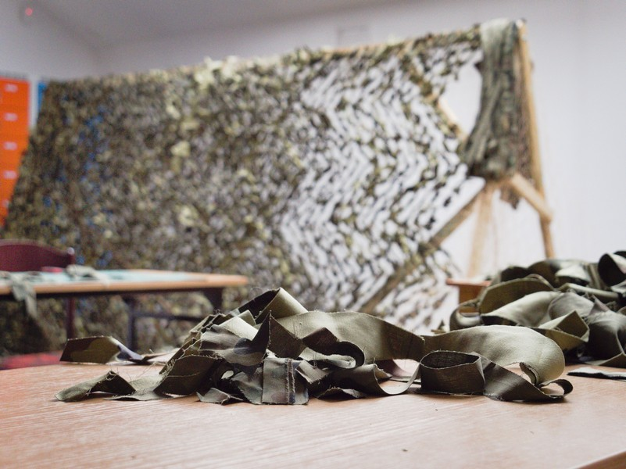
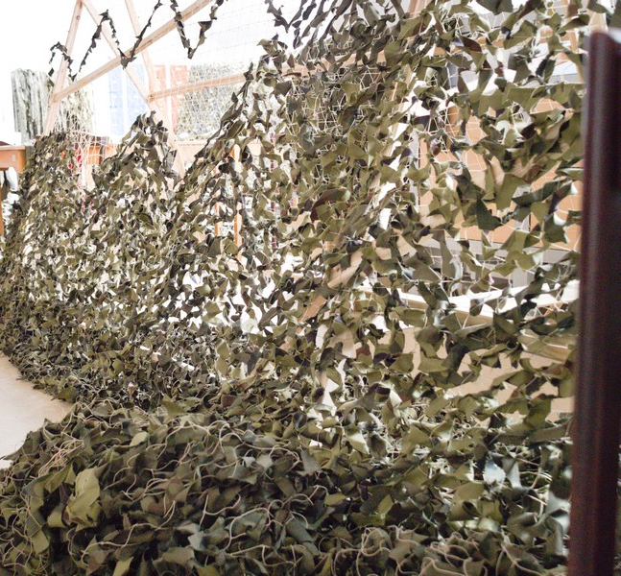
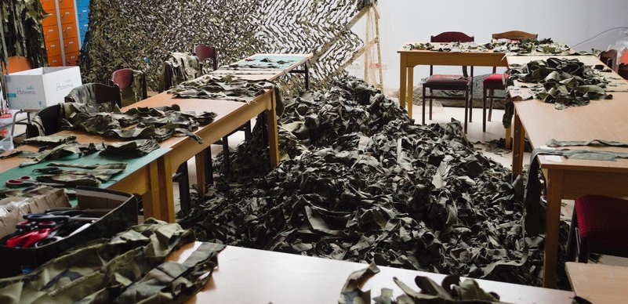
3. Services that are not normally associated with public libraries
Providing transportation, distributing aid (e.g., clothing, food, etc.), serving as a temporary shelter, obtaining information about family and friends, helping to fill out insurance claims and other form (Bishop and Veil 2011; Jaeger et al. 2006 and Nilsson 2016)
Photos courtesy of Wojewódzka Biblioteka Publiczna w Krakowie / Regional Public Library in Krakow

Slide 14
Trust, Identity and Belonging
Refugees in general perceive libraries as safe places (Chei 2022)
Library programs can play an important part in facilitating and speeding up trust-creating processes (Vårheim 2014)
Key success factors in librarians’ provision of services to refugees include trust, a welcoming atmosphere and outreach (Gonzalez 1999; 2001)
Public libraries have been shown to play a certain role in helping refugees to adapt and build a new cultural identity (Dancs 2018)
Libraries can support refugees in obtaining a sense of belonging in their new societies (Bronstein 2019; Johnston 2019)
Notes:
A recurring topic in the literature is that the refugees' trust in libraries and library staff is crucial for success.

Slide 15
Fractured Information Landscapes
Fractured information landscapes concept encapsulates what happens when people experience dramatic changes in their lives and finds that their customary information behavior(s) or practices are no longer useful or effective in the new context. Libraries can assist refugees in developing the necessary information practices for becoming information resilient (Lloyd 2015, 2016)
Research has shown that public libraries can help refugees cope with the challenges of a new and complex informational landscape through providing information and access to information technology (Kosciejew 2019)

Slide 16
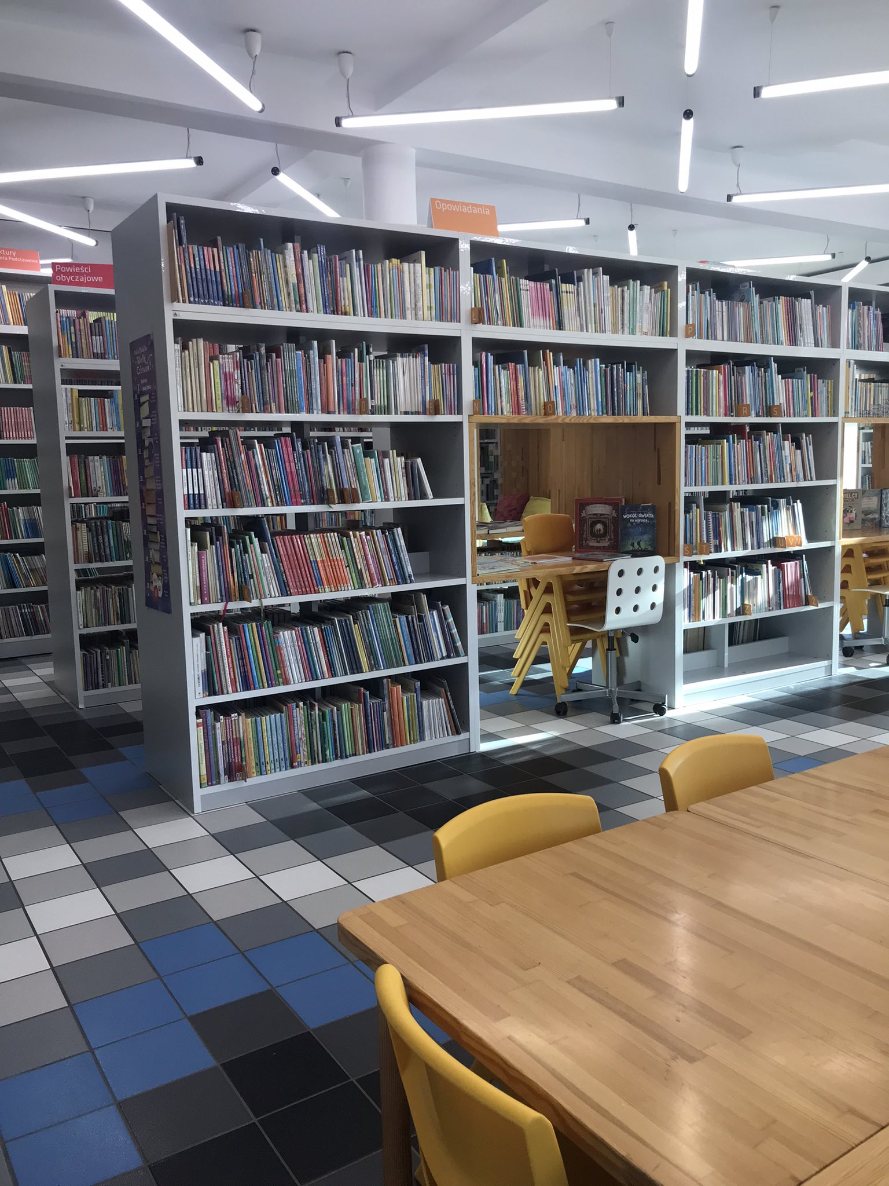
Research Questions & Methods

Slide 17
Research Questions
What roles are libraries playing in the broader response?
What specific types of programs and services are libraries developing and what types of partnerships are they forming?
What are the implications for library management and staff?
Notes:
Drawing upon a theoretical and conceptual framework social sustainability, this study elicits the overarching investigation through the following research questions:
What roles are libraries playing in the broader response?
What specific types of programs and information services are they developing and what types of partnerships are libraries forming, if any?
What are the implications for library management and staff and their professional responsibilities and/or competencies?

Slide 18
Methods
Inductive
Mix methods
Questionnaire - The ALM-Field, Digitalization and the Public Sphere (ALMPUB)
Interviews with library staff working with services to immigrants and refugees (6 per country)
Notes:
This study employs an inductive, mixed-method approach. Previously unanalyzed results from a 2018 questionnaire sent to library professionals provide a starting point for the study. The questionnaire was part of The ALM-Field, Digitalization and the Public Sphere (ALMPUB) project that was financed by the Norwegian Research Council’s KULMEDIA Program. As will be discussed, the results show that library services to immigrants and refugees have been minimal in the two countries, yet – as previously stated - insights from the field indicate that this is an area under rapid development. In order to gain an insight into how these services are being developed and the role that libraries are playing in the overall response, interviews will be conducted during November of 2022 with library professionals in both countries. Interviews will be conducted with four public library staff or managers with direct responsibility for providing services to refugees, a regional library leader, and a library leader at the national level.

Slide 19
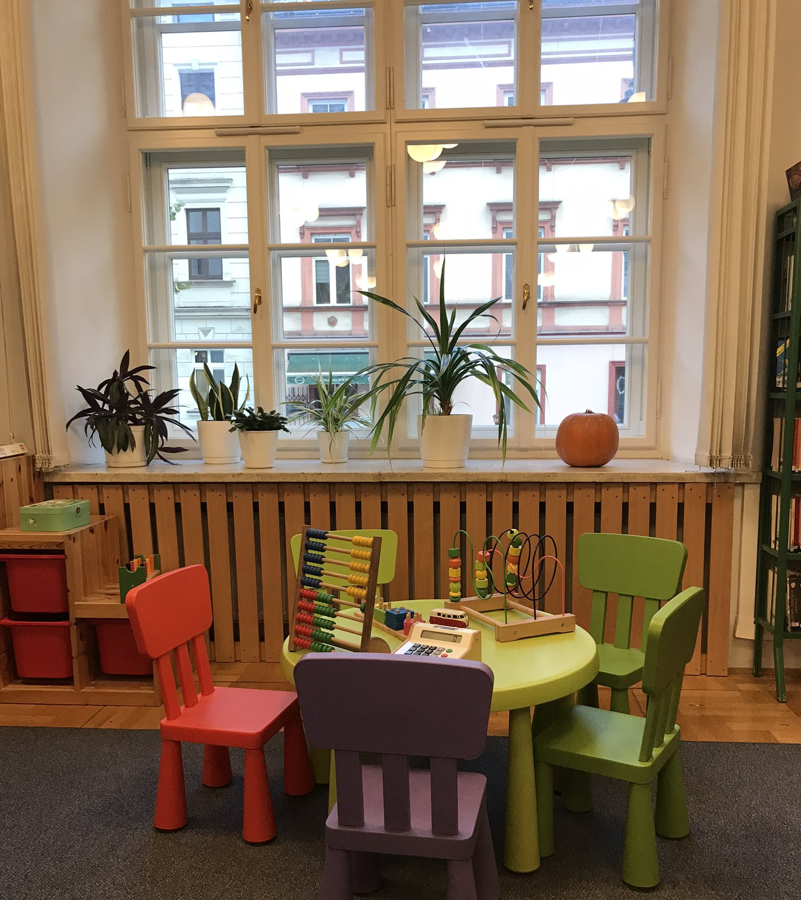
Interview Findings

Slide 20
Interviews in Hungary and Poland
12 interviews were conducted (6 in each country) with public library staff or managers with direct responsibility for providing services to refugees
The interviews were carried out in the first quarter of 2023
Libraries serving communities with larger populations of Ukrainian refugees were selected including: 2 from larger urban communities, 2 from medium size communities or suburbs, and 2 from smaller communities

Slide 21
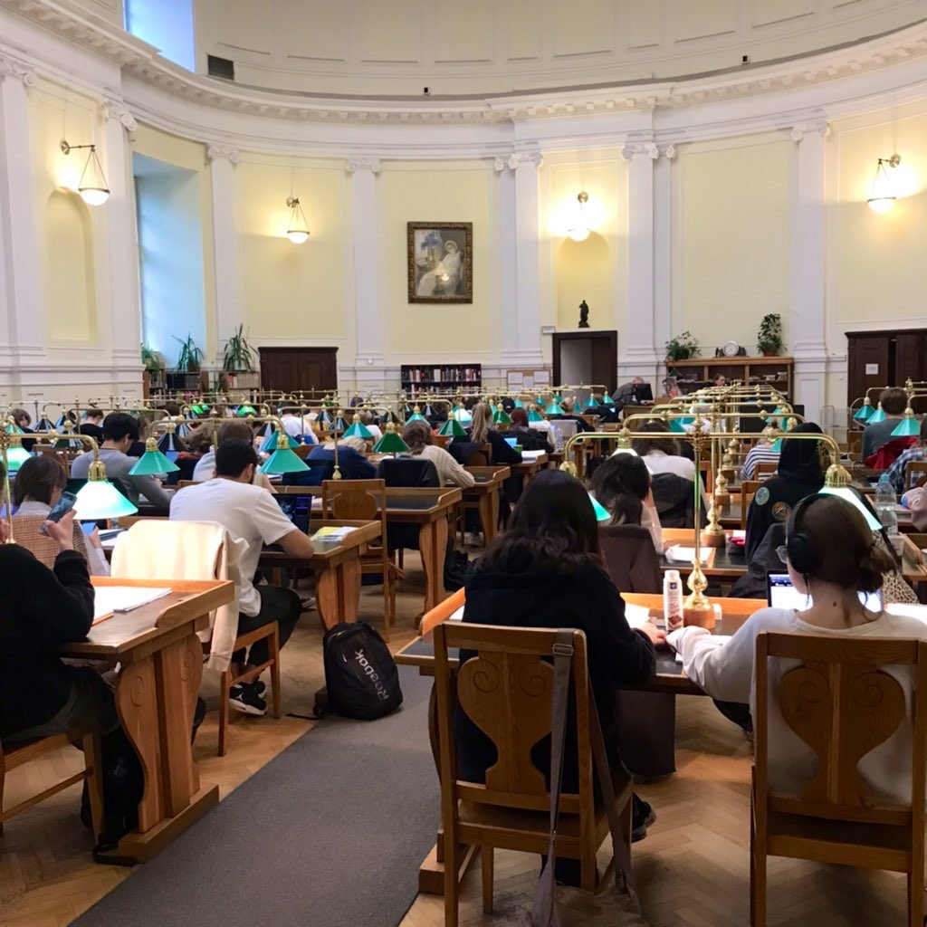
Programs and Information Services
Traditional Services
Information points for refugees
Acquisition of new materials in Ukrainian
Various social / culture activities (especially for children )
Language programs
New or Untraditional Services
Collecting / Distributing aid (e.g., clothing, food, etc.)
Serving as a temporary shelter
Information points for other organizations that were involved in support activities.
Psychological help to the refugees
Aid with finding accomodation and searching for jobs

Slide 22
Role of Libraries in Broader Response
First Stage: Basic Needs
Donation hub and organizer of local efforts to provide food, shelter, clothing and health care
Refuge and shelter
Second Stage: Settlement
Assistance with finding jobs, enrolling in schools, obtaining identification
Third Stage: Culture and Social Inclusion
Support for language learning, reading, social inclusion/integration as well as for Ukrainian culture and language

Slide 23
Library Partnerships and Organizational Efforts
Context:
Little or no guidance from national-level authorities
Lack of support from formal professional networks
Grassroot initiatives (internal motivation)
Establishment of informal networks in local communities:
Local authorities
NGO’s
Culture centers
Volunteer organizations / centers

Slide 24
Implications for library management and staff
Strengthening previously marginalized role of:
Integration consultant
Cultural facilitator
Youth worker
Strengthening the library’s role in the local community
A sense of pride in the significance of the work carried out, and deepened of sense of purpose

Slide 25
Continuation of the Research
Aim of research is to identify common library practices and challenges, and understand how library practice is developing in different contexts
Research findings will be used to inform library best practices and LIS education
Ucoming research activities:
Interviews with library professionals in Denmark, Hungary, Iceland, Norway, Poland, Sweden, and possibly Finland and Germany
Survey to library professionals in Denmark, Finland, Hungary, Germany, Iceland, Norway, Poland, and Sweden

Slide 26
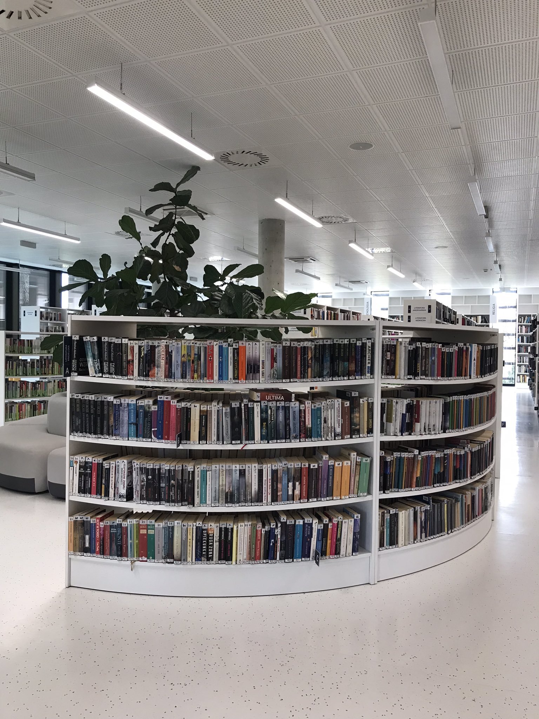
References

Slide 27
References
Grossman, Suzanne, Denise E. Agosto, Mark Winston, Rabbi Nancy E. Epstein, Carolyn C. Cannuscio, Ana Martinez-Donate, and Ann C. Klassen. 2021. “How Public Libraries Help Immigrants Adjust to Life in a New Country: A Review of the Literature.” Health Promotion Practice, March, 15248399211001064. https://doi.org/10.1177/15248399211001064.
Johnston, J. 2019. “Friendship Potential: Conversation-Based Programming and Immigrant Integration.” JOURNAL OF LIBRARIANSHIP AND INFORMATION SCIENCE 51 (3): 670–88. https://doi.org/10.1177/0961000617742459.
Johnston, J, and R Audunson. 2019. “Supporting Immigrants’ Political Integration through Discussion and Debate in Public Libraries.” JOURNAL OF LIBRARIANSHIP AND INFORMATION SCIENCE 51 (1): 228–42. https://doi.org/10.1177/0961000617709056.
Kosciejew, M. 2019. “Information’s Importance for Refugees: Information Technologies, Public Libraries, and the Current Refugee Crisis.” LIBRARY QUARTERLY 89 (2): 79–98. https://doi.org/10.1086/702193.
Lloyd, A. 2017. “Researching Fractured (Information) Landscapes Implications for Library and Information Science Researchers Undertaking Research with Refugees and Forced Migration Studies.” JOURNAL OF DOCUMENTATION 73 (1): 35–47. https://doi.org/10.1108/JD-03-2016-0032.
Pilerot, O. 2018. “The Practice of Public Library-Work for Newly Arrived Immigrants.” INFORMATION RESEARCH-AN INTERNATIONAL ELECTRONIC JOURNAL 23 (4).
Varheim, A. 2014. “Trust and the Role of the Public Library in the Integration of Refugees: The Case of a Northern Norwegian City.” JOURNAL OF LIBRARIANSHIP AND INFORMATION SCIENCE 46 (1): 62–69. https://doi.org/10.1177/0961000614523636.
———. 2017. “Public Libraries, Community Resilience, and Social Capital.” INFORMATION RESEARCH-AN INTERNATIONAL ELECTRONIC JOURNAL 22 (1).
Witteveen, A. 2016. “Public Libraries Support Refugees.” LIBRARY JOURNAL 141 (2): 13–13.
UNHCR. October 11, 2022. Operational Data Portal: Ukrainian Refugee Situation. https://data.unhcr.org/en/situations/ukraine
UNHCR Regional Bureau for Europe. July 2022. LIVES ON HOLD: PROFILES AND INTENTIONS OF REFUGEES FROM UKRAINE: Czech Republic, Hungary, Republic of Moldova, Poland, Romania & Slovakia. UNHCR. https://data.unhcr.org/en/documents/details/94176.

Slide 28
Questions?
Jamie Johnston
Anna Mierzecka
jamijo@oslomet.no
anna.mierzecka@uw.edu.pl

