Slide 1
Bringing Stories into Homes An Exploration of Books Shared in Virtual Storytime Programs
Libraries in the Digital Age
Osijek, Croatia
May 2023
Notes:
Hello I’m Maria Cahill. I’m from the University of Kentucky, and for the next 15 minutes, I would like to share preliminary findings of a study investigates the nature of the books shared through public library virtual storytime programs. The purpose of the study is to shed light on the nature of the content typically depicted in the books shared and to identify ways that libraries might consider adjusting the materials they share as they seek to expand and enrich the minds of young children.

Slide 2
LG-250035-OLS-21
Notes:
This project is funded through a three-year grant from the Institute of Museum and Library Services

Slide 3
Project Research Team
Maria Cahill
School of Information Science
Educational Leadership Studies
Luke LeFebvre
School of Information Science
Soohyung Joo
School of Information Science
Antonio Garcia
College of Social Work
Averi Cole
Graduate Research Assistant
Notes:
I am blessed to work with an amazing team of collaborators, and I especially want to acknowledge Averi Cole whose work on this particular study has been instrumental.

Slide 4
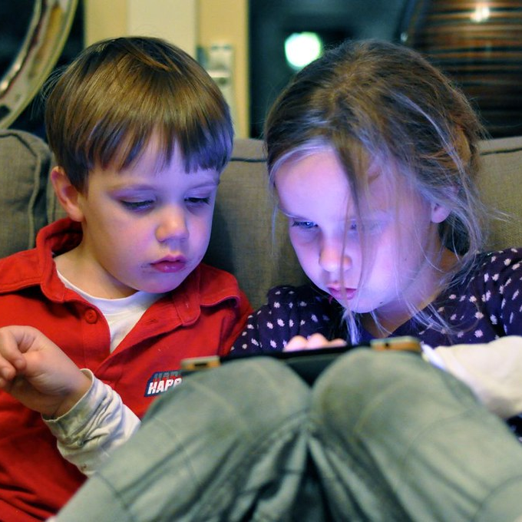
Study Context
This Photo by Unknown Author is licensed under CC BY-SA-NC
This Photo by Unknown Author is licensed under CC BY
Notes:
In response to the COVID-19 crisis, nearly all public libraries in the United States closed buildings and discontinued in-person services. Storytime programs shifted to virtual delivery modalities in public libraries large and small and in communities of all sizes (Krabbenhoft, 2020). As one of the few literacy-focused, freely available resources for children and families during the height of the pandemic when social isolation was the norm throughout the U.S, public libraries were able to bring literacy into the home environments of families of all types through virtual storytime programs.

Slide 5
Bioecological Systems Theory
Hchokr. (2012, November 20). Bronfenbrenner's Ecological Theory of Development. https://commons.wikimedia.org/wiki/File:Bronfenbrenner%27s_Ecological_Theory_of_Development_(English).jpg
(Bronfenbrenner and Morris, 2006; Moura, Nacimento, and Ferreira, 2021)
Notes:
This study is framed through the Bioecological Systems Theory (Bronfenbrenner and Morris, 2006) which proposes that child development is best conceptualized as a child situated within the center of four nested and interacting contextual systems that in combination with the child’s own innate qualities, proximal processes or interactions, and time affect progress and learning. Within this frame, the contexts in which a child is directly involved as an interacting member, such as the child’s home, informal playgroups, and school or daycare class have traditionally been considered microsystems, and mesosystems encompass the intersections of two or more microsystems. Exosystems consist of those contexts where the child is not a direct member, but which incidentally affect the child through indirect means. Finally, the macrosystem consists of social and cultural factors such as language, norms, and economic and political factors.
During the height of the COVID-19 lockdowns, the demarcations of micro- and meso-systems blurred as activities that had previously constituted separate microsystems were brought together through virtual tools which not only transformed the home environment, routines, and individuals’ roles within the home, but also the composition of proximal processes within that environment. Within children’s homes, public library virtual storytime programs oscillated in a realm between micro and mesosystems as children’s participation shifted between independent activities and interactions with the librarian and other participants and family-based participation, depending upon the involvement of caregivers and other members of the household.

Slide 6
Virtual Storytime Analysis
RQ1: What types of book genres are shared in virtual storytime programs?
RQ2: What are the key topics of the books shared in virtual storytime programs?
Notes:
Two questions guided this study: what book genres were shared during the virtual storytime programs, and what were the key topics of the books shared?

Slide 7
Sample
25 public libraries; 98 virtual storytime programs
Notes:
This study is nested within a larger project that explores virtual storytime programs in the United States.
We randomly selected one state in each of the nine U.S. Census Bureau divisions (2021), and working with state library agencies, we invited all public libraries in each of those nine states to serve as sites for this study. Of the 68 libraries whose personnel expressed interest, 25 directors signed formal approvals. Half (n =13) of those libraries are located in urban areas, eight are located in urban clusters, and four are located in rural areas.
For 24 of those library systems, we observed and digitally recorded four virtual storytime programs, and for one library system, we observed and digitally recorded two virtual storytime programs.

Slide 8
Data Analysis
N = 176
Content Analysis
Notes:
For each of the 98 virtual storytime programs, based on visual information and supported by expressed input from the virtual storytime providers, we identified 178 books shared. We then used the Library of Congress and WorldCat catalogs to collect subject terms for each. We were unable to collect subject terms for two books; thus, we eliminated them from the study. Based on genre classifications employed in previous studies (e.g. Kociubuk and Campana, 2019; Pentimonti et al., 2011), we analyzed and sorted the books into one of three categories: storybook, non-narrative informational, mixed informational which consisted of informational material presented through a narrative or unconventional structure (e.g. verse, riddle, etc.), and other which consisted of poetry, songs and folklore. Additionally, utilizing thematic analysis (Braun and Clarke 2006) we coded the subject terms into key topics.

Slide 9
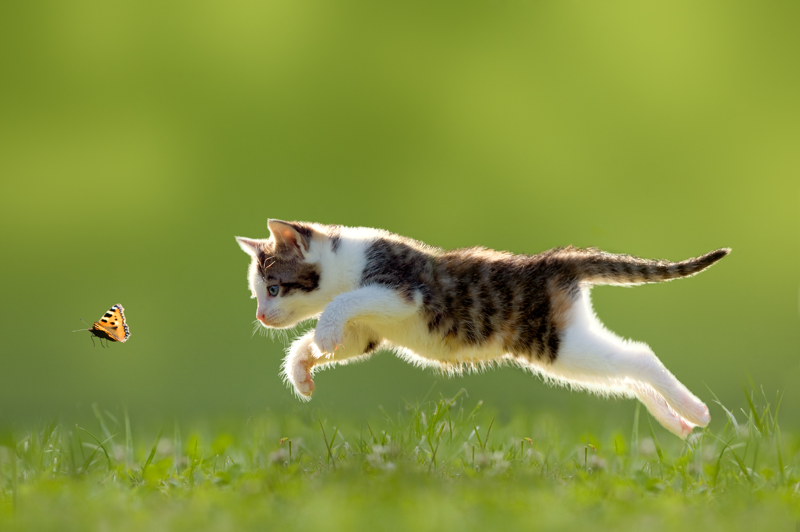
Key Topics
Animals
Feelings and emotions
Bodies, health, and wellness
Nature
Basic concepts (letters, numbers, shapes, etc.)
Communities
Families
Food
Notes:
It won’t come as any surprise to anyone familiar with children’s literature that animals were far and away the most frequent topic of the books shared during virtual storytimes, and if you know anything about librarians, you probably won’t be surprised to learn that cats were tops in the animal category. But if we look at the other topics within the context of the Covid-19 pandemic that was ensuing during the period of time when the storytimes were shared, you can see how sensitive and responsive librarians were to the needs of young children. Socio-emotional learning is really important in early childhood always, but at this point in time, everybody in the world was experiencing heightened fear and uncertainty.
Similarly, health and wellness are topics of great importance in normal times, but they are particularly so during pandemic emergencies. We’ve all heard about the adverse affects the pandemic had on children’s academic skills; yet, librarians continued to address the basic concepts that lead to school readiness for young children.

Slide 10
Genres
Notes:
Across the 176 books analyzed for this study, the most frequently read genre was storybooks (n = 87), followed by mixed informational (n = 60), informational (n = 3), and other (n = 26).

Slide 11
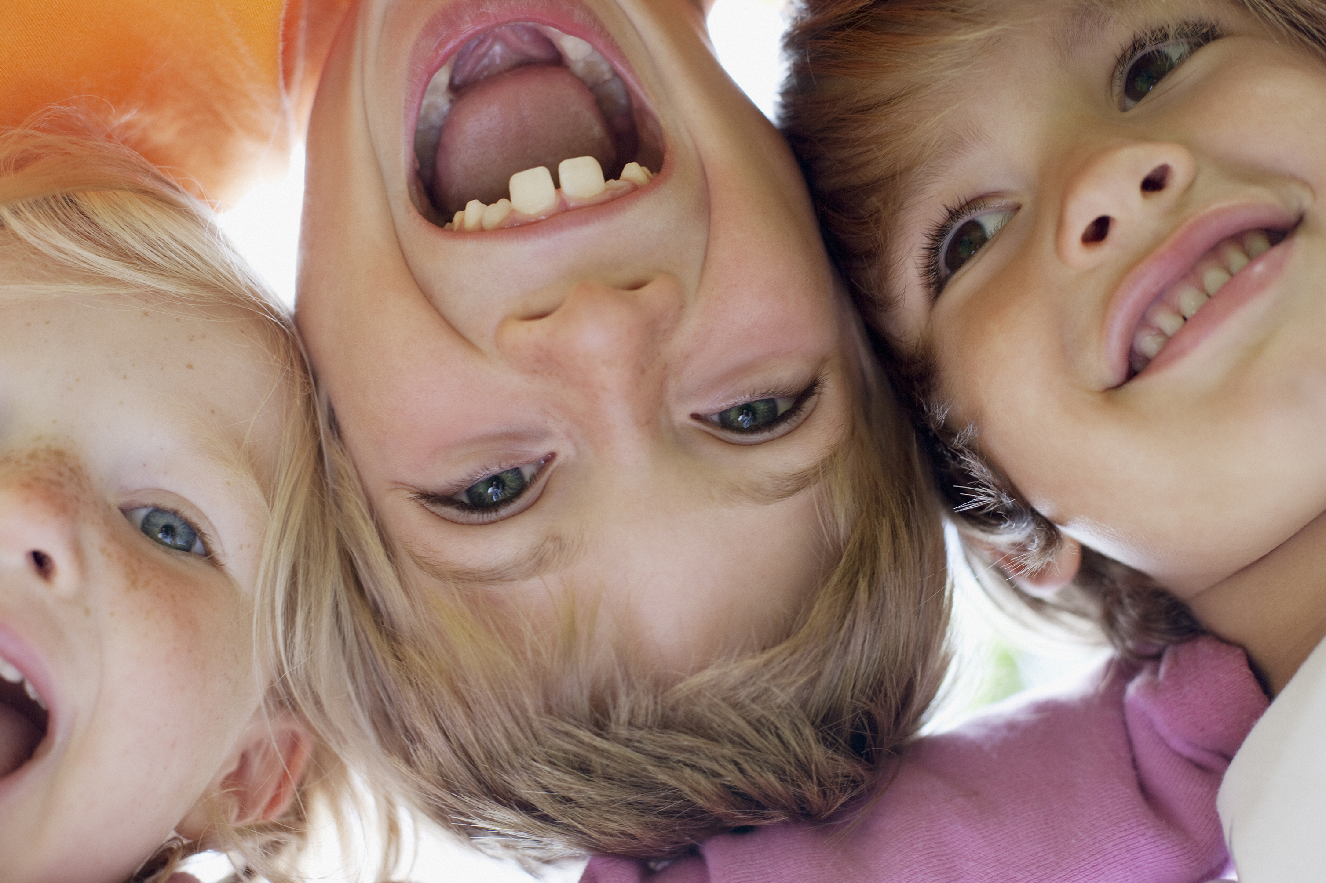
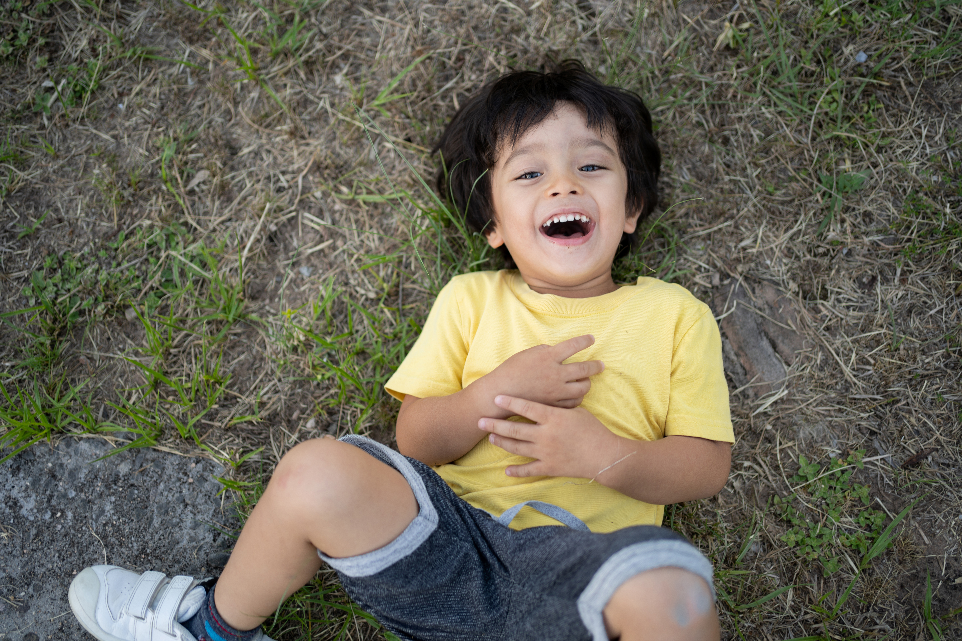
So What?
Notes:
Exposure to and familiarity with different genres support children’s learning and development in different ways, and topics of those books facilitate children’s world knowledge and support young children in the here and now, but they also instill a foundation for subsequent learning. When we consider complexity of texts for readers, we think of three factors that influence how a child will respond to that text. Quantitative factors include the syntax and vocabulary, sentence length, and format of the text itself; amongst the qualitative factors impacting text complexity is the topic of the book and what existing world knowledge a child has in relation to the topic; finally, the reader’s approach to reading and purpose for reading factor into the complexity equation. Exposure to diverse topics and formats of books in storytime favorably positions children in relation to all three components. The more exposure young children to have to various genres and the complex language integrated into picturebooks, the greater prepared they will be to successfully navigate the quantitative facets of subsequent reading tasks; expanded world knowledge through exposure to a variety of topics supports children in relation to the qualitative components of reading complexity, and finally, children who have had numerous positive experiences with books and reading in early childhood are motivated to read and approach the task with positive attitudes.
Findings from this study suggest that librarians are expanding children’s exposure to world knowledge and a variety of text structures via the books they are currently selecting for storytime programs, but that they might continue to include this as an area for further development as they continue to refine and improve their practices. Specifically, they might expand children’s exposure to additional topics and provide more opportunities for children to encounter expository text.

Slide 12
Thank you
Questions and Discussion
maria.cahill@uky.edu

Slide 13
Images
Slide 4: Unknown Authors, licensed under CC BY-SA-NC;
Slide 5: Hchokr. (2012, November 20). Bronfenbrenner's Ecological Theory of Development. https://commons.wikimedia.org/wiki/File:Bronfenbrenner%27s_Ecological_Theory_of_Development_(English).jpg
Slide 7: map created with MapChart (https://www.mapchart.net/)
Slide 9: Microsoft Office stock image
Slide 11: Microsoft Office stock images; Text complexity image from National Governors Association Center for Best Practices., & Council of Chief State School Officers. (2010). Common Core State Standards. Authors.

