Slide 1
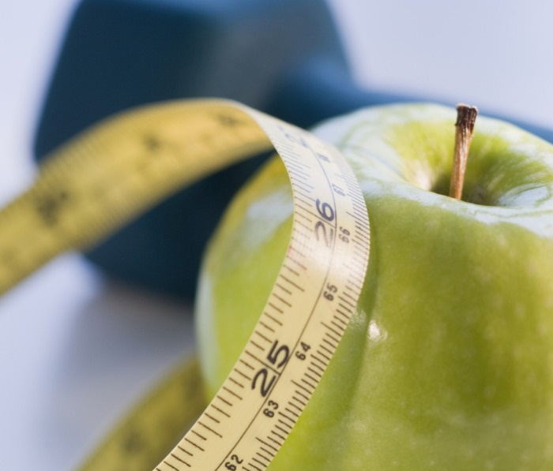
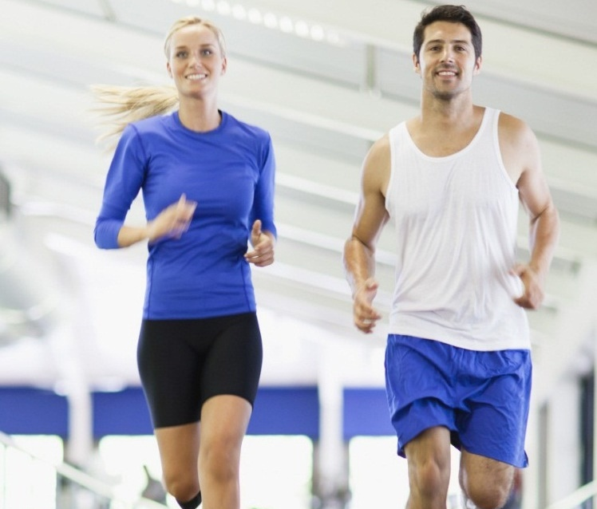
The impact of the COVID-19 pandemic on physical health and mental well-being of university teaching staff the case of Faculty of Humanities and Social Sciences in Osijek
Tin veljača, mag.cin.
doc. dr. sc. Milijana Mićunović & doc. dr. sc. Kristina Feldvari

Slide 2
most common symptoms of socio-emotional impact of new work conditions
LITERATURE REVIEW
decline in physical activity
increased food intake
rise in stress levels
and increased burnout syndrome

Slide 3
Physical activity HABITS
38% no activity at all
36% 5 or more hours in front of screen
60% sleeping disorder
(Martínez-de-Quel et al., 2021;
Maugeri et al., 2020; Ismail et al.,2020)
Eurobarometer – PA
2019 – 44%
2022 – 38%
CRO - PA
2019 – 27%
2022 – 30%
(European Commission, 2022)

Slide 4
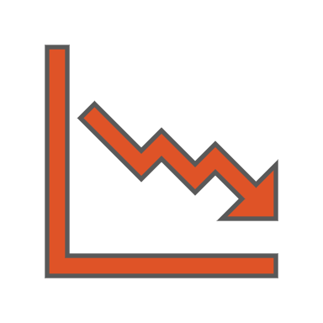
NUTRITION HABITS
intake of high-calorie food
emotional and compulsive overeating
- intake of water,
fruits, vegetables,
and low-calorie drinks
(Di Renzo et al., 2020; Ismail et al., 2020; Poskute, Nzesi, Geliebter, 2021; Coulthard et al., 2021)

Slide 5
mental health
COVID-19 and mental health (in general) > stress, anxiety, depression, sleep disorder, burnout syndrome, substance abuse, etc. (Kumar & Nayar, 2020; Maugeri et al., 2020; Pfefferbaum & North, 2020; Eurostat: Statistics explained, 2022; World Health Organization, 2022c)
common psychological symptoms amongst university teachers during COVID-19: stress, anxiety, depression and burnout (Casimiro Urcos et al., 2020; Idris et al., 2021; Ozamiz-Etxebarria et al., 2021; Scanlan & Savill-Smith, 2021; Savill-Smith & Scanlan 2022)
different stressors: increased workload, deadlines, lack of control over work, irregular hours, maintaining a work/life balance, stress of online teaching, social isolation, lack of timely government guidance (Education Support, 2020b; MacIntyre, Gregersen & Mercer, 2020; Idris et al., 2021; Scanlan & Savill-Smith, 2021)
three most common factors of anxiety, stress and burnout in HE teachers (Merchant & Lurie, 2020; Daumiller et al., 2021; Fernández-Suárez et al., 2021; Filho et al., 2021; Carr et al., 2022; Galea et al., 2022):
information overload (COVID-19 pandemic),
additional heavy workload and reshape of work conditions,
social isolation and physical distancing
Notes:
In general, the pandemic caused the rise in mental health symptoms and mental disorders, such as stress, anxiety, depression, sleep disorder, burnout syndrome, substance abuse, etc.
Since the beginning of the pandemic, existing issues were heightened and further entrenched, and university teachers accumulated different psychological symptoms, such as stress, anxiety, depression and burnout.
Different stressors were identified, like increased workload, deadlines, lack of control over work, irregular hours, maintaining a work/life balance, i.e. blurred lines between work and home, stress of online teaching, lack of social contact/isolation, lack of timely government guidance.
There were three most common factors of anxiety, stress and burnout in higher education (HE) teachers during the COVID-19 pandemic:
a) information overload concerning the COVID-19 pandemic,
b) additional heavy workload due to transition to blended model of teaching or online teaching and remote work, as well as the reshape of work conditions in general,
c) social isolation and physical distancing which impacted not only their work, but their personal life and lifestyle

Slide 6
OUR RESEARCH RESEARCH QUESTIONS
What were the lifestyle habits, dietary habits, fitness (exercise) habits and habits for mental well-being of the faculty teaching staff prior to the COVID-19 pandemic, during the COVID-19 pandemic and in the post-COVID.19 period?
What are the newly developed dietary habits, fitness (exercise) habits and habits for mental well-being (e.g. increasing or decreasing exercise, introducing healthy dietary habits or eating junk food, cultivating mental well-being more or neglecting mental well-being)?
What was the impact of social isolation and physical distancing on physical activity and dietary habits and mental well-being
What was the impact of the information overload concerning the COVID-19 pandemic and online classes/remote work mental well-being of the faculty teaching staff?
Did the faculty teaching staff experience the burnout syndrome due to work overload during the COVID-19 pandemic and transition to online teaching/remote work, and was the impact of healthy dietary habits, regular exercise and cultivation of mental well-being on dealing with the burnout syndrome?

Slide 7
METHOD
Online survey (LimeSurvey)
3 parts: 1) lifestyle and exercise; 2) dietary habits; 3) mental health), 31 questions (close-ended questions, dichotomous questions, multiple choice questions, scaled questions, matrix questions, and contingency questions)
Questionnaire – 4 main themes:
(sociodemographic characteristics)
pre-COVID-19 experience with diet, exercise and mental well-being
experience with diet, exercise and mental well-being during COVID-19 pandemic
the impact of social isolation and distancing on physical well-being (exercise)
the impact of information overload concerning COVID-19 pandemic and online teaching/remote work on mental well-being
experience with diet, exercise and mental well-being in the post-COVID-19 period
the impact of healthy dietary habits, regular exercise and cultivation of mental well-being on dealing with the burnout syndrome

Slide 8
sample
the teaching staff at Faculty of Humanities and Social Sciences, University of Osijek, including all ranks and titles
53 responses! (out of 167) (2 calls!)
questionnaire granularity
additional ‘comparative’ research (Faculty of Kinesiology)
interviews (2. phase)

Slide 9
negative impact of lockdown and self-isolation measures on PA and exercise – 29%
negative impact of pandemic on PA and exercise in general – 30%
spent more time outside the house and in nature – 38%
had more time for physical activities and exercise – 40%
consumed more calories than before – 39%
often practiced snacking between meals – 32%
began to emotionally overeat – 17%
gained extra weight during the pandemic – 32%

Slide 10
ability to work productively, collaborate and contribute to the working community
B D A
B D A

Slide 11
B D A
before
during
after

Slide 12
intentionally followed information and content about the COVID-19 - 38% once/day, 41% few times/day
information and conversations on the topic of the COVID-19 caused me a feeling of information overload - 43%
information and conversations on the topic of the COVID-19 caused me information anxiety - 49%
%
Main negative aspects of distance learning and the online way
of working and performance of work tasks and business productivity
The amount of time spent with the computer
Social isolation
Difficulty distinguishing between work and free time

Slide 13
LIFESTYLE, HABITS and well-being
negative impact on overall well-being and satisfaction – 47%
spent less time socializing with others – 72%
generally spent more time sitting than before – 53%
more time in front of computer/TV/mobile screen for entertainment (e.g. watching Netflix) - 56%
spent more time in front of the computer/mobile screen - work obligations required it - 81%
quality of life declined – 45%

Slide 14
Concluding discussion
the COVID-19 pandemic has had a discernible impact on the exercise, diet and lifestyle of HE teachers
ability to successfully cope with information overload and information anxiety during and after the pandemic has partially declined
online teaching and remote work led to partial decline in work productivity and cooperation with colleagues during and after the pandemic
though the feeling of burnout has declined during and after the pandemic, the ability to cope with the burnout has also declined
the most common factors impacting teachers’ physical and mental well-being during the pandemic were the amount of time spent in front of the computer due to online classes and remote work, blurred lines between work time and free time, and social isolation
Notes:
In general, the COVID-19 pandemic has had a discernible impact on the exercise, diet and lifestyle of HE teachers. Restrictions such as measures of social isolation and lockdown disrupted access to gyms and fitness centres, but for some this was an opportunity to spend more time outside and in nature or even spend more time exercising. There were also certain disruptions in maintaining a quality and nutritious diet with regular meal plans and healthy food options. Despite the overall negative impact of the pandemic, there were certain positive shifts in the physical activity.
Ability to successfully cope with information overload and information anxiety during and after the pandemic has partially declined which can contribute to decision fatigue and lead to less productivity and mental burnout. To mitigate the impact of infodemic, a person needs to adopt different coping mechanism.
While the shift to online teaching has enabled a continuation of education amidst the pandemic, it has also created challenges for teachers which led to partial decline in work productivity and cooperation with colleagues during and after the pandemic.
Though the feeling of burnout has declined during and after the pandemic, the ability to cope with the burnout has also declined which can be contributed to extra pressure the teachers were experiencing in regards to being online for hours each day, the lack of structure to the day, increased workload, the need to re-design their courses in a very short time frame and adopt new online teaching strategies in order to ensure their instruction remain effective.
The most common factors impacting teachers’ physical and mental well-being during the pandemic were the amount of time spent in front of the computer due to online classes and remote work, blurred lines between work time and free time, and social isolation. They, in most part, coincide with the common stressors, i.e. factors for stress, anxiety and burnout in HE teachers identified in previous studies.
This study is part 1 of our research into physical and mental well-being of teachers during the COVID-19 pandemic and provides insight into exercise, diet, lifestyle and mental well-being habits of teachers of Faculty of Humanities and Social Sciences. Part 2 includes comparative study with teachers at the faculty of Kinesiology, and Part 3 includes interviews with selected participants. Thus full conclusion and recommendations for creating strategic approach to better supporting physical and mental well-being of the faculty teaching staff, and placing basic prevention and regulation strategies in regards to physical and mental health risks, both at individual and institutional level will be given at the end of the research.

Slide 15
THANK YOU

