Slide 1
Aligning Information Literacy Standards to the Scientific Method
Seth Vuletich
Scholarly Communications Librarian
Lisa Dunn
STEM Research Librarian
Brianna Buljung
Teaching and Learning Librarian

Slide 2
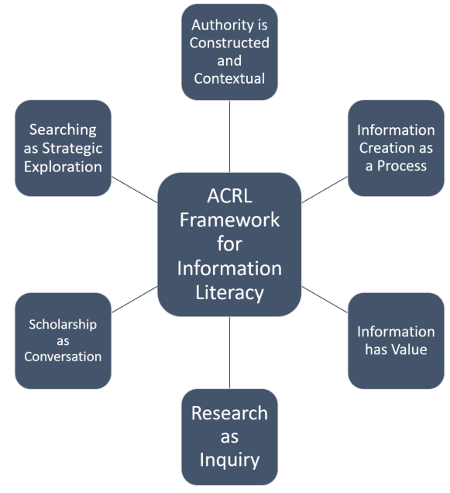
Motivation for the Research
Connect with STEM faculty and students on their own terms.
Gain a greater understanding of the role research skills play in the scientific method.
Better define the role of the ACRL Framework for Information Literacy in Higher Education in STEM instruction and research.

Slide 3
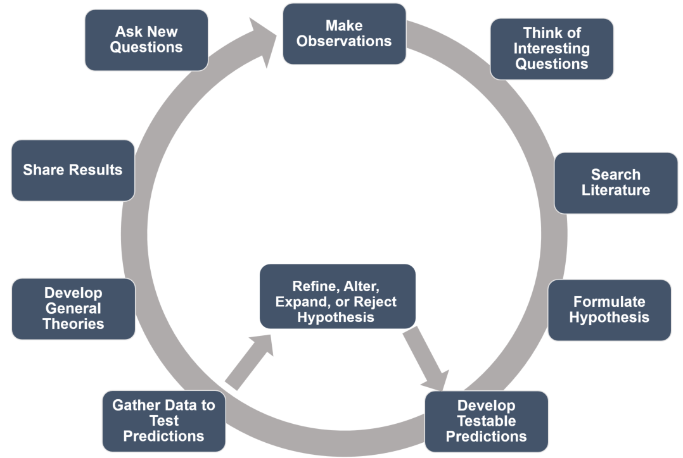
Premise of the Project
Goal: Create a framework to communicate with STEM researchers

Slide 4
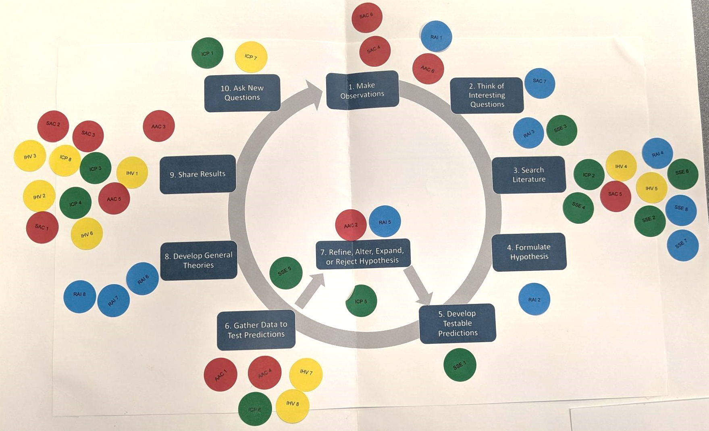
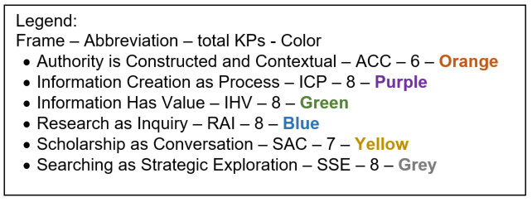
Methodology
Sticky dots – Represent each Knowledge Practice (number) in an ACRL Frame (color)
Each author mapped dots onto our Scientific Method diagram.
Dots were coded according to how we placed them on a map.
Authors’ maps – Combined to a single map. Each Knowledge Practice was given a score based on authors’ agreement.

Slide 5
Author Agreement Scoring
Frame | # of KPs | 0 | 1.5 | 2 | 2.5 | 3 | % of Agreement
Authority is Constructed and Contextual | 6 | 4 | 1 | 1 | 0 | 0 | 19.44
Information Creation as Process | 8 | 5 | 0 | 2 | 0 | 1 | 29.16
Information Has Value | 8 | 1 | 1 | 1 | 0 | 5 | 77.08
Research as Inquiry | 8 | 0 | 1 | 4 | 1 | 2 | 75
Scholarship as Conversation | 7 | 1 | 0 | 3 | 0 | 3 | 71.42
Searching as Strategic Exploration | 8 | 2 | 2 | 3 | 1 | 0 | 47.91
By ACRL Frame
Step | 0.5 | 1 | 1.5 | 2 | 2.5 | 3 | Total | % of Agreement
Make Observations | 2 | 5 | 0 | 1 | 0 | 0 | 8 | 25.00
Think of Interesting Questions | 2 | 5 | 2 | 1 | 0 | 0 | 11 | 45.45
Search Literature | 3 | 10 | 3 | 4 | 0 | 2 | 30 | 61.67
Formulate Hypothesis | 1 | 2 | 1 | 1 | 0 | 0 | 6 | 58.33
Develop Testable Predictions | 2 | 2 | 1 | 0 | 0 | 0 | 4.5 | 33.33
Gather Data to Test Predictions | 2 | 12 | 0 | 1 | 0 | 0 | 15 | 13.33
Refine, Alter, Expand or Reject Hypothesis | 2 | 6 | 0 | 0 | 1 | 1 | 12.5 | 44.00
Develop General Theories | 1 | 2 | 0 | 2 | 0 | 1 | 9.5 | 73.68
Share Results | 2 | 5 | 0 | 3 | 0 | 6 | 30 | 80.00
Ask New Questions | 1 | 4 | 0 | 1 | 0 | 1 | 9.5 | 52.63
By Scientific Method Step

Slide 6
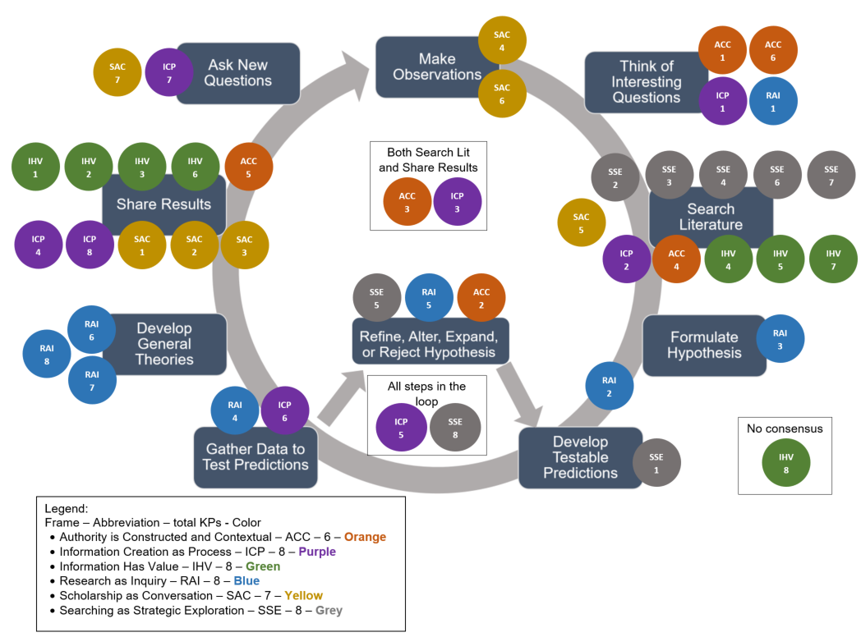
Our Map

Slide 7
Our Map

Slide 8
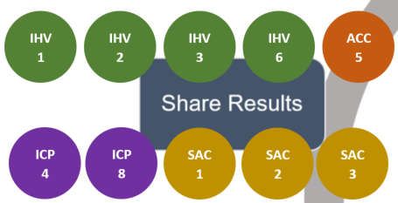
Example 1: High Author Agreement
Some KPs naturally have logical placement in the scientific method
Share Results – Aligns with Scholarship as Conversation (YELLOW); Information Creation as a Process (PURPLE); and Information Has Value (GREEN)

Slide 9
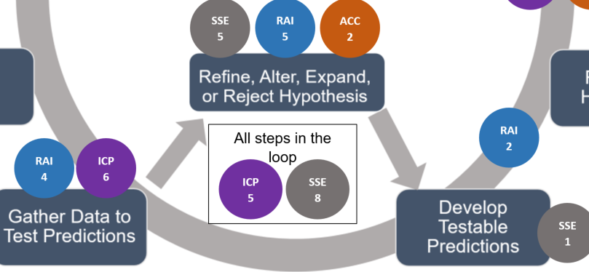
Example 2: Placement between Steps
Both dots had an initial score of 0
Agreement reached after discussion
Knowledge Practices that can be revisited at each step of this loop

Slide 10
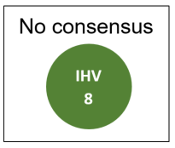
Example 3: No Author Agreement
Each author read into the KP differently:
Author A – protecting intellectual property, predatory publishing, etc.
Author B – confirmation bias and targeted search results
Author C – relevant and important, but didn’t fit well with the Scientific Method model

Slide 11
“Soft” Benefits of the Process
Discussion – On points of agreement and disagreement; led to identifying areas of further conversations.
Introspection – What do participants’ background knowledge (STEM or otherwise) “bring to the table?” – Why do we think the way we do?
Exploration – On teaching strategies and communicating with STEM researchers. How do students perceive these concepts? How do faculty perceive them?

Slide 12
Next Steps
Validate our map with librarians and STEM researchers
Use our model to identify strengths of our library instruction programs in the curriculum of Colorado School of Mines
Collaborate with our faculty to address areas for growth and integrate research skills into the scientific process
Develop micro-lessons and materials for faculty and librarians to teach research skills throughout the scientific method process
Notes:
.

Slide 13
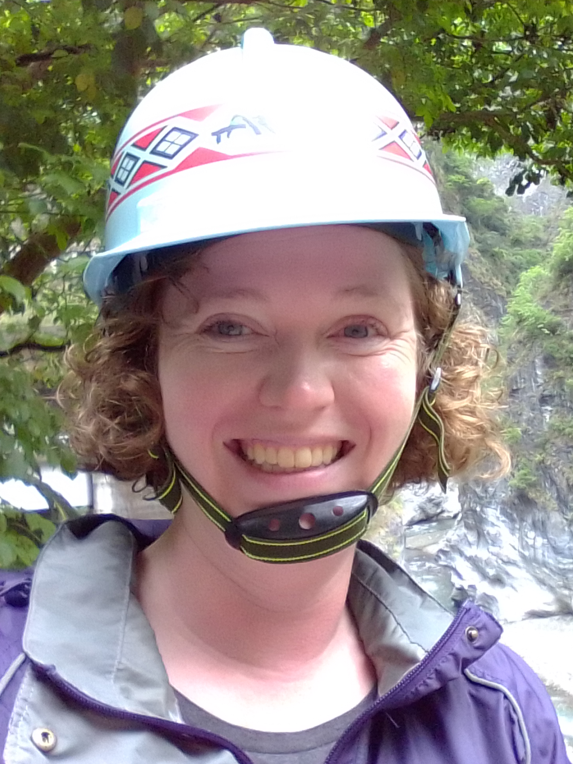
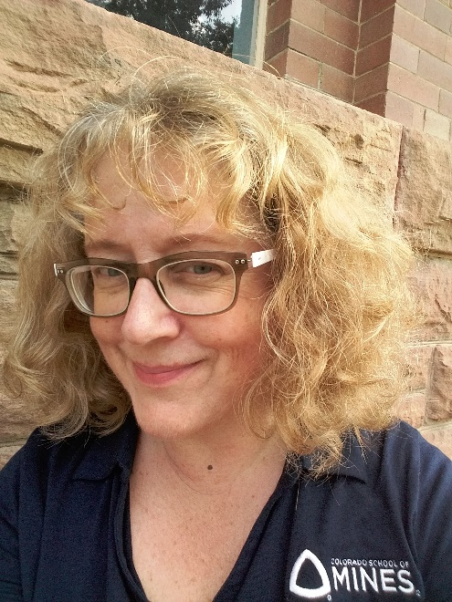
Thank you!
BRIANNA BULJUNG
Teaching and Learning Librarian
Colorado School of Mines
bbuljung@mines.edu
SETH VULETICH
Scholarly Communications Librarian
Colorado School of Mines
sethvuletich@mines.edu
LISA DUNN
STEM Research Librarian
Colorado School of Mines
ldunn@mines.edu

