Slide 1
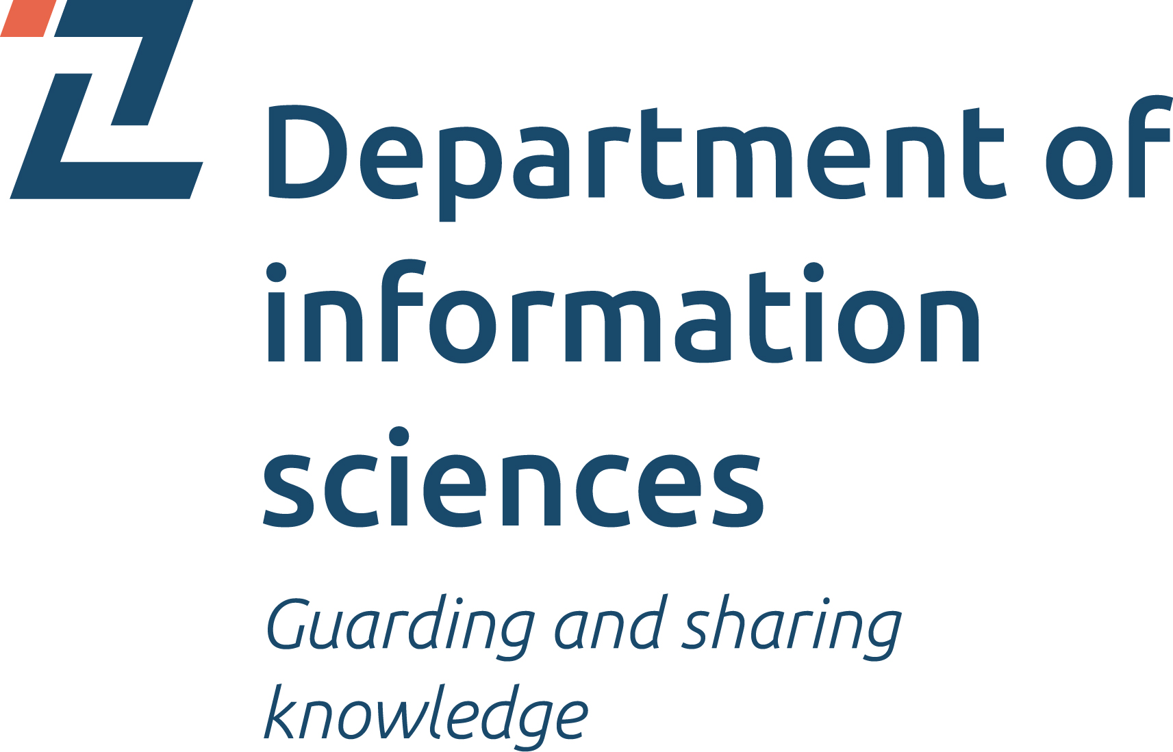
Trust in nutrition information sources used by university students
Nikolina Peša Pavlović, PhD
Mate Juric, Assistant professor
Alica Kolarić, Assistant professor
University of Zadar, Department of Information Sciences
Libraries in the digital age (LIDA) 2023, Osijek, Croatia, 24th - 26th May 2023

Slide 2
Content
Introduction
Theoretical framework
Literature review
Methodology
Results
Conclusion

Slide 3
Introduction
Accurate and appropriate information
Accurate and appropriate information helps (young people) to manage their health
University students’ independent living leads to decline in their dietary quality (Lončarić et al., 2017)
Nutrition is the most popular topic when searching for health-related information among young people (Martinović et al., 2021)
Lack of studies on the nutrition needs of young people and their trust in credible information sources
Notes:
Numerous studies have examined information needs and trust in various sources, but there is a lack of research specifically investigating the nutrition needs of young people and their trust in credible information sources.

Slide 4
Research aim
University students; nutrition information sources; use and trust
Specific nutrition needs of students
Nutrition information sources
use
Nutrition information sources
trust
Notes:
This research aims to establish if university students have specific nutrition needs and what nutrition information sources they use and trust.

Slide 5
Cognitive authority
Influences the way of thinking; related to individual’s needs and context
Source of information that a person accepts as trustworthy and allows this source to influence one's thinking
"Second-Hand Knowledge: An Inquiry into Cognitive Authority (Wilson, 1983)

Slide 6
Theoretical framework
Cognitive authority and Trust
Cognitive authority is “the extent to which users think they can trust the information” (Rieh, 2002)
Cognitive authority refers to the believability of individual sources in specific situations
how individuals perceive and recognize sources as competent and trustworthy (Savolainen, 2007; 2008)
Notes:
This theoretical framework can be applied to investigating trust in information sources, relying specifically upon the work of Soo Young Rieh
Rieh's Model of Judgment of Information Quality and Cognitive Authority has six facets: trustworthiness, reliability, scholarliness, credibility, officialness
and authoritativeness (Rieh, 2002).

Slide 7
Literature review
Youth information needs in health context
Health-related needs are primary needs of individuals and different user groups in different environments and contexts
Youth information needs in health context:
weight management and nutrition (Askola et al., 2010)
fitness and exercise; nutrition (Wartella et al., 2016)
nutrition and exercise (Känsäkoski et al., 2021)
nutrition (Martinović et al., 2021)
Notes:
According to previous literature, youth information needs in health contexts are directed to:

Slide 8
Literature review
Use and trust of nutrition information sources
Youth often seek health information online (Gazibara et al., 2022; Wang et al., 2022; Jia, Pang, and Liu, 2021)
Youth trust different sources:
nutritionists, dietitians, doctors, nurses, parents, and friends (Šmuljić et al., 2019; Askola et al., 2010; Kim, 2016; Känsäkoski et al., 2021; Martinović et al., 2021)

Slide 9
Methodology
Goals and research questions
The main goals: to examine the use and trust of the primary sources of nutrition information used by young adults
RQ1: Do students have specific nutrition needs, and what are they?
RQ2: Which information sources do students use for nutrition information?
RQ3: How much do students trust in the accuracy of information from each source?
RQ4: Does the use and trust in information sources depend on specific nutrition needs?

Slide 10
Methodology
QUAL + QUAN
Short pre-survey
QUAL (Phase 1)
QUAN (phase 2)
to reach potential respondents
for the Phase 1
Semi-structured interviews (N=6); think-aloud techniques
Survey (N=138),
26 items about:
nutrition needs
sources use
trust in sources
Mixed-method exploratory sequential research design
Notes:
The qualitative results, with the addition of the literature review, were used foR identifying themes that require further study. Based on this, variables for the quantitative phase were developed.
Interview quest.:
What is your main reason for taking care of your nutrition?
Where or from whom do you seek ideas, advice, and information?
Do you trust that the ideas, advice, and information you are getting from the source is accurate?
What makes you think so?
Coding resulted in 34 categories that were interpreted and rearranged into four themes.

Slide 11
Research samples
Interviews | Survey
Students (N=6) from the Department of information sciences, University of Zadar Purposive sampling, to gain rich insights their educational background -> awareness of the processes underlying the trust judgments | N= 138 Students from the University of Zadar Convenience and purposive sampling voluntary participation, included students interested in the topic and students actively using social networks (SNs) - dissemination via SNs
Notes:
Saturation at N=6 was determined in relation to earlier interviews and the reviewed earlier studies

Slide 12
Results
RQ1: Do students have specific nutrition needs, and what are they?
Qual (N=6): | Quant (N=138):
Reasons for managing their diet: health physical appearance feeling better having more energy | 17% - diet related to health problems (N=23), such as allergies, thyroid disorders, gastritis , anemia 26% - diet related to weight control and training (combined N=36; specifically 29 training and 22 weight management) 57% - no special nutrition needs (N=79) The percentages represent only this convenience sample

Slide 13
RQ2: Which information sources do students use for nutrition information?
Qual (N=6): | Quant (N=138):
Internet based sources: Social media (Instagram, Facebook, Youtube) Websites and Google Traditional information sources: Books, magazines Nutrition fact labels, Apps (Food labels, calorie intake) Interpersonal information sources (mother, friends, people around me) | Internet portals, media, search engines (M=3.6) Family and friends (M=3.2) Professional literature (M=2.9) Advice from doctors and other experts (M=2.9)
Notes:
QUAL: From mostly used to less used
QUANT: The results from the survey show that students mainly use Internet portals, media, and search engines to access nutrition information (M = 3.6),
followed by family and friends (M = 3.2).
On average, the use of professional literature (M = 2.9) and advice from doctors and other experts are less frequent (M = 2.9; Figure 1).

Slide 14
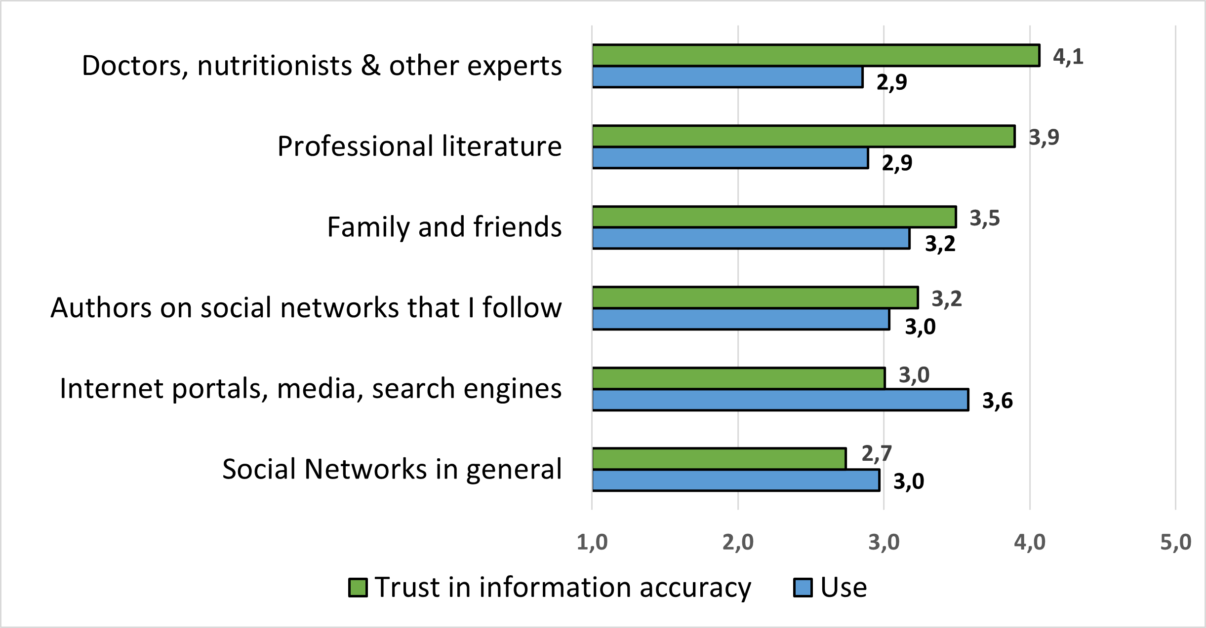
RQ3: Use of information sources and trust in the accuracy of information from those sources
Quant, N=138
Notes:
Use of information sources and trust in the accuracy of information from those source
Experts (M=4.1)
Literature (M=3.9)
Family and friends (M=3.5)

Slide 15
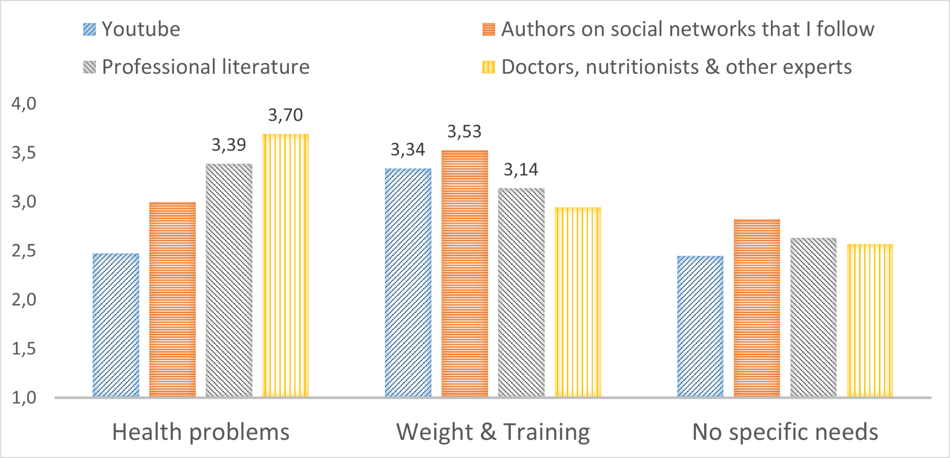
Differences in information use between three nutrition needs groups of students
3 nutrition needs groups of students
Notes:
Students with health problems are more likely to follow the advice of doctors and experts (M=3.70), followed by professional literature (M=3.39)
Students on a diet to maintain weight and/or practice sports use advices from authors on SN (M=3.53) more often and follow specific authors on social networks (M=3.53), and professional lit. (M=3.14)
Only statistically significant differences are hihlighted

Slide 16
Trust in the accuracy of information from various sources among among three nutrition needs groups of students
 | Health problems | Weight & Training | No specific needs | F | p
Authors on social networks that I follow | 2,87 | 3,64 | 3,15 | 5,10 | 0,007
Youtube | 2,67 | 3,53 | 2,90 | 7,29 | 0,001
Students on a diet to maintain weight and/or practice sports give more trust to specific authors on social networks, and Youtube
All students have a similar level of trust in doctors and other experts, professional literature, and various other sources
Students who use information from social networks have more trust in those sources, and vice versa (r=0.67)
Notes:
Regarding trust in the accuracy of information from various sources between 3 groups, the results show similar level of trust in: doctors and experts, professional literature and other sources
Here we can see 2 exceptions:
Among students on a diet to maintain weight and/or practice sports,
the level of trust in specific authors on social networks (M = 3.64) and the level of trust in YouTube (M = 3.53) as a source of information are higher than in the other two groups of students
Students who use information from SN have more trust in those sources, and vice versa, which is reflected in the significant correlation coefficient of 0.67

Slide 17
Conclusion
Trust in nutrition information sources used by university students
Internet in general (portals, media, search engines) is the most frequently used information source on nutrition, followed by family and friends
Trust in the Internet and social media, in general, is relatively low.
However,
specific authors on social media are perceived as trustworthy
students' cognitive authority of each information source is constructed based on various indicators of trustworthiness (qual insights)
students with health problems rely more on professional sources of nutrition information: experts and the professional literature
students engaged in sports and weight maintenance primarily follow social media, especially specific authors on YouTube and Instagram
Information sources can be trusted but not used, and vice versa

Slide 18
References
Askola, K., Atsushi, T., & Huotari, M. L. (2010). Cultural differences in the health information environments and practices between Finnish and Japanese university students. Information Research: An International Electronic Journal, 15(4), n4. https://files.eric.ed.gov/fulltext/EJ912766.pdf
Case, D. O., & Given, L. M. (2016). Looking for information: A survey of research on information seeking, needs, and behavior.
Corritore, C. L., Wiedenbeck, S., Kracher, B., & Marble, R. P. (2012). Online trust and health information websites. International Journal of Technology and Human Interaction (IJTHI), 8(4), 92-115. https://doi.org/10.4018/jthi.2012100106
Jia, X., Pang, Y., & Liu, L. S. (2021). Online health information seeking behavior: a systematic review. Healthcare, 9(12), 1740.
Gazibara, T., Cakic, M., Cakic, J., Grgurevic, A., & Pekmezovic, T. (2022). Familiarity with the internet and health apps, and specific topic needs are amongst the factors that influence how online health information is used for health decisions amongst adolescents. Health Information & Libraries Journal. https://doi.org/10.1111/hir.12440
Känsäkoski Helena, Noora Hirvonen, Laura Palmgren-Neuvonen, Tuula Nygård, and Maija-Leena Huotari. 2021. Finnish Adolescents’ Selection and Assessment of Health Information Sources. Information Research: An International Electronic Journal, 26 , no. 1. https://doi.org/10.47989/irpaper893.
Kim, S. U., & Syn, S. Y. (2016). Credibility and usefulness of health information on Facebook: a survey study with US college students. Information Research: An International Electronic Journal, 21(4), no. 4. https://eric.ed.gov/?id=EJ1123245
Lončarić, R., Jelić, S., & Tolušić, Z. (2017). Utjecaj sociodemografskih obilježja na percepcije studenata o zdravlju i prehrani. Agroeconomia Croatica, 7(1), 35-45. https://hrcak.srce.hr/190538
Martinović, I., Kim, S. U., & Stanarević Katavić, S. (2021). Study of health information needs among adolescents in Croatia shows distinct gender differences in information-seeking behaviour. Health Information & Libraries Journal. https://doi.org/10.1111/hir.12369

Slide 19
References
Rieh, S. Y. (2002). Judgment of information quality and cognitive authority in the Web. Journal of the American Society for Information Science and Technology, 53(2), 145–161. https://doi.org/10.1002/asi.10017
Rowley, J., Johnson, F., & Sbaffi, L. (2015). Students’ trust judgements in online health information seeking. Health informatics journal, 21(4), 316-327. https://doi.org/10.1177/1460458214546772
Savolainen, R. (2007). Media credibility and cognitive authority. The case of seeking orienting information. Information Research: An International Electronic Journal, 12(3), no 3. https://eric.ed.gov/?id=EJ1104802
Savolainen, R. (2008). Everyday information practices: A social phenomenological perspective. Scarecrow Press.
Šmuljić, Z., Mišigoj Duraković, M., & Šatalić, Z. (2019). Unos dodataka prehrani kod mladih vrhunskih sportaša: košarka, nogomet i vaterpolo. Hrvatski športskomedicinski vjesnik, 34(2), 79-89. https://hrcak.srce.hr/270488
Wang, Y., Wang, J., & Shen, Q. (2022). A Consumer Segmentation Study of Nutrition Information Seeking and Its Relation to Food Consumption in Beijing, China. Foods, 11(3), 453. https://doi.org/10.3390/foods11030453
Wartella, E., Rideout, V., Montague, H., Beaudoin-Ryan, L., & Lauricella, A. (2016). Teens, Health and Technology: A National Survey. Media and Communication, 4(3), 13. https://doi.org/10.17645/mac.v4i3.515
Wilson, P. (1983). Second-hand knowledge: an inquiry into cognitive authority. Greenwood Press.
Worsley, A. (2003). Consumers’ personal values and sources of nutrition information. Ecology of Food and Nutrition, 42(2), 129–151. https://doi.org/10.1080/036702403902-2255

Slide 20
Thank you!

Slide 21
Appendices

Slide 22
Trusted information sources and the bases of trust
Qual
N=6
Expert
Evident results
Instagram influencer
Impartial
Popular
Websites, Youtube videos
Well-organised
Motivating
Professional
Traditional information sources
Trust in library institution
Traditional publishing process
Interpersonal information sources
Experienced
Reliable
In a close relationship
Trusted sources and bases of trust
Well-intentioned
Notes:
Most important bases of trust: 1. Expert, 2. Evident results, Impartiality
The results show that cognitive authority and expertise is the important for participants, and forms a bases of trust

Slide 23
Theoretical framework
Cognitive authority
The social and cognitive aspects of authority in the context of information sources
(Wilson, 1983)
Cognitive authority
= Influences the way of thinking; related to individual’s needs and context
Trust
Trustworthiness
Credibility
Competence
Ability to provide accurate and reliable information
Perceived integrity, honesty, and dependability of the source
The extent to which source is seen as believable and convincing
Expertise in a particular domain
Notes:
"Second-Hand Knowledge: An Inquiry into Cognitive Authority wilson explores the social and cognitive aspects of authority in the context of information sources
Cognitive authority is a complex and dynamic process influenced by various factors, including trust, trustworthiness, credibility, and competence.
They are connected and essential for establishing authority in the cognitive domain.
Building trust, demonstrating trustworthiness, maintaining credibility,
and showcasing competence are all vital elements in becoming a reliable and authoritative source of information.

Slide 24
Differences in information use between three nutrition needs groups of students
ANOVA, N=138 | Health problems | Weight & Training | No specific needs | F | p
Internet portals, media, search engines | 3.78 | 3.81 | 3.42 | 2.05 | 0.133
Family and friends | 3.17 | 2.94 | 3.28 | 1.60 | 0.197
Social Networks in general | 2.77 | 3.22 | 2.91 | 1.39 | 0.252
Authors on social networks that I follow | 3.00 | 3.53 | 2.82 | 3.51 | 0.033
Professional literature | 3.39 | 3.14 | 2.63 | 6.26 | 0.003
Doctors. nutritionists & other experts | 3.70 | 2.94 | 2.57 | 10.49 | 0.000
Youtube | 2.48 | 3.34 | 2.45 | 7.64 | 0.001
Instagram | 2.52 | 3.00 | 2.42 | 2.15 | 0.121
Facebook | 1.81 | 2.13 | 2.04 | 0.61 | 0.546
TikTok | 1.20 | 1.50 | 1.36 | 0.85 | 0.431
Notes:
RQ4: Does the use and trust in information sources depend on specific nutrition needs?
3 nutrition needs groups use approximately equally often use internet portals,
media and search engines, as well as interpersonal sources.
Details can be seen on the next slide

Slide 25
Discussion
Trust in nutrition information sources used by university students
Specific nutrition needs
Students take care of their nutrition to maintain overall health (QUAL)
57% of students do not have specific nutrition needs (QUANT)
43% Need specific nutrition information, and use it
Information-seeking activity has been motivated by their nutrition information needs (Case, 2016)
Use of nutrition information
Students use mainly internet-based sources (social media, internet - in general, Google search and websites, interpersonal and traditional information sources) (QUAL)
The survey results have found that students mainly use internet portals, media, and search engines to access nutrition information (M = 3.6) and family and friends (M = 3.2). This is in line with the results of previous research (Lončarić et al., 2017; Askola et al., 2010; Worsley, 2003)
Notes:
The first research question examined if students had specific nutrition needs and what their specific nutrition needs were.
The results of the interviews show that the participants take care of their nutrition to maintain their overall health, which includes a healthy lifestyle, body fitness, and physical appearance.
The second research question examined which information sources do students use for nutrition information

Slide 26
Discussion
Trust in nutrition information sources used by university students
Students’ trust in the accuracy of information from each source
The interview results revealed the bases of authority (Wilson, 1983); reasons the respondents think the sources are worthy of trust: expertise (Corritore et al., 2007; Šmuljić et al., 2019; Känsäkoski, 2021), evident results, impartiality (Rowley et al., 2015).
The survey results show that students are aware of the untrustworthiness of the online information sources they use
Trust in experts (doctors, nutritionists); (Šmuljić et al., 2019; Askola et al., 2010; Worsley, 2003; Kim, 2016), following the trust in family and friends (Känsäkoski et al., 2021; Askola et al., 2010; Worsley, 2003).
Use and trust dependance on specific nutrition need
Students with specific nutritional needs more often use certain information sources (YouTube, authors on SN (Gazibara et al., 2022)
Similar level of trust: doctors and professionals (Kim, 2016)
Notes:
The third research question examined how much do students trust in the accuracy of information from each source.
In the second phase of the research, the survey investigated in depth the extent to which respondents trust certain sources of information.
Results indicate that the most trusted information is from experts (doctors, nutritionists, and other experts) (M = 4.1) and professional literature (M = 3.9).
This finding is consistent with some of the previous research suggesting that the most trusted sources are dietitians and doctors (Šmuljić et al., 2019; Askola et al., 2010; Worsley, 2003; Kim, 2016).
The following sources they trust the most regarding the accuracy of information are family and friends (M = 3.5). This finding is in line with previous studies (Känsäkoski et al., 2021; Askola et al., 2010; Worsley, 2003).
The results of the present study show medium levels of average trust in authors on social networks, internet portals, media, and search engines. Among those, the results reveal that the lowest was the average trust in social media in general.

Slide 27
Study limitations
Trust in nutrition information sources used by university students
No reliable gender comparisons - all participants in the first research phase were women; 82% in the second research phase
Larger sample needed to examine:
various aspects of information behaviour when searching for nutrition information need
possible differences between students engaged/or not in training and those only on weight control
New variables for future studies:
whether participants live with their parents
employment status

Slide 28
Conclusion
Trust in nutrition information sources used by university students
This study sought to explore university students' health information-seeking behaviours,
focusing on the trust they give to various information sources on nutrition
The aim was to reveal
the specific nutritional needs of students
the specific sources of information they use
how much they trust them
Wilson's conceptualisation of cognitive authority was used to frame the issues of students' trust in different information sources for the provision of nutrition-related information
Notes:
This study sought to explore university students' information-seeking behaviours, focusing on the trust they give to various information sources on nutrition.
The aim was to reveal the specific nutritional needs of students, the specific sources of information they use and how much they trust them.
Wilson's conceptualisation of cognitive authority was used to frame the issues of students' trust in different information sources for the provision of nutrition-related information.
The source that is one's cognitive authority is considered worthy of belief and influences one's thinking.

