Slide 1
Digital privacy and data protection knowledge and skills of Generation Z in Croatia
Snježana Stanarević Katavić, PhD, Assistant Professor
Hajdi Ivanović, mastef of informatology and information technology
Anita Papić, PhD, Associate Professor
Department of Information Sciences, Faculty of Humanities and Social Sciences Osijek

Slide 2
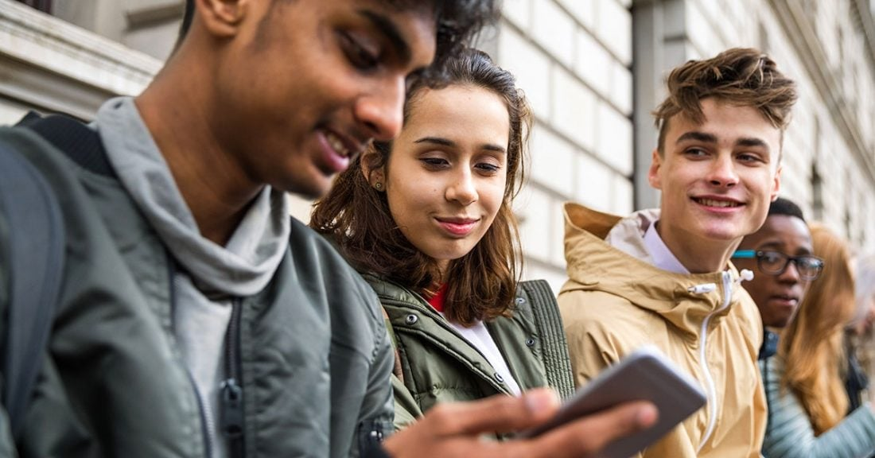
Generation Z (late 1990s - 2010)
The first generation of digital natives > rich experience in living the digital life
Use of the Internet and mobile devices is a central part of their everyday life
The growing number of Generation Z members are becoming a part of the consumer population > it is important to address the privacy issues that inevitably arise.

Slide 3
Scope of the study and its results
Research on the digital privacy of young people in Croatia has not been conducted so far.
We wanted to get preliminary insights into this topic in the Croatian context on a sample of university students as members of Generation Z.
Therefore, research results are not representative for the whole Generation Z in Croatia.

Slide 4
Research objective and research questions
The goal the study was to gain insights into the attitudes and behaviors of university students, as members of Croatian Generation Z, related to digital privacy protection.
Four research question guided the study.

Slide 5
Methodology
A survey method using an online questionnaire.
The convenience sampling method > the survey was conducted at the Faculty of Humanities and Social Sciences in Osijek in several study groups in all years of study
149 respondents took part in the research, of which 112 were female (75.2%) and 37 (24.8%) were male.

Slide 6
RQ 1: To what extent and in what ways are respondents informed about digital privacy protection?

Slide 7
How did you learn about digital privacy?
Searchin the Internet. | 68.5%
At school | 63.8%
Through the media | 57.7%
At university | 30.9%
From family members | 28.9%
From friends | 26.8%
Results suggest a considerable level of awareness and self-initiative regarding the topic of our interest and raise the question what prompted almost 70% of students to research this topic on their own.

Slide 8
Users’ level of knowledge about various aspects of digital privacy
Seven statements regarding digital privacy were included in the questionnaire and respondents were asked to mark True, False, or I don’t know.
EXAMPLES:
It is recommended to block all cookies on websites.
Incognito mode allows complete anonymity while browsing (i.e., hiding the IP address and online activity).
You can request that links to websites that contain your name are removed from Google search results if the information is inaccurate, inappropriate, irrelevant, or excessive.
Notes:
It is recommended to block all cookies on websites.
While you are on a website, other websites can track your activity on the visited website for marketing purposes.
Incognito mode allows complete anonymity while browsing (i.e., hiding the IP address and online activity).
You can request that links to websites that contain your name are removed from Google search results if the information is inaccurate, inappropriate, irrelevant, or excessive.
User data collected by social networks (e.g., Facebook) is deleted after five years.
The General Data Protection Regulation was voted in the USA.
If you do not wish to have a social network profile anymore and you decide to deactivate it, you can request that your personal data be deleted.

Slide 9
Users’ level of knowledge about various aspects of digital privacy
On average 49.2% answered that they did not know if the statements were true or not.
An average of 40% of respondents knew the correct answers
Only two statements were correctly marked by more than a 50% of respondents
Other websites can track activity on the visited website for marketing purposes - true
Incognito mode allows complete anonymity while browsing – false.
Knowledge in the field of digital privacy among our sample is not comprehensive and uniform and that there is room for improving it.

Slide 10
RQ2: What are the respondents habits and practices related to protection of digital privacy?

Slide 11
How do you protect your data and privacy on the Internet?
A multiple choice question
14 strategies offered

Slide 12
50% of offered protective strategies are used by less than 50% od respondents
HIGHLIGHTS
When using public wireless networks (e.g., in a coffee shop), I do not send or receive sensitive data, but use my data traffic for that. | 44.3%
I use the cloud (e.g., Google Drive or Dropbox) to store important and sensitive data. | 42.3%
In addition to my private e-mail address, I also have a separate e-mail address for subscribing to various newsletters, registering for websites, or shopping online. | 39.6%
Do users do not know about these measures or they do not care?

Slide 13
RQ3: How do members of Generation Z protect their privacy on social networks?

Slide 14
Key findings related to social networks
88.6% of users use 3 or more social networks
About a quarter of respondents did not adjust the basic settings for the visibility of information about themselves on social networks.
Only half of the respondents (51.7%) report being familiar with the privacy settings on all the social networks they use.

Slide 15
RQ4: What are the experiences and attitudes of members of Generation Z with regard to digital privacy violations?

Slide 16
Have you ever faced a violation of privacy online?
A relatively large share of the respondents (43,6%) have faced a violation of privacy.
I have never experienced a privacy violation on the Internet. | 56.4%
Yes, photos of me were published without my consent. | 24.4%
Yes, my profile has been hacked. | 22.1%
Yes, someone created a fake profile of me on some social networks. | 10.1%
Yes, the video in which I appear was published without my consent. | 8.1%
Yes, my personal data has been misused. | 6.7%

Slide 17
Would you like to be further educated on the topic of digital privacy?
Yes 65.1%
No 18.8%
I don’t know 16.1%
Notes:
Respondents were most concerned about the posting of information about their locations and activities, and photos and videos in which they appear without their consent.
Respondents were to a less degree concerned about the collection of data about their locations for marketing purposes, and the least concerned about collection of data about their activities and searches that are used for marketing purposes.
This finding is in line with previous studies that show that members of Generation Z do not mind collection of data for various marketing purposes, and that in fact they find personalised ads helpful.

Slide 18
Concluding remarks
Several questions were answered, and multiple questions were raised.
Preliminary findings suggest a need for additional and more extensive study of digital privacy issues of Croatian Generation Z.

Slide 19
Thank you for you attention!
Questions?

