Slide 1
Data feminism in the wild: Case studies of indexing and thesaurus projects and their futurities
Hana Marcetic
University of Borås, Sweden
Rachel Pierce
KvinnSam, University of Gothenborg, Sweden

Slide 2
Background
which sociotechnical imaginaries drive data feminist critiques of data driven systems, where they align with and where they counter dominant imaginaries/narratives
Three cataloging projects:
  Homosaurus - LGBTQ+ thesaurus
  KVINNSAM - women’s history-oriented database
  QUEERLIT – thesaurus and database of LGBTQI literature

Slide 3
Data feminism
popularized in 2020’s with the book of the same name by D’Ignazio and Klein where it is defined as
“a way of thinking about data, both their uses and their limits, that is informed by direct experience, by commitment to action, and by intersectional feminist though”
(D’Ignazio & Klein, 2020, p. 2)
employs feminist theories and perspectives to challenge the understandings of data as objective, complete or omnipotent

Slide 4
Sociotechnical imaginaries
“collectively held and performed visions of desirable futures” (Jasanoff and Kim 2015, p. 11)
influence future goals and development of specific technological solutions
investigating how the contours of the possible are constructed within practical, on-the-ground data feminism

Slide 5
- close reading
- analysis of documents
Institution | KvinnSam | Queerlit |  | Homosaurus
Empirical material | Web pages Meeting and workshop notes Subject word list Organizational plan Book published on the history of KvinnSam, written by KvinnSam librarians |  | Web pages Project documentation Scholarly texts and articles PowerPoint presentations Blog posts Press releases | Web pages Subject word lists Blog posts Project documentation Published articles Press releases

Slide 6
Kvinnsam
became a university-wide research infrastructure in 2018
infrastructure development - indexing exists in tension with indexing infrastructures, read as neutral and often inevitable because of their national scope
will take over maintaining Queerlit
Queerlit
gathering, findability and searchability
topics of representation, visibility and bias - representativeness and awareness of issues with automatization of classification and subject indexing
datafication imaginaries - future of better representation through datafication is defined within the project as development of linked data and integration with existing systems alongside the creation of a separate, user-friendly interface
HOMOSAURUS
aims to fill the gaps of dominant classification schemes - improving lived experiences of LGBTQ+ people over reimagining the entire systems that favor privileged majorities

Slide 7
relationship between feminist scholarship and cataloging projects
three ways that feminist research affects cataloging practice: (1) via the literature itself, to which indexers react via material selection and subject word choices, (2) via funded research projects, where researchers and librarians exchange ideas about indexing, and (3) via publications on indexing work
Focus on applicability
problems with classifying a community that it is proud of its lack of fixicity

Slide 8
work to be done now vs work that must wait for the future
The ability to imagine and plan for the defined by financing
data as a tool that feminism can wield
  their production is worth prioritizing
  technologies are required to produce and curate data and make it accessible
corrective approaches

Slide 9
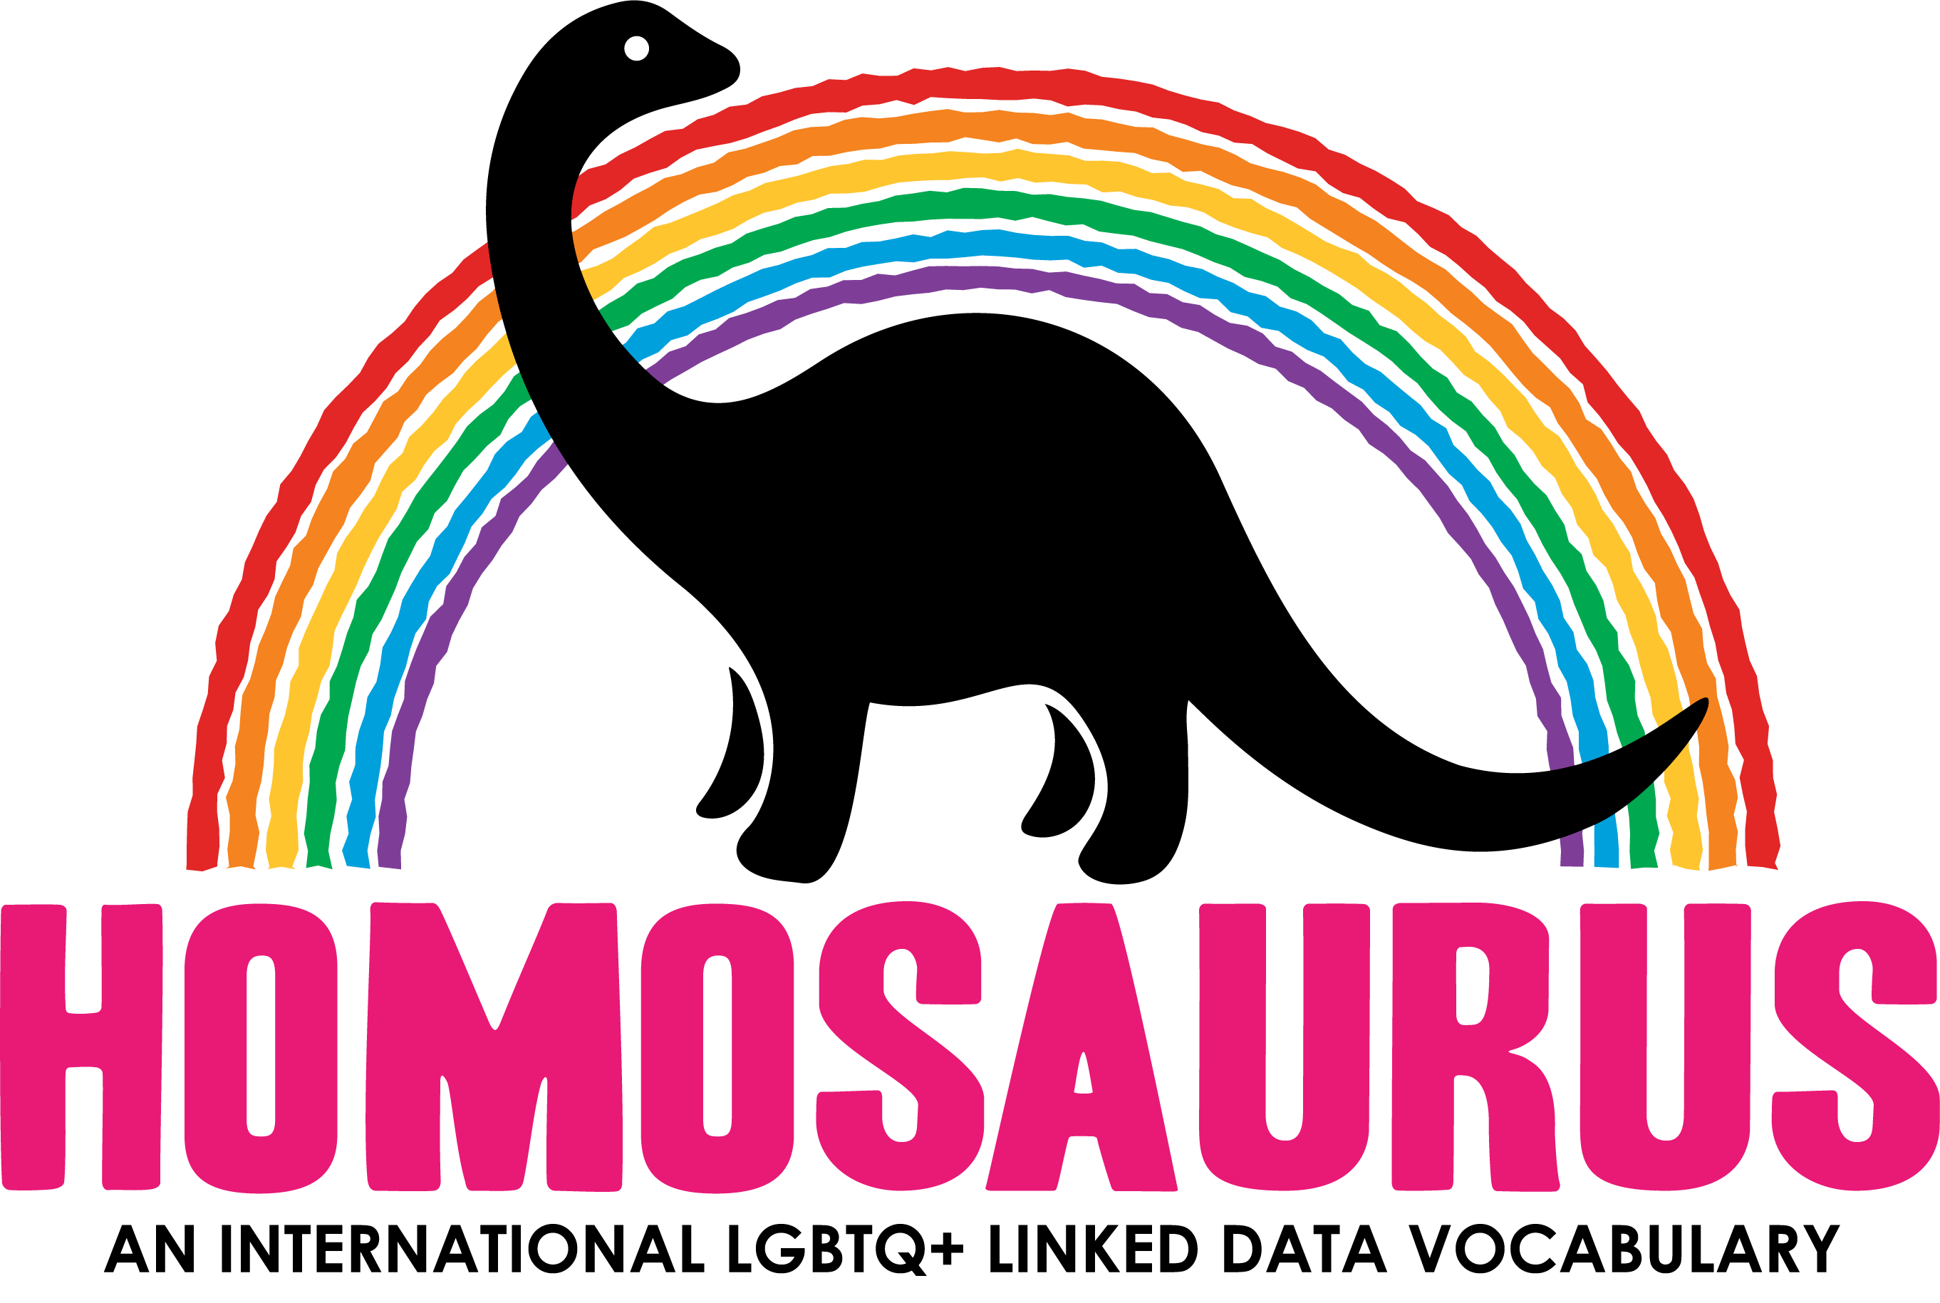
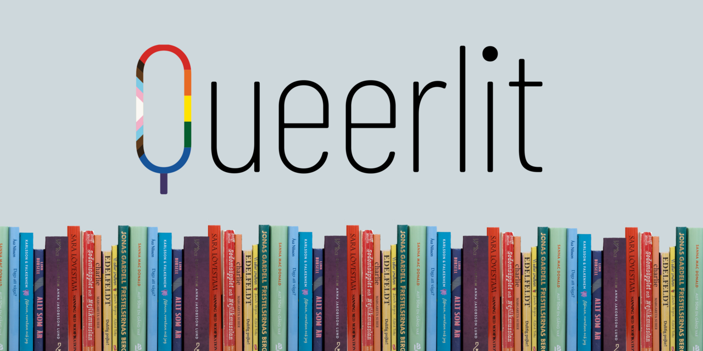
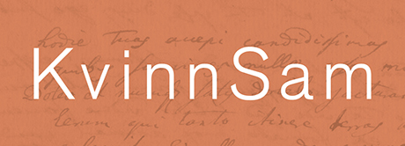
a balancing act between data feminist goals and securing resources for such projects
Two visible trends: (1) the way in which the pre-existing array of technologies, resources, and systems constrains or alters the prioritization and implementation of “utopian” suggestions prominent in scholarly literature, and (2) how “archivism” or get-it-done approaches that prioritize visibility meaning that more “utopian” goals run the risk of repeatedly being set aside in practice

Slide 10
Thank you for your attention!
References:
D’Ignazio, C., & Klein, L. F. (2020). Data Feminism. MIT Press.
Homosaurus Vocabulary Site. (n.d.). Retrieved May 17, 2023, from https://homosaurus.org/
KvinnSam—Nationellt bibliotek för genusforskning. (n.d.). Retrieved May 17, 2023, from http://www2.ub.gu.se/kvinn/
QueerlitQueerlit. (2022). Retrieved May 17, 2023, from https://queerlit.dh.gu.se/
Jasanoff, S., & Kim, S.-H. (Eds.). (2015). Dreamscapes of modernity: Sociotechnical imaginaries and the fabrication of power. The University of Chicago Press.

