Slide 1
The whiteness of European Library and Information Science
Fidelia Ibekwe
Aix Marseille Univ, CNRS, LPL, France
fidelia.ibekwe@univ-amu.fr
https://www.fideliaibekwe.info/
youtube.com/@fideliaibekwe

Slide 2
MOTIVATION
OUTLINE
RACISM in SSH
DEI in EUROPEAN LIS
TREE THAT HIDES THE FOREST

Slide 3
MOTIVATION
Since the racist murder of George Floyd in 2020, sales of books on racism increased by more than 6800% and remained very high at +2800% in 2022
Academic inquiry into race and racism also surged by more than 300%.
Racism continues to thrive because it is embedded in the cultures, structures and institutions of dominant societies and civilisations.
Higher Education and Research Institutions have an obligation to play an active part in the fight against extremist and supremacist ideologies.
A Critical Race Theoretic (CRT) paradigm has now emerged in LIS and intensified since 2020
HOWEVER, most of the research, initiatives and policies on anti-racism come from authors situated in North America, UK and Australia (Colon-Aguirre, 2022), (Inskip, 2022).
Silence from LIS in Continental Europe on racism, Diveristy, Racial Equity & Inclusivity

Slide 4
Diversity, Equity & Inclusivity (DEI): the tree that hides the forest
Putting DE&I at the forfront has served to shift the focus on individual experiences of discrimination and on demographic representatoon of marginalied others while avoiding addressing racism head on
“centering of DE&I as its core anti-racist strategy has inhibited a deep and meaningful treatment of racism as a structural phenomenon (…) as the dominant anti-racist modality within LIS, diversity has tended to coalesce around a number of core tenets and logics. The LIS diversity paradigm treats racism largely as a problem of monocultural homogeneity, identifying multicultural heterogeneity as its vision of racial justice and inclusion as its central anti-racist framework” - Hudson (2017)

Slide 5
QUANTITATIVE: PUBLICATIONS ON RACISM IN SOCIAL SCIENCES & HUMANITIES
A search for the word “racism” in all the fields of the 55 WoS subject categories in the social sciences and humanities
Timespan: 2018-01-01 to 2022-12-31
Results for ALL=(racism) and Education Educational Research or Public Environmental Occupational Health or Sociology or Ethnic Studies or Social Sciences Interdisciplinary or Political Science or History or Communication or Psychology Multidisciplinary or Religion or Social Work or Psychology Social or Psychiatry or Social Issues or Cultural Studies or Anthropology or Law or Family Studies or Geography or Philosophy or Literature or Psychology Applied or Education Scientific Disciplines or Hospitality Leisure Sport Tourism or Ethics or Urban Studies or Linguistics or Language Linguistics or International Relations or Environmental Studies or Environmental Sciences or Psychology Educational or Multidisciplinary Sciences or Information Science Library Science or Psychology Psychoanalysis or Psychology or Economics or History Philosophy Of Science or History Of Social Sciences or Development Studies or Literary Theory Criticism (Web of Science Categories).
Results: 12199 records

Slide 6
QUANTITATIVE: PUBLICATIONS ON RACISM IN SOCIAL SCIENCES & HUMANITIES
Year | Nb of publications | % of 12199
2022 | 2,227 | 18.256%
2021 | 3,451 | 28.289%
2020 | 2,721 | 22.305%
2019 | 2,116 | 17.346%
2018 | 1,684 | 13.804%

Slide 7
QUANTITATIVE: PUBLICATIONS ON RACISM IN SOCIAL SCIENCES & HUMANITIES

Slide 8
QUANTITATIVE: PUBLICATIONS ON RACISM IN SOCIAL SCIENCES & HUMANITIES
Top twenty affiliations in the publications on racism | Nb
UNIVERSITY OF CALIFORNIA SYSTEM | 632
UNIVERSITY OF NORTH CAROLINA | 292
UNIVERSITY OF LONDON | 277
CALIFORNIA STATE UNIVERSITY SYSTEM | 217
UNIVERSITY OF CALIFORNIA LOS ANGELES | 214
UNIVERSITY OF MICHIGAN SYSTEM | 201
UNIVERSITY OF MICHIGAN | 199
STATE UNIVERSITY SYSTEM OF FLORIDA | 194
UNIVERSITY SYSTEM OF MARYLAND | 192
UNIVERSITY SYSTEM OF GEORGIA | 184
PENNSYLVANIA COMMONWEALTH SYSTEM OF HIGHER EDUCATION PCSHE | 182
HARVARD UNIVERSITY | 181
UNIVERSITY OF TEXAS SYSTEM | 178
CITY UNIVERSITY OF NEW YORK CUNY SYSTEM | 171
UNIVERSITY OF ILLINOIS SYSTEM | 160
UNIVERSITY OF TORONTO | 153
NEW YORK UNIVERSITY | 145
UNIVERSITY OF NORTH CAROLINA CHAPEL HILL | 145
UNIVERSITY OF WISCONSIN SYSTEM | 139
COLUMBIA UNIVERSITY | 131

Slide 9
QUANTITATIVE: PUBLICATIONS ON RACISM IN SOCIAL SCIENCES & HUMANITIES

Slide 10
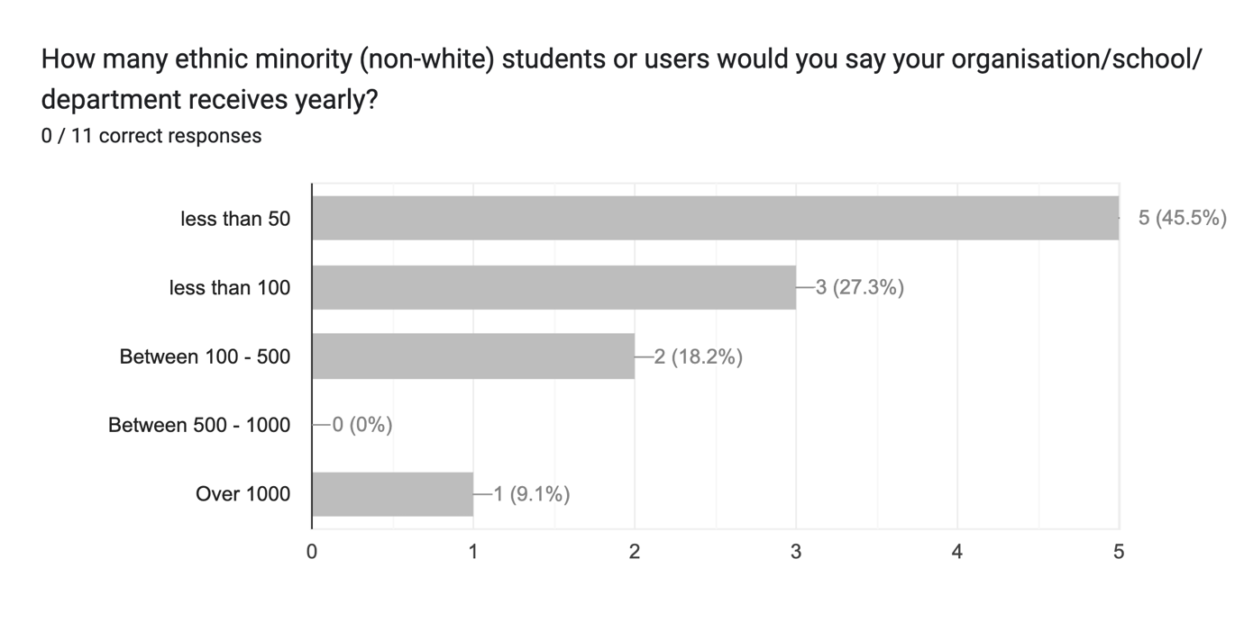
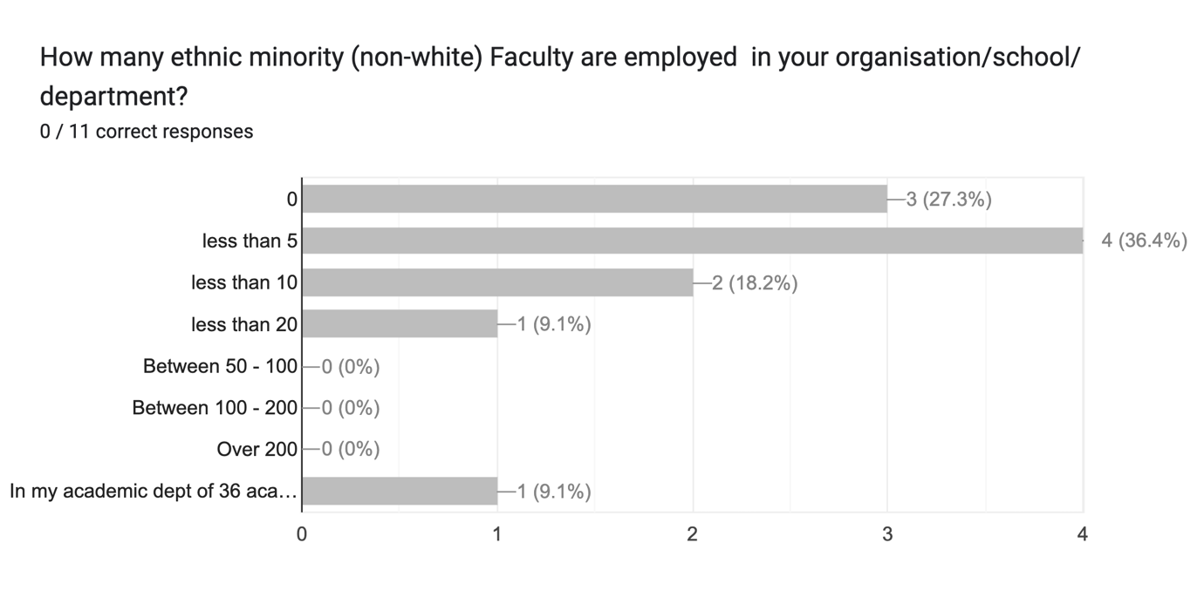
QUALITATIVE survey of DEI and anti-racism modules in European LIS institutions
“Lack of diversity and racism are linked” - Ball (2022)
A preliminary survey of LIS Faculty members from 13 EU countries (incl. the UK, Ireland)
13 responses (34% response rate), representing 9 out of the 13 countries

Slide 11
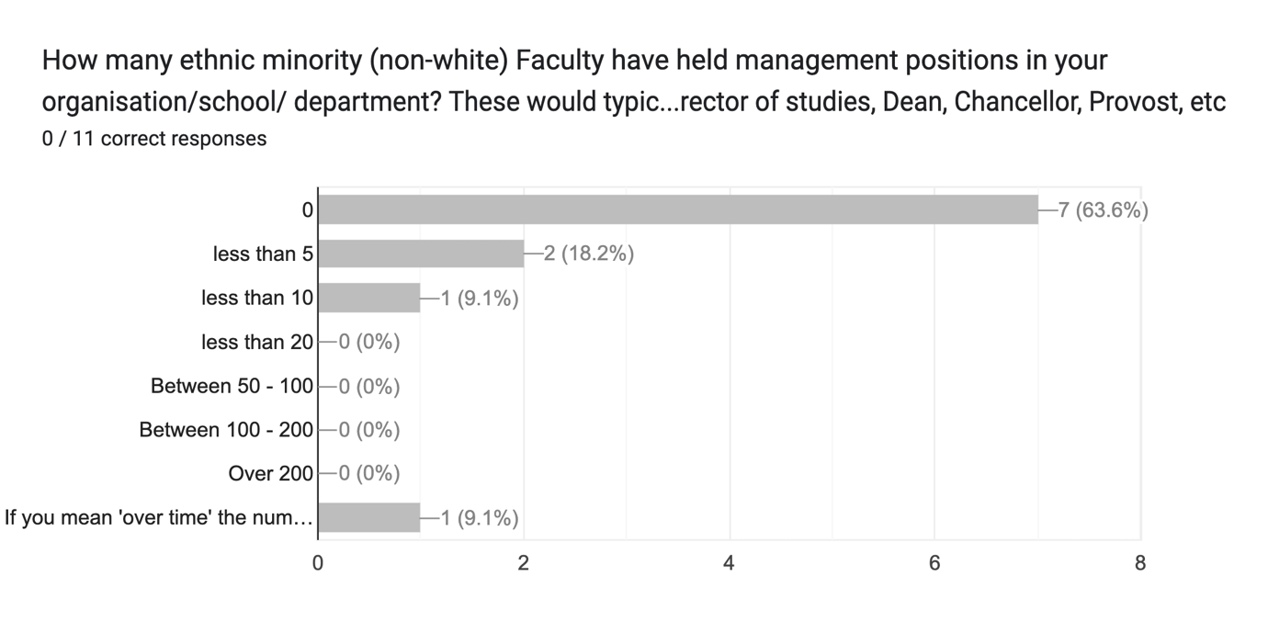
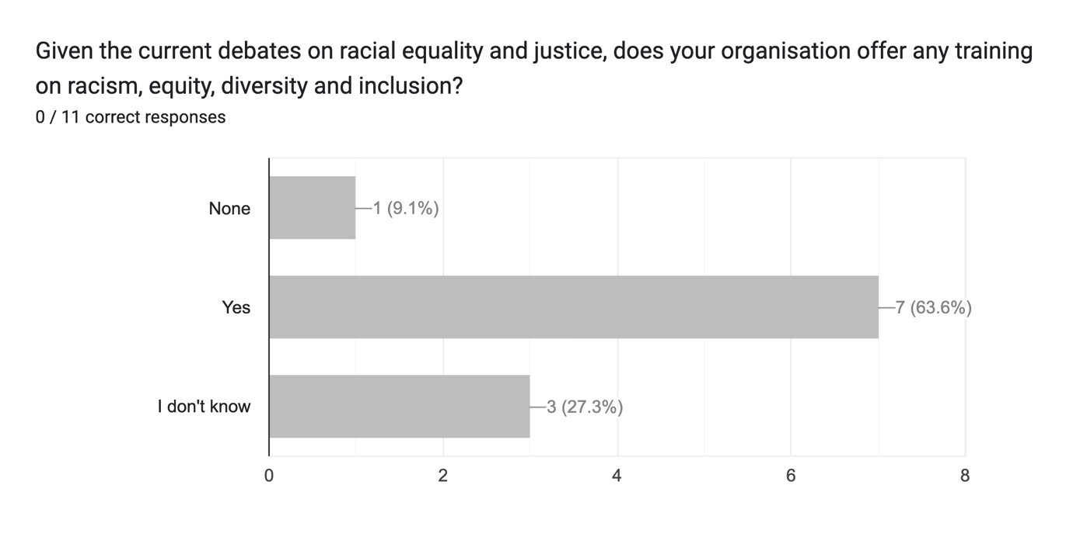
QUALITATIVE survey of DEI and anti-racism modules in European LIS institutions

Slide 12
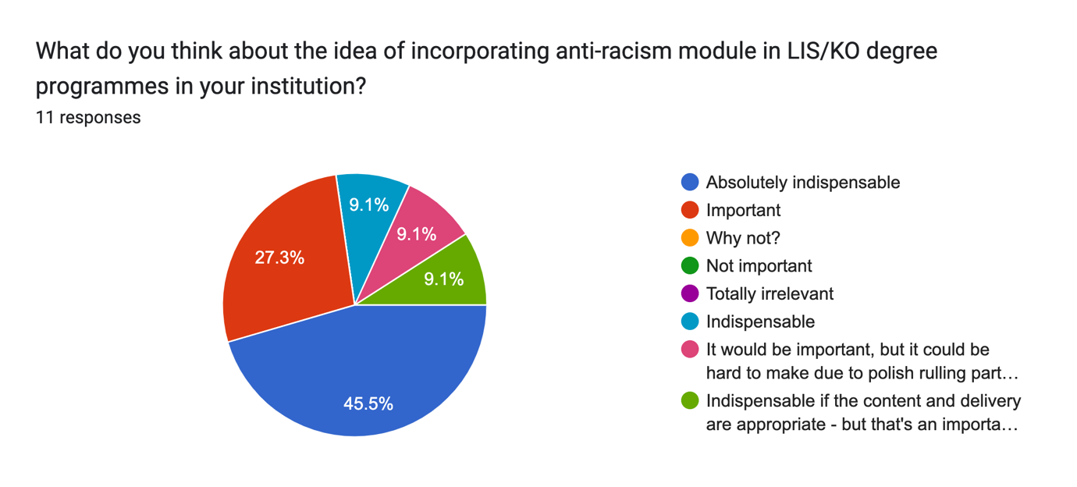
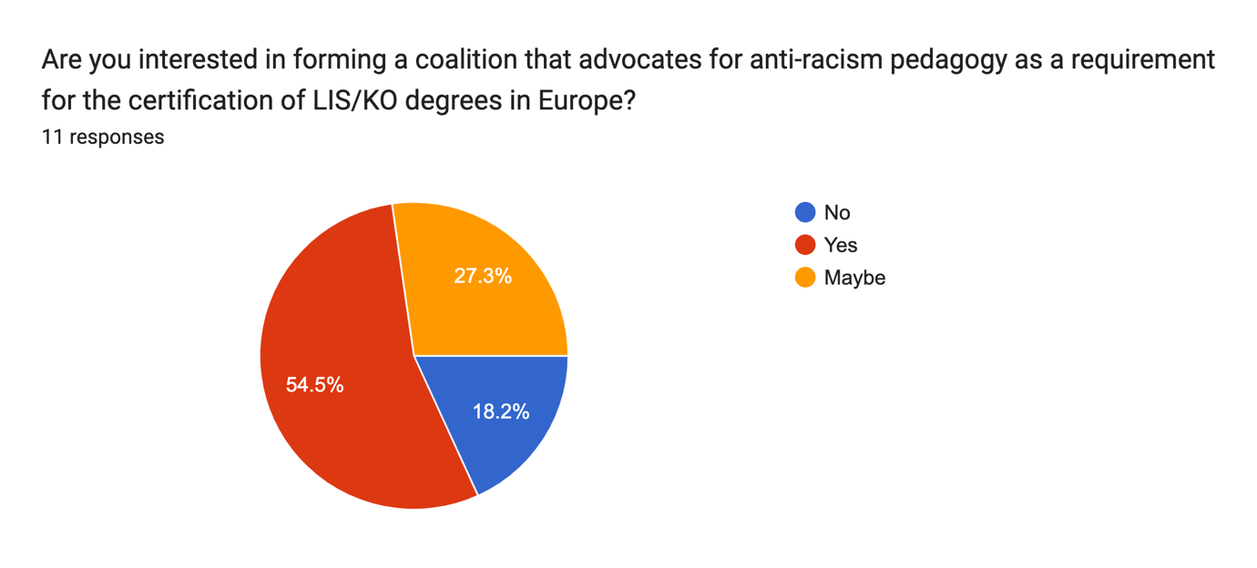
QUALITATIVE survey of DEI and anti-racism modules in European LIS institutions
Some initiatives being taken in some countries (esp. UK & Ireland) to integrate DEI into LIS curricula
BUT:
not enough clarity on the objective or content of the trainings,
the target audience not clear
No performance indicators of the eficiacy of the modules

Slide 13
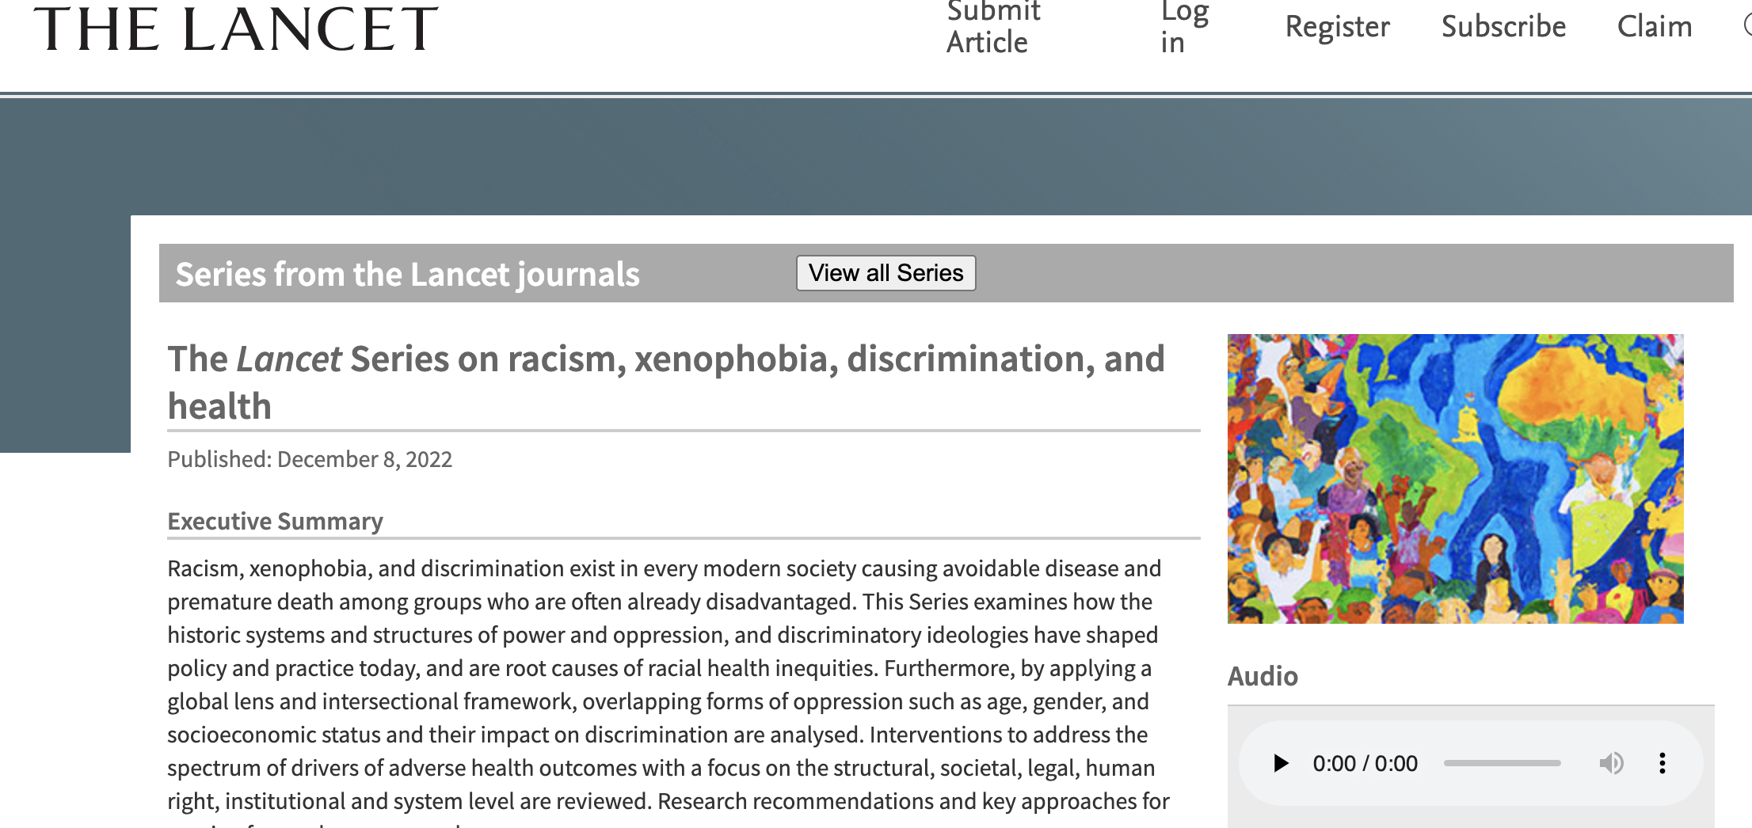
CONCLUSION
Racism is not a North American issue alone that somehow halts on the other side of the Atlantic Ocean.
The current race theoretic current sweeping through all scientific disciplines seems not to have permeated European LIS.
Teaching, research and advocacy on racial equality and diversity is NOT ONLY the natural subject of sociology, anthropology and ethnic studies

