Slide 1
Critical perspectives on current professional positioning on themes of digital transformation in the United Kingdom
Cameron M. Pierson, Ph.D
L3S Research Center, Leibniz Universität Hannover
Elizabeth Tait, Ph.D School of Information and Communication Studies, Charles Sturt University
A. Nick Vera, Doctoral Student College of Information and Communications, University of South Carolina

Slide 2
Agenda
Background and Context
Research Questions
Methodology
Preliminary Results
Compared with Pilot Study
Implications for DEI

Slide 3
The Team
Elisabeth Tait Co-lead
A. Nick Vera Research Assistant
Cameron Pierson
Notes:
Course Director and Senior Lecturer in Information Studies in Australia, though originally from Scotland.

Slide 4
Increasing AI
Background
Notes:
We’re living in a fascinating time in which we’re seeing really the birth of AI, and most recently we’re seeing open and popular use of generative AI.
Now of course we know this has raised many questions, such as how this will impact academia.

Slide 5
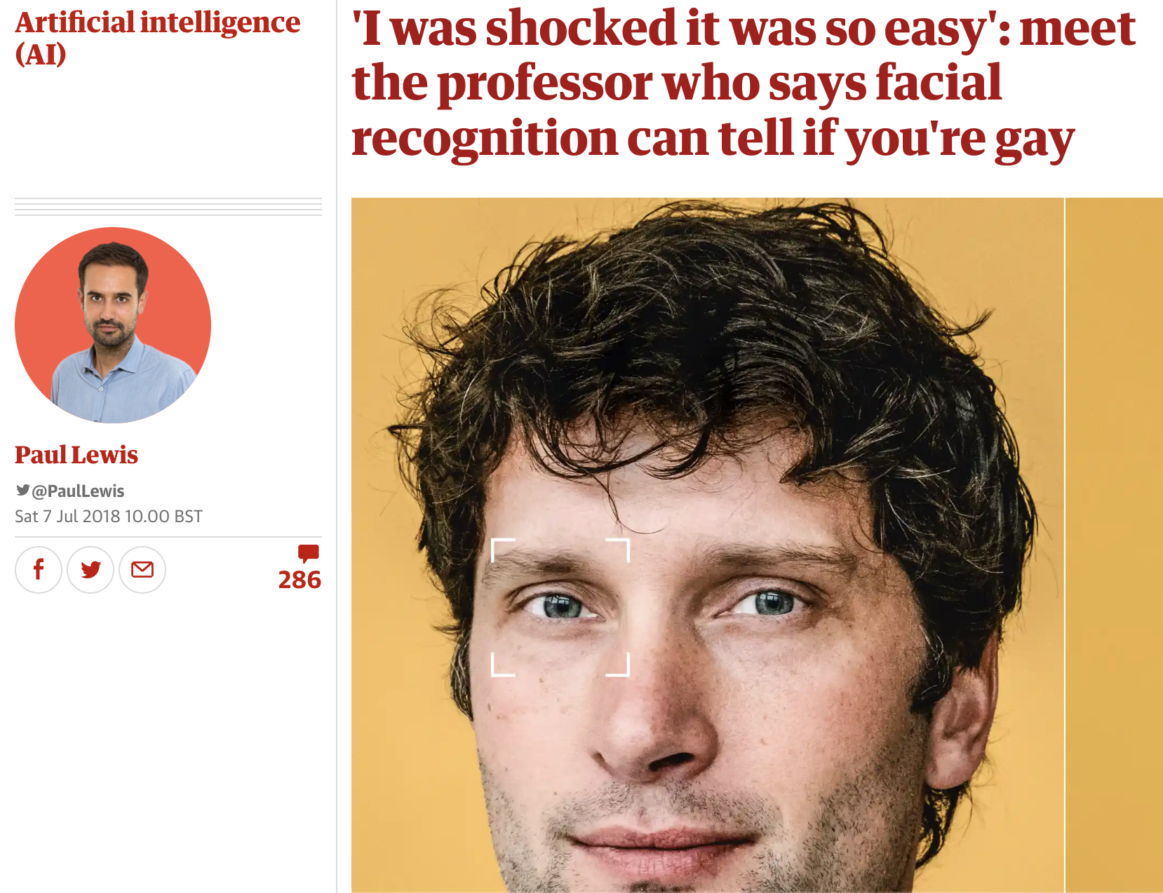
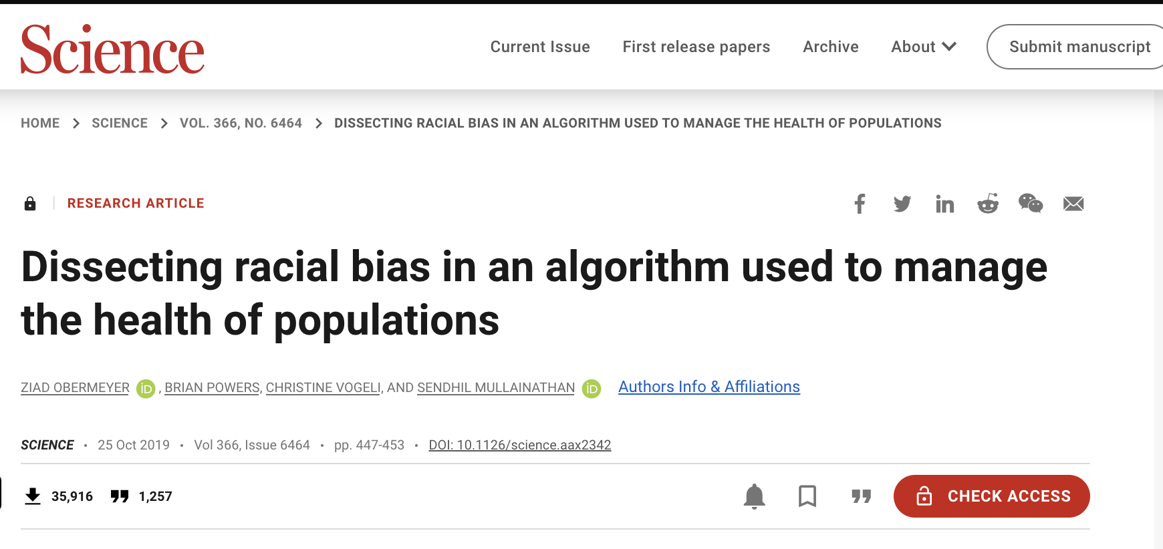
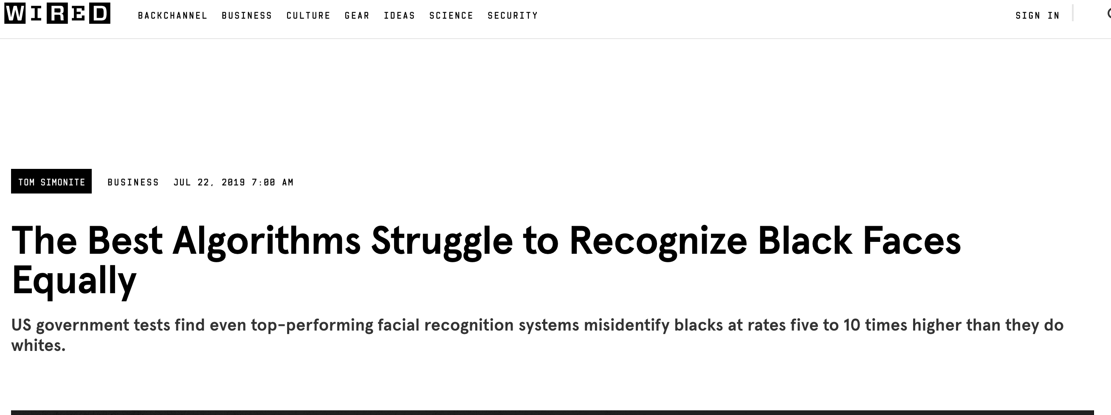
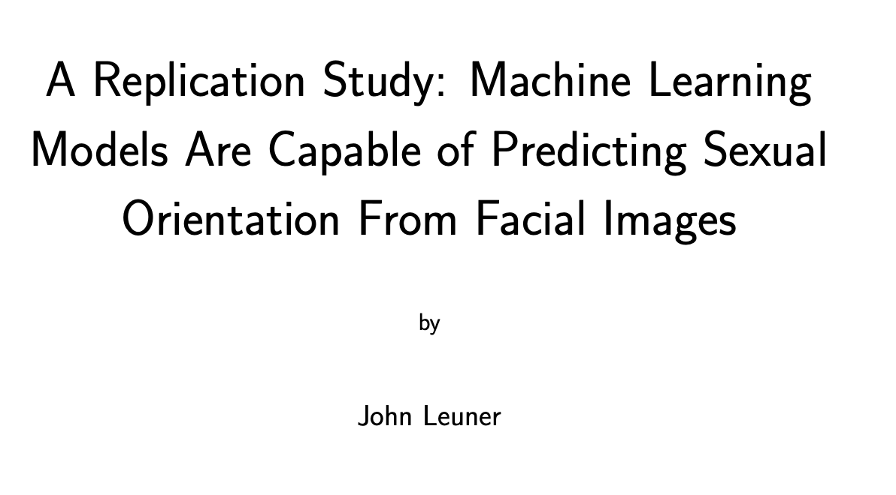
Increasing General & Professional Uses
Background
Wang & Kosinski, 2018
Notes:
Beyond general use, we’re seeing increased professional applications, such as facial recognition software at boarders, and increasingly in healthcare contexts.
We’re also seeing increasing issues of bias being automated or the potential to automate, depending on context of use.

Slide 6
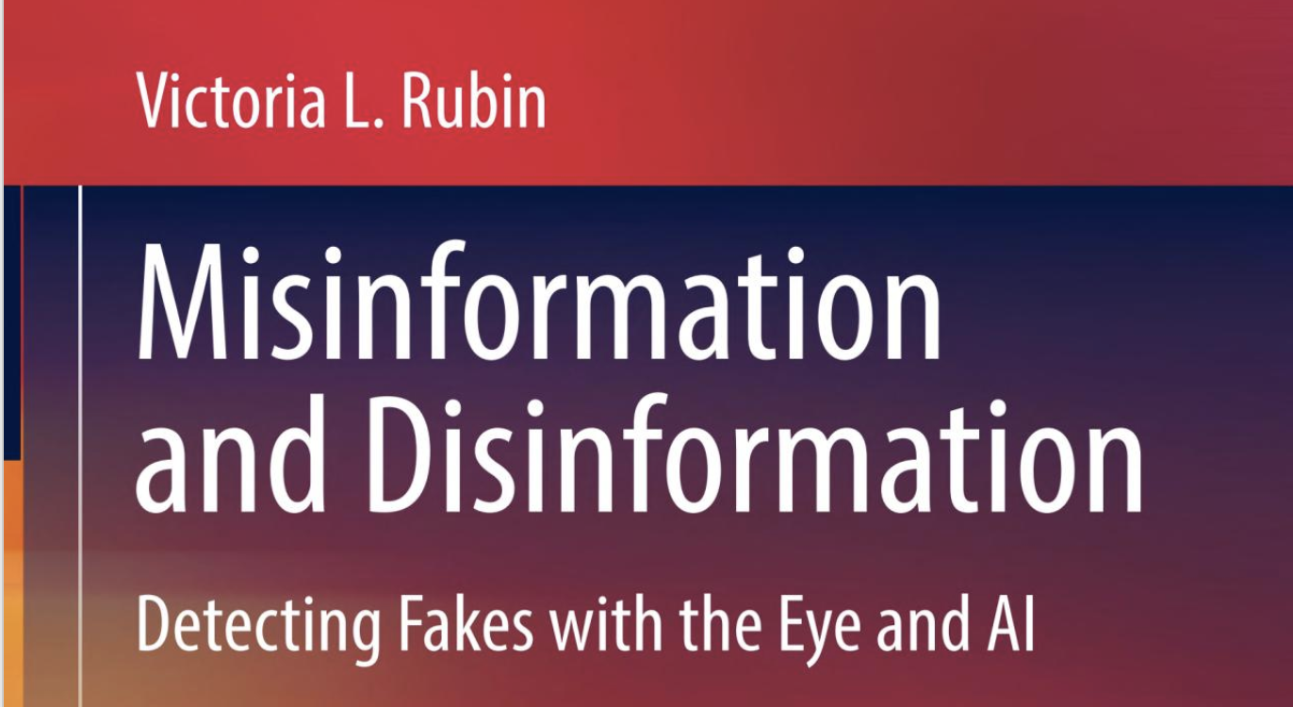
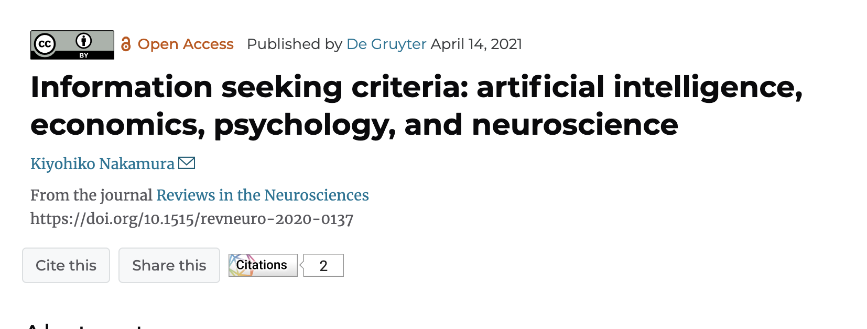
AI & LIS Professional education Huang, Samek, & Shiri, 2021 Practice Cox, 2023, Woods & Evans, 2018 Information behaviours Nakamura, 2020, Rubin, 2022
Background
Notes:
LIS beginning to consider impact of AI both on practice within the wider GLAMR sectors
How it will impact broader information environments
For example, Rubin has also argued that combatting mis-/dis-information can leverage AI
Others are leveraging concepts well known to our domain in the creation of models

Slide 7
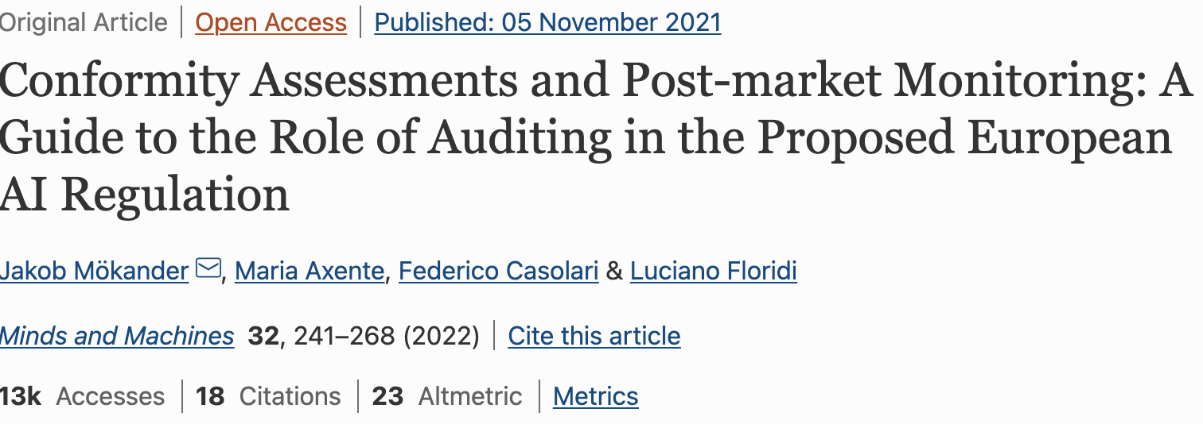
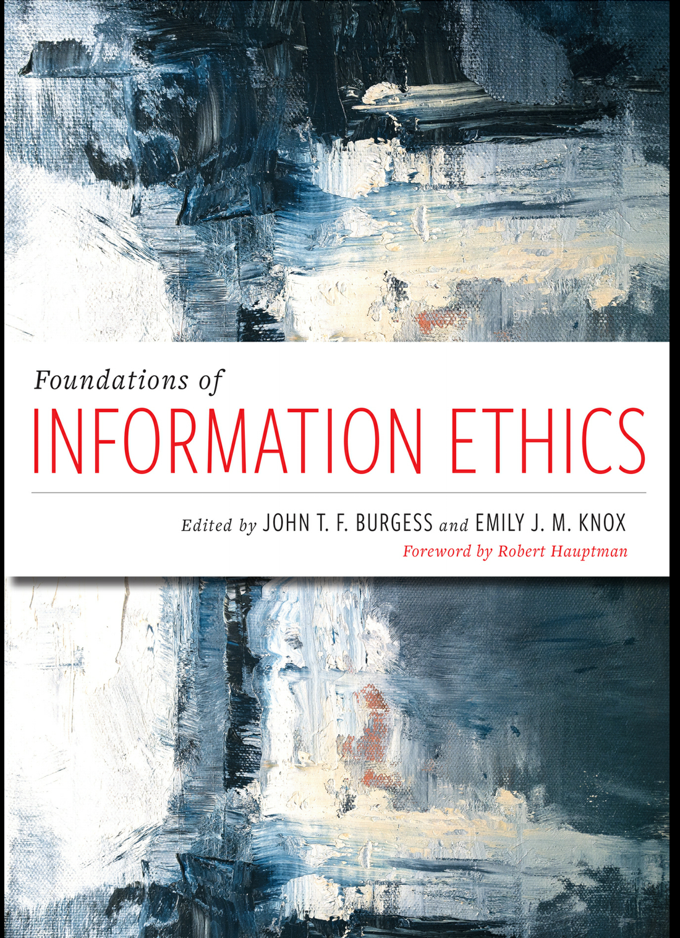
LIS Ethical & Developmental Contributions? Ethical design is crucial in AI development to proactively address actual and potential harms. LIS professionals play a key role in addressing ethical challenges.
Background
Notes:
As practitioners in the information professions tend to work at the intersection of technology, information, and people, we understand there is a unique perspective at this intersection.
LIS professionals are well-positioned to contribute to conversations on socio-technical systems and AI development, such as in information ethical considerations and the social uses and impact, and thus associated considerations.

Slide 8
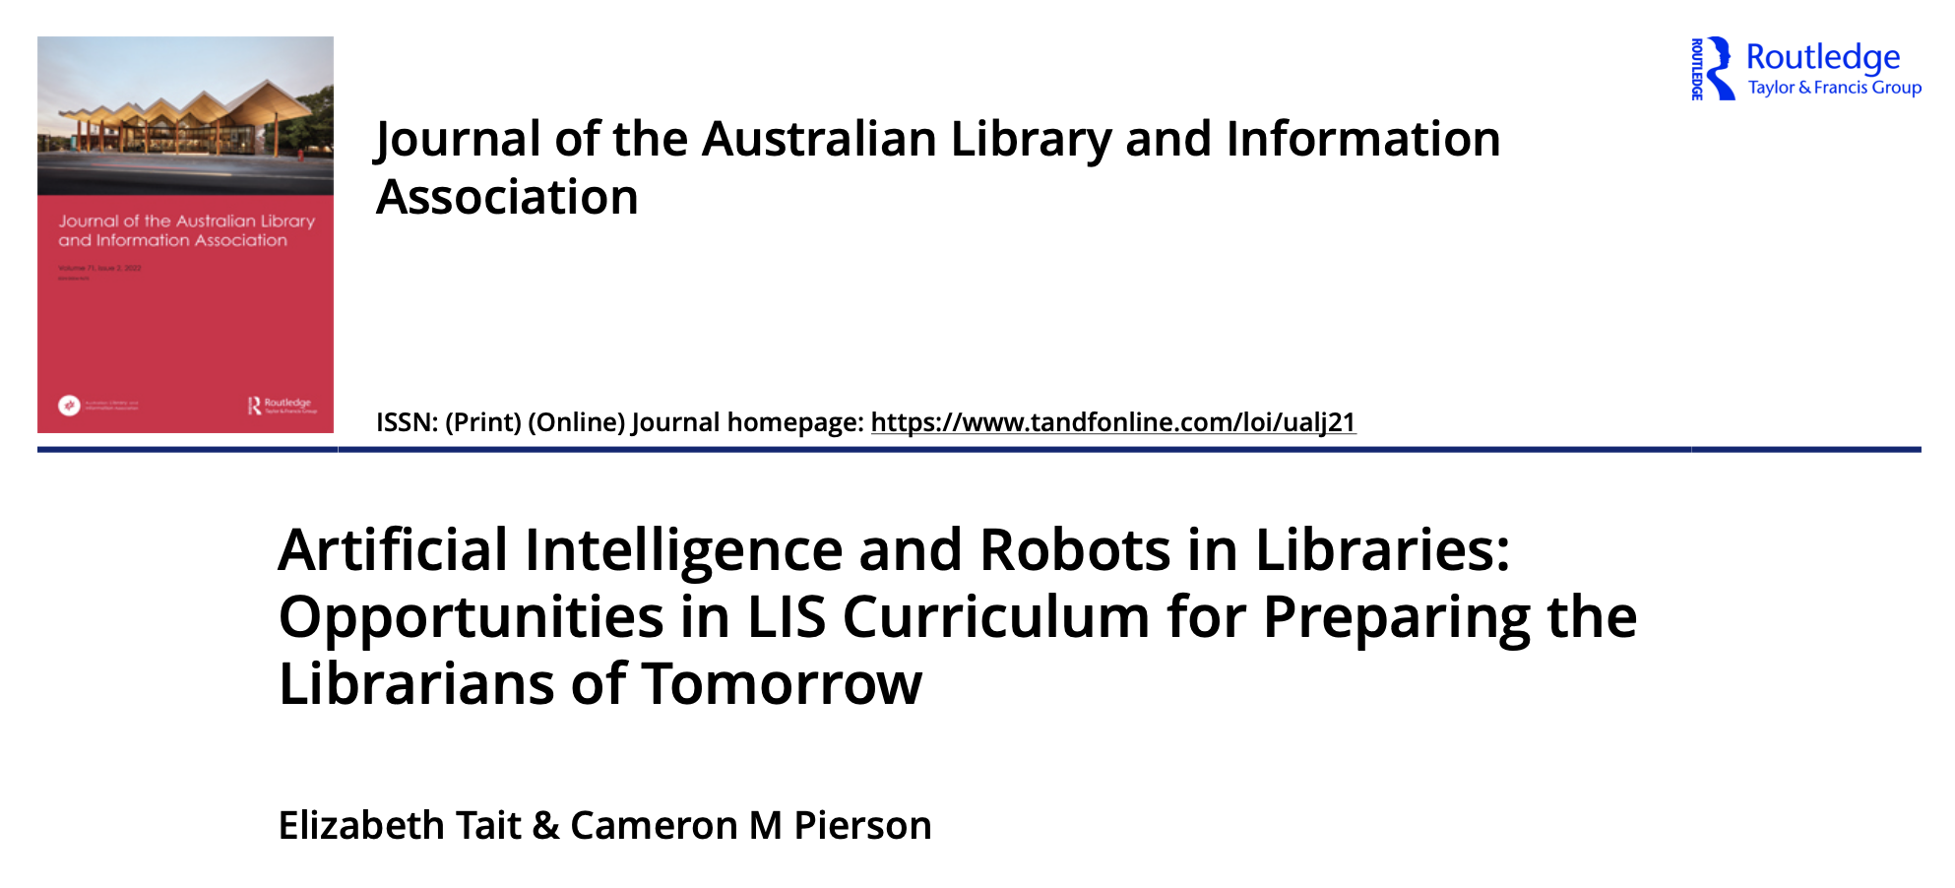
Pilot Study Reviewed Australian LIS courses & ALIA documentation Criteria (1) AI and/or robotics (2) technology (3) digital technology (4) digital-socio phenomena (e.g. digital cultural, digital divide, etc.) (5) analytics (6) data (7) information ethics or ethics as applied to the previous criteria.
Context
Notes:
So given this background and some of the initial questions around it had us considering how LIS education and professional association bodies are approaching this topic to prepare practitioners for professional contributions in this area.
This lead to our pilot study, which focused on accredited Australian LIS course and positioning from the Australian Library and Information Association
We distilled core topics from the literature into our inclusion criteria.
The inclusion criteria also acted as our coding categories, using Content Analysis

Slide 9
Reviewer 2 gave us an Idea
“Also, how does Australia compare to the global information environment in the use and/or education about AI/Robotics?
What is the global concern of using AI/robotics in the LIS environment that impact Australian educational choices?
These are questions will … emphasise the connection of how this research matters more broader.”
Notes:
R2 made an observation which gave us an idea – making a few modifications, we could replicate and expand this study to the UK context.
This was in part due to ties between the UK and Australia, particularly as their education systems are quite similar and there are historic influences there;
and that my co-author Dr Tait has lived contextual knowledge of the UK, as she is originally from Scotland.
So we saw value in looking toward the UK context to enrich further this project.

Slide 10
To what extent are topics related to digital transformation and associated ethical issues reflected in course descriptions and learning outcomes in accredited LIS programs in the United Kingdom? To what extent are topics related to digital transformation and associated ethical issues reflected in job announcements for library roles in the United Kingdom?
To what extent are topics such as digital transformation and associated ethical issues reflected in association body documentation in the United Kingdom?
Research Questions
Notes:
So within the UK context, our questions centered around how topics of digital transformation - including AI, data management, governance, and ethics - are reflected in course descriptions/ learning outcomes, association body documentation, and job announcements
A kind of a tripartite reflecting the constitution of the profession.

Slide 11
Methodology & Analysis
Document Analysis (Wildemuth, 2009):
3 document types syllabi* (descriptions and learning outcomes) job ads association body documents.
Courses
Chartered Institute of Library and Information Professions accredited (CILIP) accredited
Masters level
Most closely aligned to a library practice focus
Coded to inclusion criteria
Job ads
Sourced from: LinkedIn, CILIP, job.ac.uk, reed.co.uk
Academic, Public, School, Special/Other
Purposive sampling, n=40
Coded to inclusion criteria & if none were present
CILIP Documentation
Statements/Reports concerned with AI
Accreditation standards
Professional Knowledge & Skills Base (PKSBs)
Data Analysis
Qualitative content analysis (Patton, 2002) Focusing on presented information and contextual framing Courses & Job Ads: Criteria CILIP Documentation: What’s being said and its framing
Criteria frequencies
Notes:
We modified our inclusion and coding criteria to collapse some themes and make others more explicit.
Documents reflect socially constructed realities and provide accurate insights.
Document analysis supports data triangulation for validity of analysis

Slide 12
11 Universities, Masters Courses of Study 98 Modules (Classes) of a total 134 (73%) Criteria Frequencies:
Courses
Modules | AI, (incl. machine learning, algorithms) | Technology/ Digital technology | Digital-socio phenomena (e.g., digital culture, digital divide, inclusion, etc.) | Analytics (use of data) | Management/ curation of data (incl. metadata) | Information/ data governance and/or policy | Information ethics or ethics as applied to the previous criteria.
98, 100% | 6, 6% | 88, 89% | 24, 24% | 15, 15% | 45, 45% | 29, 29% | 24, 24%

Slide 13
Framing of AI
One module explicitly includes AI within the module title.
“Leveraging insight and understanding from data is key to making effective decisions, Data Led Decision Support and Artificial Intelligence will provide students with an understanding of the techniques that will enable them to gain actionable intelligence and insight from their data.”
Notes:
One module explicitly includes AI within the module title and as a core topic with machine learning, framed as relative to insights for private sector usage of data.

Slide 14
Framing of AI
Impact of automation on theory and practice: “assess the impact that automation has had on archival theory and practice”
Machine learning and algorithms for knowledge acquired from big data “Machine learning for knowledge acquisition; Introduction to machine learning and pattern recognition; Capabilities of different modelling, analysis and algorithmic technique”
AI framed within knowledge management
“Critically evaluate how IT is being deployed and changing the landscape of KM including virtual learning, homeworking and the use of AI.”
Algorithms within the social media landscape
“Tools and methods of social media and web-based research: archiving; data mining; algorithms”
Notes:
Additional Framing:
This topic appears to be reflected in specialised modules.

Slide 15
Job Advertisements
40 advertisements
Academic: 16
School/Academic: 1
School: 9
Public: 9
Other: 5
Criteria Frequencies:
AI, including machine learning and algorithms | Technology/ digital technology, | Digital-socio phenomena (e.g., digital culture, digital divide/inclusion, etc.) | Analytics (use of data) | Management/curation of data (incl metadata) | Information/data governance and/or policy | Information ethics or ethics as applied to the previous criteria. | None: No criteria were identifiable in ad
0 | 22, 55% | 0 | 3, 7.5% | 14*, 35% | 4, 10% | 0 | 15, 37.5%
Notes:
Now turning to Job Adverts

Slide 16
Job Ad Descriptions
Senior Metadata Services Coordinator “We are looking for someone who has demonstrable: Experience in the acquisition and development of e-book and print collections, with a particular focus on policies and licenses for acquiring and providing access to electronic content. Understanding of the HE electronic publishing environment, content supply, licensing, and national and regional consortia. Experience of evaluating, analyzing, and interpreting content usage to provide high-quality metadata services to inform service strategy, collection development, and budget planning. Experience in metadata service to facilitate the ingest, description, management, discovery of, and access to the Library print and electronic resources, ensuring that appropriate guidelines, cataloging, and classification standards are adopted and implemented.
Resources Librarian “Seeking to appoint a skilled and motivated member of the Library Resources team to support the provision of scholarly resources for education and research across the University. This will involve working across electronic and print resources, all format types (journals, books, databases, multimedia), and the digital systems and services involved in their procurement, management, and access. The role will be based within a team that currently subdivides across functions which include digitization, cataloging, acquisitions, subscriptions, and library management systems.
Notes:
So here we see both Digital technology and the Data management incl. metadata criteria reflected.
Quote 1 from – Brunel University – (A8)
Quote 2 from - University of Dundee – (A29)

Slide 17
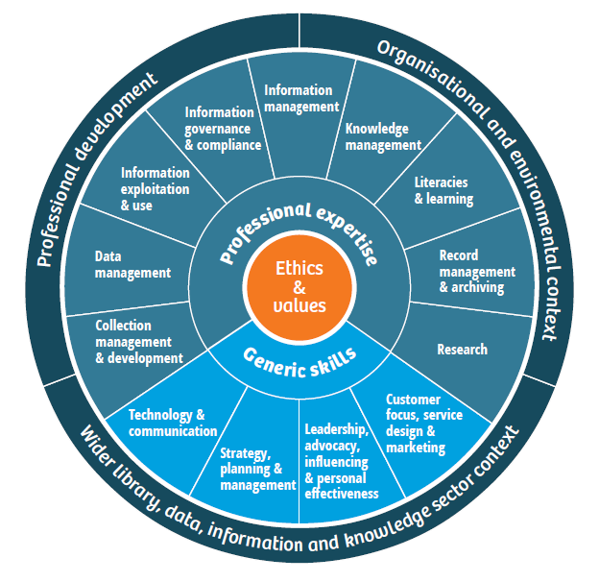
CILIP Documentation
The Professional Knowledge and Skills Base Sector skills standard - PKSBs
Accreditation for learning providers
For CILIP accreditation, courses must align with the PKSB and meet the following five criteria
1. The course should align with the Professional Knowledge and Skills Base.
2. Learning provider offers a high-quality learning experience.
3. Collaboration with employers ensures course relevance for students.
4. Staff are kept up-to-date with current professional practices.
5. Encouraging student engagement with CILIP is important.
Notes:
Turning to the association body documentation, the Chartered Institute of Library and Information Professionals provides 3 documents of primary relevance. The first two focus on professional skill sets and accredidation.
The PKSBs are the industry standard for information professionals. It outlines the essential skills and knowledge required in the field and serves as the foundation for professional development.
Accreditation of programmes therefore requires that content be aligned with the PKSBs

Slide 18
PKSBs
Notes:
In order to ensure practitioners' ongoing growth and effectiveness, it is crucial for them to possess both specialized expertise and broad-based skills that are relevant to professional development and broader sector, organizational, and environmental contexts that prioritize
Technology & Communication
Strategy Planning & Management
Leadership, advocacy, & personal effectiveness
Customer focus, service design & marketing

Slide 19
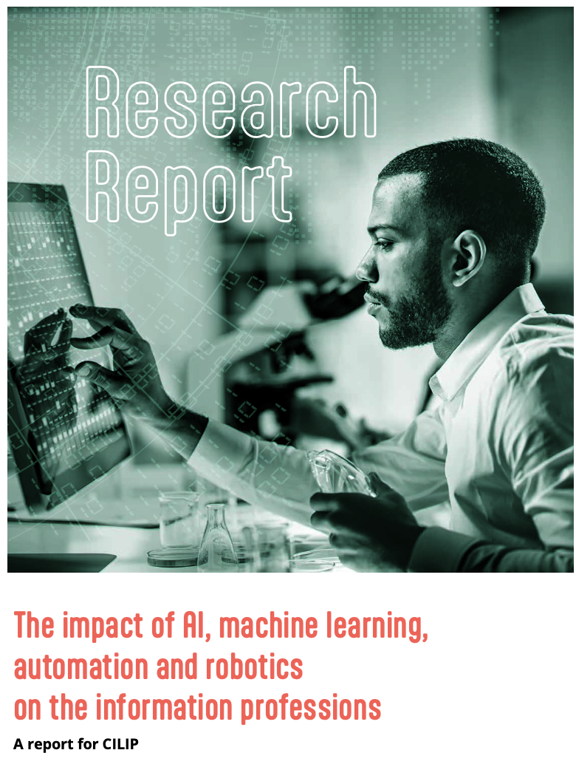
CILIP Documentation
Cox, 2021
Notes:
The third document is a report by Andrew Cox for CILIP outlining the likely impact and implications of AI on the information professions.
Early findings showed that PSKB professional and generic skills are still prevalent and valued by employers and are expressed in broad information areas (law, public, academic, special libraries) and incorporate some tenants of technology that would utilize such skills.
However Emerging skills - are skills that are becoming more valuable with the advent of AI and technology but that computers underperform in demonstrating.

Slide 20
The Impact of AI, Cox 2021
Computational thinking or ‘sense’, data science, and fusion skills are becoming more important, yet soft skills & broadly applied intelligence are suggested to remain necessary and key, contrasting with narrow functions of current AI.
Research data management in librarianship may provide the profession with additional insight to technical and domain skills of the future librarian.
Information professionals need to be more “data savvy” in general.
Data governance: contribute a unique perspective in the context of multi- stakeholder data governance.
Arguably the PKSB does not currently fully represent some of these higher order cognitive skills; for example, complex problem solving, critical thinking and creativity are not presently identified as professional skills.
Notes:
Some additional key findings centre around needed and emerging skills of the librarian in the AI context, such as computational sense, Date management, governance, and being data ‘savvy’ – while maintaining soft and broadly applicable skills in the face of narrow-function AI and with continued emphasis on working with people.
Also noted is that the PKSBs may not fully reflect these skills.

Slide 21
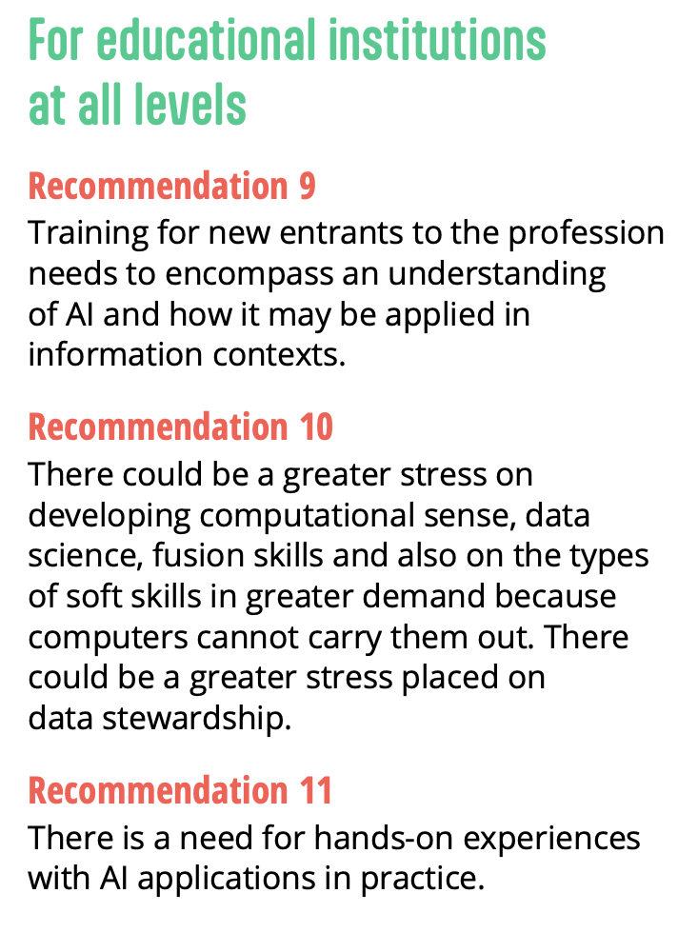
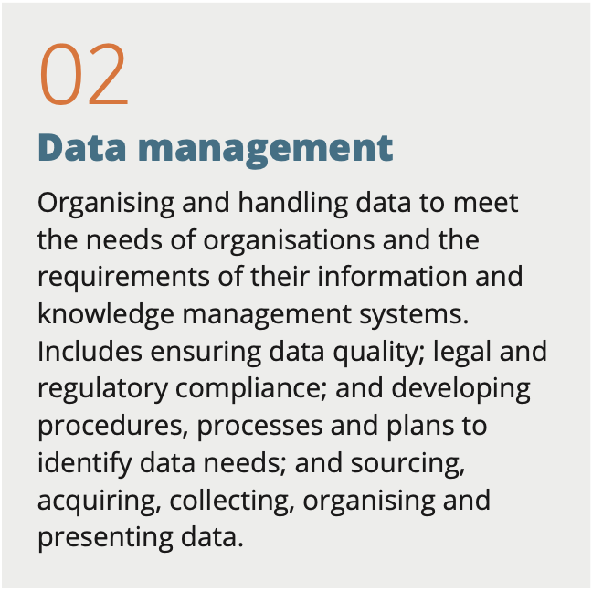
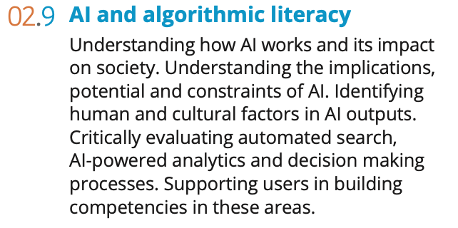
Cox’s Recommendations - 2021
PKSBs - 2021
Notes:
Cox’s 2021 recommendations pointed toward strengthening AI and data skills in the PKSBs.
At the time, while the PKSB showed significant alignment with the role of AI in some areas, there were opportunities for improvement to effectively incorporate the evolving dynamics of the profession particularly with respect to AI.
That same year, CILIP revised their PKSBs, significantly strengthening data related skills and incorporating explicit mention of AI and algorithmic skills.

Slide 22
Big Picture
CILIP’s agile shift
Emerging course reflection
State of practice as expressed by job ads – preparing
Notes:
CILIP’s agility in this case shows a current reflection of skills that will be needed.
Our data shows that courses are beginning to incorporate more AI and associated education within the context of LIS and GLAMR sector professional skills and competencies. AI specifically, however, tends to be in more specialized modules, rather than part of core aspects per se
Our sample of job ads shows that digital technology is certainly a mainstay of modern librarian work across sub sectors. While this may be unsurprising, we see that data management is also strongly reflected, with data analytics emerging.
While there were no mentions of AI, and about 37% of the sample exhibited none of the themes in our inclusion criteria in their posed descriptions.
We posit that between CILIP’s agile adjustment of PKSBs, its connection to accreditation, and the emerging landscape of our criteria themes in professional education, that the profession in the United Kingdom is strongly preparing to the integration of AI and associated technology into practice and the wider information ecosystem.

Slide 23
UK & Australia
Modules | AI, (incl. machine learning, algorithms) | Technology/ Digital technology | Digital-socio phenomena (e.g., digital culture, digital divide, inclusion, etc.) | Analytics (use of data) | Management/ curation of data (incl. metadata) | Information/ data governance and/or policy | Information ethics or ethics as applied to the previous criteria.
UK (98) | 6, 6% | 88, 89% | 24, 24% | 15, 15% | 45, 45% | 29, 29% | 24, 24%
Aus (57) | 1, 1.7% | Technology: 40, 70% Digital Tech.: 29, 50% | 12, 21% | Data 7, 7% |  | N/A | 12
Notes:
While we cannot make a direct comparison for all of these criteria, we can get a sense of comparison between the current and pilot study, between the UK and Australia.
An important detail, however, is that the UK sample is 11 programs, 98 modules, contrasting with the Australian sample of 5 programs and 57 modules

Slide 24
Courses: - Australia courses appear to prioritize social implications of technologies over technological processes. - UK courses appear to provide, to some degree, technical education with a social focus within the information professions context. - Both utilize elective or specialized modules to reflected more advanced themes, i.e., AI. Association body documentation: - CILIP now explicitly includes AI literacy within its skills base - ALIA presently does not yet explicitly indicate such literacies Opportunities: - Potential for shared explorationon of previously identified opportunity areas: Develop open access materials, including open education resources (OER), that can be shared between academics at different institutions and among practitioners. Investigate options for offering continuing professional development (CPD) and/or micro-credentials specifically targeting the required skills for existing practitioners looking to upskill. Facilitate communities of practice (CoP) for knowledge sharing
UK & Australia
Notes:
Broadly speaking, we can identify some comparative areas
For opportunities, we have a selection of those we identified in the pilot study which offer perhaps the most potential for international collaboration, given then increased ease of connectivity we have seen in the past few years

Slide 25
Implications for Diversity, Equity, and Inclusion
In education: It is crucial to teach AI knowledge at varying levels of understanding, considering diverse backgrounds in terms of professional, technological, and lived experiences.
In practice: Professionals across sectors must possess AI understanding to actively contribute to societal inclusion, supporting user learning and engagement.
To assess and evaluate the use of automated systems in terms of diversity, equity, and inclusion: A combination of technological understanding and ethical foundations, such as information ethics and a human-centered approach, is necessary.
Notes:
Broadly speaking -
To ensure diversity, equity, and inclusion (DEI) in the context of AI, it is imperative to address these aspects in both education and practice. In education, providing AI knowledge that is accessible to individuals with diverse levels of understanding and backgrounds is essential. This enables a more inclusive learning environment and equips professionals to effectively support users from diverse backgrounds. In practice, fostering societal inclusion requires professionals across sectors to possess a solid understanding of AI and its implications. This understanding should be complemented by ethical considerations, such as information ethics and a human-centered approach, to assess and evaluate the use of automated systems in relation to DEI. By combining technological understanding with ethical foundations, we can work towards leveraging AI in a manner that promotes diversity, equity, and inclusion in our society.
This will take an international effort from the information professions.

Slide 26
DEI in AI
This will take an international effort from the information professions.
Notes:
As for DEI in AI, efforts will require an international effort from the information professions – in their education and association communities to prepare practice to meaningful engage.

Slide 27
Thank you!
pierson@l3s.de
@CameronMPierson

Slide 28
References
Burgess, J. T. F., & Knox, E. J. M. (Eds.). (2019). Foundations of information ethics.
American Library Association.
CILIP. (2021). The Professional Knowledge and Skills Base Sector skills standard.
CILIP. (n.d.) Accreditation for learning providers. https://cdn.ymaws.com/www.cilip.org.uk/resource/resmgr/cilip/services/accreditation_providers_v1.0.pdf
Cox, A. (2021). The impact of AI, machine learning, automation and robotics on the information professions: A report for CILIP. CILIP. https://www.cilip.org.uk/page/researchreport
Heikkilä, M. (2023). Generative AI risks concentrating Big Tech’s power. Here’s how to stop it. MIT Technology Review. https://www.technologyreview.com/2023/04/18/1071727/generative-ai-risks-concentrating-big-techs-power-heres-how-to-stop-it/
Huang, C., Samek, T., & Shiri, A. (2021). AI and Ethics: Ethical and Educational Perspectives for LIS. Journal of Education for Library and Information Science, 62(4), 351-365. https://doi.org/10.3138/jelis-62-4-2020-0106
Leuner, J. (2018). A Replication Study: Machine Learning Models Are Capable of Predicting Sexual Orientation From Facial Images [Masters Thesis, University of Pretoria]. https://arxiv.org/pdf/1902.10739.pdf
Lewis, P. (2019, 7 July). 'I was shocked it was so easy': ​Meet the professor who says facial recognition ​​can tell if you're gay. The Guardian. https://www.theguardian.com/technology/2018/jul/07/artificial-intelligence-can-tell-your-sexuality-politics-surveillance-paul-lewis
Mökander, J., Axente, M., Casolari, & F., Floridi, L. (2022). Conformity assessments and post‑market monitoring: A guide to the role of auditing in the proposed European AI regulation. Minds and Machines 32, 241-268.
https://doi.org/10.1007/s11023-021-09577-4
Nakamura, K. (2021). Information seeking criteria: Artificial intelligence, economics, psychology, and neuroscience. Reviews in the Neurosciences, 33(1), https://doi.org/10.1515/revneuro-2020-0137
Obermeyer, Z., Powers, B., Vogeli, C., & Mullainathan, S. (2019). Dissecting racial bias in an algorithm used to manage the health of populations. Science, 366(6464), 447–453. https://doi.org/10.1126/science.aax2342
OpenAI. (n.d.). ChatGPT. https://openai.com/blog/chatgpt
Patton, M. Q. (2002). Qualitative research and evaluation methods. Sage.
Rubin, V. (2022). Misinformation and Disinformation: Detecting Fakes with the Eye and AI.
Springer.
Shiri, A. (2023). ChatGPT and Academic Integrity. Information Matters. https://informationmatters.org/2023/02/chatgpt-and-academic-integrity/
Simonite, T. (2019, July 22). The best algorithms struggle to recognize black faces equally. Wired. https://www.wired.com/story/best-algorithms-struggle-recognize-black-faces-equally/
Tait, E. & Pierson, C. M. (2022) Artificial Intelligence and robots in libraries: Opportunities
in LIS curriculum for preparing the librarians of tomorrow. Journal of the Australian
Library and Information Association, 71(3), 256-274, https://doi.org/10.1080.2475158.2022.2081111
Wildemuth, B. M. (Ed.). (2017). Applications of social research methods to questions in
information and library science (2nd ed.). Libraries Unlimited.
Wood, B. A., & Evans, D. (2018). Librarians’ perceptions of artificial intelligence and its potential impact on the profession. Computers in Libraries, 38(1), 116–124. https://doi.org/10.1177/ 0266382120952016
Images/Video:
Harry Potter Balenciaga: https://www.youtube.com/watch?v=iE39q-IKOzA
Hermonie, How to Make Balengiaga: https://www.youtube.com/watch?v=TGD8zKvRxc4
Robot in library: https://iris.ai/wp-content/uploads/2021/01/11-open-source-frameworks-for-artificial-intelligence-AI-and-machine-learning-models.jpg

