Slide 1
Exploring the Role of Games and Gamification in Academic Libraries
Dr. Tjaša Jug
LIDA Conference
Osijek, 25. 5. 2023

Slide 2
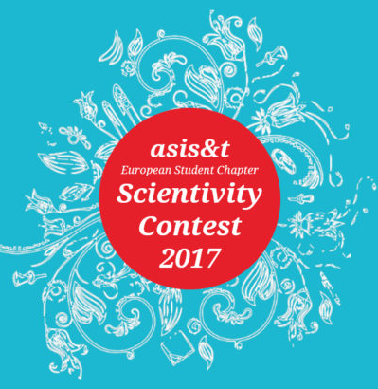
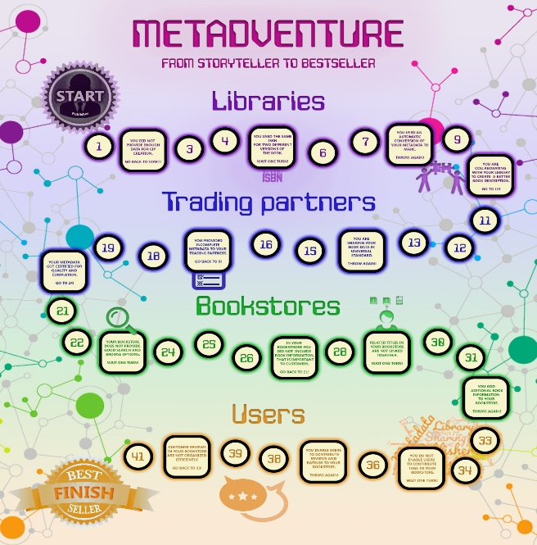
Start
Finish

Slide 3
Games
Feedback
Challenge
Abstract context
Interaction
Rules
Serious and educational games:
Skill building, learning, practicing, applying knowledge in different contexts …

Slide 4
GAMIFICATION
Game elements
Motivation
Real world problems
Non-game contexts
Continuous activity
Effective tool in many fields:
Education, science, personal development, healthcare, marketing, workplace …

Slide 5
Games and gamification in libraries
Appropriate for all types of libraries.
Rarely included in the LIS curricula.
Library introduction and orientation
Motivation for reading and circulation
EDUCATION AND Information literacy courses

Slide 6
Research questions
RQ1
Attitudes of LIS educators towards the inclusion of games and gamification in their courses.
RQ2
Goals that could be achieved by introducing games and gamification into library services.
RQ3
Activities that would be most suitable for academic library services.

Slide 7
methodology
January
2021
10 course
holders
Thematic
analysis
Interviews
Zoom/E-mail
LIS

Slide 8
Results - Inclusion of games and gamification in the courses
Slovenian LIS educators rarely include these topics in their courses.
Digital libraries, marketing, textbook publishing, designing e-learning materials.
They recognize the connection to their courses.
Motivation, learning, developing reading habits, patron types, cataloguing.
Some of them have used gamified approaches in the past.
Competitions, leaderboards, points, quizzes, role-playing, awards.
Lack of knowledge and skills prevents them to use diverse techniques.

Slide 9
Results - Inclusion of games and gamification in the library
Games and gamification would be a positive addition to the library services.
Activate
Improve knowledge
Motivate
New members
Circulation
Collection
Work
Resources
Information
Visits
Services
Independent research

Slide 10
Results - suitability of game elements and gamification approaches
General or specific games?
First-year students
Upper-year students
General games
Specific games
Escape rooms, quizzes, board games, role-playing games …

Slide 11
Results - potential barriers
Concerns related to suitability for the academic environment.
Project should be carefully designed.
Activity should be aligned with/or learning objectives.
Technically and organizationally very challenging and time-consuming.
Insufficient knowledge about games, possibilities, tools, procedures, audience.

Slide 12
conclusion
Games and gamification are well suited to library setting.
They are still rarely used and surrounded by stereotypes and scepticism.
These topics are rarely included in the (Slovenian) LIS curricula.
When informed, LIS educators and librarians are willing to change their practices.
Badges
Escape room
Lectures
Games
Kahoot!

Slide 13
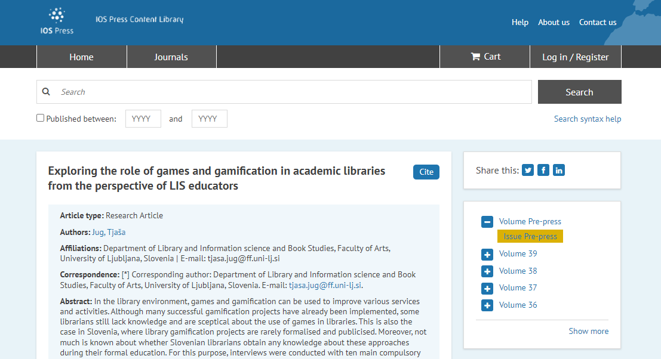
https://content.iospress.com/articles/education-for-information/efi230038

Slide 14
Game over
Thank you for playing!
+
=
E-mail: Tjasa.Jug@ff.uni-lj.si

