Slide 1
Don‘t go for different! Designing specialized information services
Elke Greifeneder & Paulina Bressel
Berlin School of Library and Information Science - Humboldt-Universität zu Berlin

Slide 2
Times are changing…
2014
„The least common denominator does not satisfy user‘s needs: metadata schemes for digital audio archives“ (Greifeneder et al., 2014)
„Don‘t go for different! Designing specialised information services“ (Greifeneder & Bressel, 2023)
2023
Notes:
https://library.ifla.org/id/eprint/937/1/139-greifeneder-en.pdf
Doch wie kommt es zu diesem change der perspektive?

Slide 3
Previous research states..
that digital services achieve high usability when their design is tailored to the needs and preferences of their primary user group and specific tasks and
that most usability studies primarily emphasize distinct user groups and their unique needs (Nicholas et al., 2010, Arshag & Ameen, 2021)
Primary user group
needs and
Tailored design
preferences
Notes:
All studies have in common that the starting point is the hypothesis of existing differences and that the research design thus seeks to validate those differences.

Slide 4
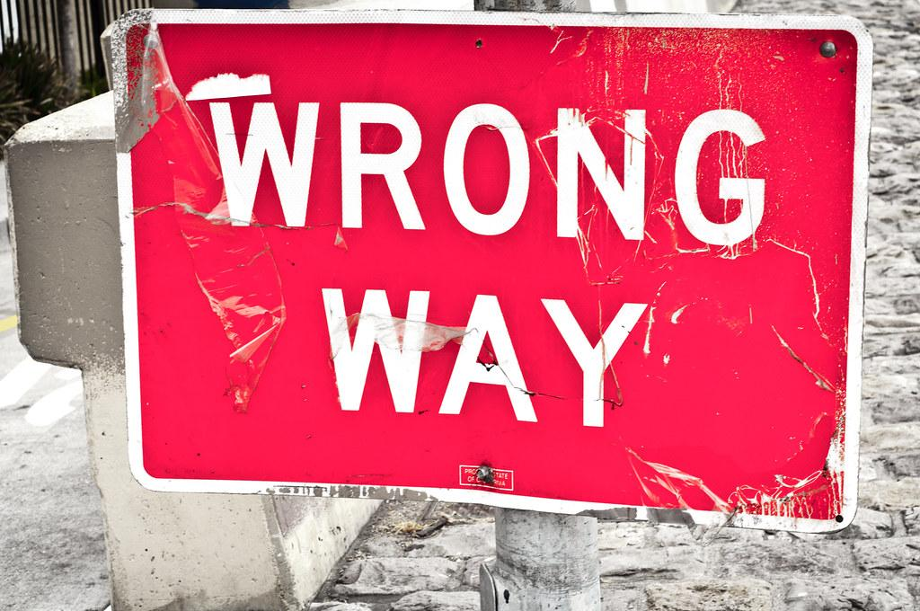
?
Primary user group
needs and
Tailored design
preferences

Slide 5
Previous research states..
that digital services achieve high usability when their design is tailored to the needs and preferences of their primary user group and specific tasks and
that most usability studies primarily emphasize distinct user groups and their unique needs (Nicholas et al., 2010, Arshag & Ameen, 2021)
We challenge the prevailing user evaluation approach and propose shifting focus towards identifying commonalities in users' information behaviors and to design for universality and inter-
disciplinarity.

Slide 6
Research Design

Slide 7
Object of study
German state-financed information and documentation services
FID = „Fachinformationsdienste für die Wissenschaft“ (FID) => specialized services for research subjects
Aim = Access to information and library services independent of the researchers‘ current location
42 different FIDs exist, each addressing a different research group, all of them offering some sort of digital portal as an entry point to specialized services
FIDs are required to fulfill the information needs of their (German speaking) user community and to validate this through user studies.
Notes:
HSP = 6 Mio
The aim of those FID is to have access to information and library services for German researchers independent of the researchers’ current location. This means, for example, German philosophical researchers, can (request) access to all services from their FID independently if they work at a department of philosophy, at one of the state funded institutions such as Fraunhofer or Max Planck or, if they live abroad. In 2022, there were 42 different specialized services funded by the German Research foundation, each addressing a different research group, all of them offering some sort of digital portal as an entry point to specialized services.

Slide 8
How similar are researchers‘ needs in regards to the usage of the specialized information service portal?
RQ:
Notes:
As you already heard, we are trying to challenge the prevailing user evaluation approach.
Our research question for this purpose was the following:

Slide 9
 | HSP | FID GiN | FID AVL | FID DK
Online unmoderated Card-Sorting | (n = 56) | (n = 92)
Online Think-Aloud | (n = 13) |  | (n = 6) | (n = 12)
Online Focus Group |  |  |  | (n = 6)
HSP → The portal of medieval and early modern manuscripts (2020 – 2021) FID GiN → The portal for german philology (2021) FID AVL → The portal for literature studies (2021 – 2022) FID DK → The portal for performing arts (2022)
Notes:
Our article is based on four usability studies of different FIDs, which we conducted independently between 2021 and 2022.
The first study HSP (portal of medieval and early modern manuscripts) was divided into two sub-studies. We analysed the usability by an online unmoderated card-sorting and an online think aloud study.
Afterwards we conducted another card sorting study for GiN, the portal for german philology. This was great because we were able to compare the results with the HSP studies
AVL, the portal for literature studies was the third FID we analyzed by conducting a small think aloud study
And last but not least the FID DK, the portal for performing arts. For this study we first conducted a think-aloud study in 2022 and afterwards an online focus group with some of the participants to dig deeper in some aspects of the study.
Researchers are the main target group of specialized information services, therefore the majority of participants were researchers from their respective area, including researchers in the early career stage and senior researchers. An exception was FID DK because, due to its highly practice-oriented discipline, its target group also includes practitioners from memory institutions such as Galleries, Libraries, Archives and Museums (GLAMS).

Slide 10
Results

Slide 11
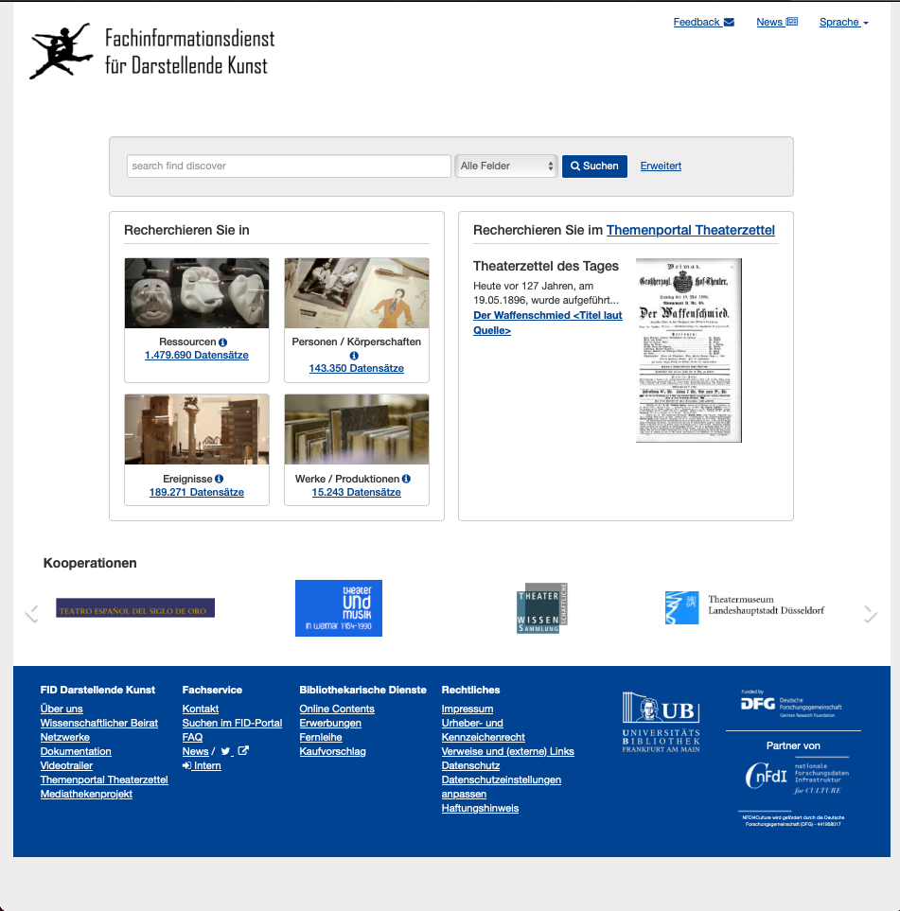
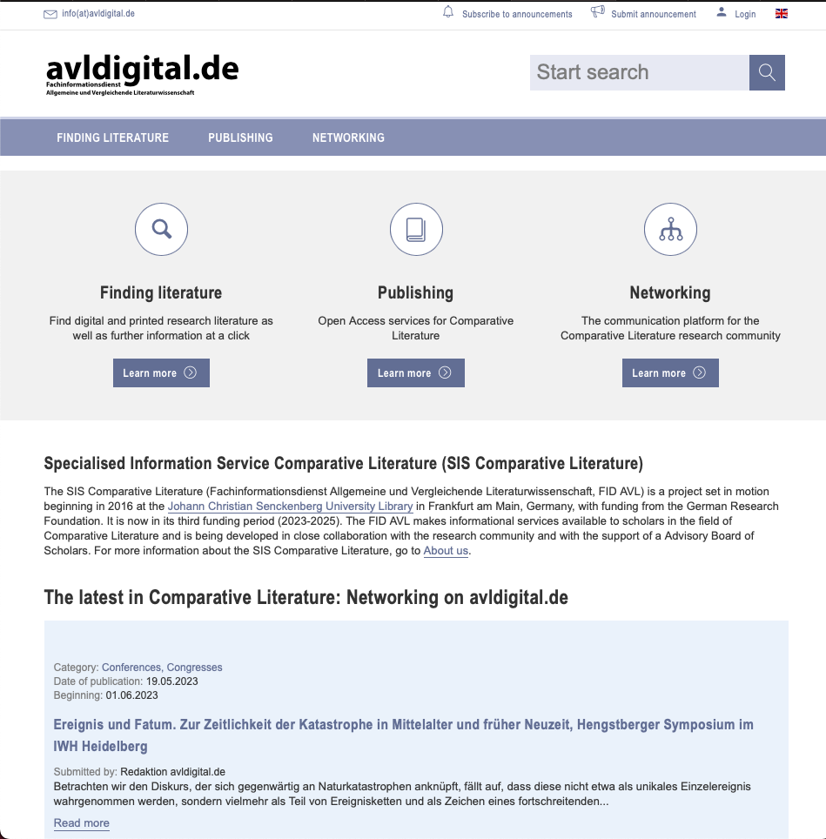
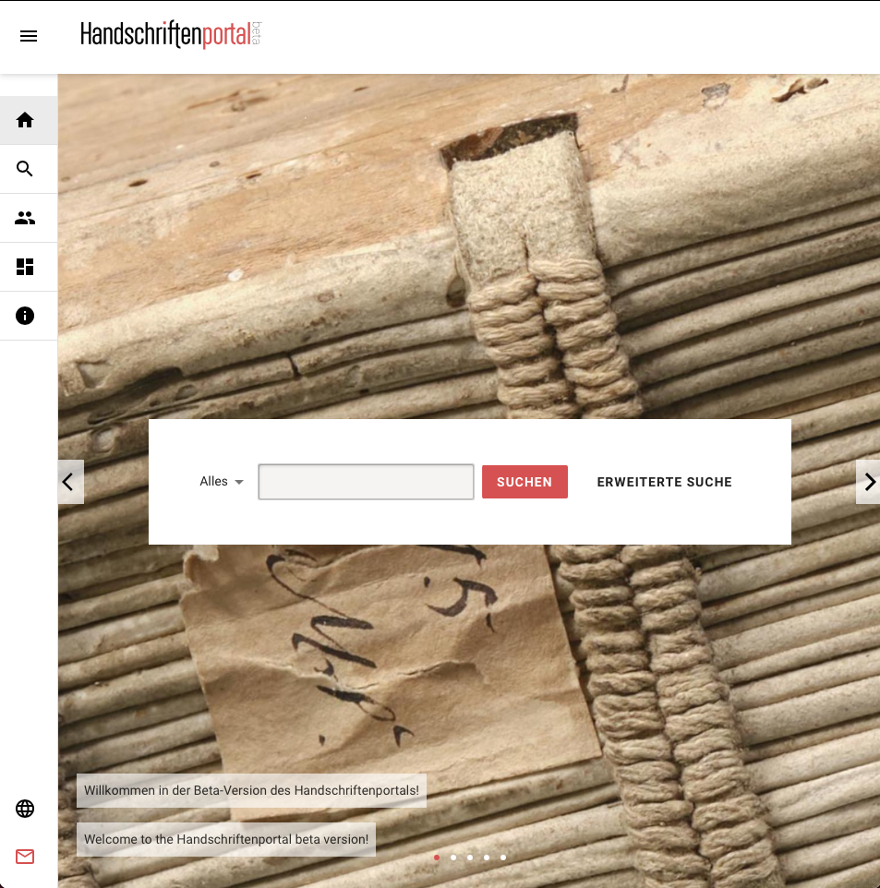
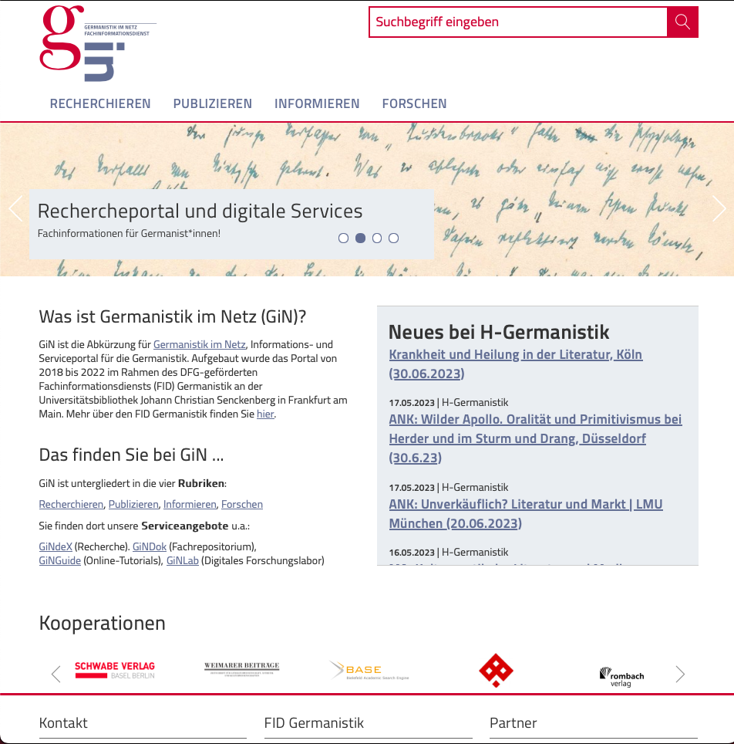
Notes:
Those are the home pages of the four mentioned FIDs.
As you can see, besides the search box, which can be found in the middle or at the side of the pages, all FIDs are different in design and services offered.
AVL & GiN various services in the middle, FID DK some services in the footer and HSP only focused on the search and work with data
Interestingly, during the studies, we recognized that there are no subject specific differences in the information behavior of the participants. Instead all participants described their seeking behavior in form of using the search box and not using many other services.
Sometimes they described using browsing functions, especially by using FIDs from other subjects, where they are not sure about available data and content. But besides this there were not subject specific differences.

Slide 12
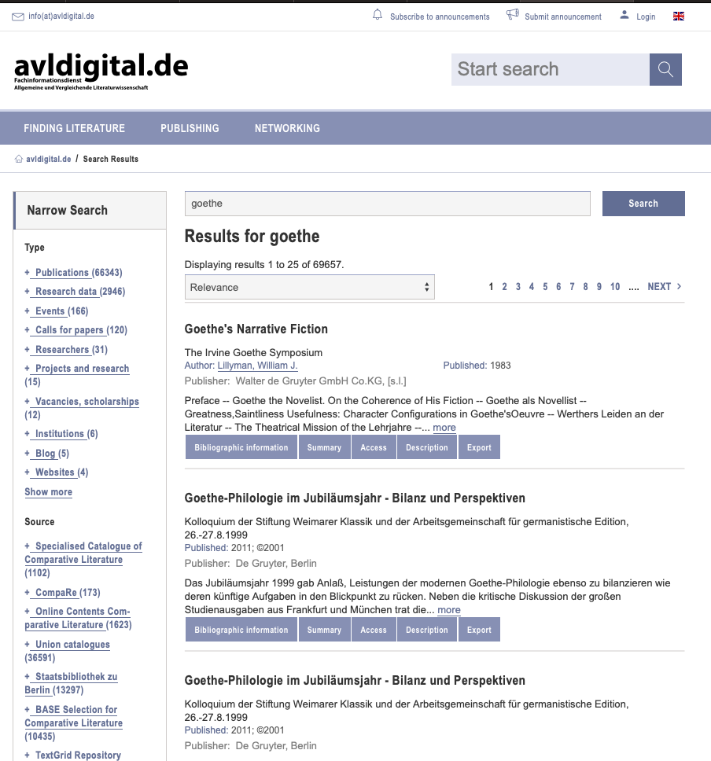
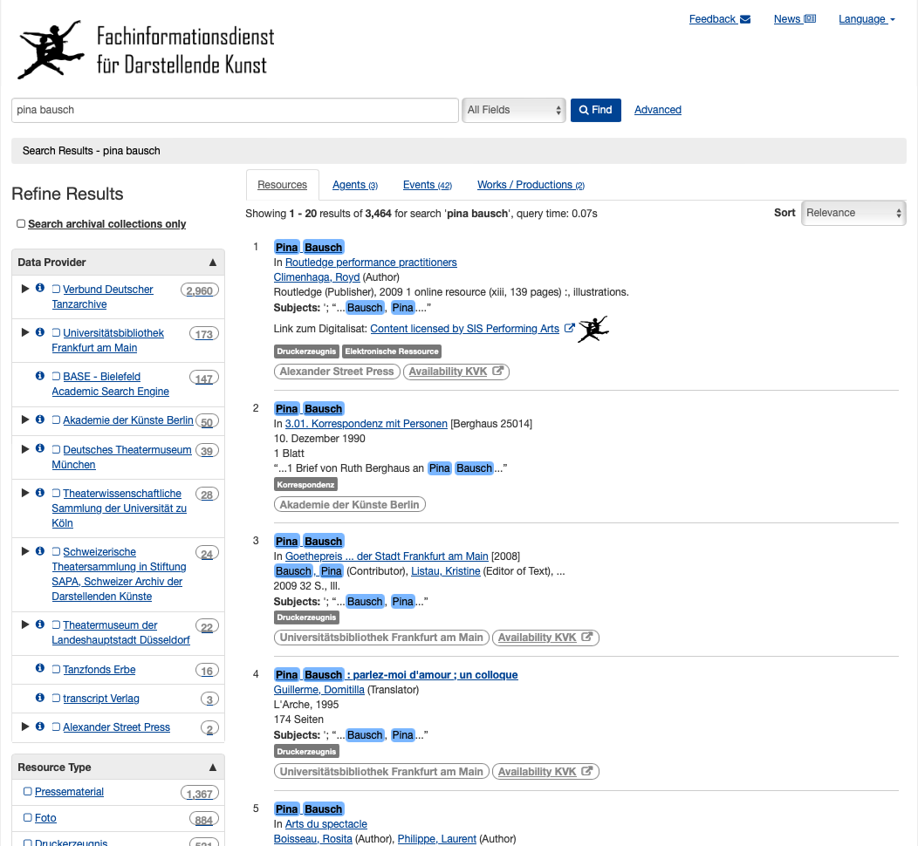
Notes:
two catalogs of different subjects, looking similar on the first view
BUT regarding different data types (text vs. visual data) or subject specific terms as for performing arts, differences exist in terms of hyperlinks, category names and structures.
Interestingly, recognized distinctions in the behavior while using the catalog were to the same extent between participants of the same subjects as between those of different subjects. It therefore seems to be a personal preference based on habituation and knowledge, instead of subject specific usage patterns.
Regardless of their subject, almost all participants made a comparison with the library catalogs of their research institution, which they use regularly.

Slide 13
Main results
Structures and content of FIDs are diverse in terms of hyperlinks, category names and functionalities which restrict intuitive use.
Participants often use multiple resources (interdisciplinarity) and prefer similar if not identical usage practices
Specialized FIDs are still important for specific sources that get lost in general catalogs
Notes:
interdisciplinarity: This was mentioned especially for small subjects where the use of interdisciplinary sources is frequent. The intuitiv usage of various FIDs are necessary in the eyes of the user.
In addition, however, they still need the FID of their own research area, since relevant sources are quickly lost in general catalogs of FIDs of larger subjects and can only be found with difficulty. Thus, all subjects in the four studies expressed gratitude for the existence of their subject-specific FIDs.

Slide 14
Take-Away
Subject specific usage patterns were rarely visible
Different data formats in the backend do not automatically require a different (frontend) information infrastructure, only small adjusments
→ Backend differences do not necessarily translate directly to the frontend.
Notes:
The think-aloud tests and focus groups focused on concrete experiences within researchers’ subject area. Participants were asked to describe how they used the portals, to demonstrate their information seeking process using a current research question that they have and to express needs towards the services. A close view on preferences in catalogs, structure and functionality of FIDs and redundant or less used services was identified. Based on previous studies in the field, it was expected to discover subject specific usage patterns. However, those were rarely visible.
The librarian perspective and argument for specialized services is that the data types are very different. Researchers from performing arts are more likely seeking visual data such as illustrations from performances while the German linguists are more likely to seek large text corpora. If the data are very different, the information infrastructure must be very different. Yet, while the backend must adapt to different data types, it may not be necessary to mirror this to the front end. There, in contrast, a homogeneous presentation is desired, which also enables the intuitive use of FIDs from other related subjects.

Slide 15
Conclusion

Slide 16
Conclusion
Interdisciplinary approaches foster comparable information-seeking behaviors and the criticism of different digital services.
Future developments of digital services ought to discuss how to balance the offering of distinct services to needs of specialized researchers and striving towards a unified model of design.
Going for similarity in design and service may reduce funding income for libraries in the long run.
Notes:
The results of those four studies showed that users of specialized digital library services may express how different they are when it comes to getting funding or keeping positions within university structures, but that their information needs and information usage behaviors are very similar.
Participants express that they are (no longer) willing to learn how to use services and expect that library services implement standard user experience practices. They prefer similar systems instead of specialized systems created only for them. This was also visible in understanding issues of unfamiliar vocabulary. A good specialized service is characterized by the fact that similar functions work. A similar structure of interfaces is helpful for the overlapping use of different specialized information services and the intuitive and quick understanding of different information services. They “need to be “walk up and use” systems that are easily learned” as already Blandford et al. said about libraries in 2001. The same applies to digital libraries and specialized information services.
Previous studies showed large differences in usage behaviors between subject domains when seeking information. The results of the present study show the opposite: the seeking behaviors were very similar and participants criticized when digital services were too different. Participants explained this with their interdisciplinary background and the need to use multiple specialized services for their research purposes.
Libraries as the stakeholders in the backend receive grant funding to develop multiple services for specialized user groups. Each difference means the chance of extra funding. Going for similarity in design and services steering towards some form of universal design may in the long run reduce funding income.

Slide 17
References
Arshad, A., and Ameen, K. (2021). “Comparative Analysis of Academic Scientists, Social Scientists and Humanists’ Scholarly Information Seeking Habits.” Journal of Academic Librarianship 47 (1). https://doi.org/10.1016/j.acalib.2020.102297.
Bressel, P. & Greifeneder, E. (2022). Studie zur Evaluierung der Websitestruktur und den zentralen Informationsangeboten des Fachinformationsdienstes "Allgemeine und Vergleichende Literaturwissenschaft (FID AVL)": Ergebnisbericht. Accessible under: urn:nbn:de:hebis:30:3-675621
Bressel, P. & Greifeneder, E. (2022). Ergebnisbericht: Nutzerstudie zur Evaluierung der Funktionalitäten und Ansicht des Handschriftenportals (HSP). (in print).
Bressel, Schlebbe & Greifeneder (2023). Ergebnisbericht zur qualitativen Evaluierung des Portals des Fachinformationsdienstes Darstellende Kunst (in print).
Greifeneder, Elke, Larsen, Bente, Larsen, Birger, Lund, Haakon and Skov, Mette (2014) The least common denominator does not satisfy user’s needs: metadata schemes for digital audio archives. Paper presented at: IFLA WLIC 2014 - Lyon - Libraries, Citizens, Societies: Confluence for Knowledge in Session 139 - Audiovisual and Multimedia with Information Technology. In: IFLA WLIC 2014, 16-22 August 2014, Lyon, France.
Greifeneder, E., and Bressel, P. (2021). Studie Zur Präsentation Der Facetten Auf Dem Handschriftenportal. Accessible under: https://doi.org/10.18452/23232
Greifeneder, E., & Bressel, P. (2021). Studie Zur Websitestruktur Von "Germanistik Im Netz (GiN)" - Portal des Fachinformationsdienstes Germanistik. Accessible under: urn:nbn:de:hebis:30:3-646114.
Greifeneder, E., & Bressel, P. (2022). “Hybrid Digital Card Sorting: New Research Technique or Mere Variant?” In Information for a Better World: Shaping the Global Future, edited by Malte Smits, 50–67. Cham: Springer International Publishing.
Nicholas, D., Rowland, I., Huntington, P., Jamali, H.R. & Hernández Salazar, P. (2010). “Diversity in the E-Journal Use and Information-Seeking Behaviour of UK Researchers.” Journal of Documentation 66 (3): 409–33. https://doi.org/10.1108/00220411011038476.

Slide 18
Thank you! Questions?

