Slide 1
Balancing act: exploring changes to scientific communication during the covid-19 pandemic
LIDA 2023 Student Showcase
March 24, 2023
Jennifer Rempel, Leiden University

Slide 2
Jennifer Rempel
Information Literacy and Resource Access Librarian
Athabasca University Library
Athabasca, AB, Canada
Book and Digital Media Studies Graduate, 2023
Leiden University, Leiden, Netherlands

Slide 3
Revision suggestions welcome!
https://tinyurl.com/lida2023jrempel

Slide 4
agenda
Traditional model of academic publishing
COVID-19 disruption: Rapid peer review and open access
Results
Going forward

Slide 5
“traditional model” of scholarly communication
MS submission
Paper submitted to appropriate venue
Peer review/editing
Bottleneck! Time-consuming process
publication
Paper published
paywall
Non-OA articles are not accessible to non-subscribers

Slide 6
Covid-19: disruption!

Slide 7
Covid-19 and changes to scholarly publishing
MS submission
Researchers encouraged to submit to pre-print repositories in addition to journals
Peer review/editing
Rapid-review instituted by relevant publishers
publication
Process shortened
Open access
OA articles made accessible to non-subscribers

Slide 8
Result:
Massive increase in output
“unprecedented wave of publications” (Odone et al. 2020)
“the largest 1-year increase in all scholarly articles, and the largest annual total ever” (Brainard, 2021)

Slide 9
Pre-prints:
Pre-print server administrators recruited more volunteers in addition to regular staff to screen papers, and by increased staff and volunteer work hours
Standards for inclusion relaxed
Only 32%of pre-print servers “involved researchers in vetting articles for criteria such as relevance of content” (Kwon, 2020)

Slide 10
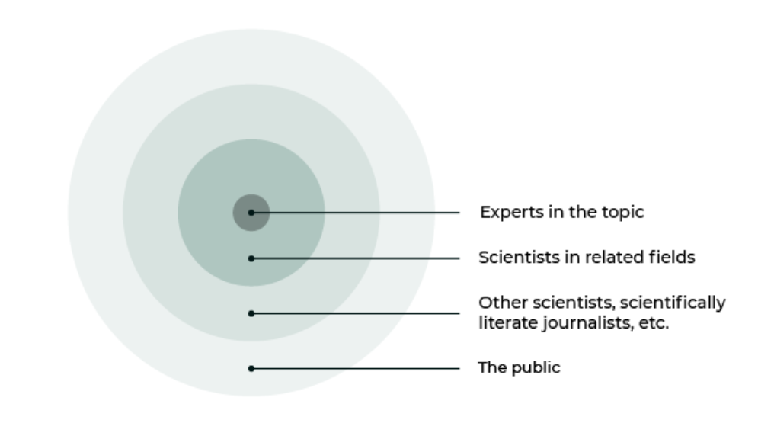
DeBruin, J. (2020, July 8). Guest post – The Covid infodemic and the future of the communication of science. The Scholarly Kitchen. https://scholarlykitchen.sspnet.org/2020/07/08/guest-post-the-covid-infodemic-and-the-future-of-the-communication-of-science/

Slide 11
Published articles:
Many publishers instituted fast-track peer-review for COVID-19-related materials (OASPA, 2020)
The “average time between submission and publication [was] reduced by nearly 50%” (Horbach, 2021)

Slide 12
consequences
“exceptionally high” retraction rate for COVID-19-related publications (Yeo-Teh & Tang, 2020)
“poor adherence to identified research priorities and a predominance of opinion over data” (Odone, et al. 2020)
spread of misinformation in media / social media

Slide 13
Going forward…
Good preprint practices
Screening irrelevant material; clearer guidelines
Peer review “triage”
Screening irrelevant material; clearer guidelines
Incentives to publish
Quality over quantity
Public understanding of science
“Immunize” media and public against misinformation through scientific literacy

Slide 14
THANK YOU!
Jennifer Rempel
jrempel@athabascau.ca
j.rempel82@gmail.com

Slide 15
Slide References:
Brainard, J., (2021). A COVID-19 publishing revolution? Not yet. Science, 373(6560), 1182-1183. https://doi.org/10.1126/science.acx9043
DeBruin, J. (2020, July 8). Guest post – The Covid infodemic and the future of the communication of science. The Scholarly Kitchen. https://scholarlykitchen.sspnet.org/2020/07/08/guest-post-the-covid-infodemic-and-the-future-of-the-communication-of-science/
Horbach, S.P.J.M. (2021). No time for that now! Qualitative changes in manuscript peer review during the Covid-19 pandemic. Research Evaluation, 30(3), 231-239. https://doi.org/10.1093/reseval/rvaa037
Kwon, D. (2020). How swamped preprint servers are blocking bad coronavirus research. Nature, 581(7807), 130-132. https://doi.org/10.1038/d41586-020-01394-6
Open Access Scholarly Publishing Association (OASPA). (2020, April 27). COVID-19 publishers open letter of intent – Rapid review. https://oaspa.org/covid-19-publishers-open-letter-of-intent-rapid-review/
Odone, A., Salvati, S., Bellini, L., Bucci, D., Capraro, M., Gaetti, G., Amerio, A. & Signorelli, C. (2020b). The runaway science: A bibliometric analysis of the COVID-19 scientific literature. Acta Bio Medica: Atenei Parmensis, 91(9-S), 34-39.
Yeo-Teh, N.S.L. & Tang, B.L. (2021). An alarming retraction rate for scientific publications on Coronavirus Disease 2019 (COVID-19). Accountability in Research, 28(1), 47-53. https://doi.org/10.1080/08989621.2020.1782203

