Slide 1
Phd forum, LIDA conference 2023
The meaning of collections for the identity of academic libraries – a Swedish university library study.
Hanna Hallnäs
Notes:
I´m ever so grateful that you took the time to come and listen. I value your input on my phd study.
I will briefly present my study, and I will do it in the company of my dog Tam. It makes me a bit less nervous to be here today if I have him close ☺

Slide 2
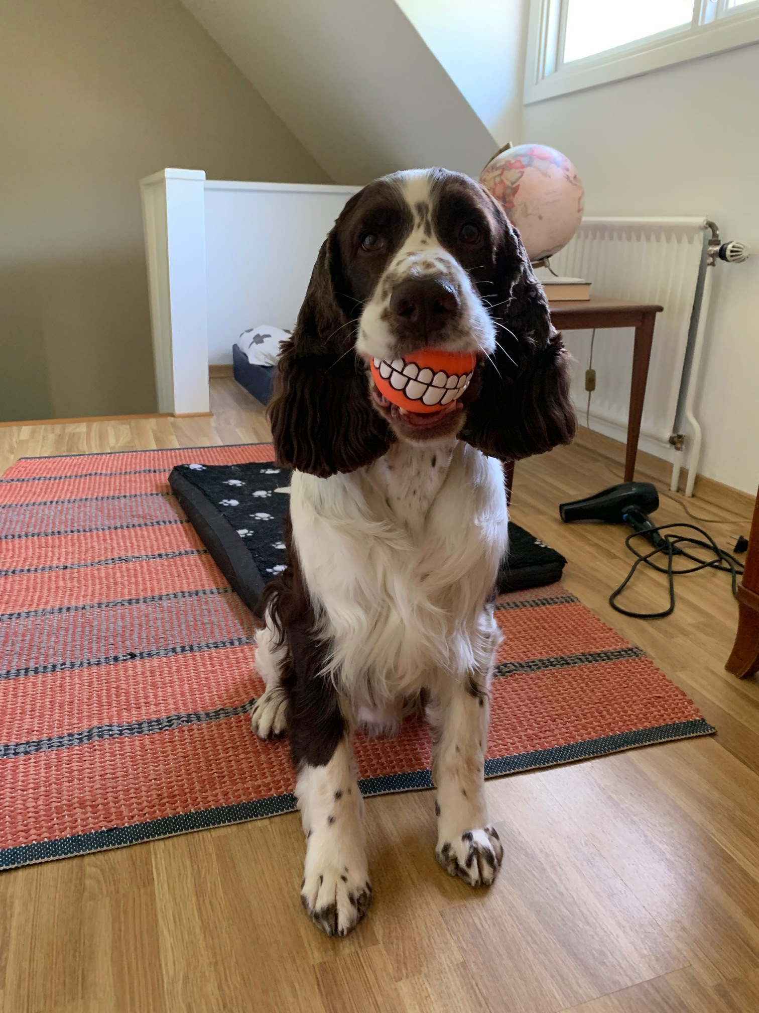
Why PhD?
I worked as a librarian for 12 years, at a Swedish university library, with the acquisition of electronic and print material.
I liked my job and colleagues! And I was happy, like Tam on the picture.
But a question started to occur in my mind:
What is a library today and is the collection really that important?
So I applied for a PhD position… (and got it!)
Tam

Slide 3
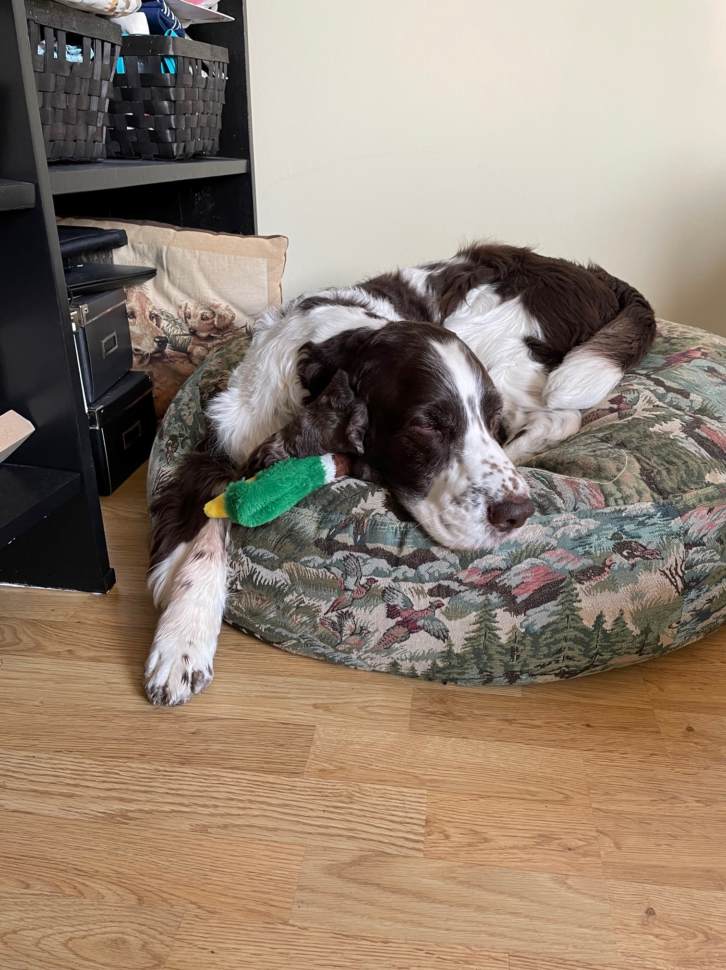
Some (boring?) details
I began my journey in September 2021,
I´m writing a monograph in Swedish,
I plan to write at least one article in English during my PhD time,
My supervisors are Ola Pilerot (professor) and Erik Joelsson (senior lecturer)
This is the first time I present my work outside of Sweden.
Tam

Slide 4
Aim
The significance of the collections of university libraries, which have changed in character, for the libraries' identity and for their position in the higher education landscape.
Overarching RQ
Potential areas of conflict when the identity takes shape.
Specified RQ
Preservation vs open science (collection perspective),
Vice-chancellor vs library management (management perspective).
Notes:
How did I go from the question ” What is a library today and is the collection really that important?” to a scientific problem? I made this figure; mostly for myself and my supervisor, but you get to see it now ☺
Box 1 – based on my question I read many articles, reports and books to summarize whats going on. Some themes where reoccuring: hybrid collections, societal changes, changes within the higher education sector, how and what the academic libraries can/should prioritize etc. A discussion of what academic libraries are facing at the moment. I landed in using the concept ”organizational identity”. All this work resulted in a aim for my study.
Box 2 – among all the things that is going on, I can see potential areas of conflicts when the identity takes shape. This is, to some extent, expressed in a overarching research question.
Box 3 – to limit my study I have choosen two areas to focus on, and this is described in my research questions.
This is an ideal picture, and my research questions are not ”perfect” yet, as you will se in my next slide.

Slide 5
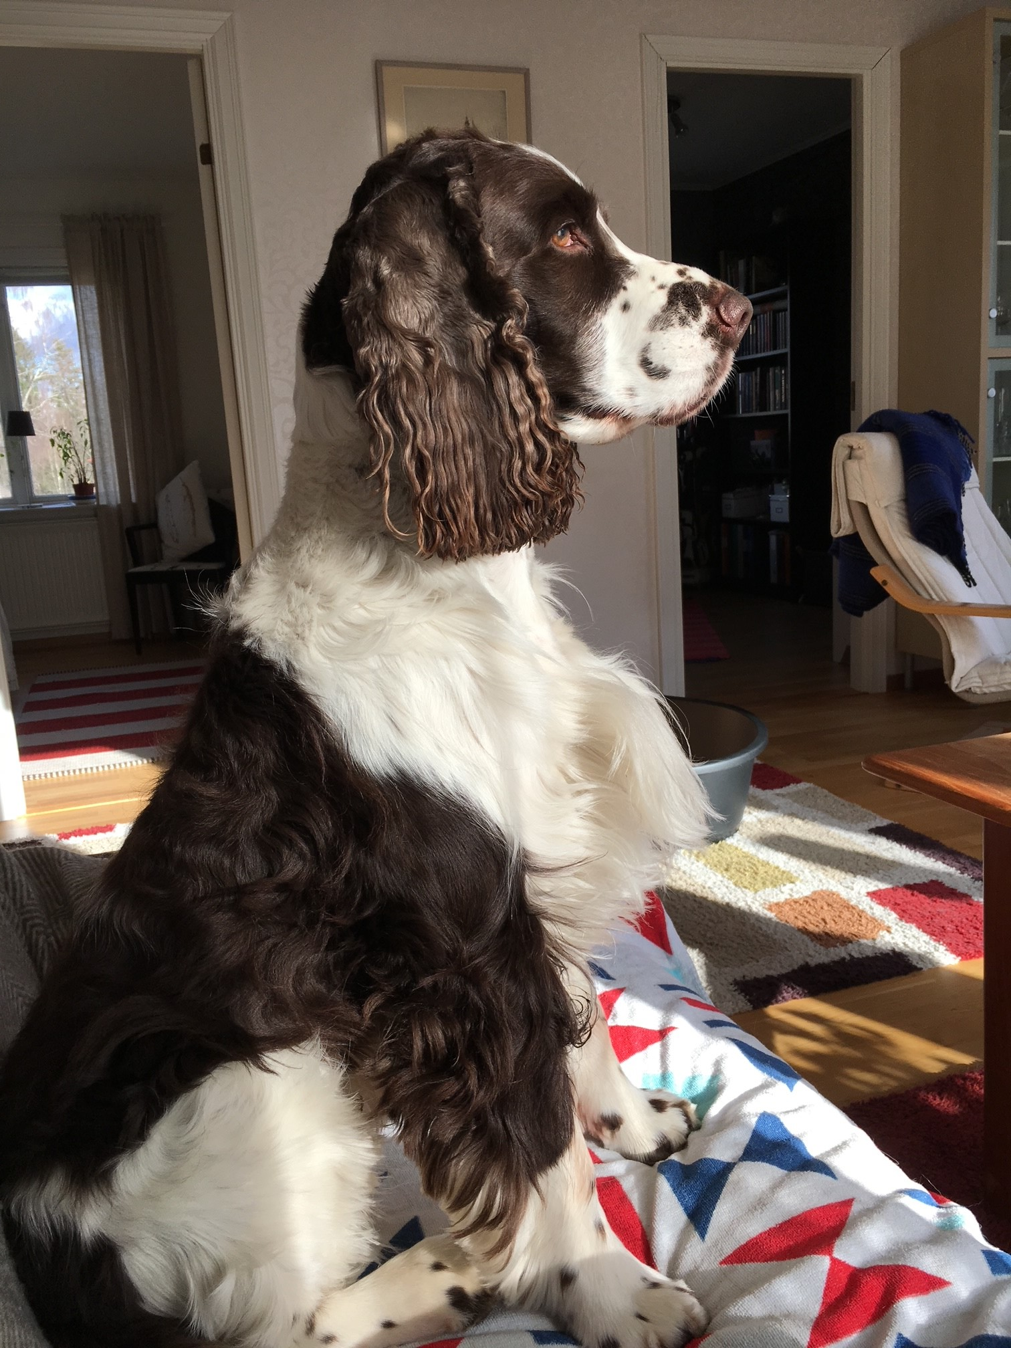
So, what is my thesis about?
Overarching research question
What tensions exist at Swedish university libraries between the task of preserving material and developing new collections, and what impact does it have on the library's identity?
This in turn leads to the following specified questions:
How is the task of preserving material at Swedish university libraries described from a management perspective?
What significance, according to the management level, is attached to the development of new collections in a context characterized by open science?
How are these sub-collections given importance in relation to the library's identity
Tam
Notes:
After a lot of watching out the window, like Tam does on the picture, and many walks in the forest, I landed in my research questions. They have been altered many times. One example is that the overarching question used to be an specified question. And I guess I will adjust the questions many times more, but this is the questions in its current state.
I´ve dwelled on whether I should use the concept of ”new collections”, or whether I should specify already in the overarching questions that its about open science. It is about perspective and limitations.

Slide 6
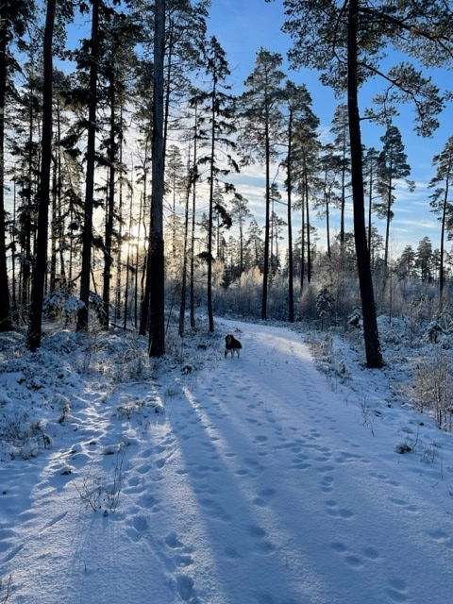
Methods and theories
Methods
In the next couple of weeks, a survey will be sent out to all managers at Swedish higher education institution libraries.
Most probably interviews with vice-chancellors and library managers.
Theoretical framework
Document theory
Hatch and Schultz’s theory on organizational identity:
Hatch, M. J., & Schultz, M. (2002). The dynamics of organizational identity. Human Relations, 55(8), 989-1018.
Tam
Notes:
When it comes to data collection methods I plan to use survey and interview. At the moment I´m working on a survey that will be sent out to all managers at Swedish higher institution libraries. The survey questions is based on previous research, recent reports within Sweden, and my own experience. I pose several questions where they are asked to show to what extent they agree or not.
Examples of statements I pose in the survey:
I understand that the budget allocation for the library shows that the university prioritizes the activity (the library),
I understand that the university management's demands for evaluation of the library's activities have increased in the last 5 years,
I understand that the university's management highlights the preservation of cultural heritage as a priority for my library,
I understand that there is a widespread perception among the institution's researchers/doctoral students that my library pursues the work for open science too intensively.
The next step will most probably be interviews with vice-chancellors and library managers at a number of university libraries. They work closely with open science and at the same time store and preserve large collections of cultural heritage. It makes them ideal to study.
My theoretical framework is under construction. I will not focus on theory in my presentation today, but I just want to mention what I´m planning to use:
Document theory to see what aspect of the document and the collection is attributed,
The dynamics when the identity takes shape is partly understood using a theory by Hatch and Schultz.

Slide 7
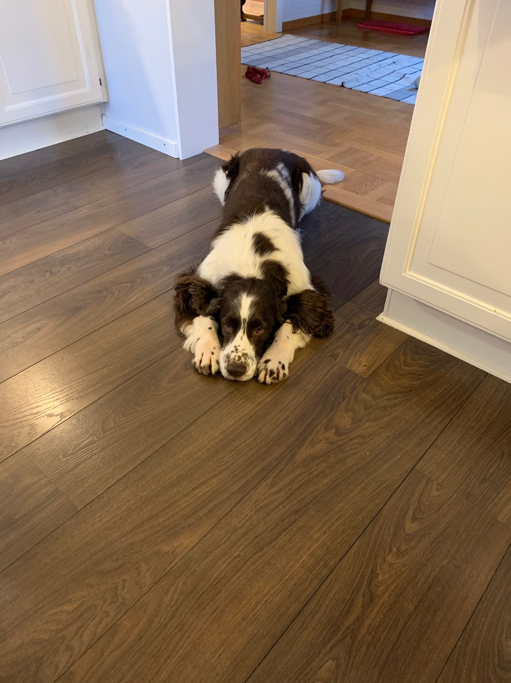
Where am I now?
Most of the time I enjoy being a PhD student!
But some days I feel like Tam: wondering if I´m doing it right. Have I chosen the ”right” methods? Are the theories applicable? Are there too many concepts of importance in my study? …collection, open science, organizational identity, document, etc.
For that reason, I value your input, both here at the PhD forum and hopefully later in the conference between sessions.
Tam

