Slide 1
Labour-market needs for industrial property skills and competences of non-lawyers
dr. Katarina Švab - dr. Polona Vilar - dr. Tjaša Jug
Faculty of arts, University of Ljubljana, Slovenia

Slide 2
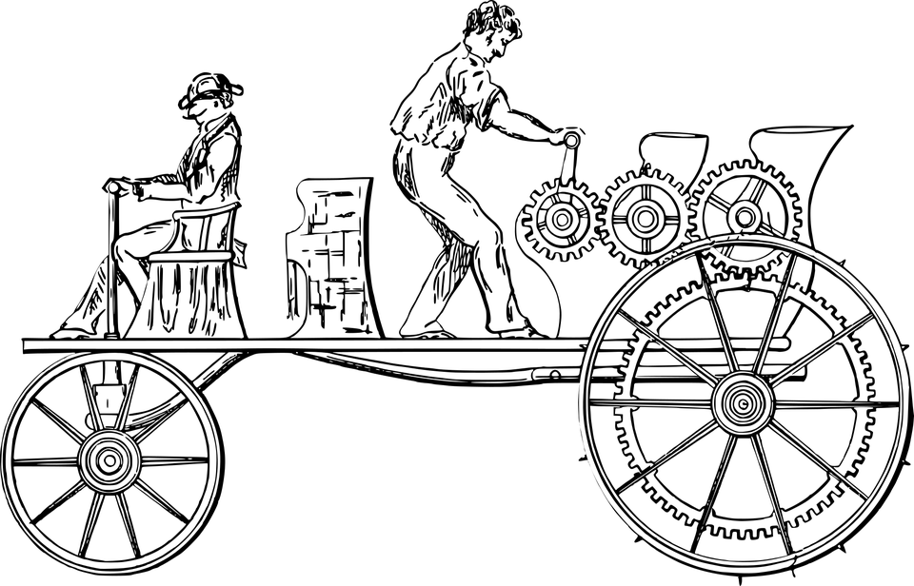
Two branches of intellectual property
COPYRIGHT AND RELATED RIGHTS
INDUSTRIAL PROPERTY
Copyright
Related rights
Patents for inventions
Industrial designs
Trademarks
Service marks
Layout designs of integrated circuits
Commercial names and designations
Geographical indications

Slide 3
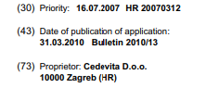
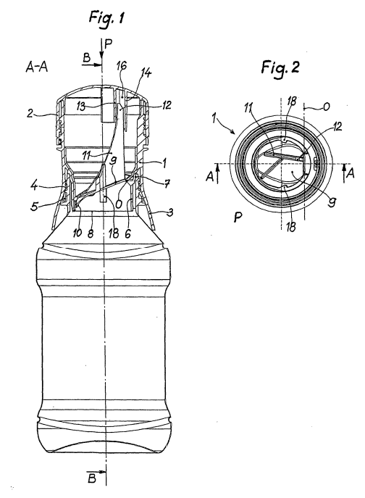
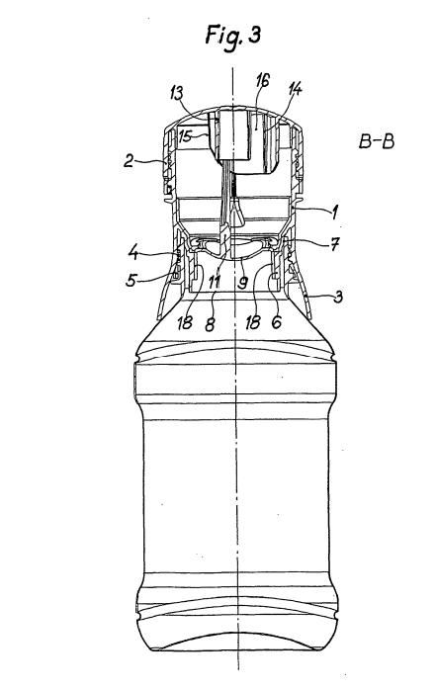
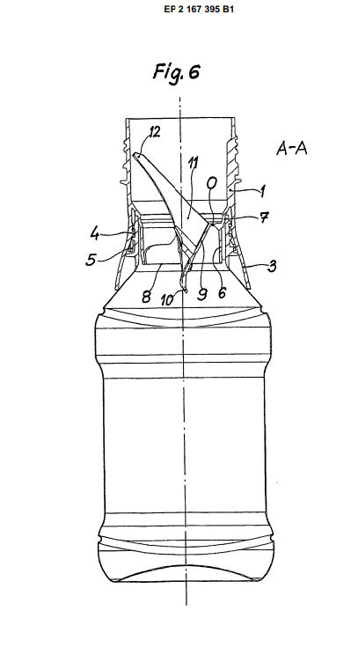
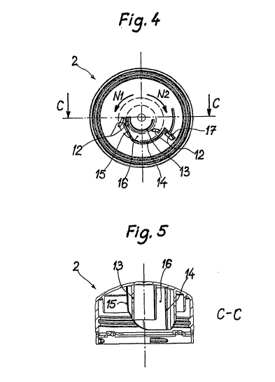
One product, many rights
Source: European Patent Office. (n.d.). Bottle cap provided with powder material box and used for drink blending. https://worldwide.espacenet.com/patent/

Slide 4
Project aimed at introducing education in the field of Intellectual Property, in the curriculum of technical Universities.
The goal is to develop innovative teaching tools for staff to acquire the skills and competences to deliver IP courses and services.

Slide 5
Research questions
RQ1
The importance of IP competencies of non-lawyers to the employers.
RQ2
Which IP competencies of non-lawyers are needed in the labour market.
RQ3
Attitudes of the employers towards training in IP.

Slide 6
Methodology
2021.
Online survey, 11 questions.
Companies that work with IP.
Personal invitations, social media, IP offices, technical libraries.
Various sampling.
177 adequately filled-in surveys.

Slide 7
Some results

Slide 8
Importance, given by the employers, to various areas of IP competencies with job candidates and current employers

Slide 9
When dealing with IP issues, does the organization/company prefer to consult an outside specialist in the field or your employees with these competencies.

Slide 10
How often does the company/organization have to deal with IP issues in their work

Slide 11
TRAINING on IP

Slide 12
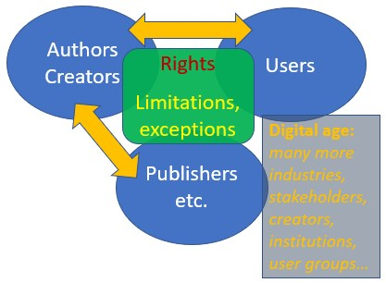
Role of libraries in IP
•IP as balancing of interests
•Libraries as creatures of the balance in IP
Providing access (lend, share)
Collecting, preserving
Market for published works
Advocating „Members of the public take their rights for granted and generally exercise common-sense, but do not usually get involved in policy deliberations.“
•Help users navigate through the „information jungle“ without getting „in trouble“
•Recognize IP issues and direct users to relevant material about IP, licensing etc.
Information, not legal advice
new forms of librarianship!​

Slide 13
gamification librarianship

Slide 14
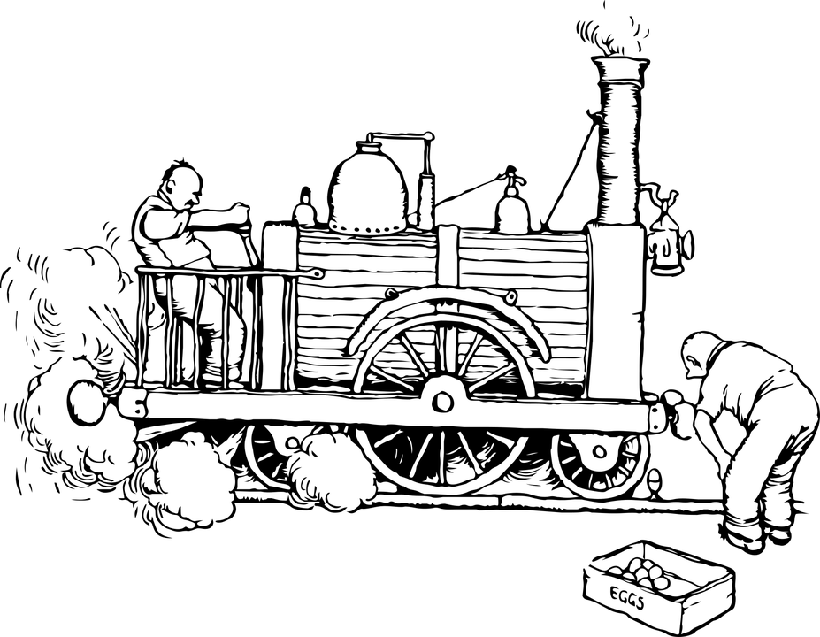
Conclusion
IP play an important role in various disciplines.
Providing an innovative, stimulating and legally secure enviroment.
Self-taught or as part of systematic training and formal educational process.
It is rarely included in the curricula of faculties other than law schools.
Important also for libraries.

Slide 15
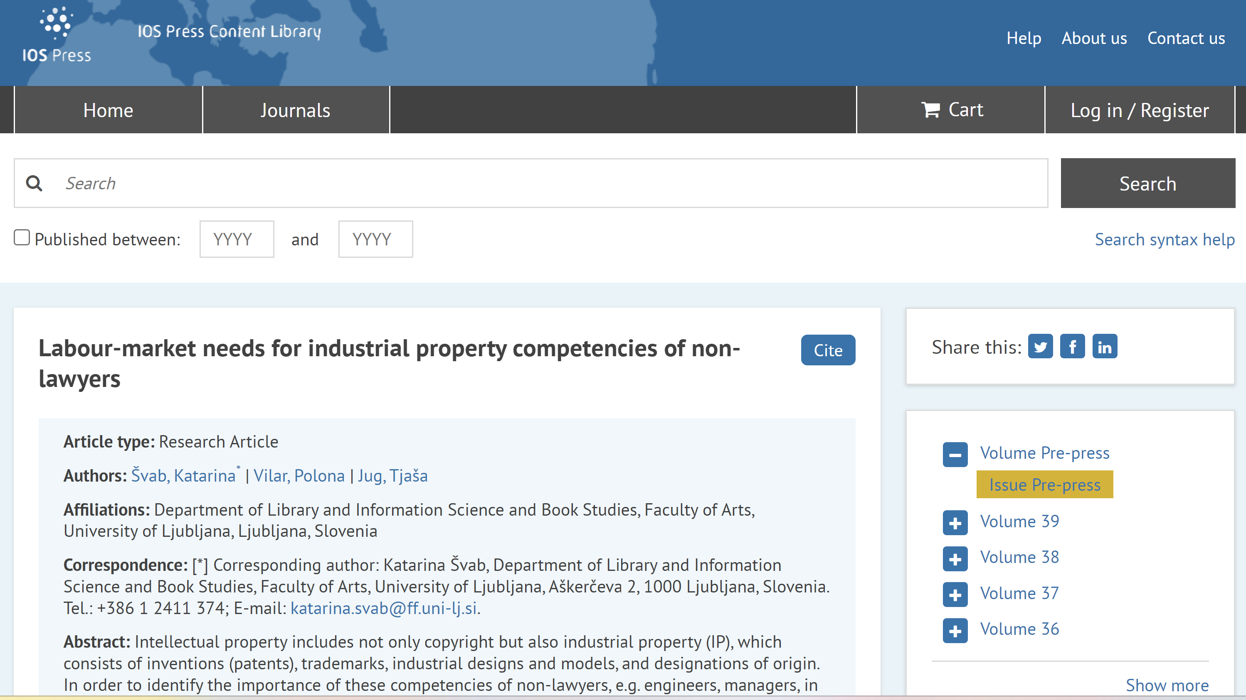
https://content.iospress.com/articles/education-for-information/efi230049

Slide 16
Thank you!
Questions?

