Slide 1
What images are communicating about the COVID-19 pandemic?
Josipa Selthofer
PhD, Assistant Professor
jselthofer@ffos.hr
Ines Hocenski
teaching assistant
ihocenski@ffos.hr
Department of Information Sciences
Faculty of Humanities and Social Sciences
University of Osijek, Croatia

Slide 2
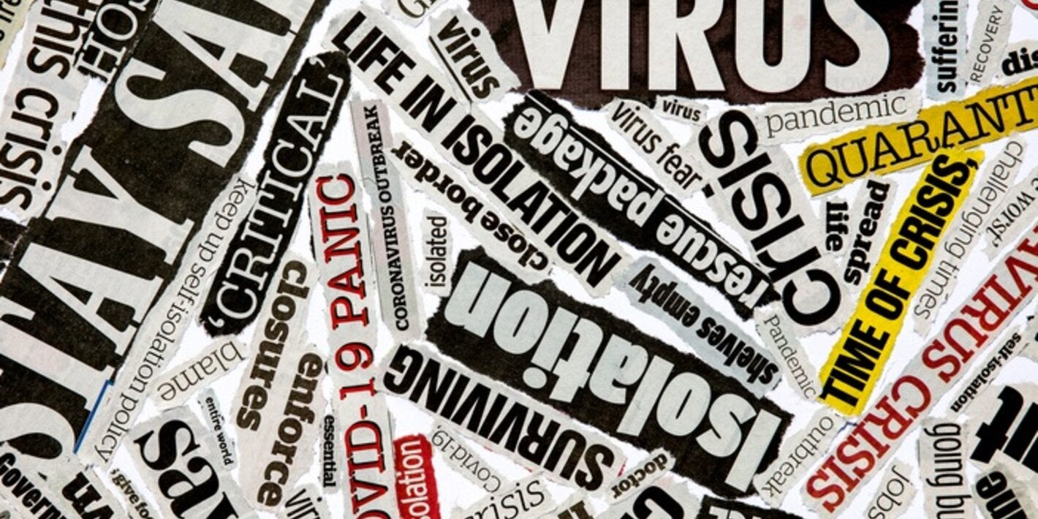
Introduction
Notes:
The coronavirus disease (COVID-19) pandemic made science become an international public sphere. In this time of mass communication, the world was under the attack of so many articles and images published on news portals. Images presented in a virtual environment were pictures of reality. Visually presented information can easily reach the target audience, transmitting a not-always-obvious message. Hidden meanings are often not known to viewers. The level of their visual literacy defines the way they are interpreted. Consumers were bombed, during the pandemic, with visual content and infodemic. Fake news and misinformation became prevalent in the age of (social) media, as it was written in The Lancet infectious Diseases. The research aims to analyze the graphic elements of images published during the COVID-19 crisis.

Slide 3
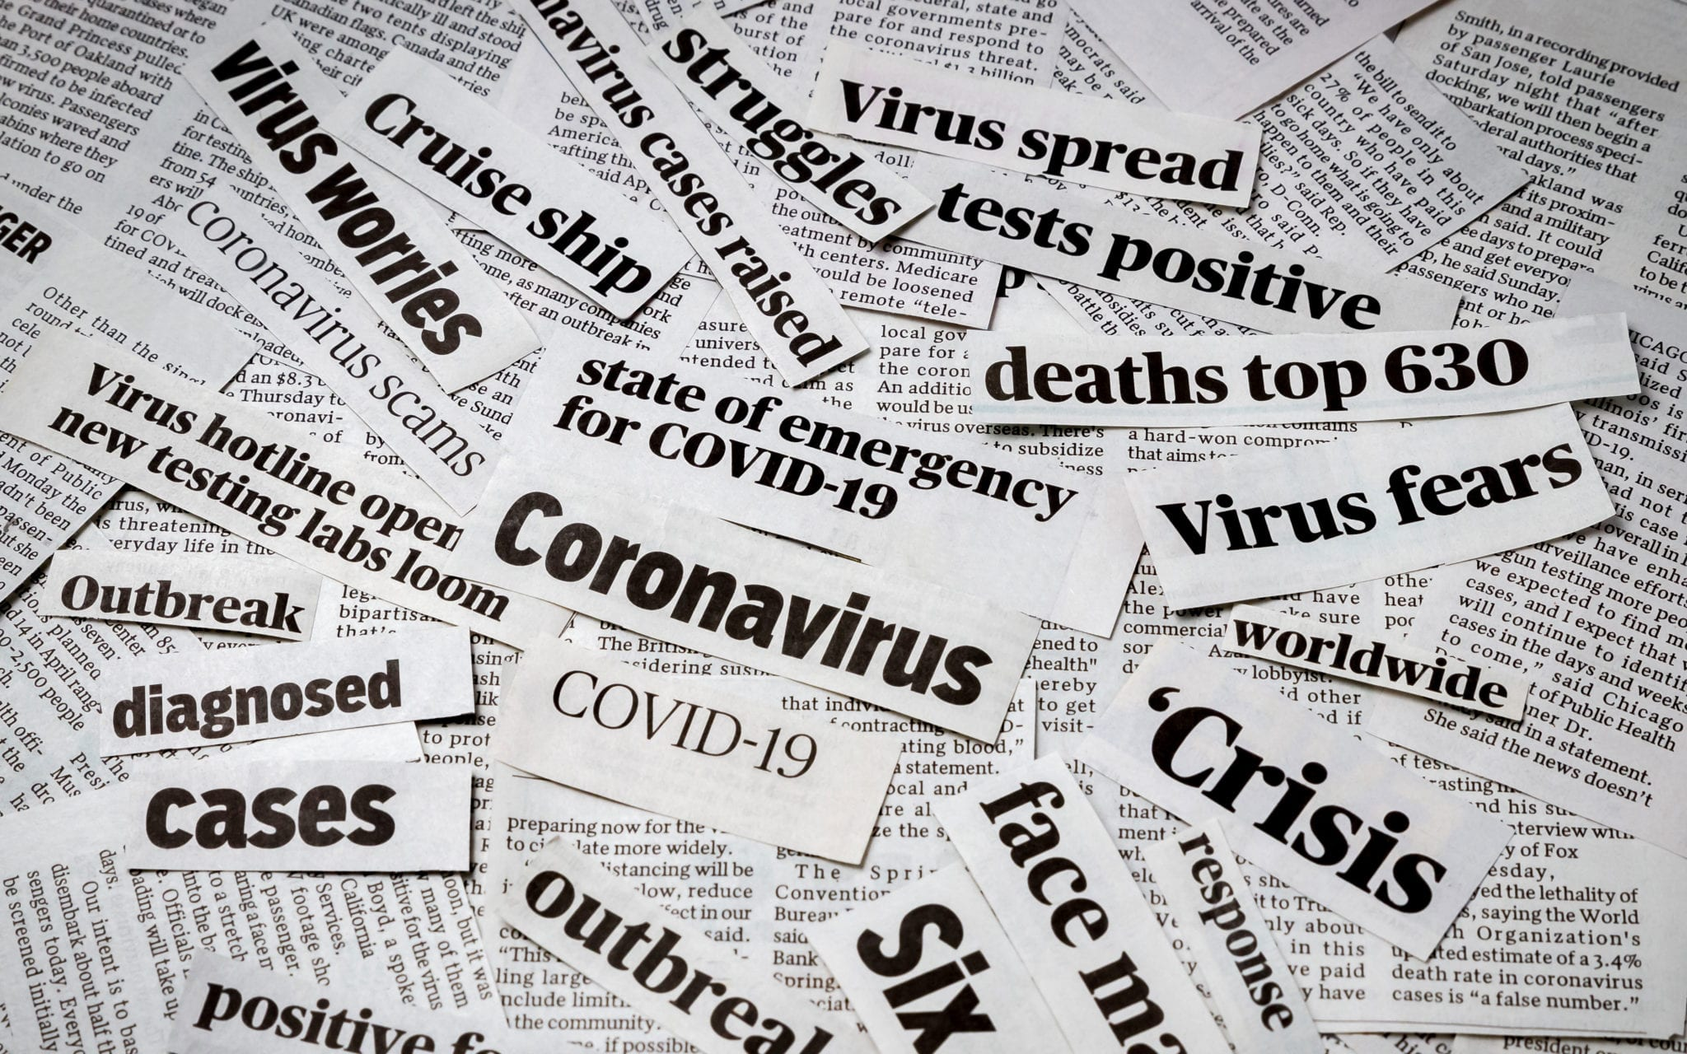
Notes:
The study aims to determine how visual information about COVID-19 was presented on news portals in Croatia from March 15, 2020, to December 30, 2021.
Study findings contribute to the knowledge of how visual communication is used in virtual environments during the COVID-19 crisis.

Slide 4
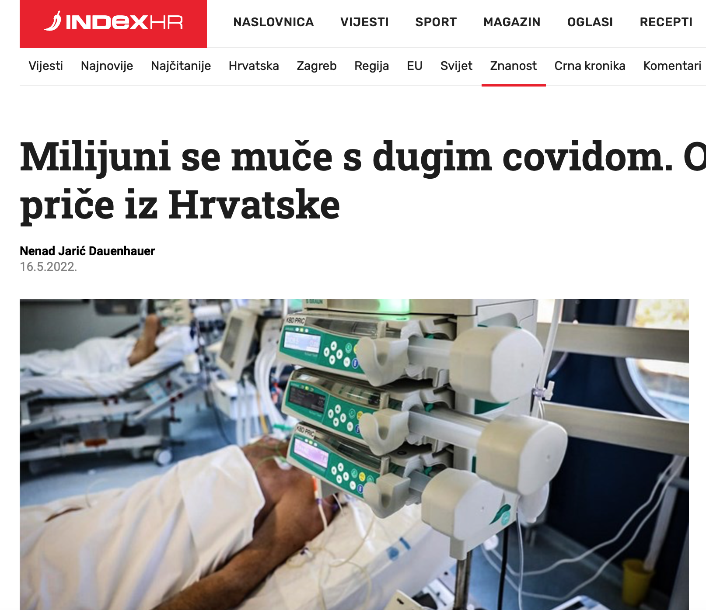
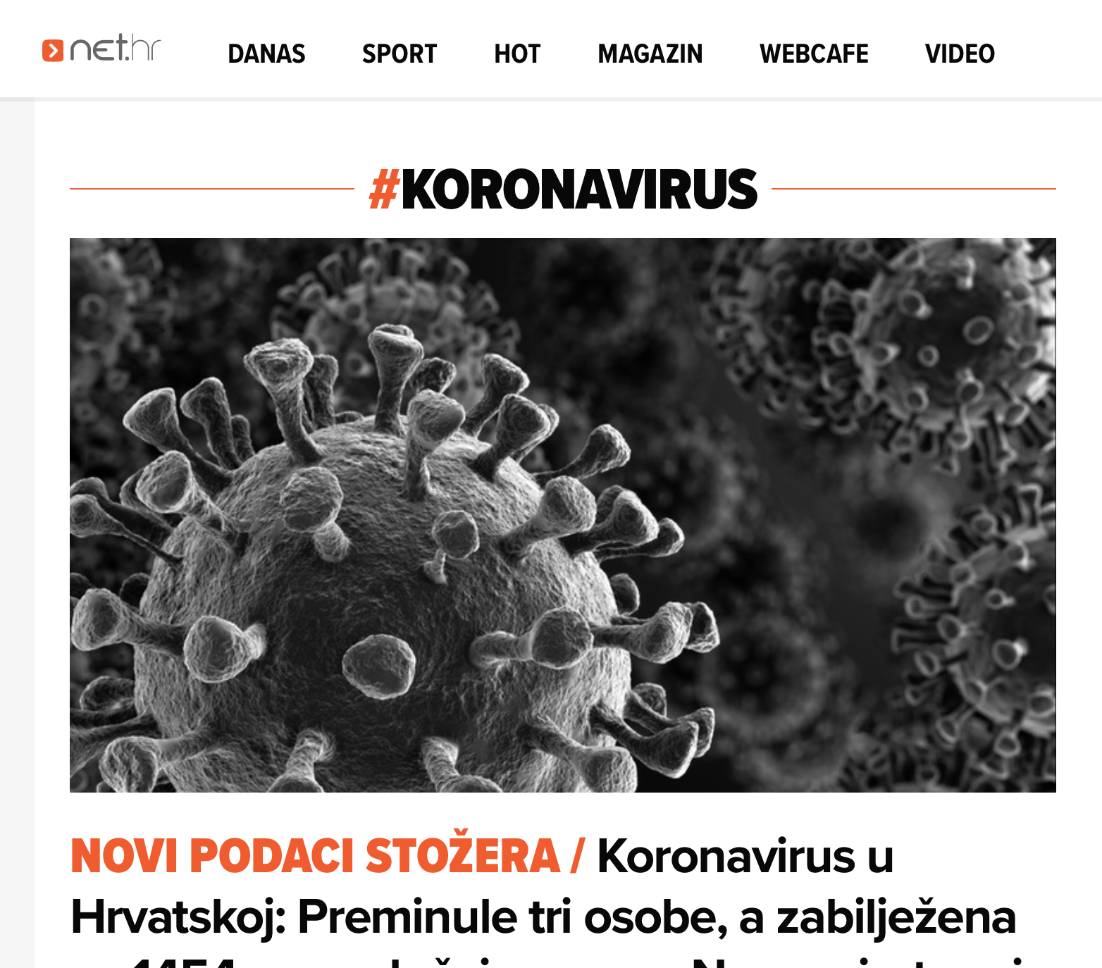
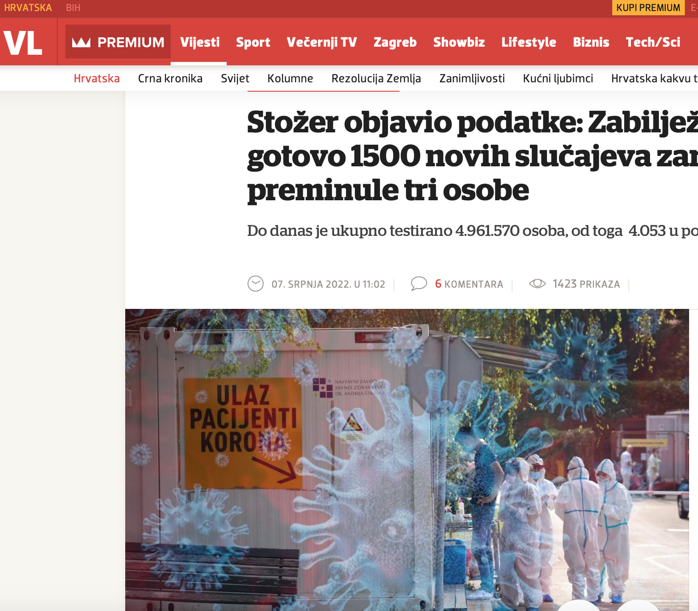
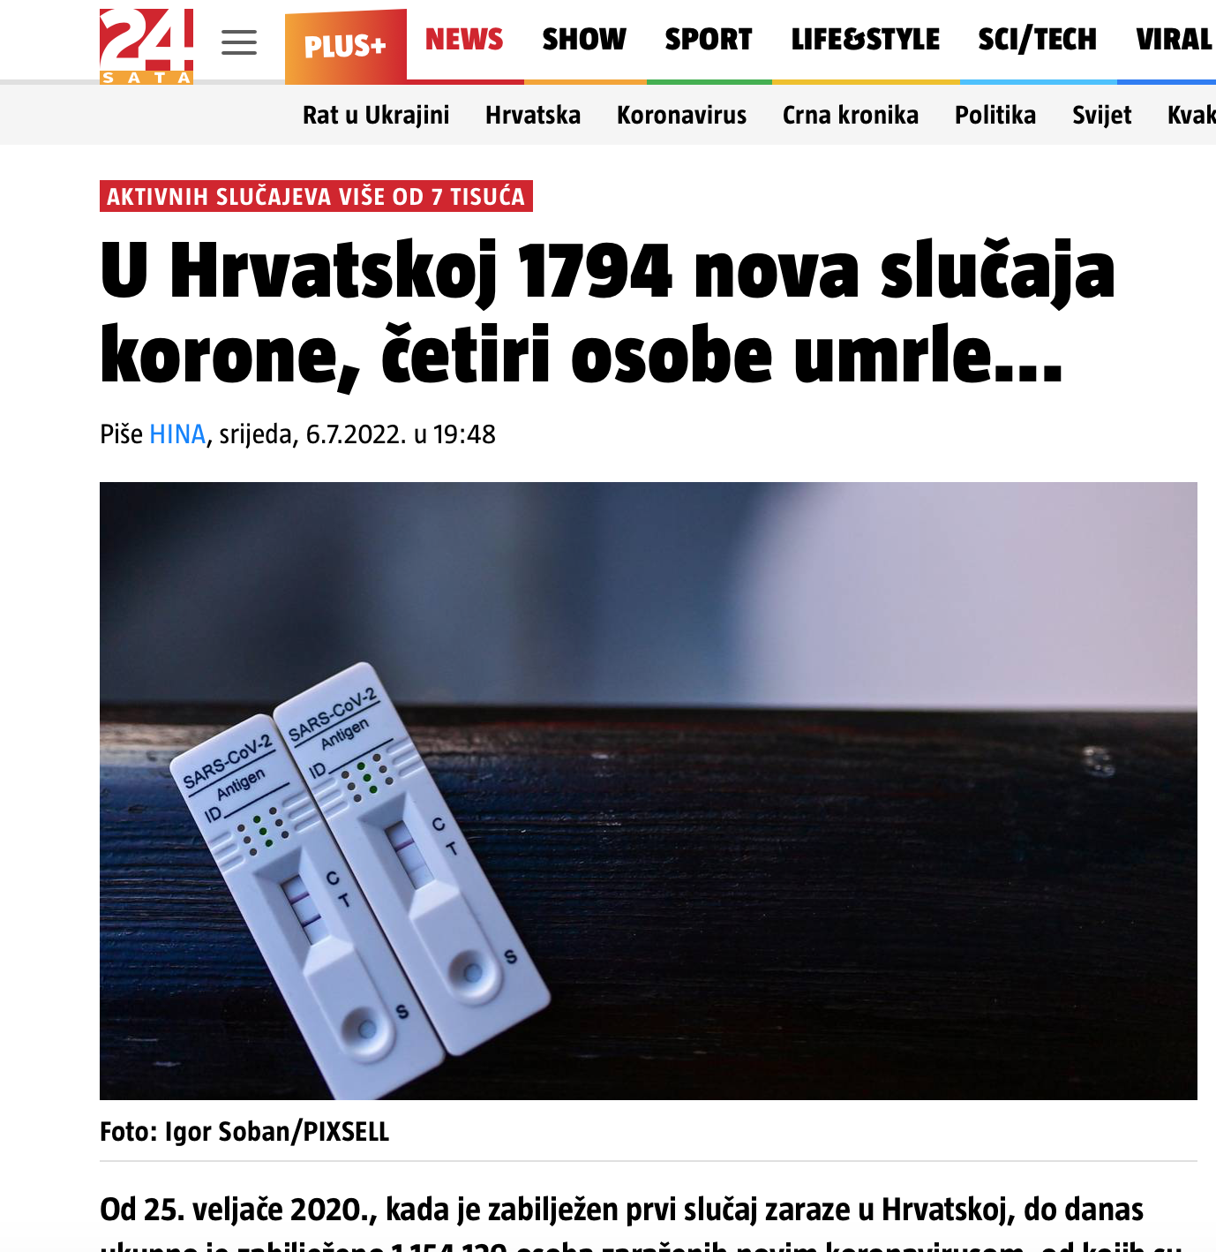
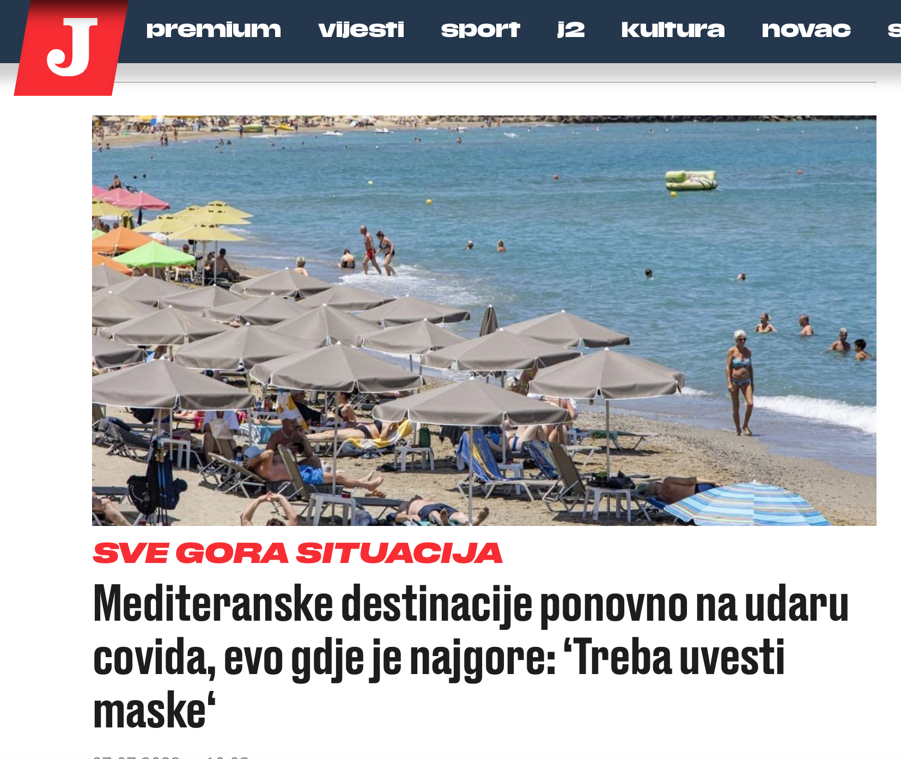
Research methodology
The methodology - visual content analysis Sample: 24sata, Index, Jutarnji, Net, Večernji list
Notes:
The five most popular Croatian news portals were the research sample: 24sata, Index, Jutarnji, Net, and Večernji list.
The methodology used was visual content analysis. Images have been downloaded from sample websites using Google Images tools and inserted in customized web applications. Research results have shown that visual communication on Croatian news portals was obtained in most cases with photographs, rather than infographics.

Slide 5
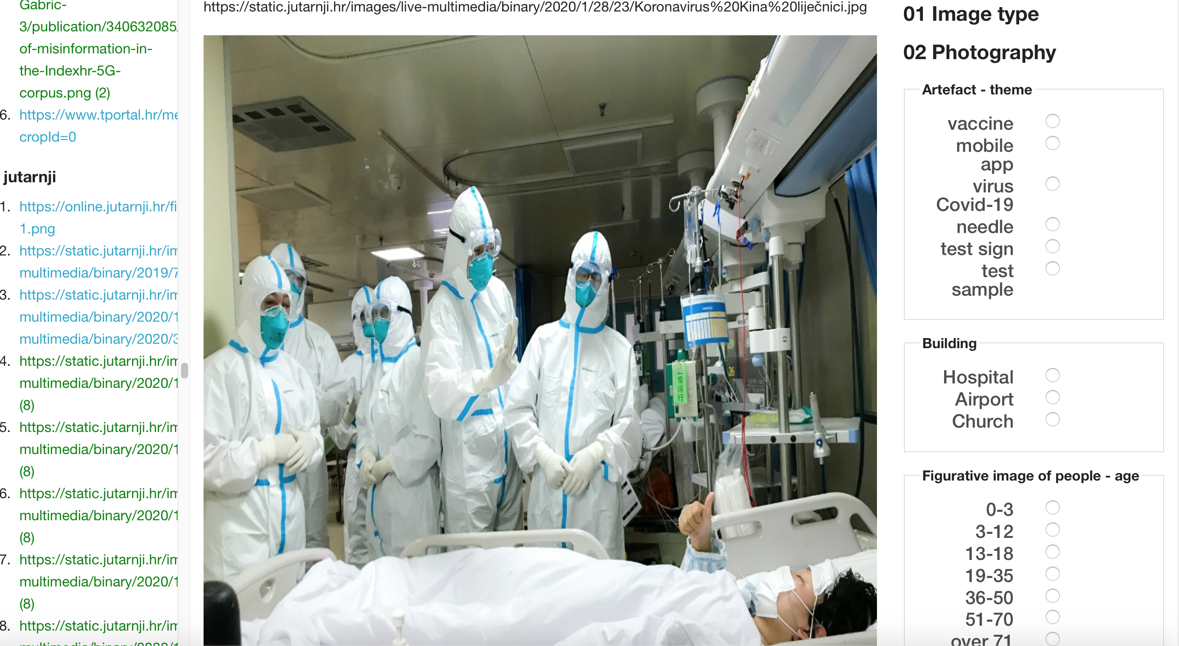
Customized web application for content analysis
Notes:
The research data were gathered and validated in a customized Web application (Selthofer, Jakopec 2014).

Slide 6
Categories and properties for the visual content analysis
photography - figurative or abstract images:
person, building, nature, or artefact
Figurative images of people:
gender
age group
social status
social distance
infographics:
the most prevalent colour
color (RGB), or 2/3 color combination
BW (grayscale)
content
text
image
symbol
graph
map
Notes:
Categories and properties in the analysis are created based on previous research in the field (Rose 2012).
Image elements from the research sample were infographics and photography.
Photographs from the research sample were marked as figurative or abstract images.
Figurative images were analyzed and assigned to one of the following categories: person, building, nature, or artefact.
Figurative images of people were further analyzed through different properties: gender, age group, social status, and social distance.
Graphic elements of the infographic were analyzed regarding the most prevalent colour used and content

Slide 7
Research results
Research sample:
376 photographs (only 1 abstract)
75 infographics

Slide 12
Notes:
38 % 2-3
34% 1

Slide 19
Conclusion
The research data collected through the study contribute to the knowledge of visual communication characteristics during the Covid-19 crisis on news portals in Croatia.
376 photographs (only 1 abstract), 75 infographics
The research results have shown that the majority of photographs presented on news portals in Croatia were:
figurative images of persons (2-3)
image theme - testing
mixed gender
undefined age (mainly because they wore face masks)
doctor-patient or nurse status
social or public distance
1 or 2 politicians
artefact type – vaccine or test sign
building type – airport or hospital
infographics – a map or text message, in RGB, black and white (grey) colour

Slide 20
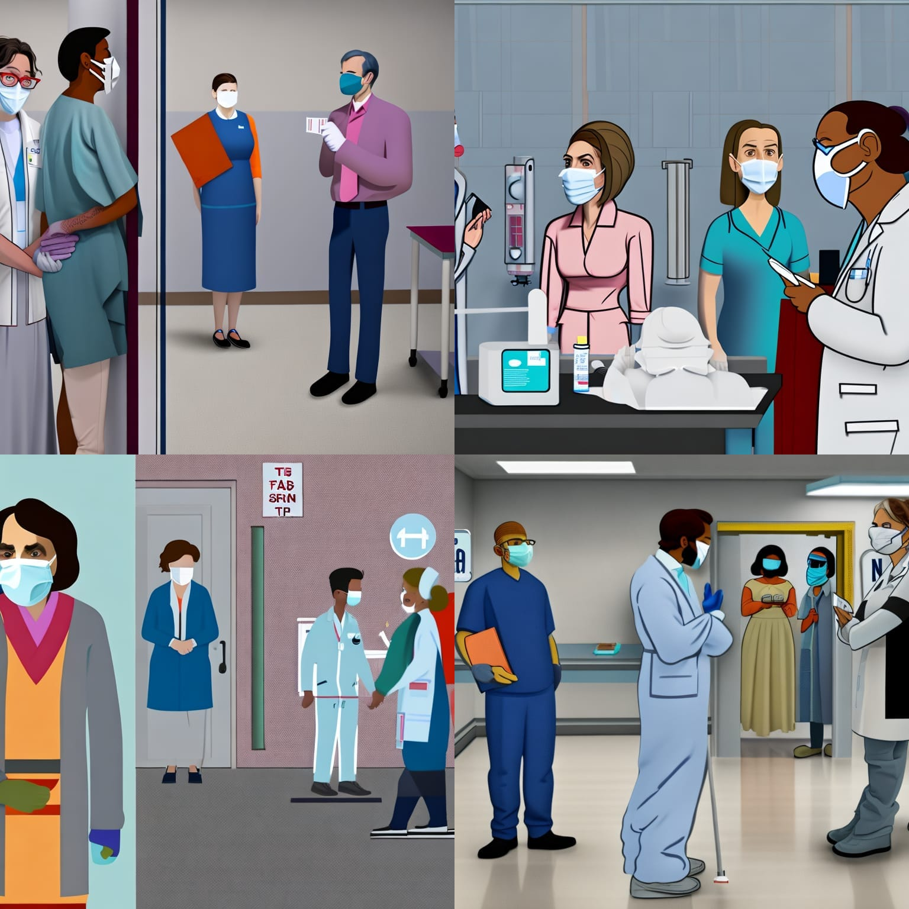
AI text to image converter result:

Slide 21
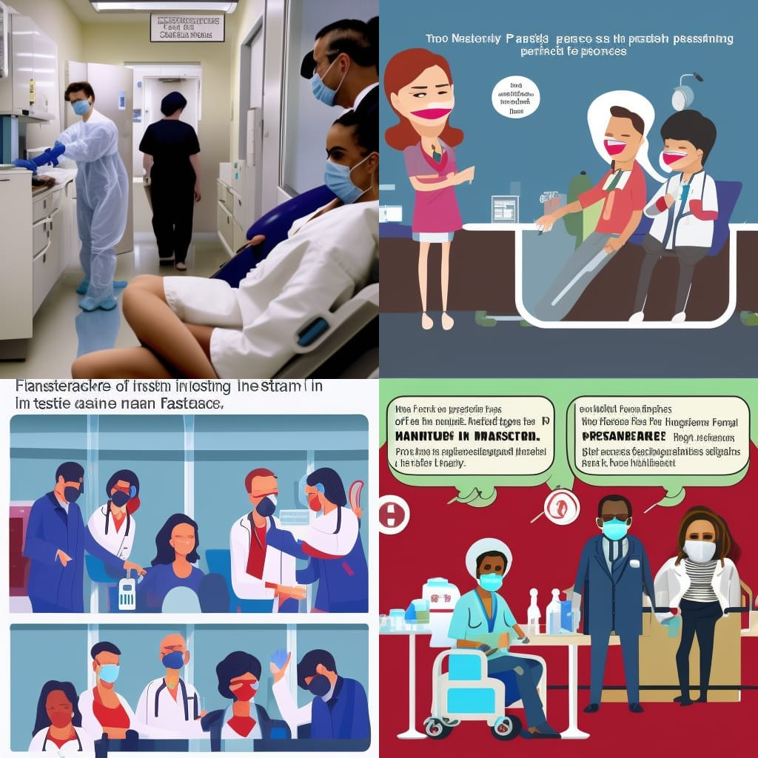

Slide 22
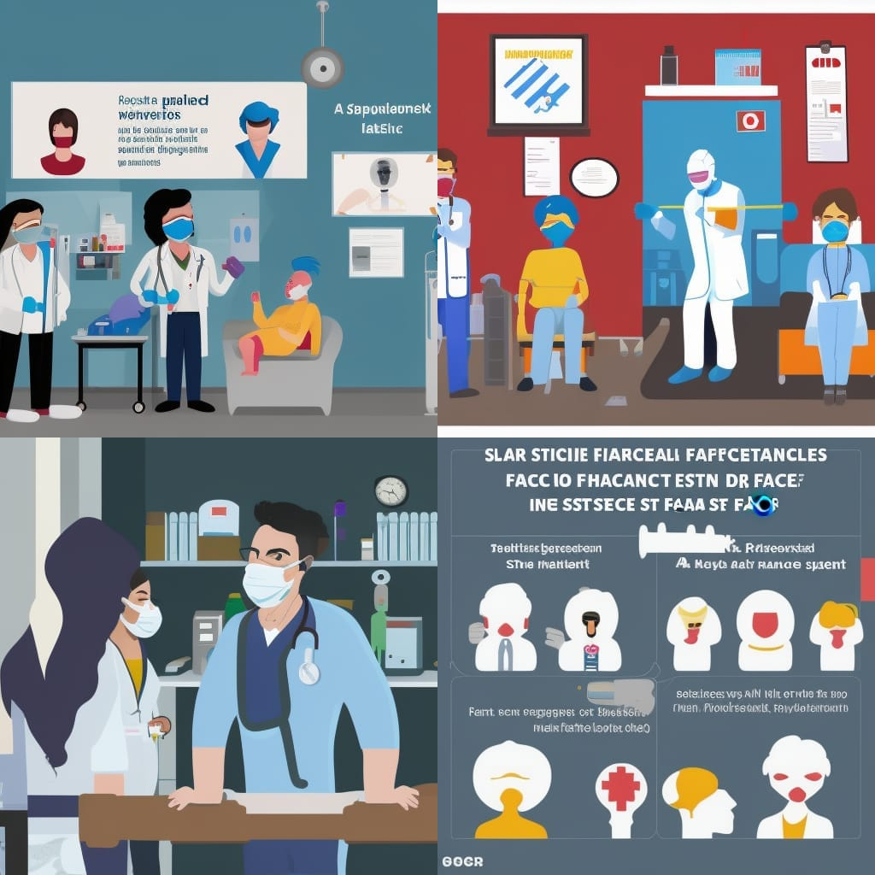
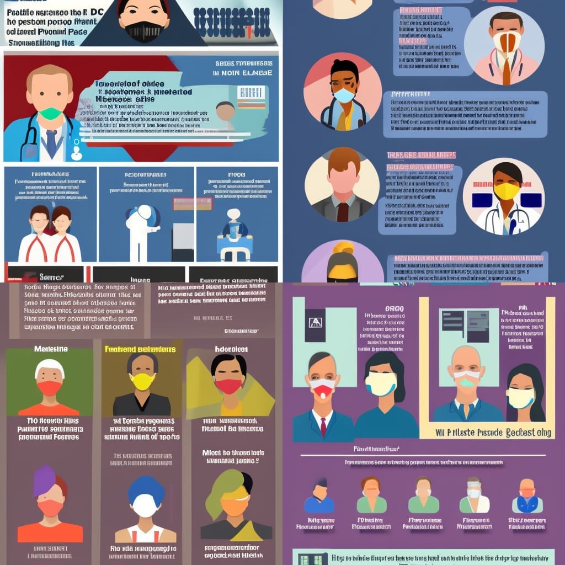

Slide 23
Thank you!

