Slide 1
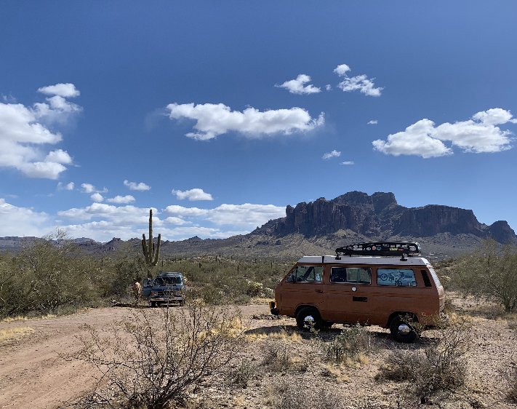
Further Extending the Concept of Place in Studying Mobile Populations
Kaitlin E. Montague, MI, Doctoral Candidate,
Rutgers University, The State University of New Jersey, USA
kaitlin.montgue@rutgers.edu
LIDA, Osijek, Croatia
May 23-26, 2023
Notes:
I’m Kaitlin Montague and I am a doctoral candidate from Rutgers University, the State University of New Jersey in the United States. Before we begin, all photographs that will be used throughout this presentation are from my data and I have my participant’s permission to use them in both presentations and publications.
Today I’m going to be presenting some thoughts on the ways I’ve been thinking about place and mobility in human information behavior (HIB) as I gear up to do my dissertation data collection this summer. First, I will briefly touch on some theories of place in HIB before identifying a gap in the literature. I will then provide a brief overview of my pilot study introducing vehicle residents who are people who live in their vehicles, as my population of interest, and main results from my pilot study. These results initiated my current thoughts about place and mobility.

Slide 2
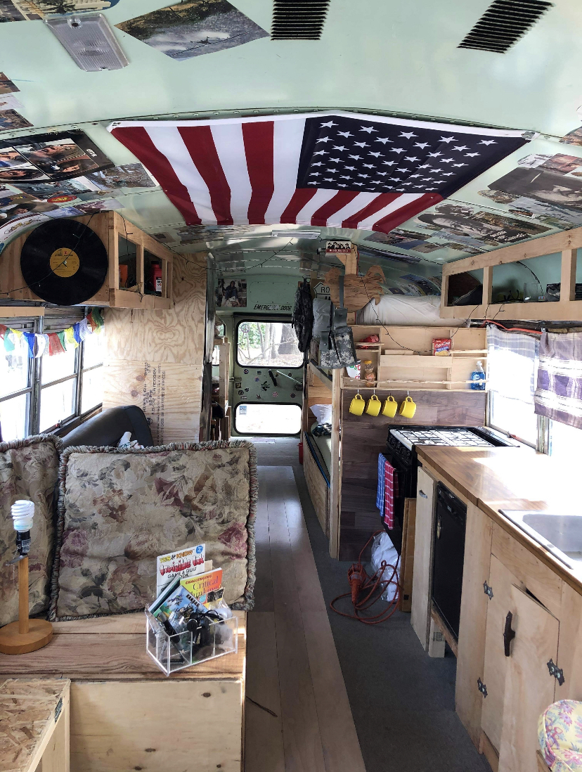
Place in Human Information Behavior
Information Horizons (Sonnenwald, 1999)
Spatial Metaphor (Savolanien, 2007)
Information Zones (Gibson and Kaplan, 2017)
Small Worlds (Chatman, 1991)
Information Worlds (Burnett & Jaeger, 2007)
Information Grounds (Fisher, Durrance, and Hinton, 2004)
Information Landscapes (Lloyd, 2006)
Notes:
We have a small group of theories that encompass place in HIB but for the purposes of this presentation, I’m going to focus on information horizons and its extensions.

Slide 3
Place in Human Information Behavior
Information Horizons (Sonnenwald, 1999)
Spatial Metaphor (Savolanien, 2006)
Information Zones (Gibson and Kaplan, 2017)
Notes:
Sonnenwald posited that within a context situation exists an “information horizon” in which we can act. Every individual has a relative and specific information horizon. These horizons may include social networks, documents, information retrieval tools, and observation in the world. They can also be determined on a social level, for instance, if someone in your social network may think of source is more appropriate than another, that might influence your own opinions about that sources’ value. Based on information horizons, Savolanien introduces the spatial representation of information source horizons, identifying a person’s most important to least important sources.
Also building off of information horizons, Gibson and Kaplan introduce information zones based on the resolution of information and service needs in terms of distance or travel time, space, and place. Instead of concentrating on the specific information behaviors of participants, their study illuminates the interactions between place, information needs, and information access. From this concept, Gibson and Kaplan (2017) constructed the foundation of a framework aimed at describing and investigating geographic zones of information access in local communities.
The first to consider travel time in relation to information access, Gibson and Kaplan (2017) provide the field with a framework through which to understand how information access influences mobility in the resolution of information and service needs in terms of distance, such as home, local, regional, and long distance, from a base, highlighting the stationary position of the information seeker. Clearly, factors such as proximity have some impact on ease of access to information, which creates space for information behavior researchers to interrogate the ways that physical properties of spaces constrain or facilitate information access.
One of the most well-known examples of this is information grounds, which highlights the physical and social elements of different types of places where information flows. Based on information grounds, we can assume that there are also corresponding characteristics of places that would constrict or block the flow of information; however, research in this area has not been investigated or theorized in the same way and this is the gap I hope to fill.

Slide 4
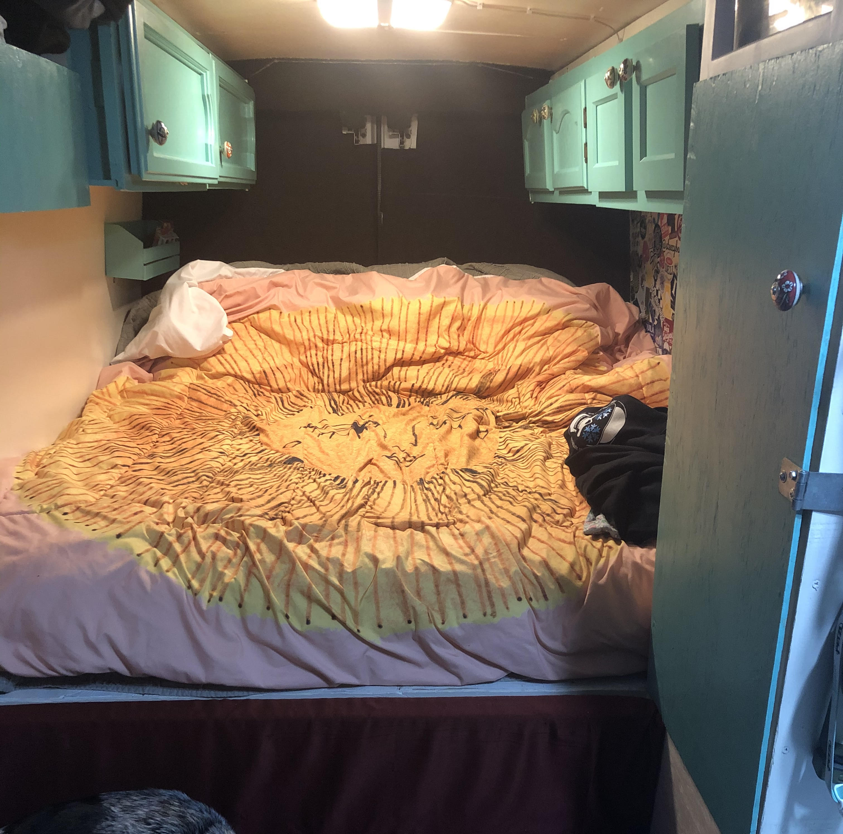
Meet Zach and Emily
White
Male and female
28 and 27 respectively
Zach is a full-time server at a mountain resort
Emily is a full-time ski instructor at the same resort
They were unable to afford rent in their expensive mountain town
Bought a van and made it home
Notes:
Now that we have established a few of the ways that HIB conceptualizes places. I’m going to introduce you to two of my seven participants as I pivot to my pilot study.
During previous research I conducted via Zoom, I met a couple named Zach and Emily. They were working full-time hours as ski instructors and restaurant servers at a mountain resort in Colorado, but were unable to afford rent in this expensive mountain town during a time when housing expenses account for more than half of the monthly salary of lower-income Americans. They chose to combine their savings to purchase a van that they would call home. Despite the rise in vehicle residency over recent years, the legality of vehicle residency is still contested in most states, criminalizing a survival strategy of lower-income Americans. In summer months, when the snow melts, Zach and Emily make their home in the woods just outside the town limits to avoid agitated tourists and the “punitive pushes” of law enforcement. Emily explained their difficulties in an interview, “In the summers, a lot of the time where we live, we don’t have cell service, it’s really hard. So, once we’re at home for the night, you don’t use your phone.” They did not intend to live “off the grid,” rather they were pushed away from critical social and informational support.
When restrictive parking policies force vehicle residents like Zach and Emily to the margins of towns and cities, the law creates information inequities by literally moving this population out of cellular or Wi-Fi service range. Digital connectivity enables access to human connections and to information resources necessary to participate in local communities and society more generally. Access to both phone and internet service is essential to survival.

Slide 5
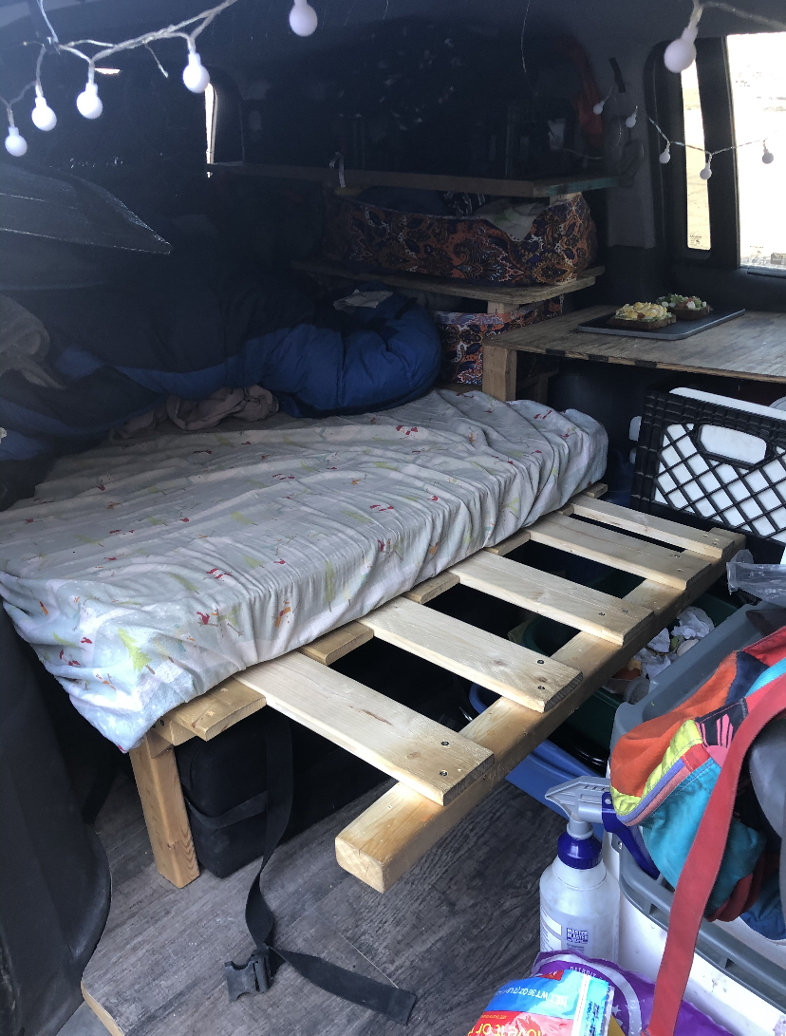
What is vehicle residency?
Unable to afford rent
Pare down belongings
Move into vehicles
Earn wages
Own their vehicle/home
Mobility is an important factor in their lifestyle
Notes:
So what is vehicle residency? For my participants, it takes shape in the decision to pare down their belongings and move into their vehicles (SUVs, vans, and mini-vans) to save money due to the unaffordability of rent in their current locations. They earn wages and maintain jobs, allowing them to sustain ownership of their vehicles and make a home inside them, further differentiating them from the homeless. Mobility is an important factor in their lifestyle as policy and law enforcement push them to the margins, out of Internet and cellular service range, accentuating their access instability which creates information inequities. Born out of these factors are the vehicle residents on which this study is based.

Slide 6
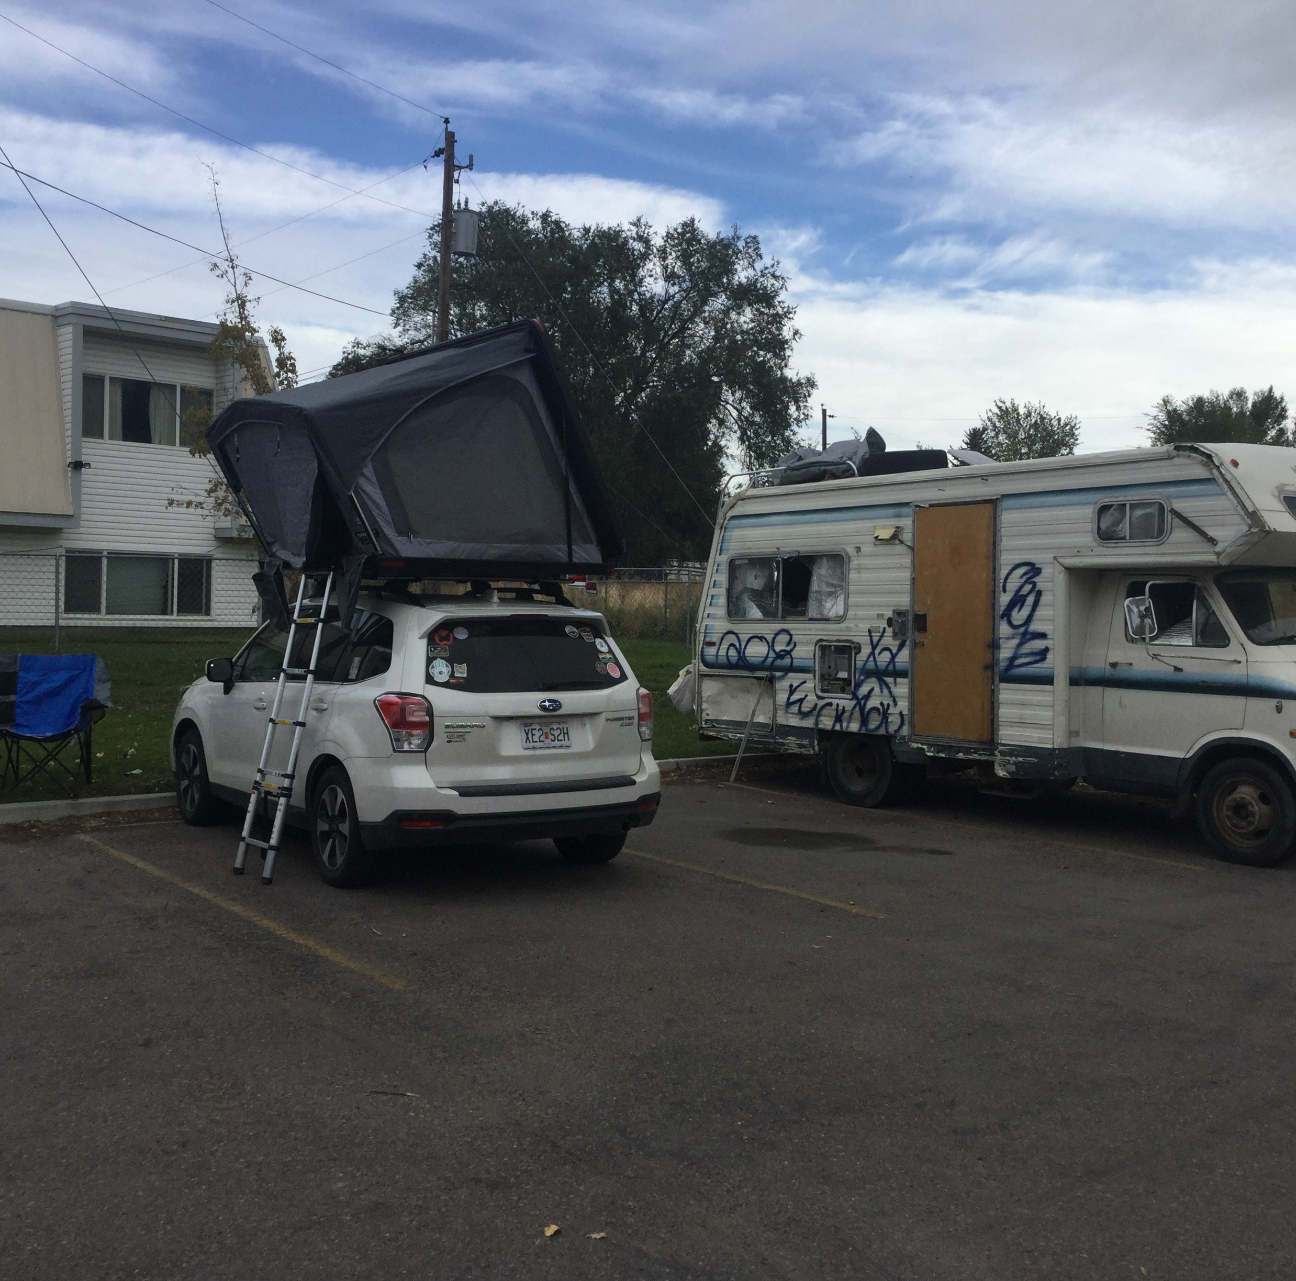
Mobilism as a Frame
movement, rather than a fixed state, is the norm
movement takes places in different directions and at different speeds
movement can cause friction but also can provide expansion for new developments (Hartmann, 2017, 2023)
Notes:
Hartmannn’s concept of mobilism provides a theoretical framing for this study. Mobilism emphasizes that
movement, rather than a fixed state, is the norm
movement takes places in different directions and at different speeds
movements can cause friction but also can provide expansion for new developments
For vehicle residents, movement is intrinsic. Mobilism extends the idea that movement is the norm which provides a framework through which we can prioritize vehicle residents’ movements.

Slide 7
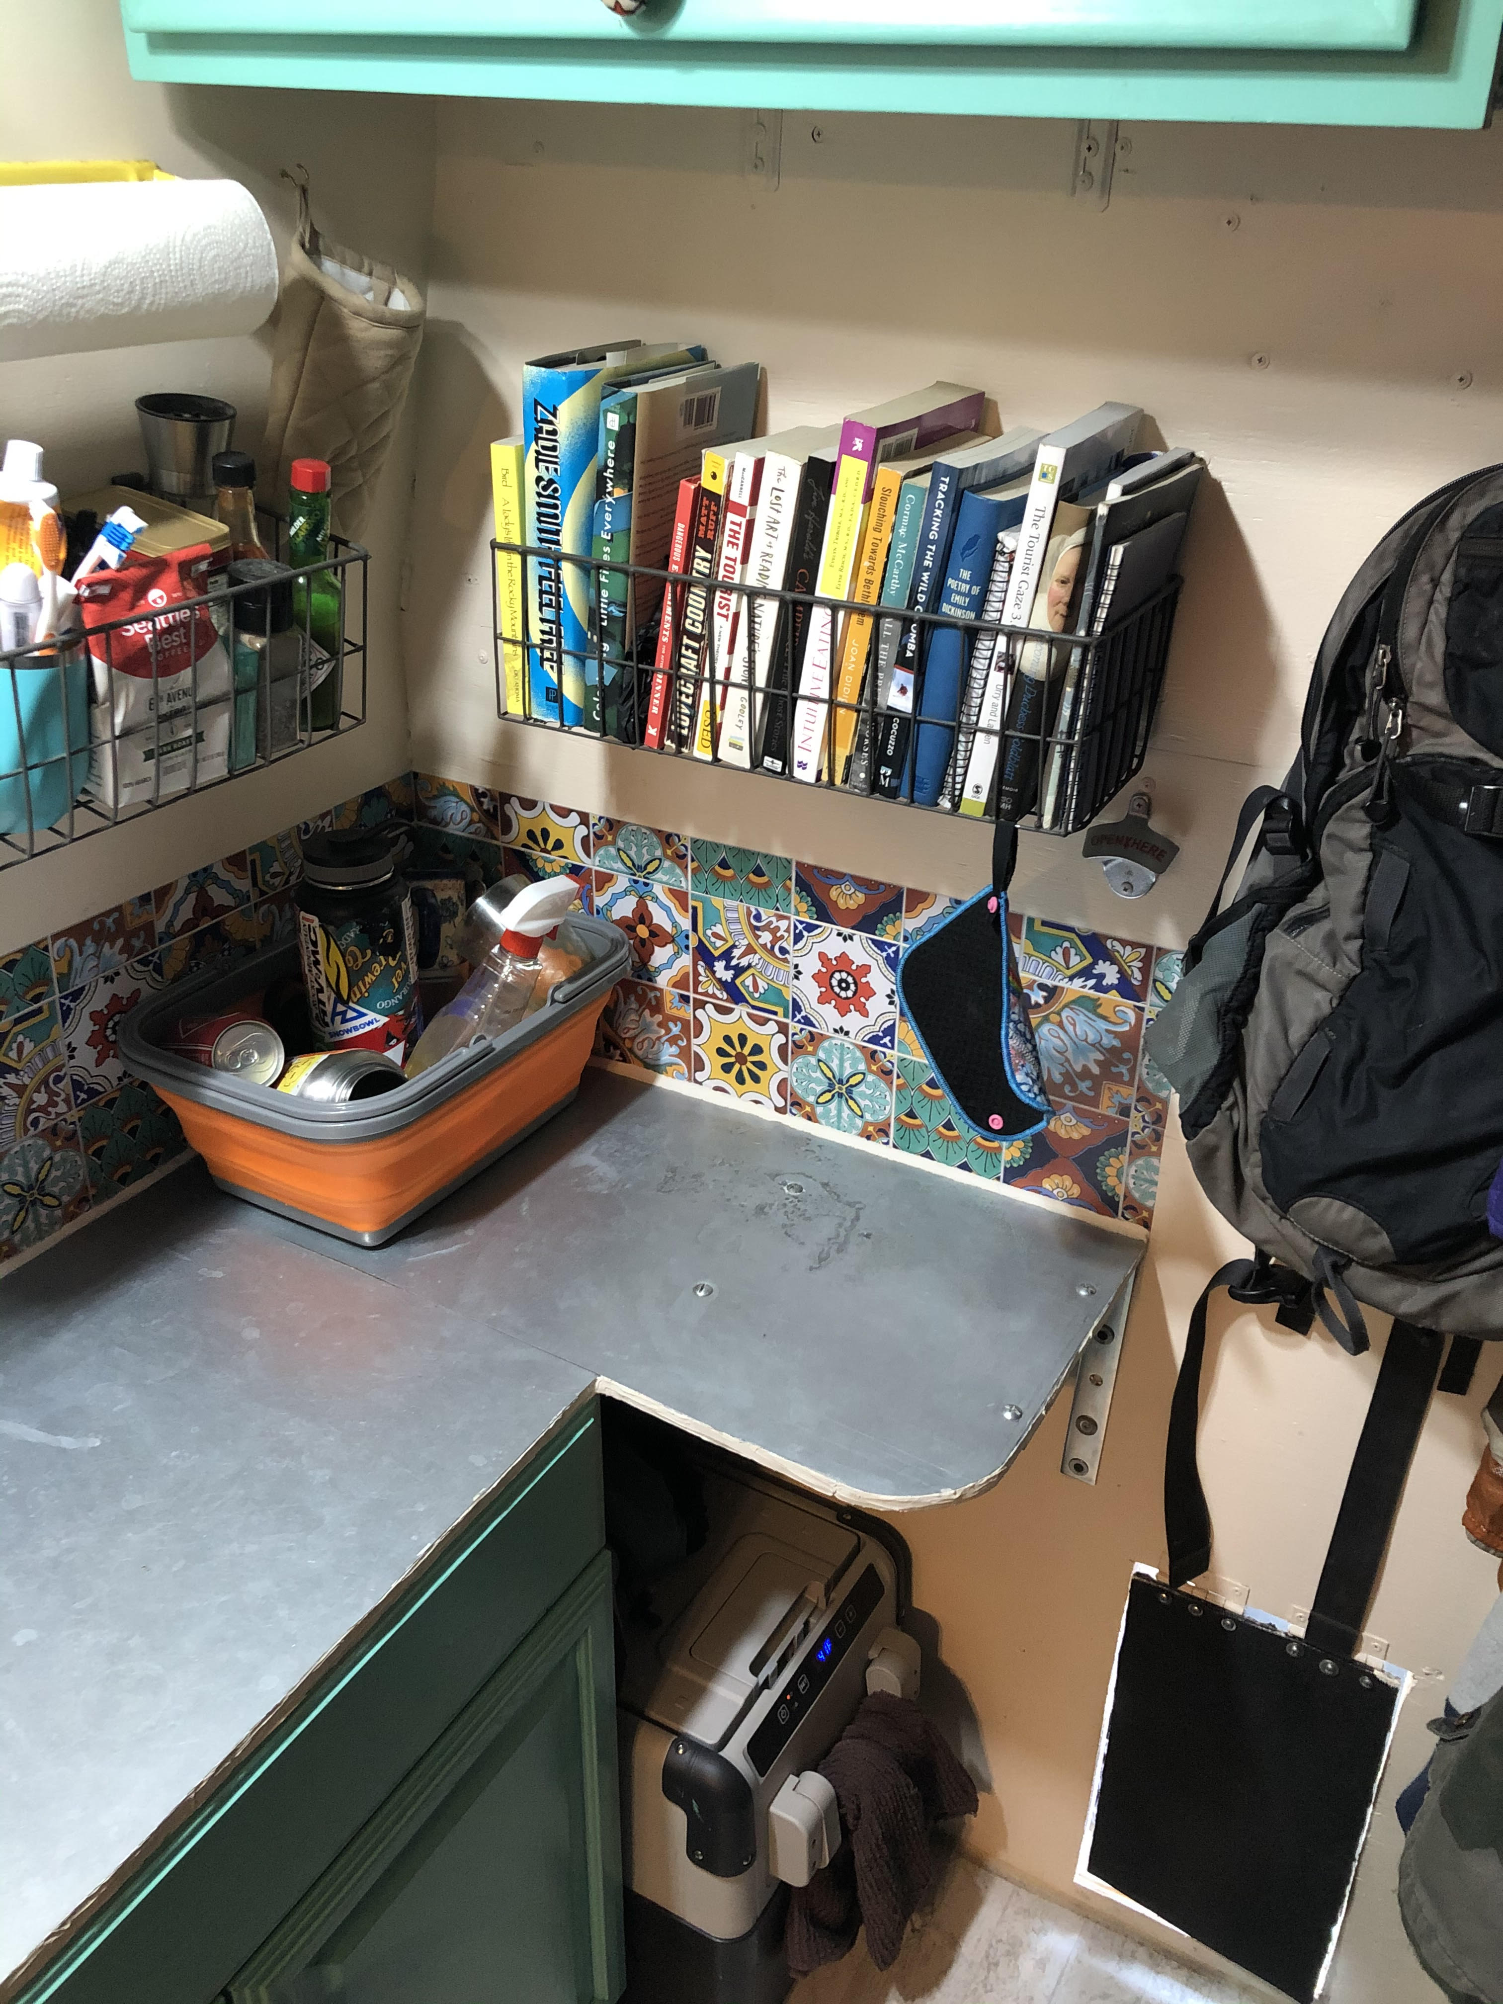
Methods
Data were collected from November 2020-June 2021
Snowball sampling
Interview 1
Semi-structured interviews
Guided tour with photos
Interview 2
Information horizon interviews (Sonnenwald, Wildemuth, and Harmon, 2001)
Analysis
Transcribed interviews to stay close to data (Corbin & Strauss, 2014)
Coded interview data using constant comparative method (Charmaz, 2014)
Notes:
My research question was what are the information practices of vehicle residents?
To understand this, data was collected in two sets of semi-structured interviews from November 2020-June 2021. The first set of interviews consisted of semi-structured interviews and guided tours of participant’s vans. The second set consisted of follow-up interviews using the concept of information horizons. Participants were recruited via snowball sampling and were located in different parts of the US (e.g., Colorado, Louisiana, California, and Arizona). To recruit the first participant, I utilized existing connections with people living this lifestyle and then used snowball sampling to obtain residual participants. Inclusion criteria was that participants must be 18 or older, have been living in a mobile vehicle for at least six consecutive months and the vehicle must run. Both sets of interviews were conducted via Zoom. The final sample included 7 participants and 14 interviews total. Two were couples; they were grouped for the purposes of data analysis.
The first set of interviews enabled me to explore the reasons why participants transitioned to a mobile lifestyle in addition to their information habits, practices, and feelings since transitioning into their vehicles.
The second set of interviews were conducted with the same participants to complete information horizon interviews to encourage participants to describe their information seeking process, information resources, and whether they were useful. Interview questions were followed by a drawing component where participants drew a diagram of themselves in the middle surrounded by their most frequently used information sources, while justifying their information source preferences aloud.
I transcribed the interviews as a means of staying close to the data. Transcripts were then coded using the constant comparative method, including iterative open coding to identify themes and illustrative quotations. During content analysis, I used induction to identify and categorize recurring conceptualizations and phenomena, then refined them by constantly comparing newly emerging patterns with previously discovered patterns. This process continued until data saturation was reached.

Slide 8
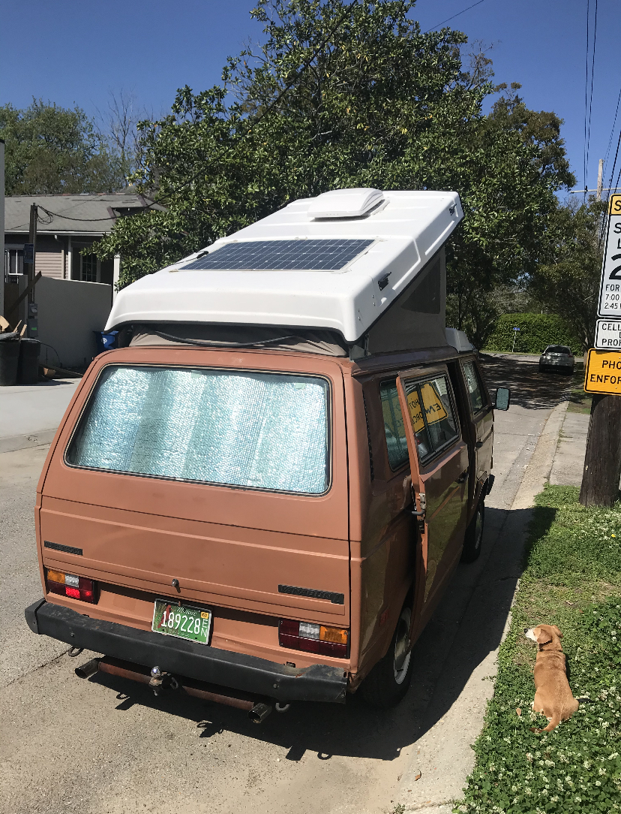
Demographics
7 Participants
1 non-binary person
2 females
4 males
Of the 7, 2 romantic couples
6 White, 1 Spanish
Ages ranged between 23-29
All obtained college degrees
All acquired student debt
All are earning an income
3 participants remain in the same general area due to their full-time employment
4 participants cross state borders regularly
Notes:
The final sample included 7 participants: one non-binary person, two females, and four males. 6 were white and one was Spanish. Their ages ranged between 23-29. All participants had obtained college degrees, have acquired some level of student debt, and are earning an income. Three participants remain in the same general area due to employment (but travel for pleasure consistently) while four participants cross state borders regularly.
Preliminary data analysis revealed three major themes: vehicle residents are information resilient; they experience access instability through mobility; and they look to friends as information sources.

Slide 9
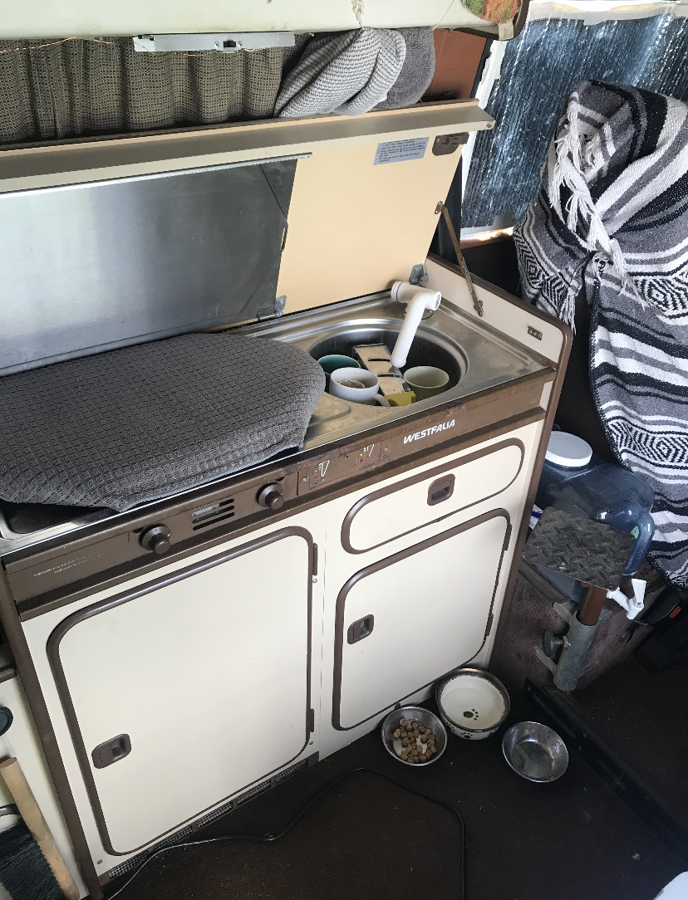
Mobility Creates and Resolves Access Instability
Access instability: centers on the challenges of sustained mobile connectivity and frequent interruptions in access that unstably housed persons experience (Galperin et al., 2021)
“Punitive pushes” (Pruss and Cheng, 2020) are important to understanding vehicle residents’ access instability
Vehicle residents seek safe parking in remotes areas out of cellular service and Wi-Fi range.
This process results in mobile access instability: disruptions in cellular connection and Internet access due to forced movements beyond service range, hindering information seeking and access
Motivation for information resolution initiates movement back to areas within service range
Notes:
For the purposes of this presentation, I am going to focus on one theme: mobility creates and resolves access instability.
Access instability is a concept that centers on the challenges of sustained mobile connectivity and frequent interruptions in access that unstably housed persons experience. The mobility of vehicle residency brings about unstable access to the mobile Internet and phone service needed to maintain a livelihood and basic existence. Legal policy and law enforcement are vital to understanding why vehicle residents must continuously move out of Wi-Fi and service range. Participants talked about migrating to new locations based on how and where law enforcement enacts location-based bans on vehicle residency, which can vary between cities, counties, and states. Left with few options after policy interrupts their schedules, vehicle residents can continue to dodge law enforcement in urban and suburban areas while maintaining cellular connections, or they can move to more remote areas with compromised cellar service and Wi-Fi. Because participants talked about the exasperating consequences of evading law enforcement, the result is that this group is forced further to the margins of society, literally off the grid, where cellular service and Wi-Fi are not easily accessible. Digital connectivity enables access to human connections, a lifeline to humanity, and information, which is necessary for upward financial mobility. Access to both is necessary to survive.
This process results in mobile access instability: disruptions in cellular connection and Internet access due to forced movements beyond service range. However, their information needs and accessibility also generate movements and service connections or reconnections. Understanding that their accessibility has been disrupted, participants lack the luxury to use their mobile phones for information seeking. When participants understand that they have a visceral information need, they go through the information seeking steps in an attempt to resolve their needs. This, however, becomes difficult when information seeking is hindered due to accessibility. Therefore, the motivation for information resolution initiates mobility to areas within cellular service range to resolve their access instability and information needs.

Slide 10
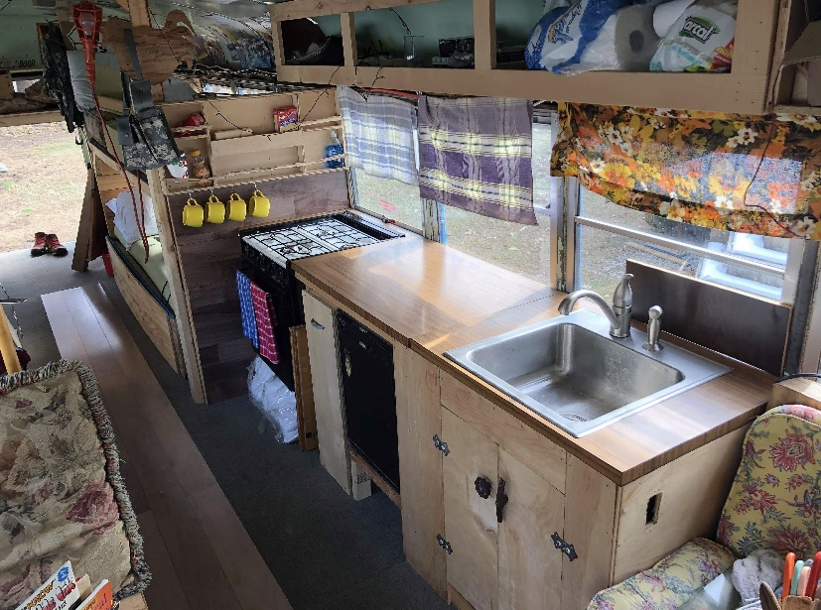
Implications
The access instability of place is directly connected with the initiated movements to locations where participants can regain information access.
Notes:
In considering barriers to access, access instability has the ripe potential to help develop theory about how places afford and constrain information access. Galperin et al. (2021) developed the concept of access instability to refer to the precariousness that characterizes mobile access and use among the unstably housed. While access instability centers on the challenges related to maintaining mobile connectivity and frequent interruptions in access, it may provide a useful lens through which to understand the ways that places constrict information access, also resulting in access instability. Pilot study results interrogate the ways that access instability was experienced in remote, marginalized places, like the woods. The access instability of place is directly correlated with the initiated movements to locations where participants can regain information access. This study highlights the movements caused by the legality of the lifestyle, causing a disruption in connection and access instability, resulting in mobile access instability.

Slide 11
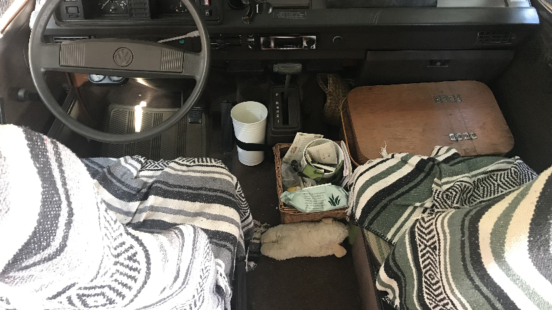
Future Directions, Limitations and Conclusion
Pilot study will inform dissertation
Limitations: small sample size, snowball sampling, and accessibility
There is value in understanding how information access is impacted by a place’s physical characteristics
Notes:
These exploratory findings from this pilot study will inform my dissertation where I aim to extend theory that accounts for the ways that the characteristics of places, mobility, and information access intersect for inherently mobile people, placing an emphasis on mobility as the norm through constantly moving information seekers.
Limitations include small sample size, snowball sampling, and accessibility.
Despite the limitations, the initial implications reveal that there is value in understanding how a place’s physical characteristics both facilitate and constrain information access and how mobility can resolve information access.

Slide 12
References
Burnett, G., & Jaeger, P. T. (2008). Small worlds, lifeworlds, and information: The ramifications of the information behaviours of social groups in public policy and the public sphere. Information Science Research, 13(2). http://informationr.net/ir/13-2/paper346.html
Charmaz, K. (2014). Constructing Grounded Theory (2nd ed.). SAGE.
Chatman, E. A. (1991). Life in a small world: Applicability of gratification theory to information-seeking behavior. Journal of the American Society for Information Science, 42(6), 438–449. https://doi.org/10.1002/(SICI)1097-4571(199107)42:6<438::AID-ASI6>3.0.CO;2-B
Corbin, J., & Strauss, A. (2014). Basics of Qualitative Research: Techniques and Procedures for Developing Grounded Theory (4th ed.). Sage.
Fisher, K. E., Durrance, J. C., & Hinton, M. B. (2004). Information grounds and the use of need-based services by immigrants in Queens, New York: A context-based, outcome evaluation approach. Journal of the American Society for Information Science and Technology, 55(8), 754–766. https://doi.org/10.1002/asi.20019
Galperin, H., Bar, F., & Nguyen, H. (2021). The power divide: Mobile communication in Los Angeles’ Skid Row. Mobile Media & Communication, 9(1), 30–50. https://doi.org/10.1177/2050157920932608
Gibson, A. N., & Kaplan, S. (2017). Place, community and information behavior: Spatially oriented information seeking zones and information source preferences. Library & Information Science Research, 39(2), 131–139.
Hartmann, M. (2017). Mobilism in Translation: Putting a New Research Paradigm to the Test. In Geomedia Studies. Routledge.
Hartmann, M. (2023). Reluctant mobilism: Forced displacement. Mobile Media & Communication, 11(1), 95–100. https://doi.org/10.1177/20501579221126965
Lloyd, A. (2006). Information literacy landscapes: An emerging picture. Journal of Documentation, 62(5), 570–583. https://doi.org/10.1108/00220410610688723
Pruss, G., & Cheng, K. (2020). The “Punitive Push” on Mobile Homes. Cityscape, 22(2), 87–94.
Savolainen, R. (2007). Information source horizons and source preferences of environmental activists: A social phenomenological approach. Journal of the American Society for Information Science and Technology, 58(12), 1709–1719. https://doi.org/10.1002/asi.20644
Sonnenwald, D. (1999). Evolving perspectives of human information behavior: Contexts, situations, social networks and information horizons. In Exploring the contexts of information behavior: Proceedings of the second international conference in information needs, seeking and use in different contexts. (pp. 176–190). Taylor Graham. https://rutgers.primo.exlibrisgroup.com
Sonnenwald, D. H., Wildemuth, B. S., & Harmon, G. L. (2001). A Research Method to Investigate Information Seeking using the Concept of Information Horizons: An Example from a Study of Lower Socio-economic Students’ Information Seeking Behavior. The New Review of Information Behavior Research, 2, 65–86.

Slide 13
Thank You!
Kaitlin E. Montague, Doctoral Candidate, MI,
Rutgers University, The State University of New Jersey
kaitlin.montague@rutgers.edu
Notes:
Thanks for listening! I look forward to your questions.

