Slide 1
COBISS.net
Network of library information systems and current research information systems
Davor Bračko, IZUM Maribor, Slovenia
Notes:
HI! My name is Davor Bračko and I come from the Institute of Information Science in Maribor, Slovenia. At first I would like to say that it‘s a pleasure for me to be in Osijek. Again!
Today I would like to present to you COBISS dot net as a Regional Network of Research Information Systems and Library Information Systems,

Slide 2

IZUM – non-profit public institution with the role of:
01
02
03
information service for research, education and culture
national bibliographic service (National COBISS Centre)
  UNESCO regional centre for the development of integrated library systems and current research information systems
Notes:
First of all, let me introduce to you the Institution that is behind COBISS,
The Institute of Information Science also called IZUM is a public institution established by the Government of the Republic of Slovenia as an information infrastructural service for Slovenian science, culture and education, In 2011 UNESCO has awarded IZUM with the status of a regional centre for library information systems and research information systems,
The activities of IZUM are mainly engaged in the development and operation of the COBISS and CRIS system and services, which represent the core of the library information system in countries linked in the COBISS,Net network (Serbia, Macedonia, Bosnia and Herzegovina, Montenegro, Bulgaria, Kosovo and Albania),
IZUM has the role of:
the information service for research, education and culture
the national bibliographic service (National COBISS Centre)
the UNESCO regional centre for the development of integrated library systems and current research information systems

Slide 3
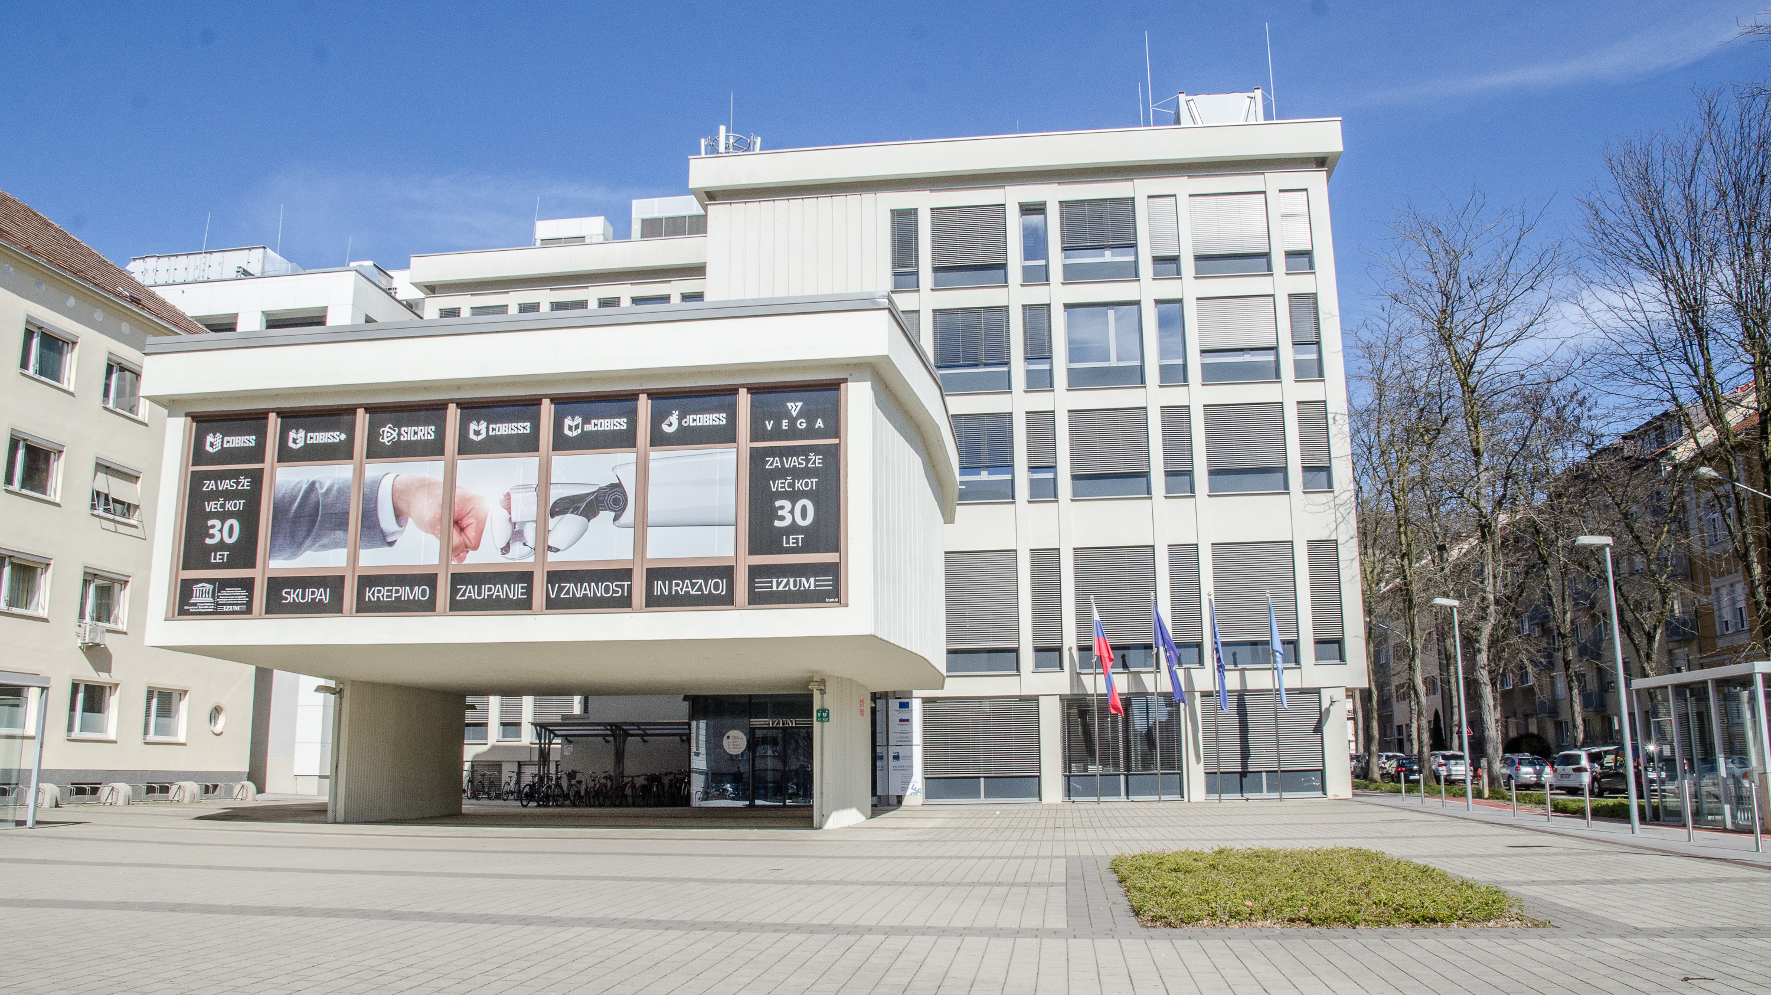
Notes:
Our building in Maribor

Slide 4
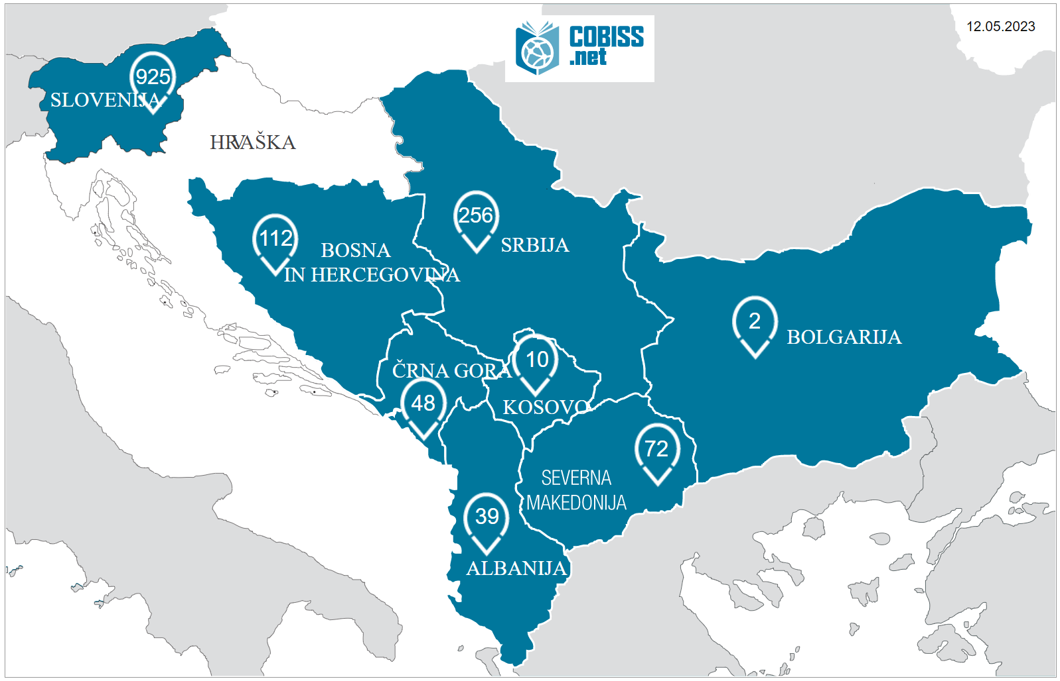
4
Notes:
On this day, the COBISS system is present in 1465 libraries in 8 countries, This year COBISS is celebrating its 35th anniversary! That says something about continuity and also resilience.
The COBISS system is the platform for the library information systems in these eight countries that are connected within the COBISS,net regional network,
The key features of the integrated management of library catalogues and researchers’ bibliographies are:
Optimization of work and added value to libraries and their users
Higher quality of bibliographic records and multi-functionality
Transparency of work of researchers
The major goals of COBISS,net network are:
To enhance the automation and inclusion of libraries of already participating countries in the national library information systems and in the COBISS,net network,
To attract the interest of libraries in member countries to the opportunity to evolve more rapidly by becoming part of the COBISS,net network,
To harmonise cataloguing rules with international recommendations and standards,
To set up compatible research information systems (SICRIS/E-CRIS) in the participating countries (databases on researchers, research organisations and research projects),
To attract the interest of the competent ministries and universities of the participating countries to accept the concept of managing researchers' bibliographies within the national library systems in order to ensure the transparency of the research results,
To increase the use of research results for the purpose of stimulating innovation processes and economic and social development in the region,
COBISS,net is also a form of cultural cooperation, which is especially appreciated in the region, as it contributes to mutual understanding and dialogue,

Slide 5
Records by library type in COBISS.net (2022)
Total no. of records: 34,219,741
Notes:
Within the COBISS,net network, practically all types of libraries are included: from national university libraries, up to school libraries, public libraries and others. And all types of libraries share and contribute bibliographic records to the cooperative bibliographic database.

Slide 6
Libraries within the COBISS.net network (2022)
 | .SI | .SR | .MK | .CG | .BH | .AL | .RS | .BG | .KS | SKUPAJ
national | 1 | 2 | 1 | 1 | 1 | 0 | 1 | 1 | 0 | 8
public | 62 | 105 | 33 | 16 | 21 | 12 | 21 | 0 | 6 | 276
university and academic | 82 | 91 | 11 | 13 | 32 | 24 | 16 | 0 | 1 | 270
special | 136 | 47 | 22 | 7 | 7 | 3 | 2 | 1 | 3 | 228
school | 644 | 10 | 6 | 11 | 0 | 0 | 0 | 0 | 0 | 671
TOTAL | 925 | 255 | 73 | 48 | 61 | 39 | 40 | 2 | 10 | 1,453
Notes:
This table shows the number of different types of libraries included in the different countries within the COBISS,net network.

Slide 7
COBISS.net in numbers (2022)
 | .SI | .BH | .MK | .SR | .CG | .BG | .AL | .RS | .KS | TOTAL
Since | 1987 | 1998 | 2001 | 2003 | 2003 | 2010 | 2012 | 2014 | 2018
Bibliographic records | 19,626,029 | 679,409 | 1,282, 322 | 9,461,015 | 978,433 | 1,230,502 | 177,948 | 675,675 | 28,259 | 34,436,592
Holdings data | 28,670,872 | 1,700,785 | 2,562,527 | 12,489,683 | 1,203,369 | 1,095,425 | 123,457 | 986,836 | 49,020 | 48,881,974
Notes:
This table shows the number of bibliographic records and library holdings, As you can see, there are more than 34 million bibliographic records in the COBIB databases and almost 50 millions of holdings!

Slide 8
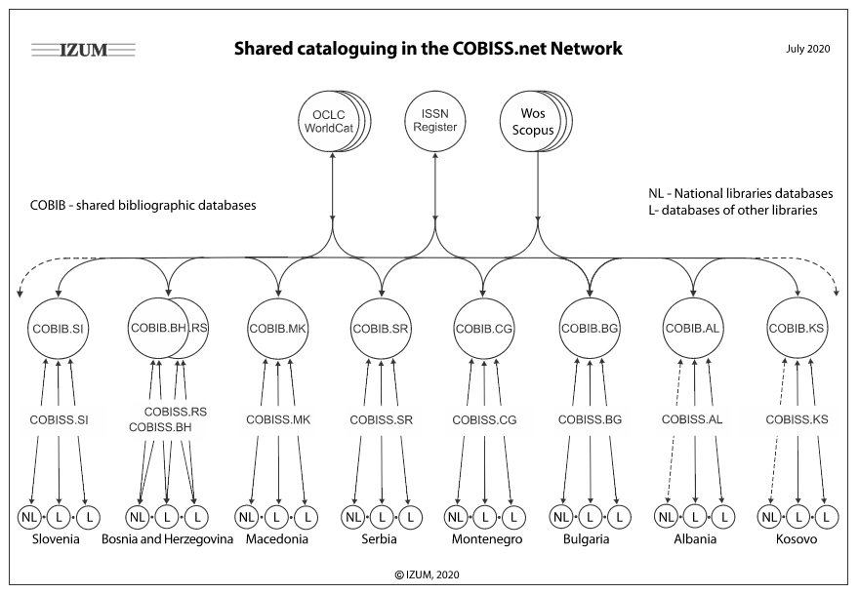
Notes:
One of the foundations of COBISS is the shared cataloguing system, In its centre are the COBIB union bibliographic databases and local bibliographic databases of participating libraries as represented in this picture
The COBISS.net network is also connected to the OCLC Worldcat database and the ISSN register. This connection enables participant libraries to download bibliographic records and records for serials to shared and local bibliographic databases.

Slide 9
Bibliographic record exchange (2022)
 | COBIB.SI | COBIB.SR | COBIB.BH | COBIB.MK | COBIB.CG | COBIB.BG | COBIB.AL | COBIB.RS | COBIB.KS | Downloaded TOTAL
COBIB.SI | 2 | 1,329 | 315 | 180 | 218 | 37 | 5 | 206 | 1 | 2,293
COBIB.SR | 5,194 | 0 | 1,287 | 1,616 | 819 | 416 | 157 | 1,112 | 45 | 10,646
COBIB.BH | 2,185 | 3,000 | 0 | 309 | 821 | 19 | 30 | 543 | 1 | 6,908
COBIB.MK | 777 | 1,408 | 481 | 0 | 376 | 303 | 96 | 179 | 25 | 3,645
COBIB.CG | 881 | 8,263 | 1,136 | 421 | 0 | 43 | 32 | 2,093 | 12 | 12,881
COBIB.BG | 30 | 27 | 1 | 7 | 2 | 0 | 0 | 0 | 0 | 67
COBIB.AL | 61 | 26 | 21 | 13 | 3 | 1 | 0 | 4 | 35 | 164
COBIB.RS | 921 | 15,498 | 1,177 | 318 | 1,436 | 15 | 3 | 0 | 0 | 19,368
COBIB.KS | 191 | 90 | 76 | 75 | 32 | 5 | 472 | 9 | 0 | 950
TOTAL | 10,242 | 29,641 | 4,494 | 2,939 | 3,707 | 839 | 795 | 4,146 | 119 | 56,922
Notes:
Shared cataloguing enables a rational division of labour and time saving in the procedure of cataloguing library materials and managing catalogues, Each item needs to be catalogued only once; after that, all participants in the system and in the COBISS,net network can access this record through the COBIB union bibliographic database, You’ll hear more details about this a little bit later,

Slide 10

The Federal Secretariat for Development elects RCUM as the developer of the Scientific and Technological Information System of Yugoslavia
RCUM is transformed into the Institute of Information Science of the University of Maribor (IZUM)
Libraries from the former Yugoslav countries (except Croatia) gradually start renewing the cooperation with IZUM in establishing LIS on the COBISS platform
Agreement on the establishment of the COBISS.net network is signed
First transfer of records from the COBIB.SI shared database to WorldCat
UNESCO awards IZUM the status of a regional centre for library information systems and research information systems
All libraries within the COBISS.net network start using COBISS3 software exclusively
Implementation of C+ and mCOBISS in all COBISS.net network countries
Implementation of COBISS Digital Repository in all COBISS.net network countries
Over 33 million items of material entered into the local catalogues of 1440 libraries in COBISS.net
1990
2003
2011
2019
2020
2022
2009
2018
1988
1993–2003
Notes:
Here you can see the story of COBISS dot net through the last three decades.
One of the most important milestones is the year 2003 when the agreement on the establishment of COBISS,net was signed,
The other one is the year 2011 when IZUM was appointed regional centre for library information systems and research information systems by UNESCO,

Slide 11

Researchers’ Bibliographies and E-CRIS
Notes:
Beside standard bibliographic data the COBIB database records also include the unique ID (researcher's code) of the author and the designation of the type of bibliographic unit,
These bibliographic records are the basis for personal bibliographies of researchers, Researchers‘ Bibliographies and CRIS (which stands for National Current Research Information System) are two of the pillars of COBISS system,
CRIS contains data about Research entities: researchers, organisations, groups, projects and programmes,
COBISS and CRIS represent a centralised and uniformly classified bibliographic service that enables researchers to acquire their bibliographies following a uniform methodology and perhaps even more important, they provide an insight into research results to both professionals and the general public,
Researchers‘ Bibliographies connect COBISS and E-CRIS systems, They can include:
evaluation of bibliographic indicators of scientific performance
evaluation for the purposes of awarding habilitations (appointment of university lecturers)
data from international providers, for example Web of Science and Scopus (JCR, SNIP, citations)

Slide 12

dCOBISS Digital Repository
Notes:
The digital repository is another service that is available to all libraries within the COBISS,net network,
More or less, we are all aware nowadays that knowledge is also cultural heritage which must be preserved for future generations, The digitization of written, graphic, audio and other types of records enables storing of copies which are mostly stored by libraries, That is what dCOBISS is for,
The digital repository dCOBISS is linked to OpenAIRE - Open Access Infrastructure for Research in Europe
The application is independent but also integrated with other COBISS application (COBISS3/Cataloguing, COBISS+, CRIS)
Accessible to all libraries that are members of the COBISS,net network
Libraries in the countries within the COBISS,net network have the option of managing publications in their central repository of their system
dCOBISS supports synchronization with local repositories

Slide 13

Unpaywall
Notes:
In addition to that, COBISS also provides access to foreign databases, Also in full text and free of charge,
Unpaywall is a FREE service that maintains a database of links to full-text articles from open-access sources all over the world, The content is harvested from legal sources including repositories run by universities, governments, and scholarly societies, as well as open content hosted by publishers themselves,
Unpaywall is a global search engine for scientific publications and other results of research work, which offers over 30 million open-access, i,e, free scientific articles, These articles are available in full-text in over 50,000 different repositories, Additionally, Unpaywall is not limited to the IP area of a university or any other form of authentication,
This is now also available to all users of the COBISS system and all users of libraries that are members of the COBISS,net network,
In addition to that, some countries in COBISS,net newort also have access to payable databases, which depends on the subscriptions of each country or library,

Slide 14
What IZUM offers to libraries in COBISS.net
03
02
04
01
A variety of training programmes (for librarians and IT professionals), the organisation of specialised workshops and international COBISS conferences.
05
Proven methodology and software to manage researchers‘ bibliographies within the COBISS system, applications for setting up a national current research information system (E-CRIS), and evaluation of research results.
Server capacities for COBISS and E-CRIS applications and services.
Proven organisational solutions and COBISS software support for the automation of library functions with shared cataloguing within the COBISS.net network, and access to the global WorldCat catalogue (OCLC).
Support in acquiring financial resources for development activities (international development cooperation).
Notes:
IZUM is a non-profit organisation, a public institution with more than 110 employees, which has never pursued commercial interests either in Slovenia or abroad, For more than 30 years, IZUM has been present in a wider region with its professional and innovative initiatives, and over this period it has won the trust of the public, IZUM has become an important regional centre for the development of library information systems and research information systems, That was recognised, as well, by UNCESCO which, at its General Assembly in November 2011, awarded IZUM the status of the UNESCO Regional Centre, Within the COBISS,net network, IZUM offers libraries the following:

Slide 15

THE PATH TO SUCCESS
Notes:
Our mission is threefold:
to help librarians to organize their collections more efficiently
to help library users to find and use these collections more easily
to help researchers to make their work results more recognizable
Conclusion
COBISS,net is an established international development cooperation project for the development of national library information systems and current research information systems, Linking between the two systems is crucial for managing researchers' bibliographies and evaluating research results, Previous collaboration has yielded positive results, and we trust that that COBISS,net is of great importance for the development of the region and for its successful integration into the EU,
I hope that in this short presentation I have given you an insight into COBISS dot net and its role in libraries and the work of researchers in the region,
Thank you for your attention,

