Slide 1
Designing an OER Course in the Field of Written Heritage Preservation – Importance of Content Adaptation
Ines Horvat, Marija Milošević and Damir Hasenay Department of Information Sciences, Faculty of Humanities and Social Sciences

Slide 2
Overview
Written Heritage Preservation
Open Educational Resources (OER)
Bloom’s taxonomy
OER Content Framework Design
Introduction
Conclusion

Slide 3
Introduction
education of information professionals
written heritage preservation
OERs
accessibility
various initiatives
Erasmus+ project
OER in the field of written heritage preservation

Slide 4
Written heritage preservation
Economic and Legal
aspect
Technical and Operational
aspect
Cultural and Social
aspect
Educational
aspect
Strategic and Theoretical
aspect
Economic and Legal
aspect
Technical and Operational
aspect
Cultural and Social
aspect
Educational
aspect
Strategic and Theoretical
aspect
Preservation management process
Result of preservation management

Slide 5
Open Educational Resources
5R activities
dimensions:
digital
pedagogical

Slide 6
Bloom’s taxonomy
REMEBERING
APPLYING
ANALYSING
UNDERSTANDING
EVALUATING
CREATING
LOTS
HOTS
Bloom’s Digital Taxonomy (A. Churches)
digital verbs
collaboration as a new element

Slide 7
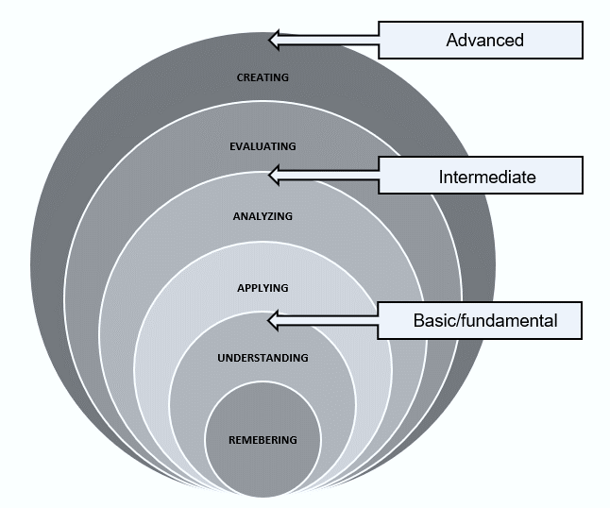
OER content framework design
preservation proficiency levels
according to Bloom’s Taxonomy
“knowledge/content base” for preservation education
key aspects + Bloom’s taxonomy

Slide 8
Key issues in strategic and theoretical aspect + Bloom’s taxonomy key verbs
Context in which the institution operates
interpreting
classifying
Planning and development of preservation programs
explaining
using
Preservation policy
describing
creating
Institution comparation
comparing
Theoretical framework
recognizing
exemplifying
designing
making
judging
testing
listing
structuring

Slide 9
Tools

Slide 10
Bloom’s taxonomy key verbs + activities in OER in written heritage preservation
REMEMBERING
quiz/test (h5p, Moodle..)
flashcards (Quizlet)
UNDERSTANDING
infographics (Canva)
mind mapping (MindonMap)
APPLYING
simulations (Zoom, Skype)
presentations (Office 365)
ANALYSING
illustrations (Gimp)
EVALUATING
commenting (forums, chats)
referencing tools (Zotero)
discussions (chats, forums)
quiz (Kahoot, Plickers)
flowcharts (LucidChart)
mindmapping (FreeMind)
research (search engines)
journaling (Google Docs, Office 365)
CREATING
planning (Google Calendar)
surveying (SurveyMonkey, Google Forms)
design (Gimp, Adobe Illustrator)

Slide 11
Conclusion
an OER specific to the written heritage preservation needs to encompass the complexity of the field
one of the main challenges
appropriately showcase the content
proposed content framework
enables the successful implementation of content in OER according to:
its complexity
its efficient design
appropriate tools

Slide 12
Thank you for the attention!

Slide 13
References
Butcher, N., Kanwar, A., & Uvalić-Trumbić, S. (2011). A basic guide to open educational resources (OER). https://unesdoc.unesco.org/ark:/48223/pf0000215804.
Churches, A. (2008). Bloom’s Digital Taxonomy. https://www.researchgate.net/publication/228381038_Bloom%27s_Digital_Taxonomy
Digital Education for Crisis Situations: Times when there is no alternative (DECriS) (2023). Erasmus + funded project 2020-1-HR01-KA226-HE-094685. https://decris.ffos.hr/.
Green, C. (2017). Open Licensing and Open Education Licensing Policy. In R.S. Jhangiani and Jhangiani, R. Biswas-Diener (Eds.), Open: The Philosophy and Practices that are Revolutionizing Education and Science (pp. 29-41). London: Ubiquity Press. DOI: https://doi.org/10.5334/bbc.c. License: CC-BY 4.0Wi
Hasenay, D., Krtalić, M. & Šimunić, Z. (2011). Obrazovanje studenata informatologije o čuvanju i zaštiti kulturne baštine – temeljna znanja i njihov prijenos u praksu. Život i škola 25, 61-75. https://hrcak.srce.hr/71624

Slide 14
References
Krtalić, M., Hasenay, D., and Aparac-Jelušić, T. (2011). Upravljanje zaštitom pisane baštine u knjižnicama – teorijske pretpostavke. Vjesnik bibliotekara Hrvatske 54,1-36. https://hrcak.srce.hr/80113
Pawlowski, J. M., Bick, M. (2012). Open Educational Resources. Business & Information Systems Engineering 4, 209-212. https://doi.org/10.1007/s12599-012-0219-3
Picciano, A. G. 2021. Theories and Frameworks for Online Education: Seeking an Integrated Model. In A Guide to Administering Distance Learning (pp. 79-103). https://eric.ed.gov/?id=EJ1154117
Wiley, D. (2007). On the Sustainability of Open Educational Resource Initiatives in Higher Education. OECD. https://www.researchgate.net/publication/265101203_On_the_Sustainability_of_Open_Educational_Resource_Initiatives_in_Higher_Education
Wiley, D. (2014). The Access Compromise and the 5th R. https://opencontent.org/blog/archives/3221

