Slide 1
Library and Information Science Study Program Through the Eyes of Students: Preliminary Findings
Sanjica Faletar
PhD, Professor
sfaletar@ffos.hr
Kornelija Petr Balog
PhD, Professor
kpetr@ffos.hr
Mirna Gilman Ranogajec
Teaching and Research assistant
mgilman@ffos.hr
Department of Information Science,
Faculty of Humanities and Social Sciences,
University of Osijek, Croatia

Slide 2
Introduction
The Aim and Purpose of Research:
Strengths and weaknesses of the LIS study program at the Department of Information Sciences of the Faculty of Humanities and Social Sciences at the University of Osijek, Croatia
Student satisfaction with their study program and the obtained competences

Slide 3
Motivation:
The undergraduate three-year program underwent a major revision and from the academic year 2020/2021 it has been possible to study Library and Information Science as both one-major and two-major programs.
Before that, students could only study LIS as one-major program that incorporated courses on publishing and IT
The Department is expected to start the revision of the graduate program in academic year 2023/2024
Making this preliminary research a valuable source of information

Slide 4
Research questions:
How satisfied are students with their study program?
Are there any differences in satisfaction between:
1.a. graduated students and currently enrolled students?
1.b. single major students (LIS) and double major students (LIS+IT /Publishing)?
How satisfied are students with the competences they received?
Are there any differences in satisfaction between:
2.a. graduated students and currently enrolled students?
2.b. single major students and double major students
What are the strengths and weaknesses of the study program?

Slide 5
Methodology
Anonymous online survey
November and December 2021
The quantitative results = SPSS
The qualitative results = content analysis
63 respondents
27 out of 55 students currently enrolled
36 out of 219 LIS students who graduated
Notes:
Multiple choice, open-ended and Likert-type questions

Slide 6
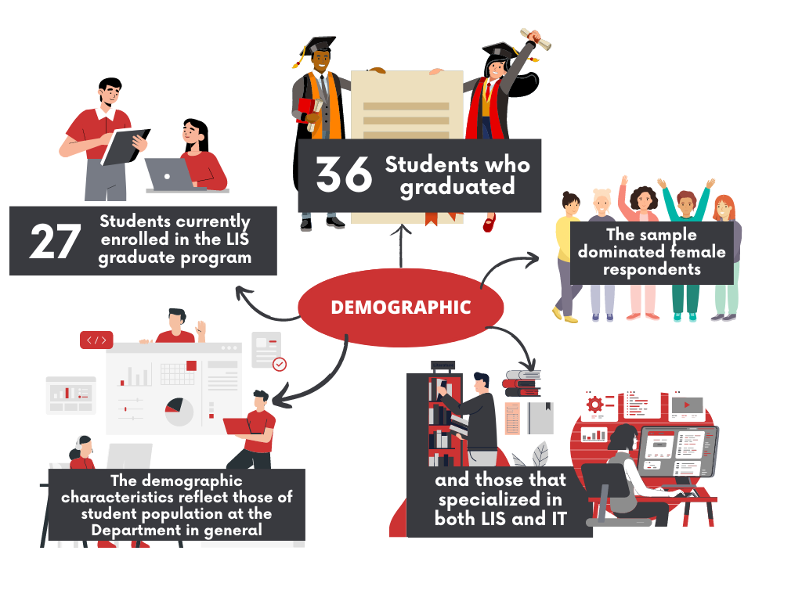
Notes:
Online survey was filled out by 49.1% students currently enrolled in the LIS graduate program at Osijek Department and 16.4% students who graduated from the Department.
The sample dominated female respondents, and those that specialized in both LIS and IT.
The demographic characteristics reflect the characteristics of student population at the Department in general:
majority of graduate students are female and study a combination of LIS and IT.

Slide 7
Survey
Areas covered: Perception of the study program
Alignment of learning outcomes with job market
Amount of practical work
Organisation of practical work
International internship or study abroad opportunities
Elective courses
Availability of exam literature
Teachers' expertise
Relationship with teachers
Extracurricular activities

Slide 8
Survey
Acquired professional (core LIS competences) and lifelong learning competences
communication skills
learning skills
digital competences
social and civic competences

Slide 9
Results and discussion

Slide 10
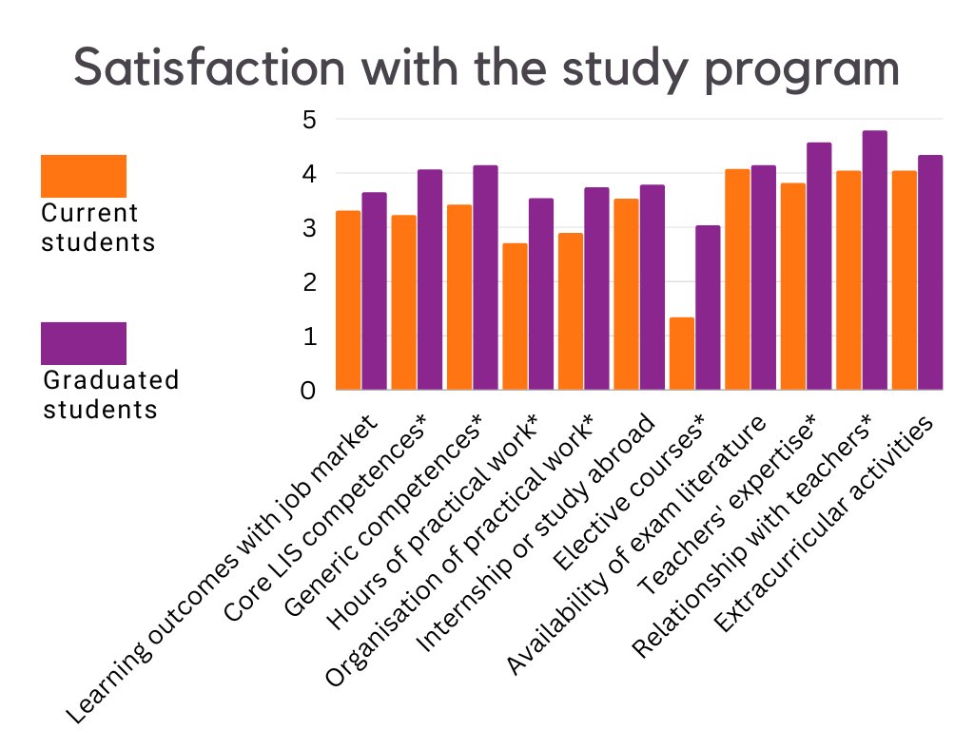

Slide 11
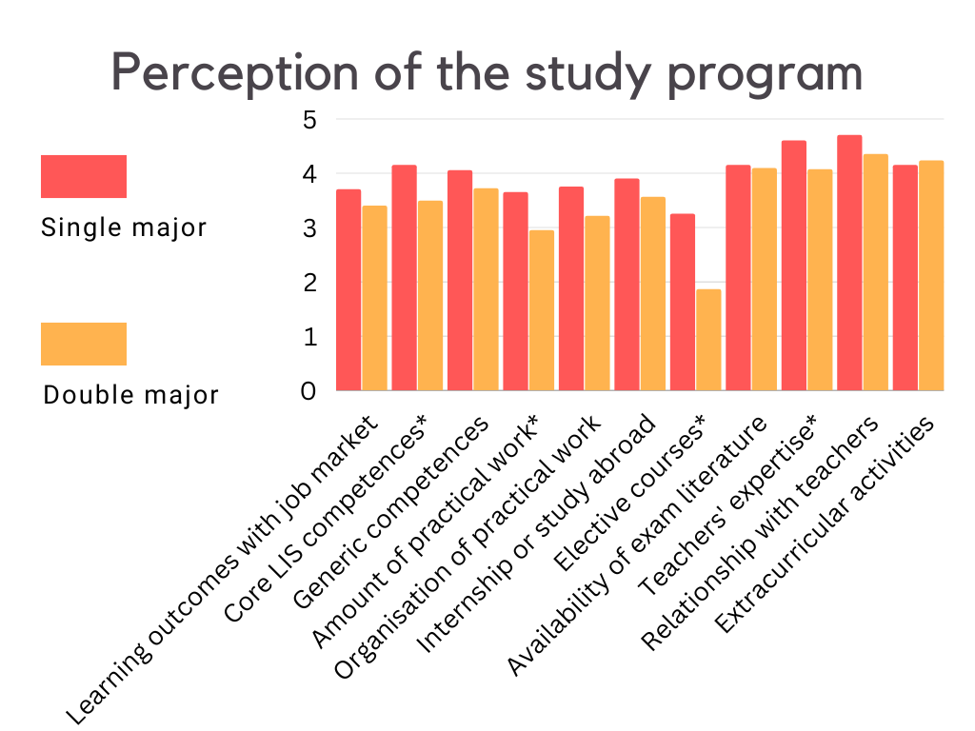

Slide 12
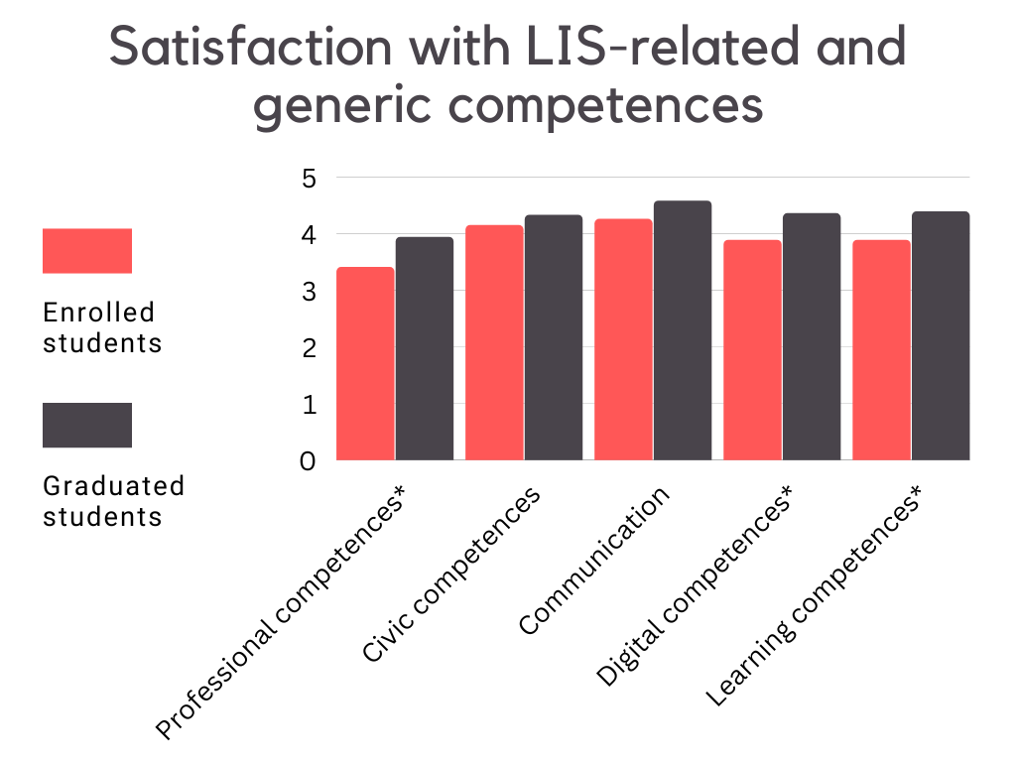

Slide 13
Conclusion
RQ 1a and 1b
Findings show that respondents are moderately satisfied with all studied aspects of the study program except for the amount of practical work and its organization, and the number and quality of elective courses.
Findings also show that currently enrolled students (double major students) are less satisfied with all attributes of the study program than the respondents who have already graduated.
The alumni, i.e. graduated students, who were mostly employed in the LIS field, were much more positive in their rating of satisfaction with the various aspects of LIS curriculum.

Slide 14
Conclusion
RQ 2a and 2b
Currently enrolled students were less satisfied with all acquired competences than respondents who have already graduated.
While only 5.4% graduated students are not satisfied how the study program prepared them for the job market, 75.0% would enroll in the same program if they had to do it again.
Furthermore, a total of 84.7% of all respondents would like to work in LIS-related field.

Slide 15
Conclusion
RQ 3
The respondents recognized the following strengths of the LIS study program: good communication with teachers, extracurricular activities (conferences, projects, mobility), working in small groups, project and team work, independent work, good atmosphere, wide employment possibilities, interdisciplinarity and development of critical thinking through practical project work.
Most of these refer to lifelong learning competences, and not professional knowledge and skills.

Slide 16
Conclusion
RQ 3
Weaknesses of the program: not enough practical work, project-based practical work, too much theoretical courses, too much assignments/quizzes/essays, lack of elective courses, lack of pedagogical courses which would equip students to work in educational institutions, and repetition of content from undergraduate study

Slide 17
Concluding discussion
The most positive attitudes were expressed by single-major LIS alumni, and this might lead to the speculation that they were more pleased with their competences and skills because they were able to study in depth various topics during their studies.
And finally, currently enrolled graduated students studied during the COVID-19 lockdown measures in 2020 and online classes, which resulted in a negative student experience as found by other studies

Slide 18
Limitations
Difficulties with reaching students once they graduate and move away (in the country or abroad)
Voluntary participation
Student overload with solving surveys
Lower response rate
Students who studied online during COVID-19 did not experience the study program as they would if taken the classes in person
Former students based their answers from recollection (but had the opportunity to test their knowledge and skills in a business environment)

Slide 19
Contribution
Relevant results for the revision of the LIS study program at the Osijek Department
A solid base for making evidence-based decisions in the curriculum revision process
Larger implications for LIS education in general because it has confirmed some of the results from international studies
Indicated possible trends in LIS education worldwide
More attention to the balance between theoretical and practical knowledge and skills, professional and lifelong learning competences, and adequate teaching methodologies

Slide 20
Questions?
Sanjica Faletar
PhD, Professor
sfaletar@ffos.hr
Kornelija Petr Balog
PhD, Professor
kpetr@ffos.hr
Mirna Gilman Ranogajec
Teaching and Research assistant
mgilman@ffos.hr
Department of Information Science,
Faculty of Humanities and Social Sciences,
University of Osijek, Croatia

