Slide 1
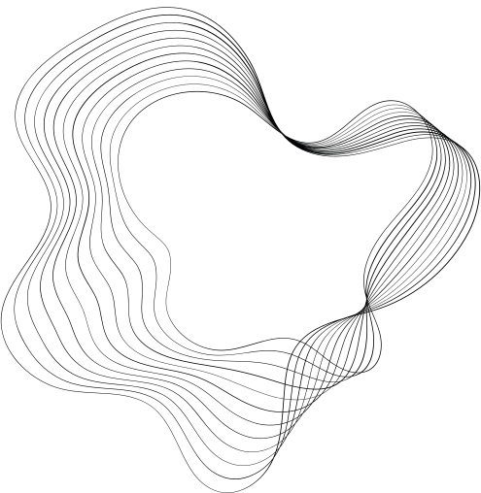
TOWARDS VIRTUAL RESEARCH ENVIRONMENT FOR GLAGOLITIC
MANUSCRIPT STUDIES
Associate Professor Marijana Tomić, PhD¹ ²
Laura Grzunov, research assistant¹ ²
Marta Ivanović, associate³
1 Centre for Research in Glagolitism, University of Zadar, Croatia
2 Department of Information Sciences, University of Zadar, Croatia
3 Publishing Department, University of Zadar, Croatia

Slide 2
CONTENT
1
RESEARCH - aim, goal and methodology
2
INTRODUCTION
2.1
RESEARCH IN CROATIAN GLAGOLITISM
2.2
GLAGOLAB PORTAL
3
RESULTS AND DISCUSSION
4
CONCLUSION

Slide 3
RESEARCH
The aim of this research is to identify and examine the features of a virtual research environment that would enhance the possibilities of an interdisciplinary collaborative research of Croatian Glagolitism in a digital environment.

Slide 4
METHODOLOGY
SURVEY
SCHOLARS IN THE CROATIAN GLAGOLITISM
to find out scholars' opinions on the use
of digital tools and methods in researching Glagolitism
get an insight into scholars' experience with digital tools and methods in their research.
to identify the digital infrastructure
elements that would be the most useful and applicable for the research process in the field of Croatian Glagolitism

Slide 5
INTRODUCTION
Manuscripts & manuscript studies
crucial sources for research in a number of disciplines
manuscript studies within the DH framework (e-codices, Fragmentarium, Manuscriptorium)
transformation of digital libraries into digital laboratories
interdisciplinary collaborative manuscript research
common digital infrastructure
Notes:
disciplines: textual and literary studies, linguistics, history, culturology, etc.
research infrastructure:
physical to hybrid and virtual

Slide 6
INTRODUCTION
VRE (virtual research environment): "collaborative digital environments that facilitate the integration of information resources and tools to support a particular set of research activities"
Blanke and Hedges, 2013
librarians - active role in research process, not just providers of tools and services
Simon and Steyer, 2020
Notes:
5 interrelated areas of manuscript research:
digitization, the catalogue description, scientific examination of material aspects, paleographic analysis and deep text encoding + AI (datafication and automatic optical recognition of signals) and digital infrastructure
digital: environment, reproductions of manuscripts and infrastructure

Slide 7
CROATIAN GLAGOLITISM
CROATIAN GLAGOLITISM - important area of research in the field of humanities in Croatia
a significant part of the Croatian corpus is written in the Glagolitic script
GLAGOLITIC MATERIAL - the interest for digitization is growing
digital reproductions of glagolitic material - scattered in numerous library and archive portals and catalogues
Notes:
in this study the focus is on the features of digital research infrastructure for research in Glagolitism
---- pa prva točka
CENTAR!
--- pa druga točka
systematic digitization of Glagolitics started with the Old Slavic Institute in 2006 (Magdić, 2015)
high quality digital reproductions and metadata for their descriptions --- only available to scholars of the institute!
Glagoljica.hr (National and University Library in Zagreb)
available in open access
digital library - not a research portal!

Slide 8
THERE IS CURRENTLY NO COMMON DIGITAL INFRASTRUCTURE FOR SCIENTIFIC RESEARCH IN GLAGOLITISM
Notes:
!!!

Slide 9
GLAGOLAB
portal and digital laboratory for collaborative
research and promotion of the Croatian Glagolitism
catalog of manuscripts and catalog of watermarks
designed with the aim of becoming a reference point for research in Glagolitism in digital environment, with the features of a digital laboratory
respond to the needs of the researchers,
provide infrastructure for cooperative work and communication among scientists,
provide digital tools for manuscript research and advice on their usage,
provide support for manuscript research within DH framework,
offer research data storage,
serve as a place where the most important (digital reproductions and metadata) data and data sets on Croatian Glagolitism will be available in digital format.
Notes:
other catalogs, bibliography and lexicon are in development

Slide 10
RESEARCH
The goal of this study was to identify and examine the features of Virtual Research Environment that would open up possibilities for interdisciplinary collaborative research on Glagolitism in a digital environment.
Notes:
As Marta already mentioned the goal of this study was to identify and examine the features of Virtual Research Environment that would open up possibilities for interdisciplinary collaborative research on Glagolitism in a digital environment.

Slide 11
RESULTS AND DISCUSSION
SURVEY - January 2023
23 scholars responded to the invitation
ANONYMOUS SURVEY
29 multiple-choice questions
Notes:
The survey examined the needs and expectations of the Glagolitic scholars concerning VRE for research in Glagolitism.
Survey was sent in January 2023. 23 scholars responded to the invitation.
Survey was anonymous and consisted of 29 multiple-choice questions.

Slide 12
SURVEY - 5 PARTS
01
02
03
04
05
Information about the respondent
Research in Glagolitism
– digital collections
Research in Glagolitism
– methods
Research in Glagolitism
– tools
Research
in Glagolitism
– research infrastructure
Notes:
It was divided into 5 parts. The first part was focused on information about the respondentd. The second part focused on the use of digital collections by the researchers. Third and fourth part were directed towards digital methods and tools and last part toward research infrastructure.

Slide 13
DATA ABOUT RESPONDENTS
aged between 31 and 50 (70%)
26% older than 51
WORK ENVIRONMENT
scientific institutes (60,9%)
Universities (30,4%)
2 respondents are retired
FIELDS OF INTEREST
text research - linguistics, palaeography, etc. (87%)
historical research (26,1%)
codicology
Notes:
Most of the respondents, 70% of them, were aged between 31 and 50 years.
The majority of them works at scientific institutes (60,9%). 30,4% workd at univeristies and 2 respondents are retired.
87% (the majority) of respondents are engaged in text research.

Slide 14
RESEARCH IN GLAGOLITISM – DIGITAL COLLECTIONS
Notes:
The part of the survey focused on digital collections showed that

Slide 15
82,6% - prefer to use digital reproductions
52,2% use both traditional and digital research methods
Notes:
82,6 of the respondents prefer to use digital reproductions although more than half of that number prefers an occasional use of the original.
More than half use both traditional and digital research methods and even 47.8% of them said that they would do more research with the use of digital methods and tools, if more materials were available in digital form.

Slide 16
47.8% of the scholars say they would do more research with the use of digital methods and tools, if more materials were available in digital form
majority of the respondents (73.9%) believe that the Croatian heritage and scientific institutions should do more concerning the digitization of the Croatian Glagolitic literature.
Notes:
82,6 of the respondents prefer to use digital reproductions although more than half of that number prefers an occasional use of the original.
More than half use both traditional and digital research methods and even 47.8% of them said that they would do more research with the use of digital methods and tools, if more materials were available in digital form.

Slide 17
their research work would significantly benefit from a shared platform that would collect data on all digitized Glagolitic manuscripts/old books/fragments and related material (seals, watermarks, etc.).
91,3%
Notes:
Almost all respondents agree that their research work would significantly benefit from a shared platform that would collect data on all digitized Glagolitic manuscripts/old books/fragments and related material (seals, watermarks, etc.).
jedan od najznačajnijih rezultata
u glagoljaštvu postoji pozitivan stav prema upotrebi dig metoda u istr

Slide 18
RESEARCH IN GLAGOLITISM – METHODS
Notes:
In the part of the survey dealing with research methods

Slide 19
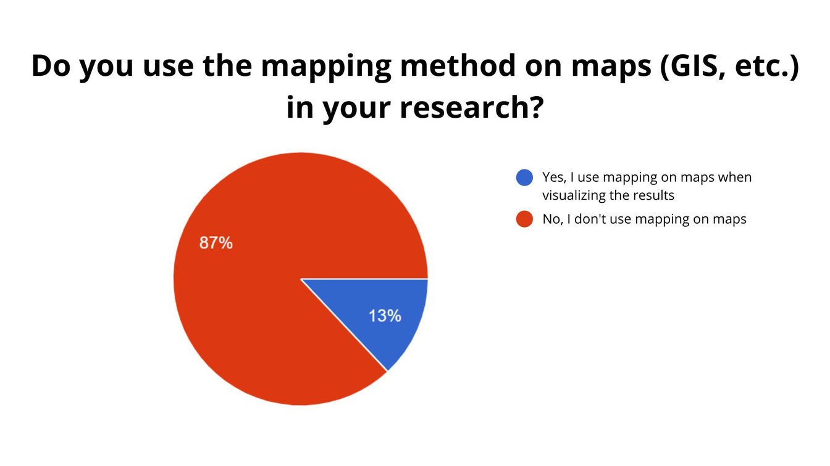
Notes:
Although most of them emphasized that they use and prefer digital methods, when they were asked if they use the text or content visualization method and the mapping method, more than 60% answered that they do not use the mentioned methods.

Slide 20
Notes:
Concerning the importance of research data in the context of contemporary science, the respondents were asked how they store their research data. Most of them store data and results on a computer or external memory, and even 13% of the respondents do not store research data systematically.

Slide 21
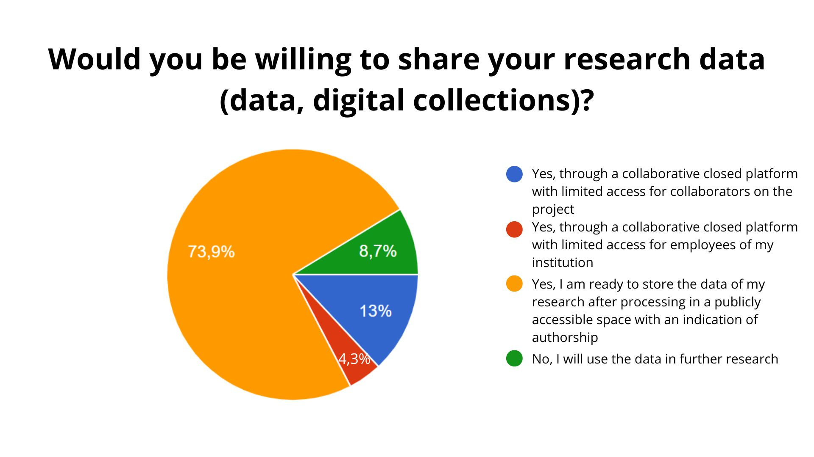
Notes:
On the other hand, the 73,9% of respondents are willing to share their research data and make it publicly accessible with and indication of autorship.
These results definitely informed us to plan the infrastructure for data sets and storage and re-use within VRE.

Slide 22
RESEARCH IN GLAGOLITISM – TOOLS
Notes:
As for the tools used in the research

Slide 23
Notes:
69,6% of respondents said that they think the use of digital tools can enable answers to new research questions, which could not be answered with traditional approaches.
The results showed that the community

Slide 24
WHAT KIND OF DIGITAL TOOLS
DO THEY NEED IN THEIR RESEARCH?
tools for transcription/transliteration (collaborative and individual) - 73,9%
dictionary creation tools - 56,5%
tools for text annotation - 60,9%

Slide 25
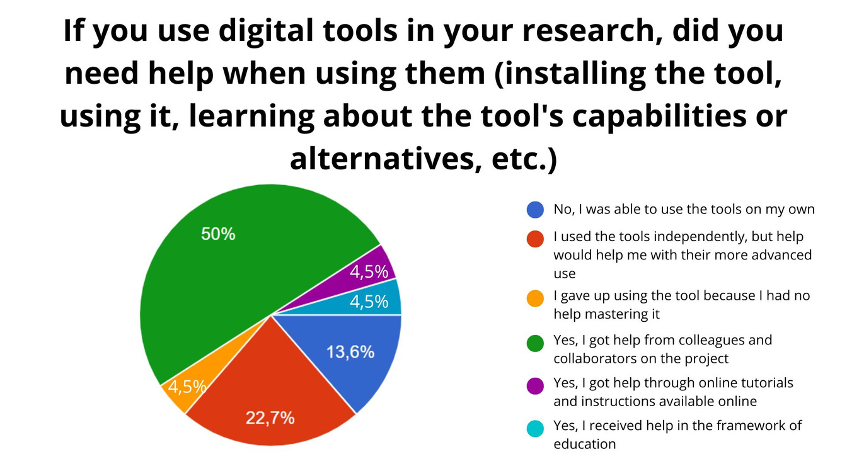
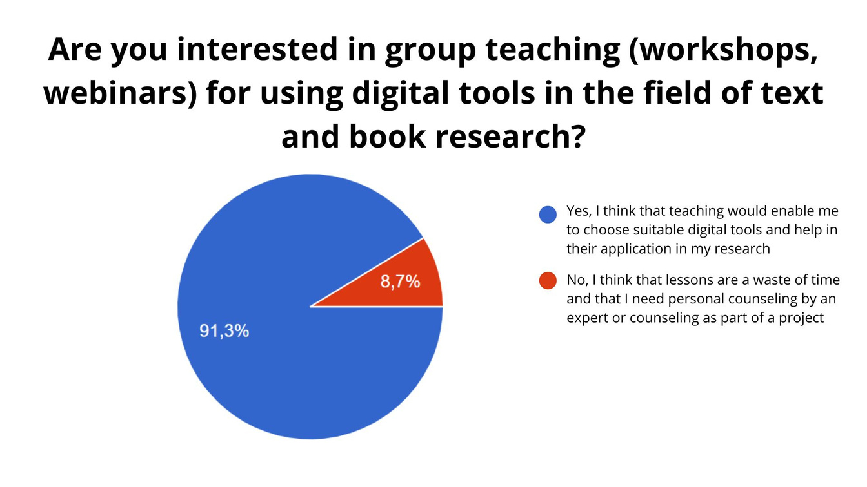
Notes:
It should be taken very seriosuly that the cast majority of respondents stated that they were interested in a group training in the use....

Slide 26
RESEARCH IN GLAGOLITISM – RESEARCH INFRASTRUCTURE

Slide 27
THE RESEARCH INFRASTRUCTURE IN
THE DIGITAL ENVIRONMENT SHOULD CONTAIN:
digital collections of Croatian Glagolitic (unified search via common/integrated search engine) – 100%
digital collections of Croatian Glagolitic (access to individual collections of institutions) – 78.3%
lists of available digital collections on Glagolitic and related topics – 78.3%
bibliography of works on Croatian Glagolitic – 82,6%
online lexicons of Croatian Glagolitic – 65.2%
visualization of the digital corpus (timelines, display by geographical areas, tagging) – 73.9%
tools for creating dictionaries and lexicons – 78.3%
tools for transcription/transliteration (individual, collaborative) - 87%
text marking tools – 69.6%

Slide 28
CONCLUSION
VRE for research in Glagolitism can be organized through a digital laboratory and should provide:
digital tools for manuscript research and advice on their usage
tutorials for finding and using digital tools
space for discussion on the usage, problems and experience in using the tools
the list of and links to digital collections, projects, literature, data sets on Glagolitism
a repository for storing and re-using research data
GLAM institutions - consider the fact that scholars are not satisfied with the level of digitization
great effort should be devoted to the digitization of Glagolitics
scholars should be consulted for selection of material for digitization
librarians
design, maintain and upgrade a VRE for research in Glagolitism,
provide support to scholars in using digital tools and methods
contribute to the process of data management
Notes:
scholars have a positive attitude towards using collaborative digital research infrastructure, tools and methods in their research

Slide 29
THANK YOU FOR YOUR ATTENTION!
Marijana Tomić, mtomic@unizd.hr
Laura Grzunov, lgrzunov@unizd.hr
Marta Ivanović, mivanovi1@unizd.hr

