Slide 1
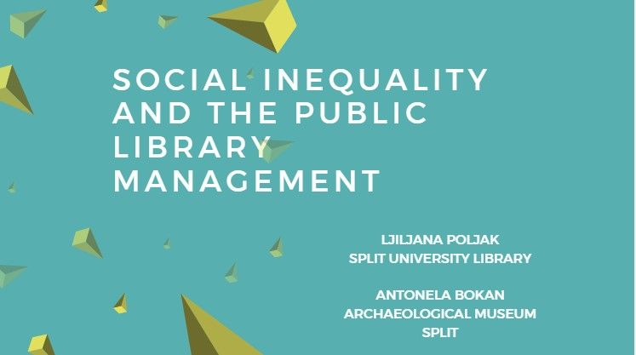

Slide 2
SOCIAL INEQUALITY
“Social inequality exists when people frequently receive more of a society’s ‘valuable goods’ than others owing to their position in the social network of relationships.” (Hradil 2001.)
4 BASIC DIMENSIONS
material wealth, power, prestige, education
4 NEW DIMENSIONS
working conditions, housing, environmental and leisure conditions

Slide 3
OVERVIEW
LIBRARIES ARE
ACCESS, READING, EDUCATION, INFORMATION, KNOWLEDGE, LIFELONG LEARNING, IMPACT, LITERACY, LEISURE TIME, INCLUSION, CULTURE, MULTICULTURE, CREATIVITY, IMAGINATON, IDEAS…
..THE WAY FORWARD ..
OPEN TO ALL?

Slide 4
..YES to..
all members of the community regardless of their race, nationality, age, sex, religion, language, disability, economic, work status and education… (IFLA Public Library Service Guidelines)

Slide 5
WELL..
Libraries are open to all… BUT, not everybody come to libraries
„Those who use the libraries are more likely to make use of many sources of information, of which the public library is just one. Those who do not use libraries use fewer other sources of information as well.” (Rainie, Estabrook, Witt 2007.)

Slide 6
DO WE KNOW WHO ARE REAL USERS OF PUBLIC LIBRARIES?
College degree?
Highschool degree?
Young adults and children?
Workpeople?
Unemployed?
Unqualified?
Bohemians?
Desperate housewives?
Homeless?
(…)

Slide 7
RESEARCH PROJECTS
Research project Public Library Policy and Social Exclusion (Leeds Metropolitan University in partnership with the London Borough of Merton (Libraries), Sheffield Libraries, Archives and Information and John Vincent) (2000.)
Pew Internet & American Life Project and University of Illinois Libraries Survey (2007.)
InterConnections: the IMLS National Study on the use of Libraries, Museums and Internet: Public library report (2008.)
LACK OF RECENT RESEARCH AND RESEARCH IN EUROPE

Slide 8
Research project Public Library Policy and Social Exclusion (Leeds Metropolitan University in partnership with the London Borough of Merton (Libraries), Sheffield Libraries, Archives and Information and John Vincent) (2000.)
PUBLIC LIBRARIES
serve a disproportionately high number of middle-class people, whilst working-class people use libraries very irregularly
children from wealthy homes use libraries and borrow library books far more frequently than do their poorer peers
often abandoned their role in provision of services for working class and “disadvantaged” communities
often failing excluded people

Slide 9
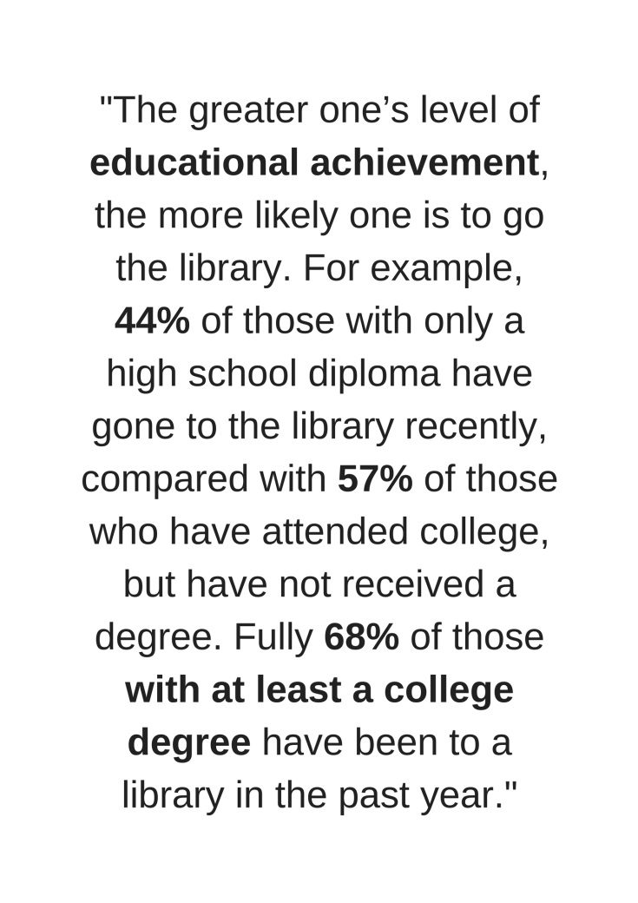
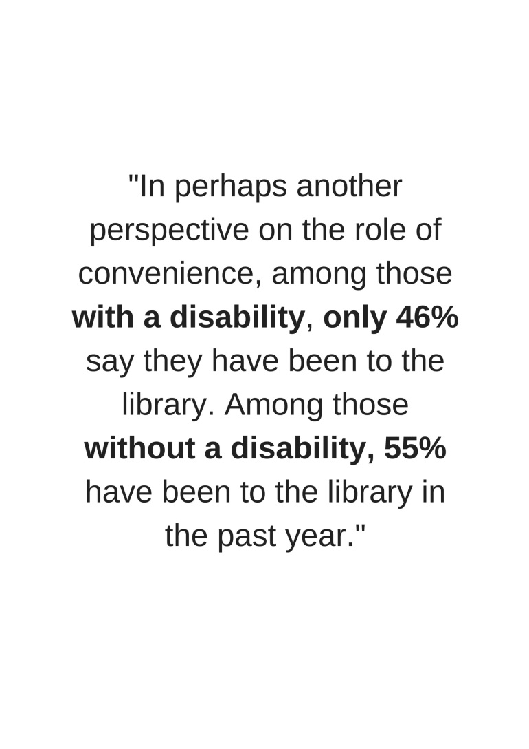
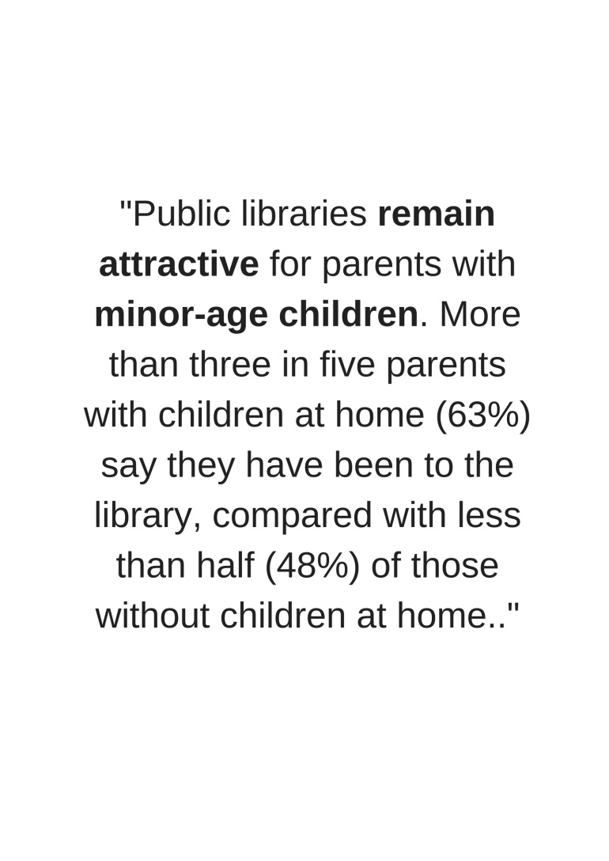
Pew Internet & American Life Project and University of Illinois Libraries Survey (2007.)

Slide 10
Almost seven in ten Americans (69%) say that public libraries are important to them and their family: 38% of Americans ages 16 and older say that the public library is “very important,” and 31% say it is “somewhat important.” Some 17% say it is “not too important,” while 13% say it is “not important at all.”

Slide 11
Institution of Museum and Library Services (IMLS) (2008.)
College degree | 85,9%
Highschool degree | 44%
Young adults and children | 40%
Workpeople | 60%
Unemployed | 55,8 %
Unqualified | 39%

Slide 12
Excluded Social Group
Bohemians | ?
Homeless | ?
Housebound people | ?
Prisioner and famillies | ?
Racial and ethnic minorities | ?
Refugees | ?
Travellers | ?

Slide 13
WE NEED TO KNOW…
Who are our users?
Who are our non-users?
Who are excluded social group?
Who wants to go to the library?
Who has the fear of the library?
Who thinks that library is only for educated people?
.. WE NEED TO RESEARCH
*THOUGHT FOR FUTURE*
In order to overcome the principle of complete openness and use of library services, users of the library should be everybody, regardless of possession of a membership card.

Slide 14
SOCIAL INEQUALITY AND THE PUBLIC LIBRARY MANAGEMENT: RESEARCH
AIM
Discover potential social inequality segments in public library management.
PURPOSE
Signalize the problem of social inequality and indicate possible ways to prevent future development of social inequality in libraries.
RESEARCH QUESTIONS
1. In which segments of public library management system social inequality can be identified?
2. Which are the ways to prevent the future development of social inequality that is found in the parts of public library management?
METHODOLOGY
Analysis of documentation of national strategies (for public libraries)
SAMPLE
Croatia, England, and Finland

Slide 15
DOCUMENTATION
CROATIA
Croatian Librarianship Strategy 2016-2020 (Proposal)
Strategy for Public Libraries 2013-2015 (Proposal)
ENGLAND
Libraries Deliver: Ambition for Public Libraries in England 2016-2021
FINLAND
The Way Forward for Public Libraries 2016-2020

Slide 16
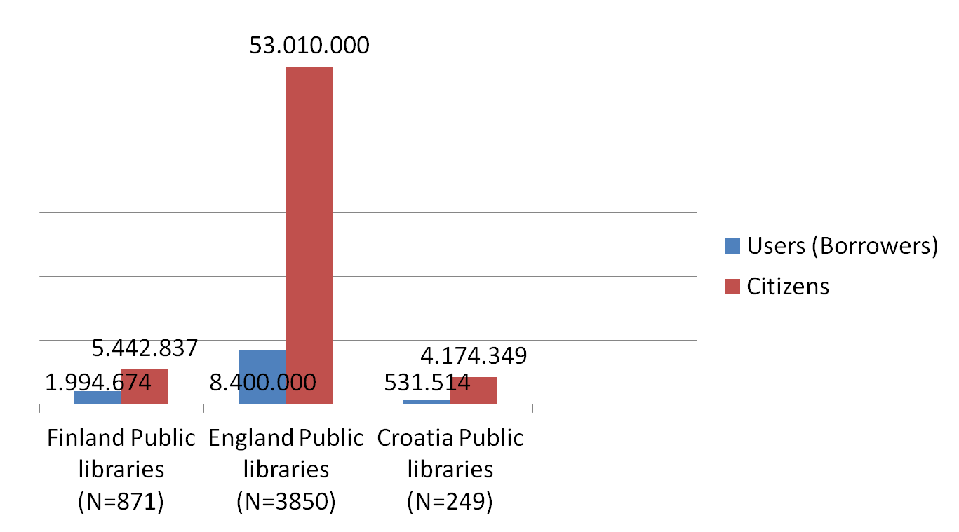

Slide 17
ENGLAND
36% USERS ARE ADULTS IN UPPER SOCIO-ECONOMIC GROUP
32% USERS ARE ADULTS WITH LIMITING DISABILITY
74% OF PEOPLE IN ENGLAND THINK THAT LIBRARIES ARE AN ESSENTIAL SERVICE TO THE COMMUNITY
FINLAND
90% OF THE GENERAL PUBLIC (USERS AND NON-USERS) FELT LIBRARIES WERE EITHER VERY EFFECTIVE AT MEETING THE NEEDS OF THEIR LOCAL COMMUNITY
88% OF ADULTS LIBRARY MEMBERS AGED 25-64 HAVE COMPLETED UPPER SECONDARY EDUCATION
58% OF LIBRARY MEMBERS ARE OVER 65

Slide 18
Potential social inequality segments
SOCIAL INCLUSION
potential library users and non-users
free use
FINANCING
SOCIAL ENGAGEMENT AND COOPERATION
DIGITAL INEQUALITY

Slide 19
SOCIAL INCLUSION
potential library users and non-users
proportion of services that are provided without charge
Is there enough concern about attracting non-users, or libraries are predominantly focused on existing ones?

Slide 20
CROATIA
Social inclusion and equality are not explicitly emphasized but are involved
ENGLAND
“Libraries can have a critical role in helping people to realize their potential, and especially those from disadvantaged backgrounds.”
FINLAND
Equality as one of the five values on which the strategy is based

Slide 21
THE WAY FORWARD
„Everyone has the rights and skills to use information resources“
„Everyone has the right to participate and influence the society and living environment“
„Everyone has the opportunity to visit library“
„Everyone can access digital information and literature“
„Library collections are easily found and combined with other information“

Slide 22
Potential users and non-users
Croatia
municipalities with no library access (238 in 2015)
functional network of libraries and services
England
some people can’t visit libraries or would prefer to use digital means (digital and outreach provision)
Finland
citizen ⬄ library user

Slide 23
Free use
Croatia
improving free access to information sources and services (by 2020)
England
lending books and other printed material free of charge for those who live, work or study in the area
Finland
While promoting equality, the library is free of charge for everybody

Slide 24
FINANCING
excessive dependence on the founders or the local authorities (often the main financiers of the public libraries)
inequality in available funds among different libraries

Slide 25
Croatia
the founders should be more legally bounded to fulfill their obligations
England
Funding library services in varied and sustainable ways (diversify funding by generating additional income streams)
public service mutual model
Finland
Transparency: „Using tax funds responsibly”

Slide 26
SOCIAL ENGAGEMENT AND COOPERATION
Library as an active agent in the community
Innovation (different ways of approaching the same problem or impact they want to achieve)

Slide 27
Croatia
Cooperation through functional national system
England
partnerships with formal learning organisations, local economic development organisations, other government and partner services
Finland
Library for citizens ; Sence of community as value
Planning services, space, cooperation with business

Slide 28
DIGITAL INEQUALITY
Informatization and ever-shifting information and communication technologies:
greater access and use ⬄ growing digital divide

Slide 29
Croatia
Development of library services in digital surroundings
England
improved digital access and skills
Finland
Supporting media skills
Everyone can access digital information and literature
Library domesticates technology to be part of customer service

Slide 30
FOCUS ON…
CROATIA
Libraries > users
ENGLAND
Modifications in library management
FINLAND
Citizens
Goals as aspects of contemporary library

Slide 31
SWOT ANALYSIS
STRENGHTS | LIBRARY MISION AND VISION | VISIBILITY | AWARNESS | SERVICES
WEAKNESSES | LACK OF RESEARCH | FINANCING | FOCUS ON EXSISTING USERS | EQUAL PARTNER
OPPORTUNITIES | SOCIAL ENGAGEMENT | PROMOTION OF EQUALITY | TECHNOLOGY | FREE OF CHARGE
THREATS | UNFAMILIARITY WITH DIFFERENT PROFILES OF POTENTIAL USERS | FAST CHANGING COMPETENCSES | EXCLUDED SOCIAL GROUP | PHYSICAL ACCESS

Slide 32
IN GENERAL
SOCIAL INEQUALITY EXSISTS IN LIBRARY ENVIRONMENT
TWO MAIN PREVENTION ADVICE
CONDUCT MORE RESEARCH
THINK ABOUT POTENTIAL USERS
STRATEGIES HAVE TO RESPOND ON THE NEEDS OF OUR LIBRARY COMMUNITIES

