Slide 1
Climate Change Discussion among Friends
Theory of motivated information management (TMIM) perspective
Notes:
I think we can all agree Climate Change is one of the defining social justice issues of our time. It’s a planet wide threat that requires societal response on a global scale. But discussing information with this kind of potentially devastating impact is frequently as difficult as it is essential. As citizens in democratic societies, we can push to influence political forces to affect change. As information scientists, we can help demystify the complex cognitive and affective forces that influence individuals to discuss climate change in hopes of bolstering advocacy efforts. In my project, I approach this using TMIM.

Slide 2
Presentation outline
Theoretical framework
Locus of Control
Research questions
Results
Implications
Discussion/questions
Notes:
Today, I will explain the theoretical framework I adopted as well as some measures from psychology I suspected might be relevant to Climate change discussions. Then I will share my results and possible implications. I hope you will have some questions and suggestions for me as I continue to study these conversations.

Slide 3
Theory of Motivated Information Management (TMIM)
Notes:
TMIM is a fairly recent theory and Affifi and Weiner who initially proposed it in 2004 are still refining it. I chose TMIM to study climate change discussions, because unlike most other information seeking models and theories it doesn’t assume individuals will always be interested in seeking information. Instead, Affifi and Weiner propose that in situations where information might have potential negative consequences, individuals will experience tension between how much they don’t know and how much they actually want to know (uncertainty discrepancy). This will then cause affective response, usually in the form of anxiety which will negatively affect both what they expect to gain from information seeking (outcome expectancy) and their assessment of their ability to seek information (efficacy).
Affifi and Weiner propose 3 kinds of efficacy. Because information seeking in this framework is usually a discussion among individuals – communication efficacy measures individuals’ perception that they can successfully enact information seeking behavior (so successfully communicate about climate change with friends) coping efficacy measures to what extent they can cope with the outcome of their conversations, and target efficacy is individuals’ belief that the information target is willing and able to produce the information. These 3 types of efficacies are sometimes (as in this conceptual model) actually indicative of a higher order construct of efficacy. But more frequently, only one or more are included in separate models. In any case, according to this theory, efficacy positively influences information seeking intent. I should point out that this theory has also been used to study information avoidance. I studied intention to engage in CH discussion with friends.

Slide 4
Research question 1
Which TMIM variables significantly predict individuals’ intentions to discuss climate change impact on the environment with their friends?
Notes:
And so, my fist research question was… Or does TMIM framework explain intention to discuss climate change among friends.

Slide 5
Locus of Control
Internal
External
Chance Powerful Others
Notes:
In addition to TMIM, I was also interested in personality characteristics that might influence some of these constructs directly and indirectly also information seeking intention.
Locus of control measures the amount of personal control individuals believe they have over their circumstances (Rotter 1966). Briefly, internally oriented individuals believe they have more control over their destiny than externally oriented individuals. Since Rotter (1966) introduced the construct, Levenson (1981) showed that the external locus of control is multidimensional and includes powerful others (i.e., destiny controlled by deity and/or elites) and chance (i.e., destiny controlled by chance). Research shows, most of us are somewhere on this spectrum and only pathological personalities tend to be on the extreme ends of this.

Slide 6
Research question 2
How do Locus of Control orientations (i.e., internal, powerful others and chance) relate to TMIM constructs?
Notes:
In other words do these personality traits influence how individuals perceive their ability to discuss climate change information and what their expectations from such conversations.

Slide 7
Measurement instruments
Scale | N of items | Mean | Cronbach’s Alpha
Uncertainty Discrepancy | 3 | 9.66 | 0.92
Anxiety | 4 | 16.54 | 0.92
Outcome Expectancy | 3 | 9.84 | 0.85
Coping Efficacy | 2 | 6.19 | 0.81
Target Efficacy | 3 | 7.83 | 0.85
Communication Efficacy | 2 | 7.23 | 0.74
Information Seeking Intent | 2 | 7.75 | 0.96
Locus of Control (I) | 8 | 24.24 | 0.83
Locus of Control (P) | 8 | 24.24 | 0.79
Locus of Control (C) | 8 | 32.69 | 0.83
N = 244
Notes:
I don’t have enough time to go over numerous scales I constructed and used in this research. However, I adapted Affifi’s TMIM scales to fit climate change discussion context and I used Levenson’s LoC measurement instrument.
As you can see, I used anywhere from 2 to 8 items and my reliability statistics were fine. All alpha levels were above .7, which allowed me to include these items into the model.
Before I present the models, I want to point out that I did run 2nd order confirmatory factor analysis for efficacy constructs (coping, target, communication) and they in this case turned out to be distinct so I tested 3 separate TMIM climate change models to account for each type of efficacy separately.

Slide 8
Confirmatory Factor Analysis (CFA)Results
Observed Variables | Loadings
 | Model 1 | Model 2 | Model 3
AnxD1 | 0.82
AnxD2 | 0.89
AnxD3 | 0.86
AnxD4 | 0.81
OutE1 | 0.83
OutE2 | 0.87
OutE3 | 0.8
ISI1 | 0.93
ISI2 | 0.99
UD1 | 0.61
UD2 | 0.91
UD3 | 0.94
LoC_I3 | 0.63
LoC_I5 | 0.54
LoC_I6 | 0.78
LoC_I7 | 0.84
LoC_I8 | 0.79
ComE1 | 0.53
ComE2 | 0.44
TeH1 |  | 0.58
TeH2 |  | 0.75
TeH3 |  | 0.98
CpE1 |  |  | 0.69
CpE2 |  |  | 0.98
Notes:
As you can see here, the observed variable loadings were all fine. At the bottom of the screen you also see the 3 distinct efficacies and their associate loadings.

Slide 9
TMIM Climate Change SEM – Model 1
χ2 = 304.559 (P = 0.0000)
RMSEA = 0.069
CFI = 0.947
Notes:
In the first model, I used communication efficacy. As a reminder, this was students’ confidence in their own ability to effectively communicate with their friends about climate change. You can see at the bottom of the screen, that the model was a good fit. It was also for the most part consistent with the TMIM and all of these paths are significant. However, anxiety in this case positively affected both outcome expectancy (or how much they believed talking about it with friends would lead to positive outcomes) and communication efficacy (whether or not they would be able to communicate the issues effectively).
Although this is not consistent with TMIM, it’s very much consistent with the recent research in psychology on Collective problem-focused coping . Since climate change affects everyone people tend to cope with the issue by thinking that if we all work together then things will turn out fine in the end. Which also explains why in all 3 models anxiety actually positively affects outcome expectancy. Social support is also a huge component. Research also shows that people use talking to friends about climate change as a way of coping, which would explain the positive relationship between anxiety and communication efficacy.
Individual orientation LoC was the only type that had a significant relationship in this and all other models. So, in this case, sense of control over one’s destiny has a small but measurable effect on positive outcome from conversations about climate change.

Slide 10
TMIM Climate Change SEM- Model 2
χ2 = 331.444 (P = 0.0000)
RMSEA = 0.0671
CFI = 0.948
Notes:
This model includes target efficacy or how honest and forthright students expected their friends to be about climate change.
Again, the model was a good fit. However, information seeking intent was directly influenced by outcome expectancy rather than target efficacy as hypothesized by TMIM. Also, this time anxiety negatively affected students’ judgements about their friends’ honesty in discussing climate change but it continued to positively affect their expectations of a positive outcome of such conversations. You can also see that this time the individual orientation for LoC positively influenced both positive outcome of climate change conversations and feelings about friends’ honesty during these conversations.

Slide 11
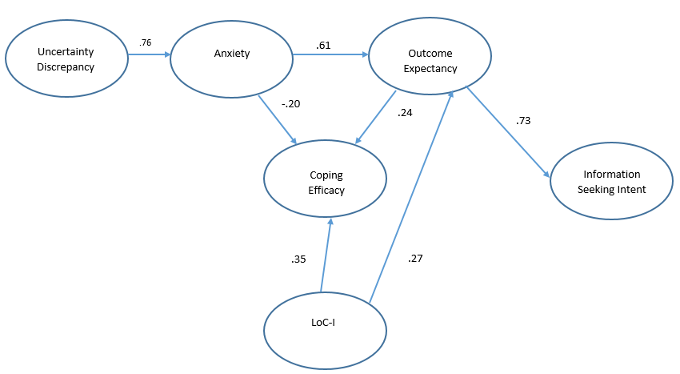
TMIM Climate Change SEM- Model 3
χ2 = 290.305 (P = 0.0000)
RMSEA = 0.0659
CFI = 0.952
Notes:
Finally, the last model includes coping efficacy or students’ confidence in their coping skills regarding their friends’ attitude toward climate change. Again, contrary to TMIM in this model it was the outcome of conversations rather than the coping efficacy that influenced information seeking intent directly. Also, as in the previous model anxiety negatively affected coping efficacy (or how well students thought they would cope with the outcome of the conversations) which is consistent with TMIM. LoC also positively affected both efficacy and outcome expectancy.

Slide 12
Conclusion and implications
TMIM framework works for climate change discussions
Individual LoC affects both outcome expectancy and efficacy
3 efficacy types are distinct constructs
Notes:
TMIM framework works for climate change discussions but instead of efficacy, outcome expectancy was key to information seeking intention. So, in as much students felt a sense of hope that these discussions were going to lead to some sort of positive outcome their intention to seek information increased.
Individual LoC orientation affects both outcome expectancy and all 2 types of efficacy but not communication efficacy. And so, communication efficacy is not affected by sense of control over circumstances. Given that it relies on cognitive skill building rather than coping with emotional states, this also makes sense.
The 3 efficacy types are distinct constructs and only communication efficacy directly influenced information seeking intention. This is significant because unlike the other 2 types which are tied to managing emotional responses such as trust and coping, this one is tied to problem solving. Effective communication relies heavily on knowledge about a topic and so information literacy regarding climate change become an important component in influencing information seeking intent through communication efficacy. And this is something we can influence.

Slide 13
Selected bibliography
Afifi, W. A., & Weiner, J. L. (2004). Toward a Theory of Motivated Information Management. Communication Theory, 14(2), 167-190.
Fowler, C. c., Gasiorek, J., & Afifi, W. (2018). Complex Considerations in Couples’ Financial Information Management: Extending the Theory of Motivated Information Management. Communication Research, 45(3), 365-393.
Noushari, F. R., Zare, H., Baradaran, M., & Moamma, N. (2017). The effectiveness of stress management training on self-efficacy, cognitive emotion regulation and psychological well-being. Journal of Psychology, 20(4), 453-467.
Ojala, M. (2012). Regulating Worry, Promoting Hope: How Do Children, Adolescents, and Young Adults Cope with Climate Change? International Journal of Environmental and Science Education, 7(4), 537-561.

Slide 14
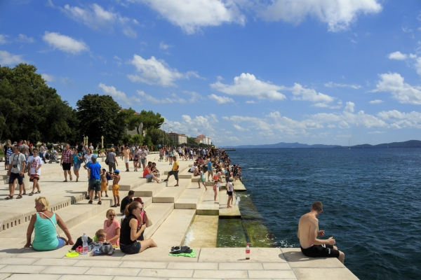
Questions and discussion

