Slide 1
Uncertain Interventions: LGBTIQ Users in Public Libraries as an Example of Collaboration between Critical Librarianship and Contemporary Art
Irena Bekić, Petra Dolanjski
Zagreb City Libraries, S. S. Kranjčević Library
LIBRARIES IN THE DIGITAL AGE (LIDA) 2018
University of Zadar, Croatia, 13 - 15 June 2018

Slide 2
Our starting point is the position of the library profession, which presupposes ethics of information sciences, according to which the information needs to be accessible to everyone. The library is considered a place of social justice, which operates within certain social, political and economic circumstances.
In practice, this implies a critical and activist approach.

Slide 3
Research questions:
The inclusion of LGBTIQ persons in programmes, services and holdings of public libraries, as well as the level of meeting the information needs of LGBTIQ persons.
The question of the transformational potential of libraries i.e. the possibility of artistic intervention in the field of information and communication sciences and, indirectly, in society.
Which artistic methods and tactics that can, not only produce aesthetic or discursive reshaping of everyday life, but also transform everyday existence in the sense of creating new forms and organisations of life?
Which strategies and methods in librarianship serve to establish new forms of sociality?

Slide 4
Critical theory critical pedagogy contemporary art practice
Critical librarianship Library as the agonistic public space

Slide 5
Public spaces, as well as societies, are structured through ‘agonistic struggle’ that results in a specific configuration of power relations and predomination of one hegemonic project over the other. Agonistically-comprehended public space articulates that which is suppressed by dominant consensus. (Mouffe)
In order to become agonistic space, libraries should redefine their position, re-examine their own inclusivity, and the social
Economic and political structures within they operate.

Slide 6
Art, with its engaged practices, tries to expose what is concealed by a dominant consensus. Thanks to its resources, it can open channels for the oppressed to enter the public.
Combines tactics and strategies such as interdisciplinarity, participativity, different forms of disguise and mimicry, it can initiate processes of recognizing and create new paradigms. In doing so, it reveals the problematic places of the hegemony.

Slide 7
Jacques Rancière's concept of 'aesthetic regime‘
Two policies within artistic aesthetic:
Art as autonomous and self-sufficient aesthetic practice, separated from other forms of life.
Art as inseparable from other segments of human activity, became close to everyday life, even at the cost of ending in non-art.
In the negotiation between the logic of these two policies, as well as the aesthetics of the artistic and non-artistic system, a heterogeneous field of reality or new forms of sociality is established new areas of understanding of different social actors, which opens space for new forms of living.

Slide 8
Coexistence of gallery and library hybrid space / (alternative art libraries by Ksenia Cheinman; transitional zones by David Carr…).
Creating new and variable surroundings and encourage dialogue by juxtaposing the different points of perception and contextualisation, offering unexpected visualizations. New
space of knowlege, new manners of learning, new paradigmes…
agonistic public space

Slide 9
Nadija Mustapić „2 i 2”, photo: Toni Meštrović

Slide 10
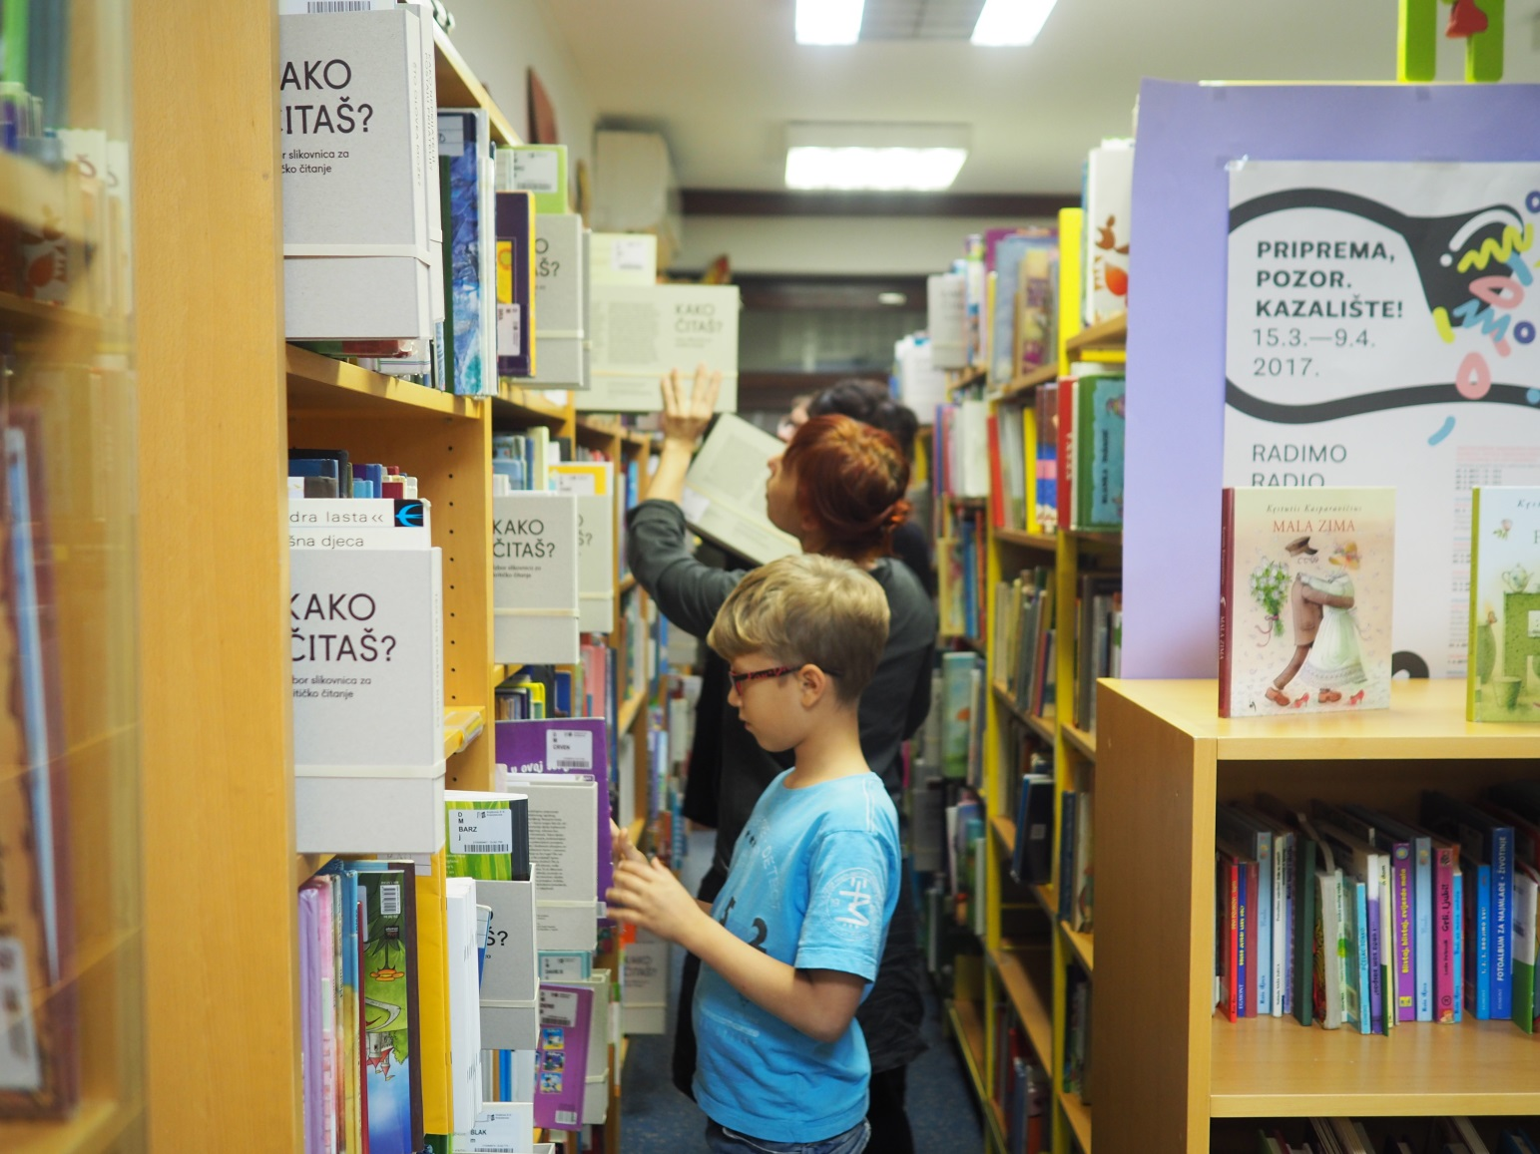
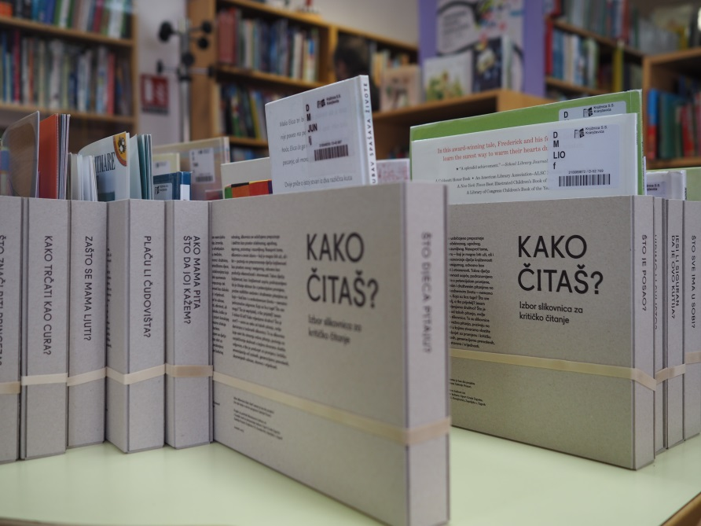
Ana Kuzmanić „This Isn’t Books”, photo: Ana Kuzmanić

Slide 11
Uncertain Interventions: LGBTIQ Users In Public Libraries
Prozori Gallery / S. S. Kranjčević Library, Zagreb City Libraries

Slide 12
The starting point of the project
The project articulates the problematics of LGBTIQ persons and their positions in the context of public libraries as public cultural institutions, in the context of information and communication sciences and in the context of the society in general.
The aims: indicating the heteronormativity of librarianship in Croatia, problematising the question of procurement, programmes and services directed/inclusive in relation to LGBTIQ persons as the group that is still invisible within the library system in Croatia, and directing the academic and professional community toward this group of users.

Slide 13
The mission of the public libraries
IFLA’s Guidelines for Public Libraries (2011) - public libraries should be at the disposal to all members of the community .
IFLA and UNESCO’s Manifest for Public Libraries (1994) – its holdings and services must not be exposed to any kind of ideological, political, or religious censorship.
The Glasgow Declaration on Libraries, Information Services and Intellectual Freedom stresses that the discrimination against gender or sexual orientation must not be permitted.
IFLA’s Expert Committee has approved the forming of the Special Interest Group – SIG for LGBTIQ users (2013).

Slide 14
Croatian legislation
LGBTIQ community is protected by law from discrimination, hate, and violence – the Anti-Discrimination Act; Criminal Code – which regulates the right to the protection of family life of LGBTIQ life partnerships.
Life Partnership Act for persons of the same sex, whereby life partnership is equalised with marital partnership, but not on the field of the right to adopt children.
The Gender Equality Act, Article 6 of which prohibits discrimination against sexual orientation, while Article 16 prohibits women and men to be publicly displayed and presented in an offensive, degrading, or humiliating manner with regard to sex and sexual orientation.
The Constitution of the Republic of Croatia simultaneously prevents the implementation of complete marriage equality of homosexual and heterosexual persons (on the basis of the referendum conducted in 2013).

Slide 15
Uncertain Interventions: LGBTIQ Users In Public Libraries as an interdisciplinary platform
Associates: Department of Information and Communication Sciences at the Faculty of Humanities and Social Sciences in Zagreb, Domino Association, Centre for Women’s Studies and independent art scene, artists Helena Janečić and Silvio Vujičić.

Slide 16
Project stages 2016/2017
Meetings of the focus-group.
Scientific study on the information needs of LGBTIQ persons in Croatia (dr. sc. Ana Barbarić and dr. sc. Aleksandra Pikić).
Roundtable with a discursive analysis of the subject and public presentation of the study results and the conclusions of the research phase of the overall project.
Art production and exhibition, accompanying exhibition program - educational, workshops, 2017.
Artistic documentation.

Slide 17
Artistic documentation. Focus group meeting.
Author: Helena Janečić

Slide 18
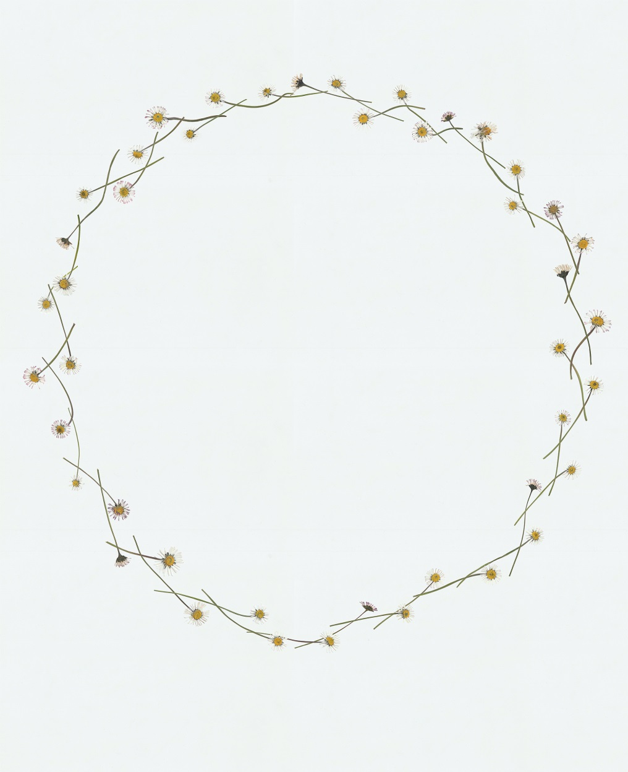
Exhibition as presentation, aestheticisation and communication Silvio Vujičić: Flowerworks
Silvio Vujičić: „Flowerworks”, bookmarker and poster details

Slide 19
Silvio Vujičić: „Flowerworks”,
photo: Silvio Vujičić

Slide 20
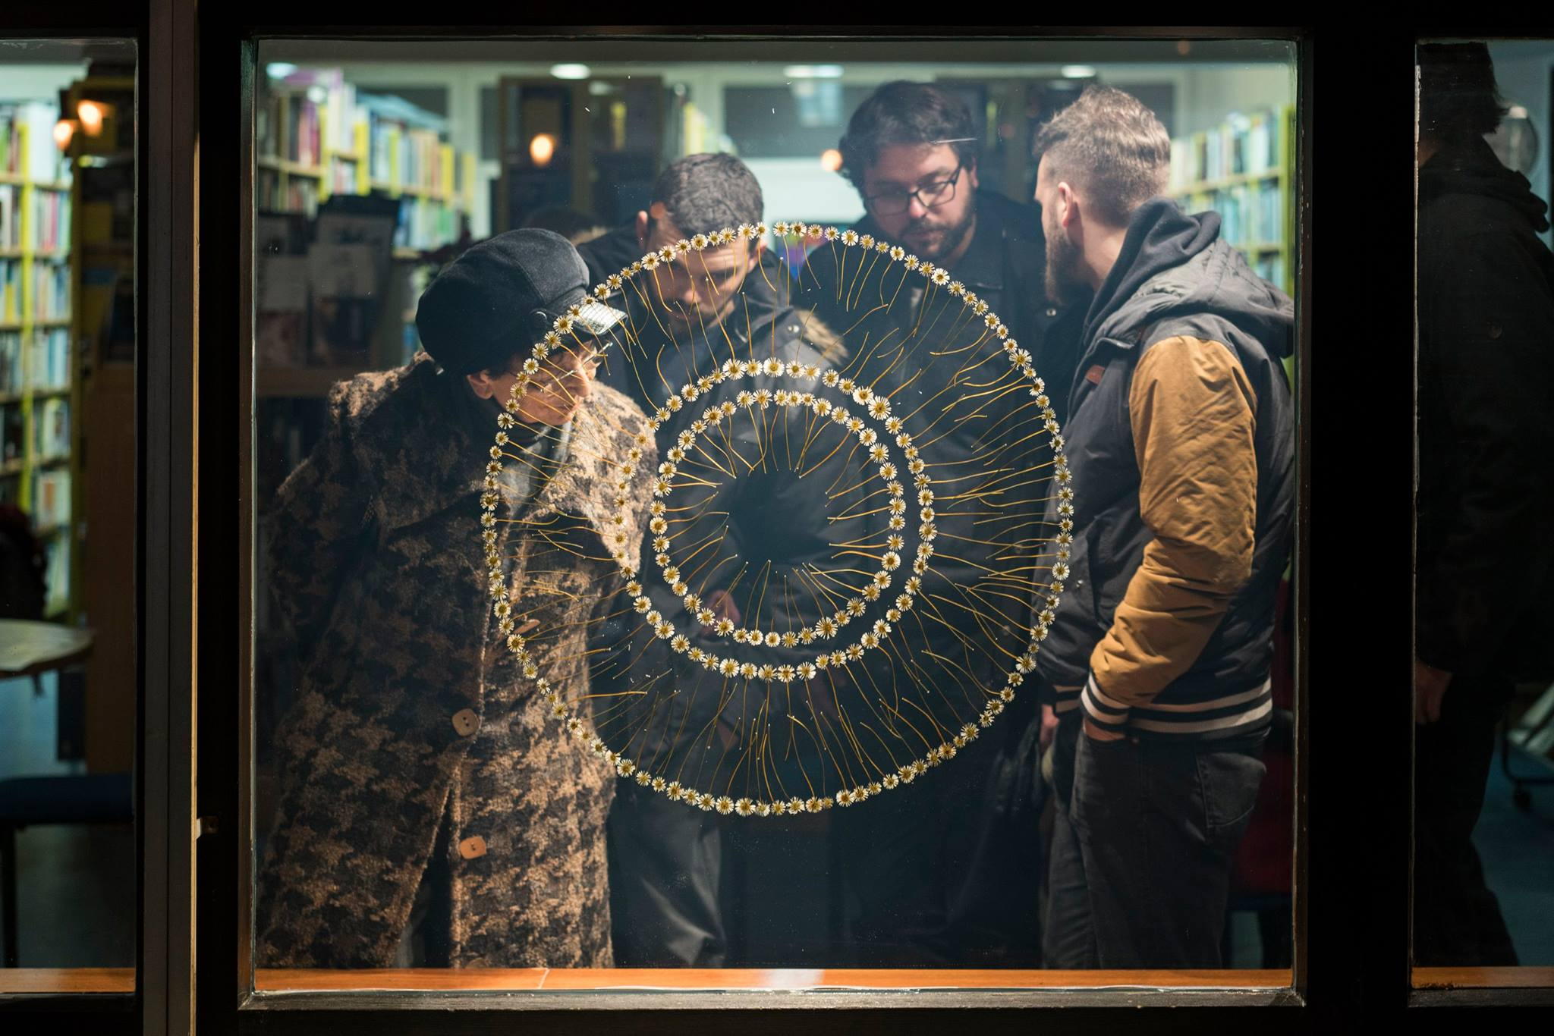
Silvio Vujičić: „Flowerworks”,
photo: Karla Jurić

Slide 21
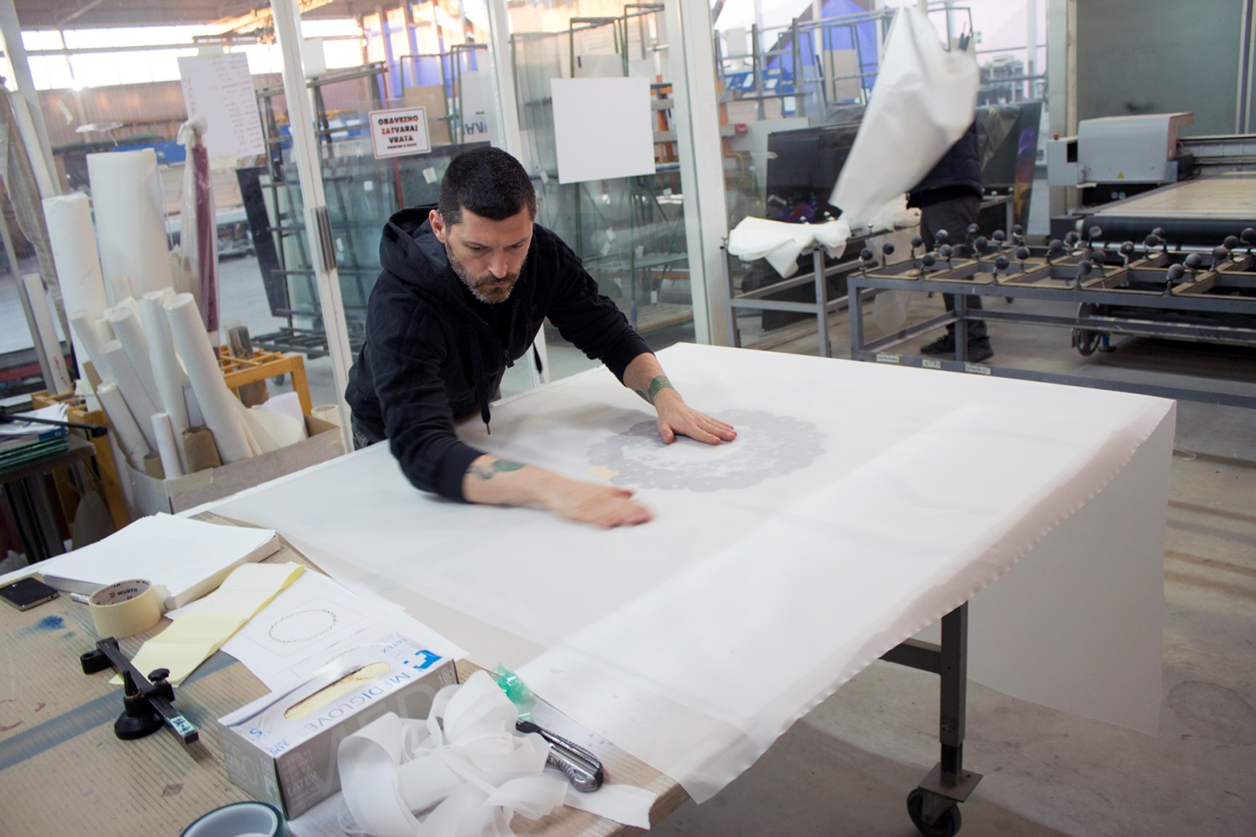
Silvio Vujičić: „Flowerworks”, preparation for
the exhibition,
photo: Silvio Vujičić

Slide 22
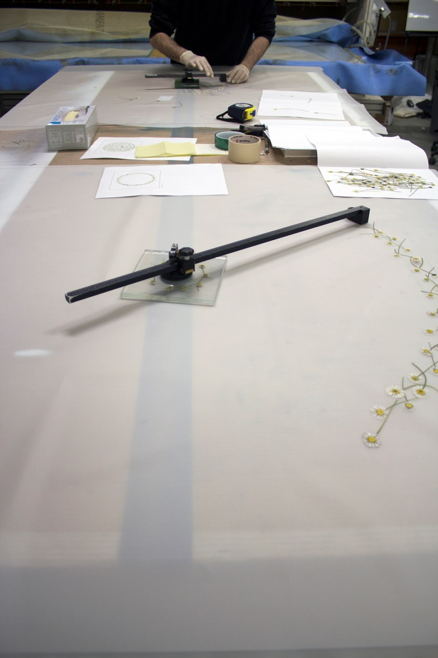
Silvio Vujičić: „Flowerworks”, preparation for the exhibition,
photo: Silvio Vujičić

Slide 23
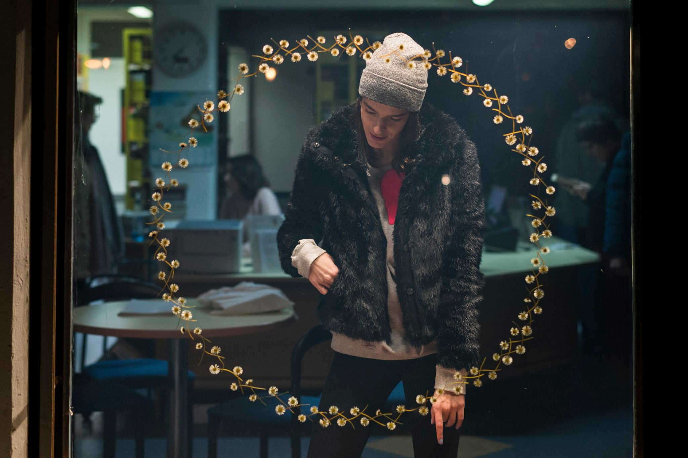
Silvio Vujičić: „Flowerworks”,
photo: Karla Jurić

Slide 24
Daisy (Bellis perennis ) is a small low-growing European plant having a rosette of leaves and flower heads of yellow central disc flowers and pinkish-white outer ray flowers. Bellis may come from bellus, Latin for "pretty", and perennis is Latin for "everlasting. The English Daisy is also considered to be a flower of children and innocence.^{(Wikipedia)} Daisy is a male homosexual, a weak effeminate cowardly man. ^{(Gay slang dictionary)} Daisy is a girl you never knew you wanted or needed so bad, until you met her. ^{(Urban dictionary)}
A garland created from the daisy flower (generally as a children's game) is called a daisy chain.^{(Wikipedia)} A configuration of four or more people in which each person is orally stimulating the genitals of the person in front of him/her while simultaneously being stimulated orally by the person, if any, behind. If such a line forms a complete circle, the Daisy Chain is "perfect”. ^{(The swinging life)} Daisy Chain is the process of attaching computer cables in sequence to create a longer cable distance. ^{(Urban dictionary)}

Slide 25
Silvio Vujičić: „Flowerworks”,
photo: Silvio Vujičić

Slide 26
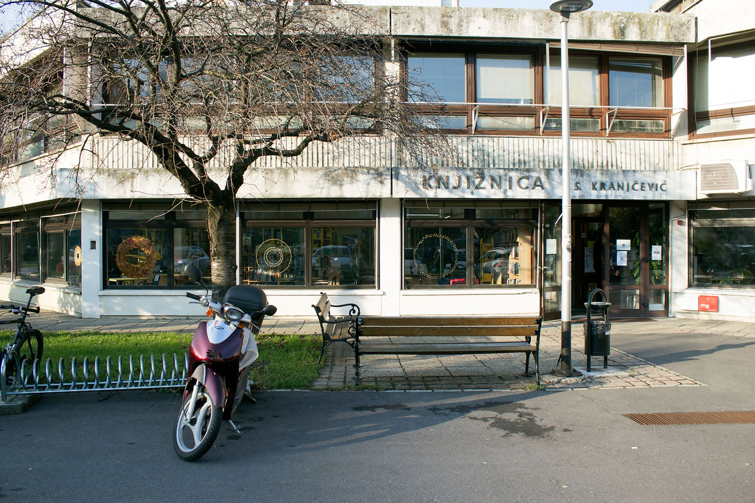
Silvio Vujičić: „Flowerworks”,
photo: Karla Jurić

Slide 27
Results and conclusion
The results of the research have shown that public libraries are not recognised as sources of information related to LGBTIQ identities: public libraries have been positioned only in the fourth place, after internet, friends, and LGBTIQ organisations.
Public libraries should take an active and critical position in relation to the reality in which they operate, but also in relation to own activity and inclusivity.
Public libraries have the potential to operate as empowering and activist/activating spaces for different marginal and sensitive social groups.
In the context of the project, the gallery activity has manifested itself as the manner in which the problematics of LGBTIQ persons and public libraries can be articulated and brought into focus more rapidly rather than problematising it only within the library community: art communicates its positions with the audience more easily and directly, and can make them more visible within the framework of the public sphere.

Slide 28
“If learning is the admission of the possible to our thinking, it means that we must learn to construct new contexts – we might call them transitional zones – where unusual and perhaps unexpected knowledge can be temporarily organized.”
Carr, David. 2006. A Place Not a Place: Reflection and Possibility in Museums and Libraries. Oxford: Altamira Press.

